Slide 1

Linear Regression and Exploratory Data Analysis
GROUP – 1
SREEJA DACHARLA – S20200020256
DHARANI POKURI - S20200020294

Slide 2
Abstract
The combined cycle power plant(CCPP) dataset is considered to predict the net hourly electrical energy output of a Combined Cycle Power Plant by performing Linear Regression and Exploratory Data Analysis.
Factor Analysis and Structural Equation Modelling are performed under Exploratory Data Analysis.
The dataset contains 9568 data points collected over 6 years, with hourly measurements of ambient variables and energy output when the plant was set to work with full load.
Evaluating the accuracy of the predictive model using appropriate metrics and statistical tests.

Slide 3
Problem Statement
To investigate the relationship between hourly average ambient variables
Temperature,
Ambient Pressure,
Relative Humidity,
Exhaust Vacuum and the net hourly electrical energy output of a Combined Cycle Power Plant (CCPP).
The study aims to develop a predictive model using linear regression analysis to estimate the net hourly electrical energy output of the CCPP based on the ambient variables.
Exploratory Data Analysis includes Factor Analysis and Structural Equation Modelling

Slide 4
Methodology
A linear regression model is applied to the dataset, followed by factor analysis and concluding with Structural Equation modeling.
Structural Equation Modelling
Data Set Analysis
Linear Regression
Cross Validation
Factor Analysis
Interpretation of Results
Analysis of the dataset is done with the help of Box Plots, Histograms, and Correlation plots.
Regression is performed between the response variable(EP) and regressors (AT, V, AP, RH)
The dataset is split into two parts where one acts as test data and the other as train data and vice versa.
The dimensionality of the data is reduced by performing factor analysis.
SEM is a combination of Multiple Linear Regression and Factor Analysis
Different statistical tests and measures are used to analyze the goodness of Fit.

Slide 5
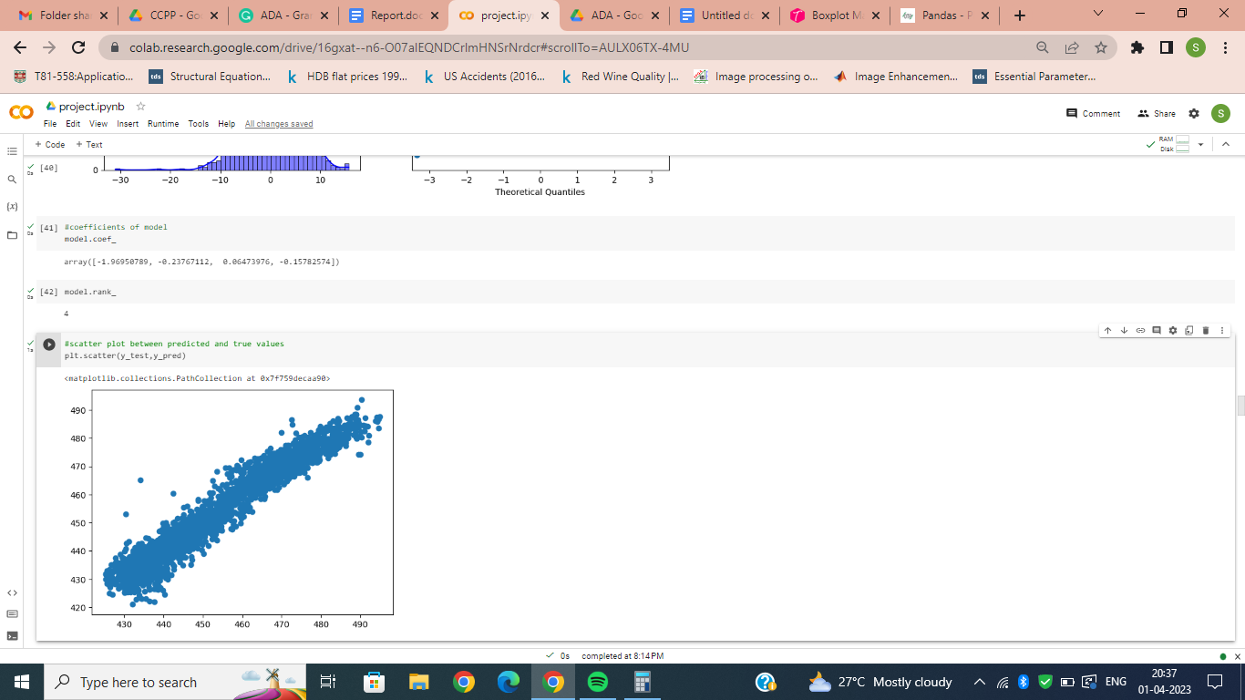
Linear Regression
Assumption Tests
Error Normality
Homoscedasticity
Multi Collinearity
Auto Correlation
Linear Regression
Linear Regression with Cross Validation
Metrics
R2-Score
Summary using OLS

Slide 6
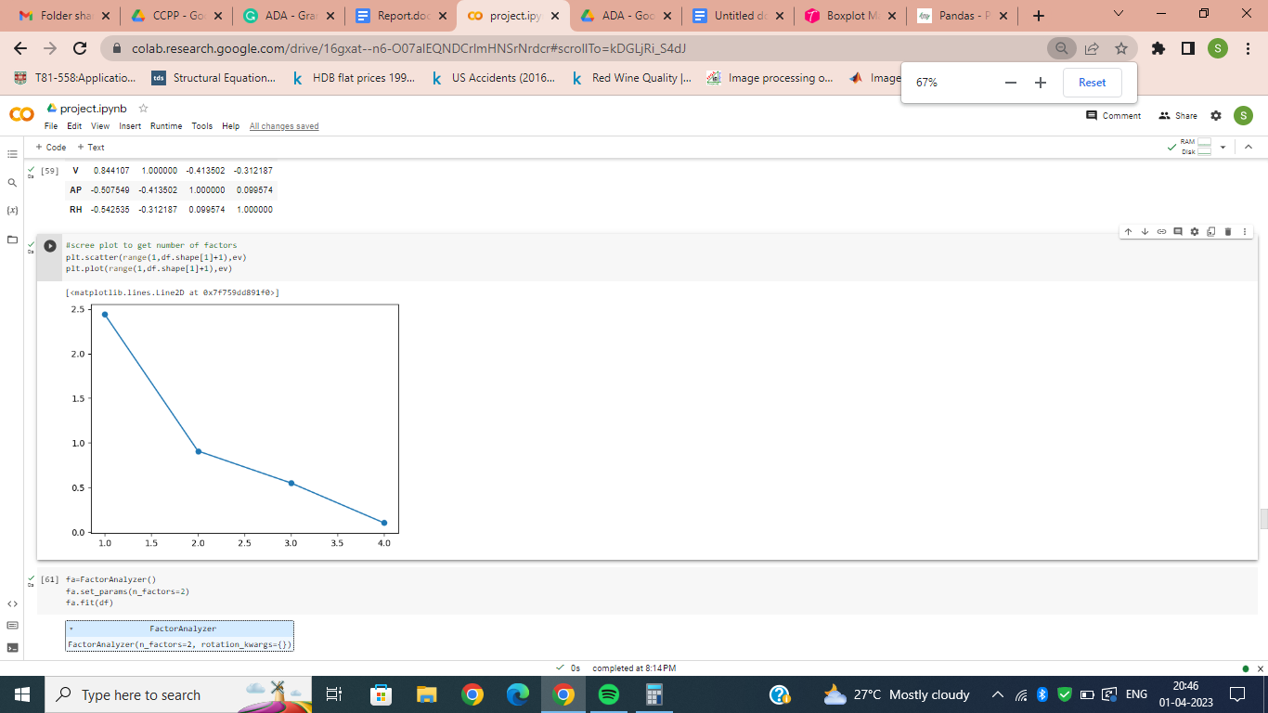
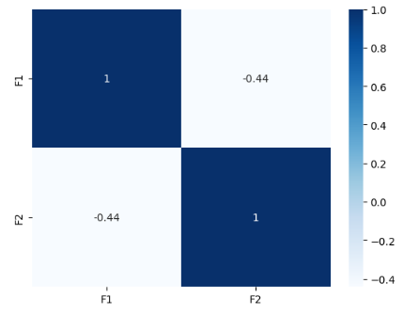
Factor Analysis
Reduction Techniques
Bartletts Sphericity Test
Screw Plot
Factor Analysis
Linear Regression with final factors and CV

Slide 7
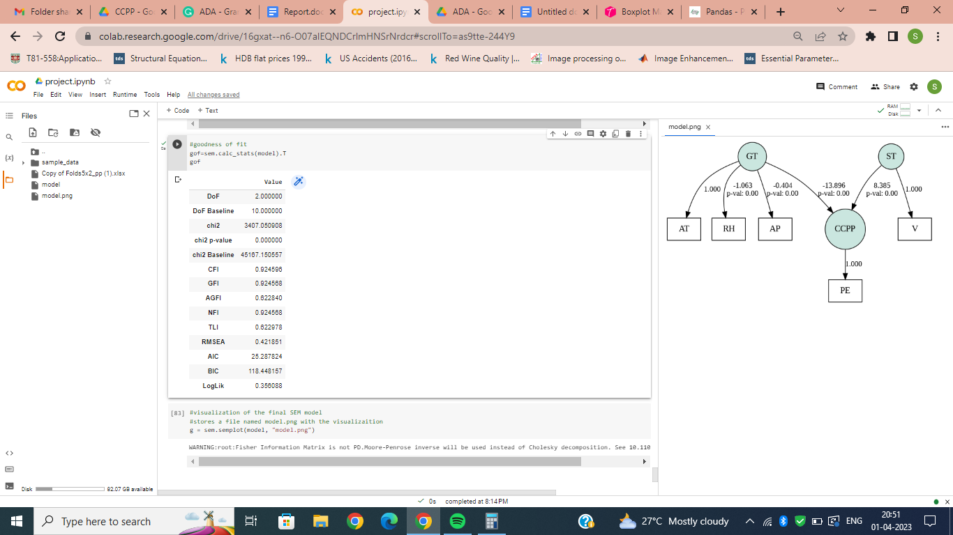
Structural Equation Modelling
Parameter Extraction
Goodness of Fit
Visualization

Slide 8
Conclusion
The dataset is subjected to different models throughout the analysis. Starting with Linear regression, followed by factor analysis, and finally Structural Equation modeling.
After the factor analysis, the data size is reduced to half which reduces the storage space while the accuracy drop is only by 5% which is acceptable.
SEM provides us with an overall analysis rather than a window of the analysis like linear regression or Factor analysis does. In a way, SEM includes the analysis done by both linear regression and factor analysis.
Thank you.

