Slide 1
ACTIVE CITY ADMINISTRATION
By
A.Sreeja
(6011763192)
UNDER THE GUIDANCE OF
PROF.M.PADMAVATHAMMA GARU
PHD , MPhil, M.SMED, M.Sc,B.Sc.
PROFESSOR

Slide 2
Objective:
To create a user-friendly online interface for citizens to communicate with administrative body and reduce the distance and time barrier between citizens and administration. To create a online platform where people can share ideas, invoke discussion, issue complaints, create suggestion/petitions for improvement of city administration. To encourage to bring transparency and flexibility in system.

Slide 3
Modules:
1. Administration Module
2. Citizen Module
3. Officer Module
4. NGO Module

Slide 4
Use Case Diagram for Admin:

Slide 5
Use Case Diagram for Citizen:

Slide 6
Use Case Diagram for Officer & NGO:

Slide 7
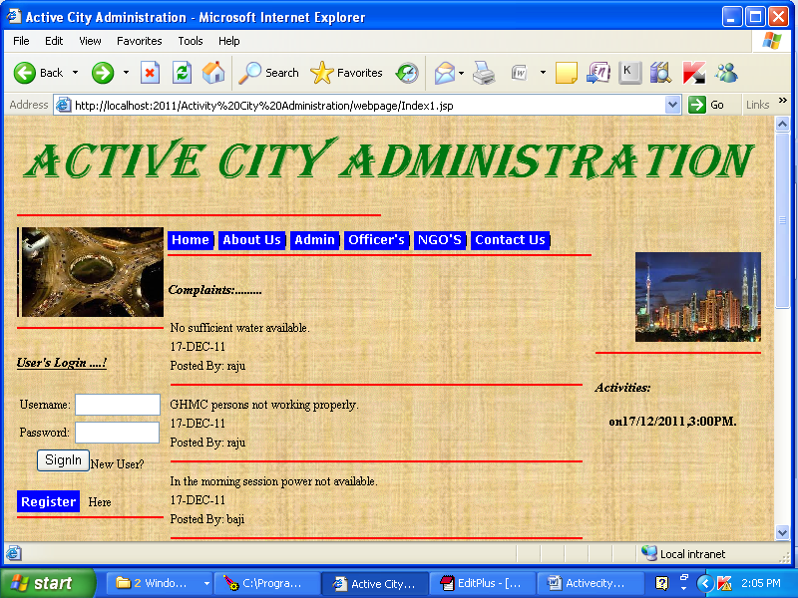

Slide 8
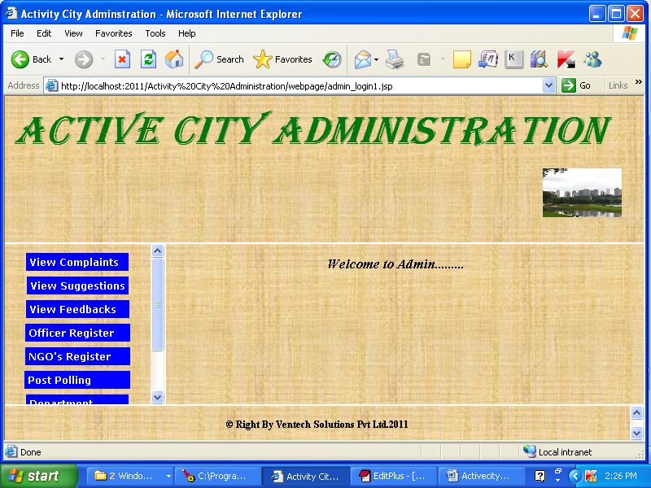

Slide 9
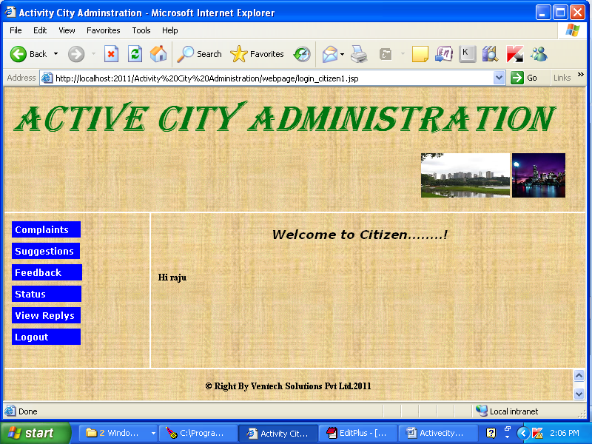

Slide 10
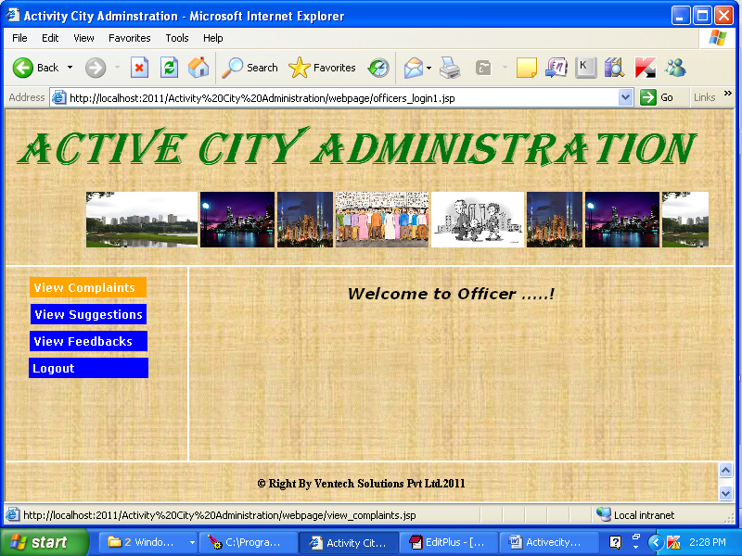

Slide 11
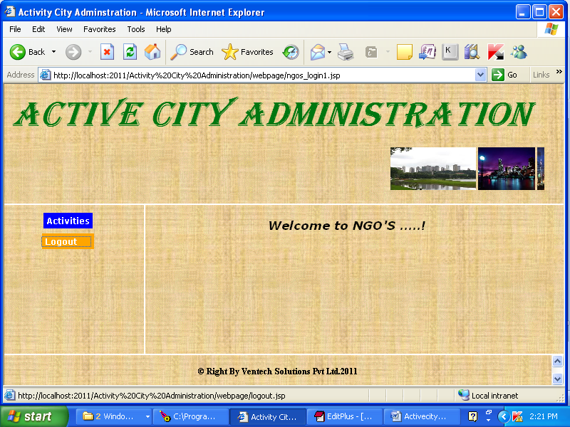

Slide 12
Software Requirement:
Technology : Python
Web technology : HTML, JavaScript, CSS
Web Server : Djnago server
Python Version : 3.6
Backend Database : sqlite3

Slide 13
Hardware Requirement:
Processor : Pentium IV
RAM Capacity : 1 GB

Slide 14
CONCLUSION
To create a online platform where people can share ideas, invoke discussion, issue complaints, create suggestion/petitions for improvement of city administration. To encourage to bring transparency and flexibility in system.

