Slide 1

SVU MCA
A
Major Project Presentation on
ACTIVE CITY ADMINISTRATION
Submitted By :
A. Sreeja
6011763192
Under the esteemed guidance of
PROF. M. PADMAVATHAMMA
M.Phil., PH.D.,M.S.,MED.,MSC,B.SC.
DEPT OF COMPUTER SCIENCE – S V UNIVERSITY - TIRUPATHI

Slide 2
Abstract of the Project
Project Modules
Software/Hardware Requirements
USECASE DIAGRAM
Screenshots
CONCLUSION
Abstract of the Project
To create a user-friendly online interface for citizens to communicate with administrative body and reduce the distance and time barrier between citizens and administration. To create a online platform where people can share ideas, invoke discussion, issue complaints, create suggestion/petitions for improvement of city administration. To encourage to bring transparency and flexibility in system.
DEPT OF COMPUTER SCIENCE – S V UNIVERSITY - TIRUPATHI
1/7

Slide 3
Abstract of the Project
Project Modules
Software/Hardware Requirements
USECASE DIAGRAM
Screenshots
CONCLUSION
Modules
Administration Module 2. Citizen Module
Login a. Registration
View Complaint b. Login
View Suggestion c. Complaints
View Feedback d. Suggestions
Post Polling e. Feedback
Add Department f. Logout
Officer Registration
NGO registration
Logout
3. Officer Module 4. NGO Module
a. Login a. Login
b. View Complaints b. Add Article
c. View Suggestions c. Logout
d. Logout
DEPT OF COMPUTER SCIENCE – S V UNIVERSITY - TIRUPATHI
1/7

Slide 4
Abstract of the Project
Project Modules
Software/Hardware Requirements
USECASE DIAGRAM
Screenshots
CONCLUSION
REQUIREMENTS
Software Requirements
Technology : Python
Web technology : HTML, JavaScript, CSS
Web Server : Djnago server
Python Version : 3.6
Backend Database : sqlite3
Hardware Requirements
Processor : Pentium IV
RAM Capacity : 1 GB
DEPT OF COMPUTER SCIENCE – S V UNIVERSITY - TIRUPATHI
1/7

Slide 5
Abstract of the Project
Project Modules
Software/Hardware Requirements
USECASE DIAGRAM
Screenshots
CONCLUSION
USECASE DIAGRAMS
DEPT OF COMPUTER SCIENCE – S V UNIVERSITY - TIRUPATHI
1/7

Slide 6
Abstract of the Project
Project Modules
Software/Hardware Requirements
USECASE DIAGRAM
Screenshots
CONCLUSION
USECASE DIAGRAMS
DEPT OF COMPUTER SCIENCE – S V UNIVERSITY - TIRUPATHI
1/7

Slide 7
Abstract of the Project
Project Modules
Software/Hardware Requirements
USECASE DIAGRAM
Screenshots
CONCLUSION
USECASE DIAGRAMS
DEPT OF COMPUTER SCIENCE – S V UNIVERSITY - TIRUPATHI
1/7

Slide 8
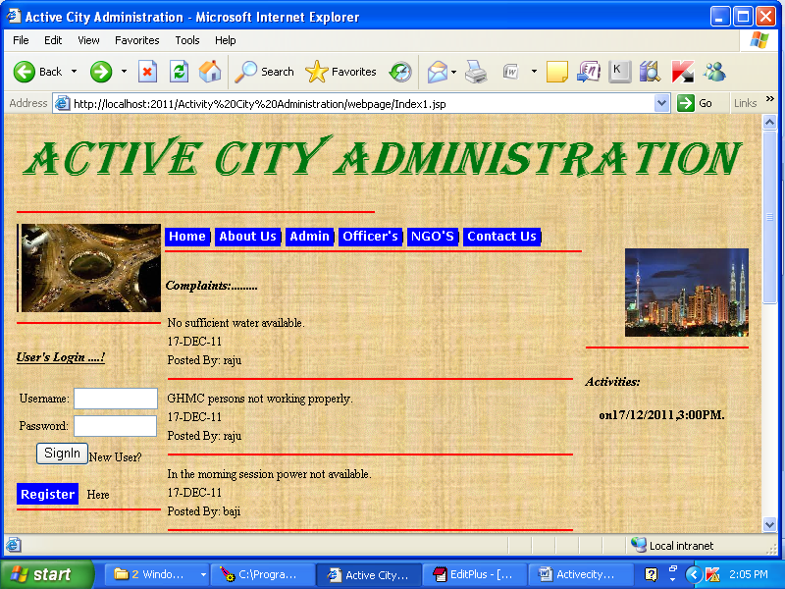
Abstract of the Project
Project Modules
Software/Hardware Requirements
USECASE DIAGRAM
Screenshots
CONCLUSION
Screenshots
HOME
DEPT OF COMPUTER SCIENCE – S V UNIVERSITY - TIRUPATHI
6/7

Slide 9
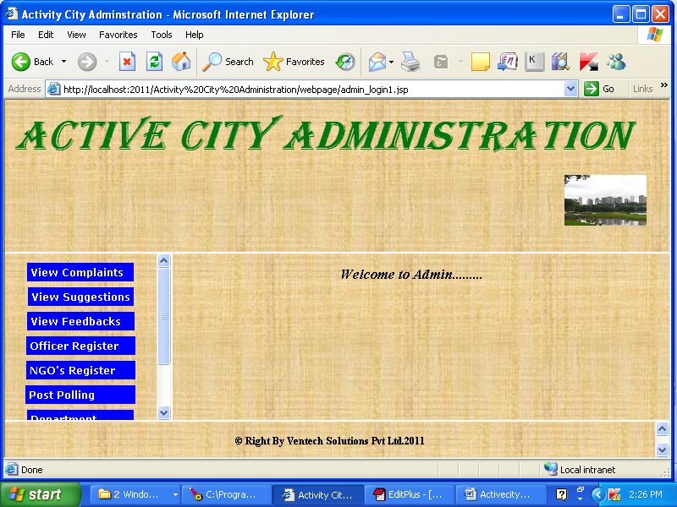
Abstract of the Project
Project Modules
Software/Hardware Requirements
USECASE DIAGRAM
Screenshots
CONCLUSION
Screenshots
ADMIN:
DEPT OF COMPUTER SCIENCE – S V UNIVERSITY - TIRUPATHI
6/7

Slide 10
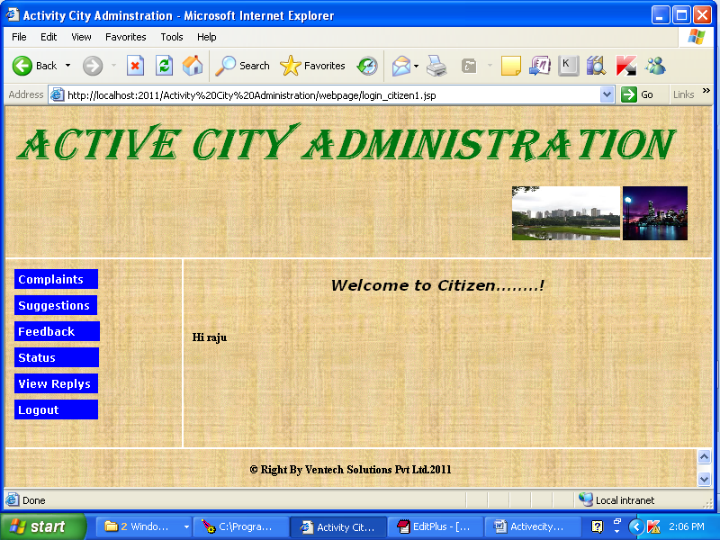
Abstract of the Project
Project Modules
Software/Hardware Requirements
USECASE DIAGRAM
Screenshots
CONCLUSION
Screenshots
Citizen:
DEPT OF COMPUTER SCIENCE – S V UNIVERSITY - TIRUPATHI
6/7

Slide 11
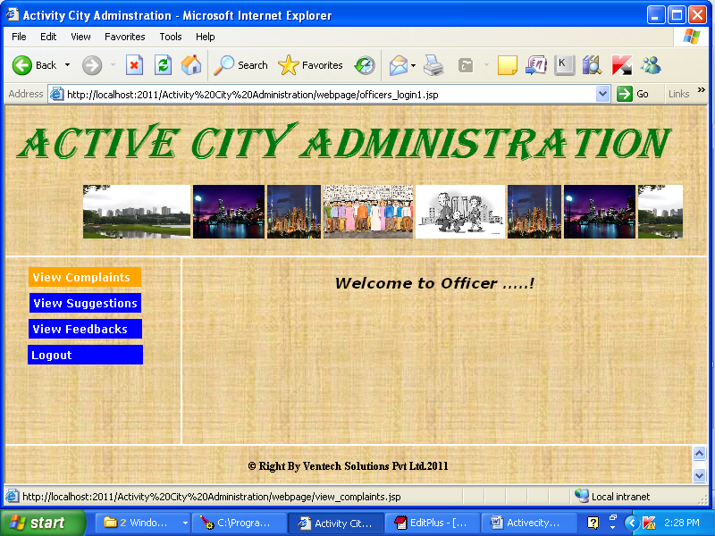
Abstract of the Project
Project Modules
Software/Hardware Requirements
USECASE DIAGRAM
Screenshots
CONCLUSION
Screenshots
Officer :
DEPT OF COMPUTER SCIENCE – S V UNIVERSITY - TIRUPATHI
6/7

Slide 12
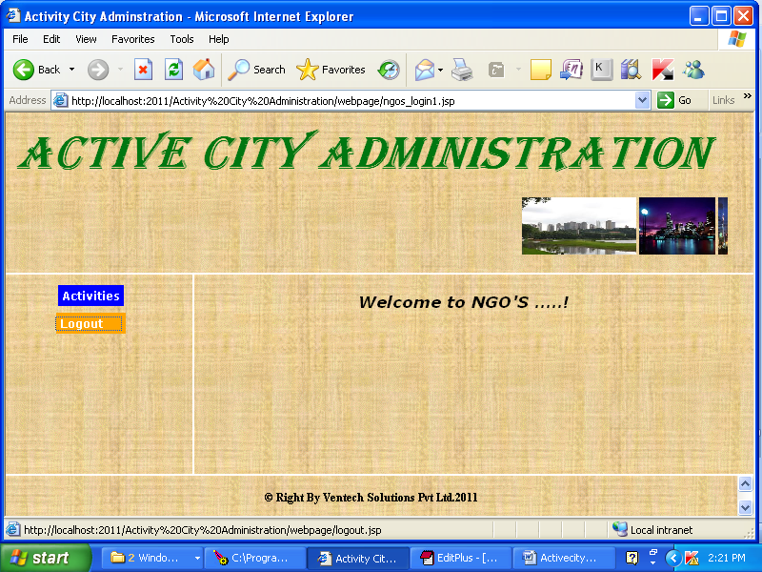
Abstract of the Project
Project Modules
Software/Hardware Requirements
USECASE DIAGRAM
Screenshots
CONCLUSION
Screenshots
NGO :
DEPT OF COMPUTER SCIENCE – S V UNIVERSITY - TIRUPATHI
6/7

Slide 13
Abstract of the Project
Project Modules
Software/Hardware Requirements
USECASE DIAGRAM
Screenshots
CONCLUSION
CONCLUSION
To create a online platform where people can share ideas, invoke discussion, issue complaints, create suggestion/petitions for improvement of city administration. To encourage to bring transparency and flexibility in system.
DEPT OF COMPUTER SCIENCE – S V UNIVERSITY - TIRUPATHI
1/7

Slide 14
Q and A?
?
Thank you
DEPT OF COMPUTER SCIENCE – S V UNIVERSITY - TIRUPATHI

