Slide 1
CLASSIFICATION OF MALARIA INFECTED CELLS USING MACHINE LEARNING
TS- WEB TRACK
Presented By:
Miss Sreeja
Miss Lakshmi Pravallika
Miss Sai Prasanna
Miss Mani Varsha
Miss Nandini
Guided By: Poovaragavan velumani

Slide 2
OUTLINE
Abstract
Problem Statement
Aims , Objective & Proposed System/Solution
System Design
System Development Approach(Technology Used)
Algorithm & Deployment
Conclusion
References
Future Scope

Slide 3
Abstract
The detection of malaria infection using infected cells is a critical aspect of early diagnosis and treatment of the disease. One approach to detecting malaria is the examination of blood samples under a microscope to Identify the presence of infected red blood cells. However, this method can be time-consuming and subject to human error.
Recently, advances in image analysis and machine learning have led to the development of new methods for the automated detection of infected cells. One such method is the use of Convolutional Neural Networks (CNNs) to classify infected cells based on microscopic images. CNNs are deep learning algorithms that are particularly well-suited to image classification tasks and have been shown to achieve high accuracy in detecting malaria infected cells

Slide 4
Problem Statement
●Malaria is a serious and potentially life-threatening disease caused by parasites of the genus Plasmodium that are transmitted to humans through the bite of infected mosquitoes.
● The disease affects millions of people globally, primarily in developing countries, and is a leading cause of death and illness.
● Symptoms of malaria include fever, chills, headache, muscle aches, and fatigue. Early diagnosis and treatment are critical to preventing the progression of the disease and avoiding serious complications.
● Current control measures include the use of insecticide-treated bed nets, antimalarial drugs, and preventative measures to reduce mosquito populations. However, despite these efforts, malaria continues to be a major public health challenge

Slide 5
Proposed Solution
The primary goal of this research is to develop an ML model that can diagnose whether a person is healthy or infected with malaria. The models are developed using thin blood smear images. A classifier that successfully performs the recognition of infected cells can add great value to traditional medical methods of malaria identification and treatment. Furthermore, computer-aided detection and diagnosis in medical imaging offers a beneficial second opinion to the doctors and assists them in the screening process.

Slide 6
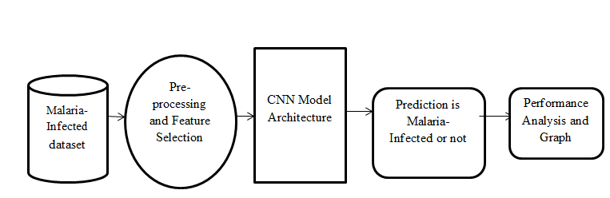
System Architecture

Slide 7
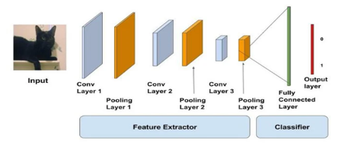
System Deployment Approach
Programming Language: Python, HTML, CSS, JS
Hardware: 4GB RAM (At least)
250 GB of Hard Disk Space (At least), 1 GB of VRAM (At least)
Software: Windows 7 or later, Ubuntu, Mac OS X or later
Technologies Used: Convolutional Neural Network, Tensor Flow, Google Colab, Digital Image Processing.

Slide 8
Algorithm & Deployment
We employ ten-fold verification throughout the data set to train and test our CNN model, with 90% of the pictures being used for training and 10% being used for testing. 90% of the photos in model training are isolated from the actual training set, with the remaining 10% utilised for back distribution validation.
In addition to ten times the verification, performance test requirements include average accuracy, sensitivity, accuracy, accuracy, F1 score, and the Matthews correlation coefficient. To learn transfer, a pre-trained AlexNet based on the CIFAR-100 data set is employed as an outlet. Connected to a typical SVM separator so we can compare transfer readings to our CNN model.

Slide 9
THANK YOU

