Slide 1
Planning Satellite Swarm Measurements for Earth Science Models: Comparing Constraint Processing and MILP Methods Rich Levinson^{1,2} Samantha Neimoeller¹ Sreeja Nag^{1,3} Vinay Ravindra^{1,3} {rich.levinson, samantha.c.niemoeller, sreeja.nag, vinay.ravindra} @nasa.gov ¹NASA Ames Research Center ² KBR Wyle Services, LLC ³ Bay Area Environmental Research Institute Moffett Field, CA 94035 Collaborators: Mahta Moghaddam (University of Southern California) Daniel Selva (Texas A&M University) Funded by: NASA Earth Sciences Technology Office (ESTO)

Slide 2
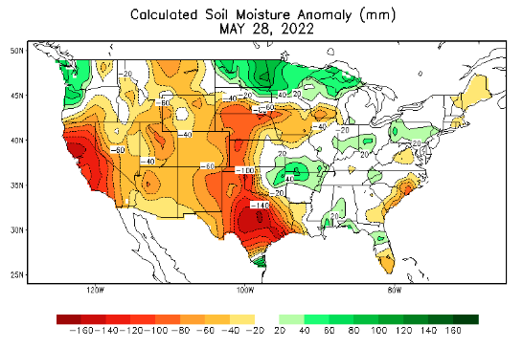
Background and Motivation
Soil Moisture Prediction
Soil moisture is a key indicator for predicting floods, mudslides, wildfires, other phenomena
Problem:
We have initial solution for improving soil moisture prediction
Our Constraint Processing planner follows a narrow beam of heuristically guided trajectories through a huge search space
We don't know how optimal our heuristic solution is
Research Questions:
How close to optimal is our heuristic solution?
Can we model our constraints in Mixed Integer Linear Programming (MILP)?
How long would it take MILP to prove optimality on our 6-hour plan horizon?
(NOAA/National Weather Service website)
Notes:
Dynamic Constraint Processing means the set of decision variables changes during the solving process. In our case decision variables are removed when we propagate choices forward in time, so the solution node has fewer decision variables than the root.

Slide 3
Dynamic Constraint Processing vs. Mixed Integer Linear Programming
Dynamic Constraint Programming (DCP)
Suboptimal but Fast
Constraints enforced "on-demand"
Variables dynamically eliminated by constraint handlers
Mixed Integer Linear Programming (MILP)
Optimal but Slow
Less flexible constraint modeling
Quantitative declarative constraints
Scalability challenges
Flexible Constraints & Search Control
DCP
MILP
Speed & Scalability

Slide 4
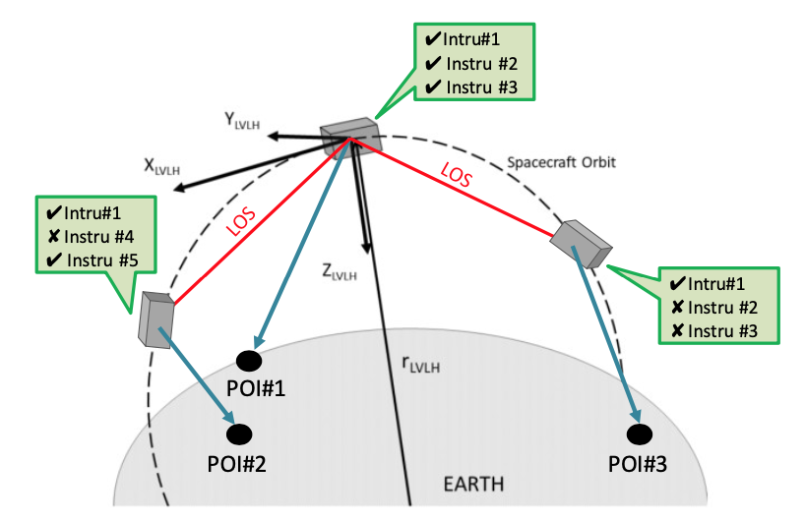
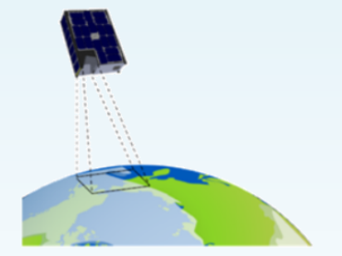
D-SHIELD: Distributed Spacecraft w/ Heuristic Intelligence to Enable Logistical Decisions
GP#2
GP#1
GP#3
Multiple satellites w/ multiple instruments to observe Ground Positions (GP)
Each satellite has 2 different sensors & can point at 61 different angles
Each observation covers multiple GP (9 km x 9 km tile)
For each satellite: Assign a sensor command for every Time Point (TP) when it can see any GP

Slide 5
D-SHIELD Constraints
Constellation-wide constraint
Duplicate Observations: No duplicate GP observations (across all satellites)
Satellite-level mutex constraints (only do one thing at a time)
Image Lock – hold viewing angle for 3 seconds per observation
Maneuver constraints – slew time for changing view angle

Slide 6
Planner Input: GP Access Times & Command Choices
Search space for each satellite:
Access times (TP)
Command choices (sensor & view angle) for each access time (TP)
List of GP covered by each command
Timepoint (TP) | Command Choices | Ground Positions (GP) covered by command
10 | L.32 (L-band, angle 32) | 25, 26, 27
 | P.32 (P-band, angle 32) | 24, 25, 26, 27, 28
 | P.34 (P-band, angle 34) | 36, 38, 40, 47, 49

Slide 7
Planner Input: Prediction and Measurement Errors
Soil Moisture Prediction Error
Measurement Error
Ground Position (GP) | Timepoint (TP) | Prediction Error
15 | 100 | 0.02
 | 500 | 0.23
Sensor Command | Ground Cover | Measurement Error
L.48
 | Forest | 0.035
 | Shrubs | 0.025
Error increases with time and rain
Error decreases with "good" observation (measurement error < pred. error)

Slide 8
Planner Input: Prediction and Measurement Errors
Soil Moisture Prediction Error
Measurement Error
Ground Position (GP) | Timepoint (TP) | Prediction Error
15 | 100 | 0.02
 | 500 | 0.23
Sensor Command | Ground Cover | Measurement Error
L.48
 | Forest | 0.035
 | Shrubs | 0.025
Goal: Observe GP having most prediction error,
using measurements with least error

Slide 9
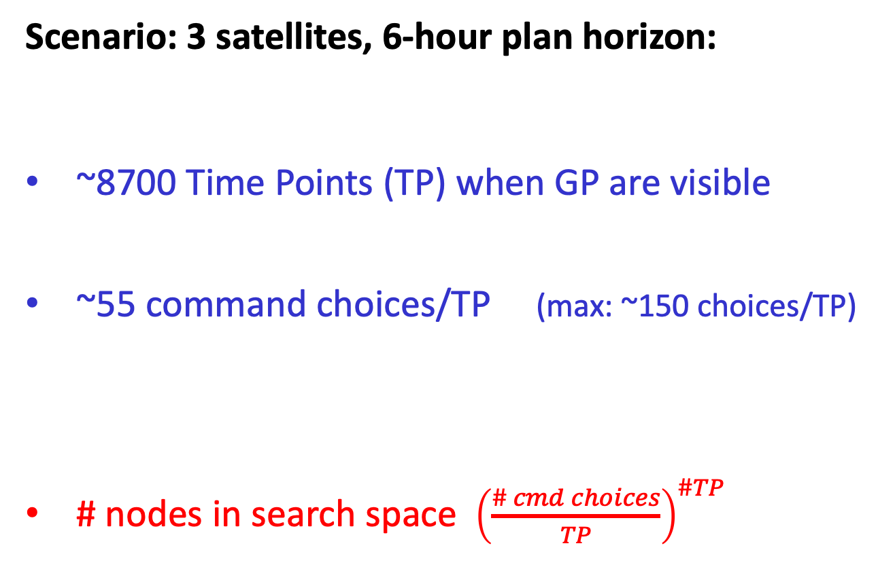
Search Space Combinatorics
Scenario: 3 satellites, 6-hour plan horizon:
~8700 Time Points (TP) when GP are visible
~55 command choices/TP (max: ~150 choices/TP)
# nodes in search space ${\left(\frac{\# cmd choices}{TP}\right)}^{\#TP}$
1.7m GP total
(global)
765k GP visible in 6 hrs
17k fit in 6 hr plan
= 55⁸⁷⁰⁰ = "Infinity"

Slide 10
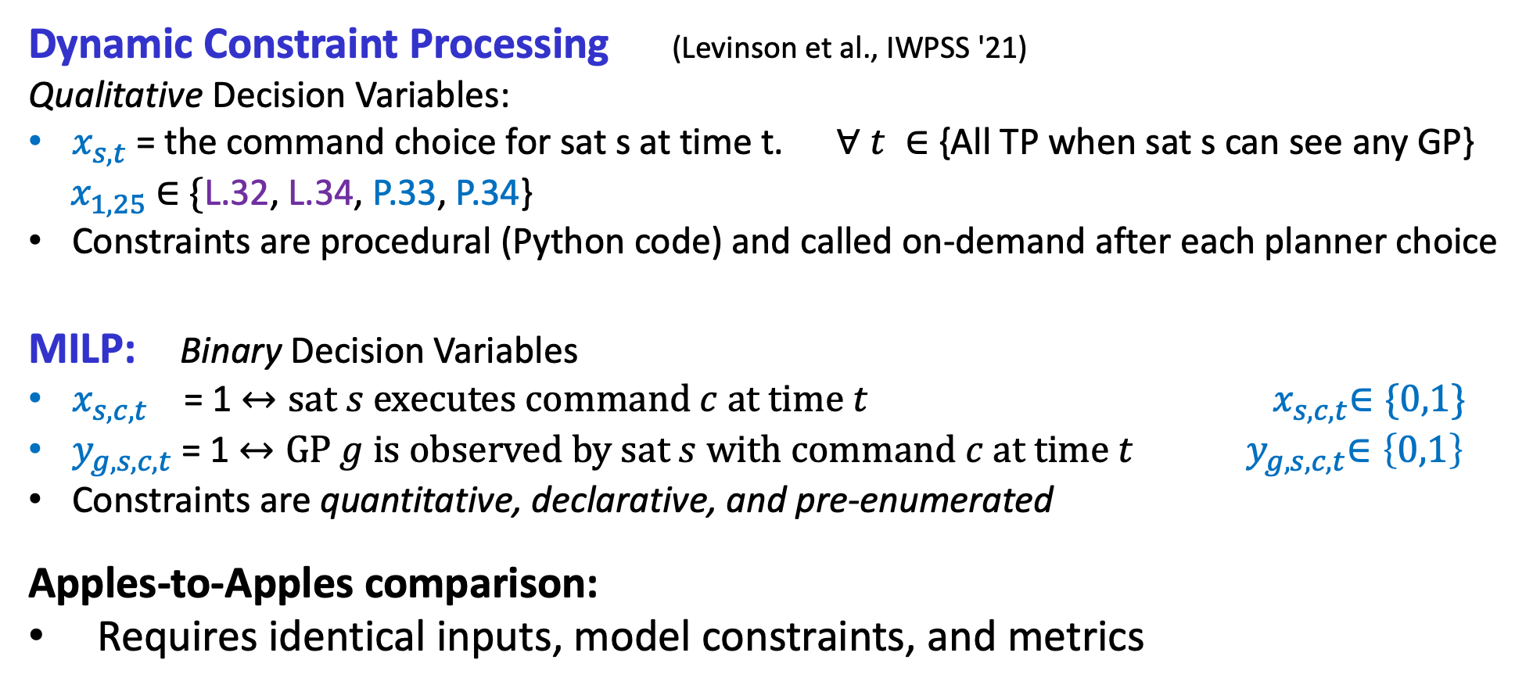
Different Planning Models
Dynamic Constraint Processing (Levinson et al., IWPSS '21)
Qualitative Decision Variables:
$x_{s, t}^{ }$= the command choice for sat s at time t. $∀ t ∈${All TP when sat s can see any GP}
${ x}_{1, 25}^{ }$ $∈$ {L.32, L.34, P.33, P.34}
Constraints are procedural (Python code) and called on-demand after each planner choice
MILP: Binary Decision Variables
$x_{s,c,t}^{ }$ = 1 $↔sat s executes command c at time t$ ${ x}_{s,c,t}^{ }∈\{0,1\}$
$y_{g,s,c,t}^{ }$= 1 $↔GP g is observed by sat s with command c at time t$ ${ y}_{g,s,c,t}^{ }∈\left\{0,1\right\}$
Constraints are quantitative, declarative, and pre-enumerated
Apples-to-Apples comparison:
Requires identical inputs, model constraints, and metrics

Slide 11


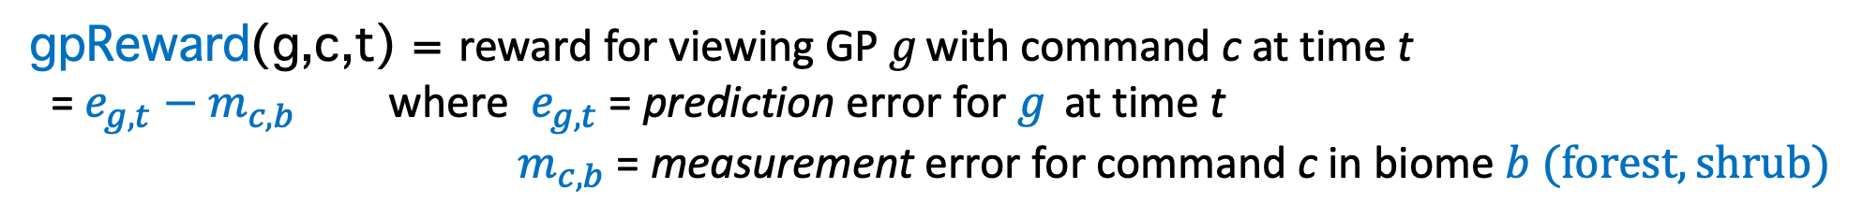
Objective: Maximize reduction of GP model error
Plan:
maximize $Σ \text{commandReward}\left(cmd\right)$
$∀ cmd ∈plan P$
TP | Cmd | Observed GP | Command Reward
10 | L.32 | 25, 26, 27 | 0.25
20 | P.21 | 33,35,39,40 | 0.32
30 | p.25 | 50,21 | 0.20
objective: cmd rewards |  |  | 0.77
$$Σ$$
commandReward (s, c, t) = reward for sat s executing cmd c at time t
= $Σ$ $\text{gpReward}\text{(}\text{g}\text{,}\text{c}\text{,}\text{t}\text{)} ∀ GP g ∈\{GP \text{visible} \text{by} \text{sat} \text{s} \text{using} \text{cmd} \text{c} \text{at} \text{time} \text{t}\text{\}}$
gpReward(g,c,t) = reward for viewing ${\text{GP} g}_{ }$with command c at time t
= $e_{g,t}{− m}_{c,b}$where $e_{g,t}$ = prediction error for $g_{ }$ at time t
${ m}_{c,b}$ = measurement error for command c in biome $b (forest, shrub)$

Slide 12
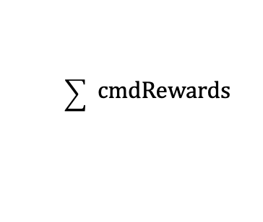
Comparison: Science Value
$$\sum_{ }{ }cmdRewards$$
6 test cases with increasing plan horizons and complexity
Cases 1 – 5: DCP achieves ~ 60 % optimal
Case 6: Unsolvable by MILP in 50 hour time limit, but DCP solves in 28 mins

Slide 13
Comparison: Efficiency
MILP is always more efficient with higher objective rewards per command and per GP
MILP plans always has fewer commands (makespan): Less slewing & energy cost

Slide 14
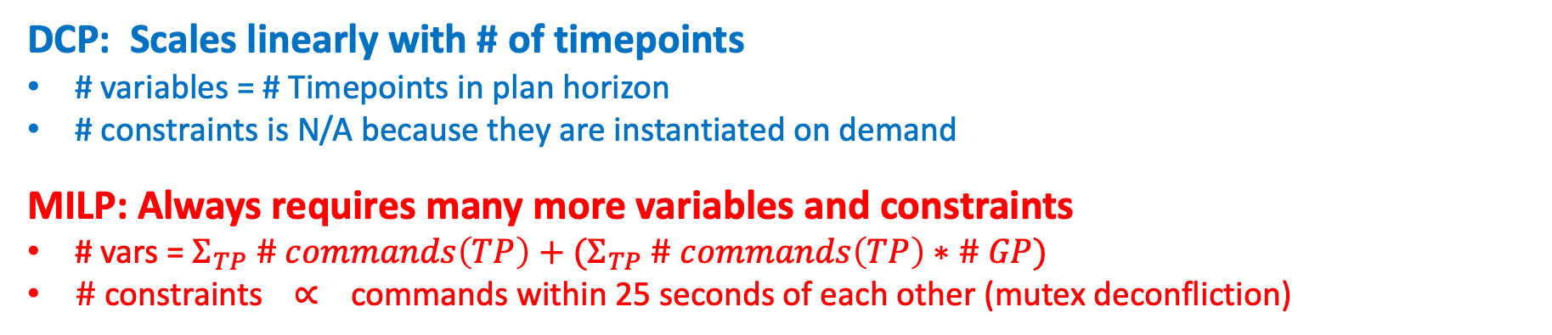
Comparison: Model Size
DCP: Scales linearly with # of timepoints
# variables = # Timepoints in plan horizon
# constraints is N/A because they are instantiated on demand
MILP: Always requires many more variables and constraints
# vars = $Σ_{TP} \# commands\left(TP\right)+(Σ_{TP} \# commands\left(TP\right)∗\# GP)$
$\# \text{constraints}$ ∝$\text{commands} \text{within}\text{ 25 }\text{seconds} \text{of} \text{each} \text{other}$ (mutex deconfliction)

Slide 15


Conclusion
 | DCP | MILP
Optimal
Plan Efficiency
Speed
Flexible Constraints
Heuristic Search Control
Model Size/ Scalability
Both methods are useful, especially when used together

Slide 16
Future Work
Search Control:
Monte Carlo Tree Search (MCTS)
Divide & Conquer (independent subproblems with TP gap delimiters)
Closing the execution loop
Simulated satellites execute their plans with noise
New constraints:
Relaxed 3-second image lock (not yet modelled in MILP)
New domain:
wildfire prediction

Slide 17
Thank You
Questions?
rich.levinson@nasa.gov
video

Slide 18
Experiments
Experiments ran on: 2020 MacBook Pro 13-inch 2.3 GHz Quad-Core Intel Core i7, 32 GB RAM.
DCP solutions implemented in Python
All MILP solutions used Gurobi 9.5.
Data sets and software will be released open source

Slide 19
Six Test Cases
Experiment includes 6 test cases varying by:
Plan horizon
1,000 secs (~17 mins)
1,800 secs (30 mins)
7,200 secs (2 hours)
21,600 secs (6 hours)
Rainy or non-rainy GP cohort (rainy GP recently received rain)
Triage heuristic
solve for the 15% most needy GP first
mitigation for MILP model size combinatoric explosion

Slide 20
Planner Objective: Maximize model improvement (error reduction)
Each GP: prior model error & cmd choices w/ measurement errors
Error(GP) = F(time, rain, biome type, instrument(s), view angle)
Error increases with time and rain
Error decreases with "good" observation (measurement error < model error)
GP | TP | Model Error | cmd | Measurement Error
2 | 27 | 0.08 | L.41 | 0.14
 | 1500 | 0.39 | P.48 | 0.07
GP | Model Error | cmd | Measurement Error
2 | 0.39 0.07 | P.48 | 0.07

Slide 21
Planner Input: GP Access Times and Command Choices
For each satellite: Search space of access times, viewing options (commands), and covered GP
Command choice examples: L.34 = <L-band, angle 34> ,
P.32 = <P-band, angle 32> TP Command
(time) choices GP covered by choice
1311: L.32: [3165]
L.34: [3445, 3446]
P.33: [3165]
L.32 & P.32: [3165]

Slide 22
D-SHIELD Architecture
Preprocessing
Prepare raw science data for planner
Planner inputs: GP view times, command choices, soil moisture model errors, measurement errors
Measurement errors
Science Inputs:
Ground Positions (GP)
w/ biome type (shrub, forest, baren)
GP access times w/ viewing cmd options
Measurement error model
Slew time & energy requirements
Observed & predicted rain
Ground sensors
Spacecraft & instrument h/w specs
Sensor | Angle | Measurement Error
L-Band | 48 | 0.035
P-Band | 50 | 0.021
L-Band & P-Band | 42 | 0.025
GP model errors
GP | TP | Model Error
1 | 100 | 0.03
 | 500 | 0.23
2 | 200 | 0.20
 | 700 | 0.26
Planner
Objective: reduce GP model error
Planner output: Satellite command sequences (per sat)
observation results (image data)
Satellite 2 (simulated) command execution
Soil Moisture Predictor
Satellite 1 (simulated) command execution

Slide 23
Search Space Combinatorics
TP 1
55
Tree depth:
8700
55
55
TP
8700
Each node is a decision var associated with a TP
~55 children/node (~55 cmd choices/TP)
Tree Depth: 8700 = # of TP

Slide 24
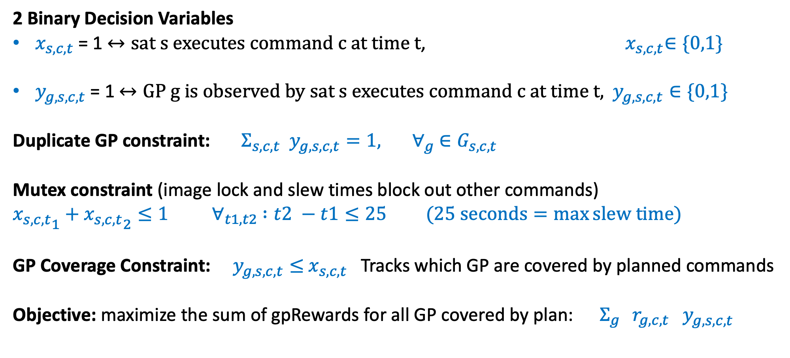
Planner Model (MILP)
2 Binary Decision Variables
$x_{s,c,t}^{ }$= 1 $↔sat s executes command c at time t$, ${ x}_{s,c,t}^{ }∈\{0,1\}$
$y_{g,s,c,t}^{ }$= 1 $↔GP g is observed by sat s executes command c at time t,$ $y_{g,s,c,t}^{ }∈\{0,1\}$
Duplicate GP constraint: $Σ_{s,c,t} y_{g,s,c,t}^{ }=1, ∀_{g}$ $∈G_{s,c,t}$
Mutex constraint (image lock and slew times block out other commands)
${x_{s,c,t}^{ }}_{1}+{x_{s,c,t}^{ }}_{2}≤1$ ${ ∀}_{t1, t2}$ $:t2 −t1≤25 (25 seconds=\max{slew time)}$
GP Coverage Constraint: $y_{g,s,c,t}^{ }≤$ $x_{s,c,t}^{ }$ Tracks which GP are covered by planned commands
Objective: maximize the sum of gpRewards for all GP covered by plan: $Σ_{g } {r_{g,c,t} y}_{g,s,c,t}^{ }$

Slide 25
DCP vs. MILP: Model Size and Performance
MILP could not solve 6-hour plan horizon within 50 hours, but DCP solves it in 28 minutes.
MILP requires many more vars and constraints
MILP makespan is always smaller

Slide 26
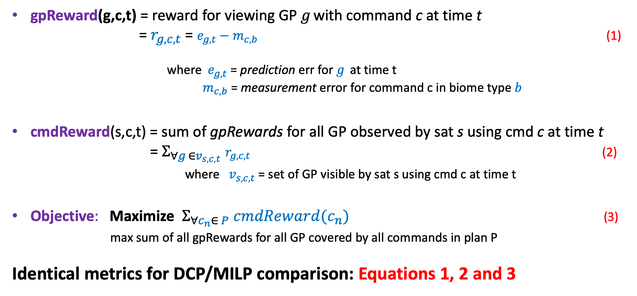
Objective: Maximize reduction of GP model error
gpReward(g,c,t) = reward for viewing ${\text{GP} g}_{ }$with command c at time t
= $r_{g,c,t}$ = $e_{g,t}{− m}_{c,b} \text{(1)}$
where $e_{g,t}$ = prediction err for $g_{ }$ at time t
${ m}_{c,b}$ = measurement error for command c in biome type $b$
cmdReward(s,c,t) = sum of gpRewards for all GP observed by sat s using cmd c at time t
= $Σ_{∀g_{ }∈v_{s,c,t}}$ $r_{g,c,t} \text{(2)}$
where $v_{s,c,t}$ = set of GP visible by sat s using cmd c at time t
Objective: Maximize $Σ_{∀c_{n}∈ P}$ ${cmdReward(c}_{n})$ (3)
max sum of all gpRewards for all GP covered by all commands in plan P
Identical metrics for DCP/MILP comparison: Equations 1, 2 and 3

Slide 27
Conclusion
Dynamic Constraint Processing (DCP) | Mixed Integer Linear Programming (MILP)
Pro Speed Better search control Flexible modeling Domain heuristics Explainable AI | Pro Provably optimal solutions Relies on 3rd party solver (benefit of robust, heavily tested tool)
Con Suboptimal solutions Subject to local minima and path dependencies | Con Slow Limited model flexibility Difficult to include domain specific heuristics Solver variability Declarative model requires pre-enumerating 10's of millions of constraints in model Variable domains, constraints must be quantitative

Slide 28
Planner Input and Output
Inputs: TP and GP choices
Outputs: Plans for each satellite
Satellite 2 Timepoint (TP) choices:
Command choices and times for viewing each GP (per satellite)
Command search space, 1 file for each satellite
Command choice examples: L.32 = <L-band, angle 32> ,
P.34 = <P-band, angle 34> Cmd
Time choices GP covered by choice
1311: L.32: [3165]
L.34: [3445, 3446]
P.33: [3165]
P.34: [3445, 3446]
P.35: [3445, 3446]
L.32 & P.32: [3165]
Ground Position (GP) choices:
Choices for when & how to view each GP
Science-value search space
Measurement error depends on GP biome-type (shrub, forest, baren)
One file for whole constellation
Choices for GP: 3165
TP Cmd Pred. Meas.
Sat (time) Choices Error Error
1 1311 L.32 .008 .038
1 1311 P.33 .008 .017
1 1311 L.32 & P.32 .008 .010
2 1259 L.33 .042 .028
2 1259 P.33 .042 .028
Satellite 2 Plan:
Time Command
[2-4] P.48
[5-14] Idle
[15-17] L.48
[18-36] Idle
[37-40] Slew
[41-43] L.44
Satellite 1 Timepoint (TP) choices: Command choices for each TP
Command search space = choices for every TP when a sat can observe GP
1 file for each satellite
Command choice examples: L.34 = <L-band, angle 34> ,
P.32 = <P-band, angle 32> TP Command
(time) choices GP covered by choice
1311: L.32: [3165]
L.34: [3445, 3446]
P.33: [3165]
L.32 & P.32: [3165]
Satellite 1 Plan:
Time Command
[2-4] P.48
[5-14] Idle
[15-17] L.48
[18-36] Idle
[37-40] Slew
[41-43] L.44

Slide 29
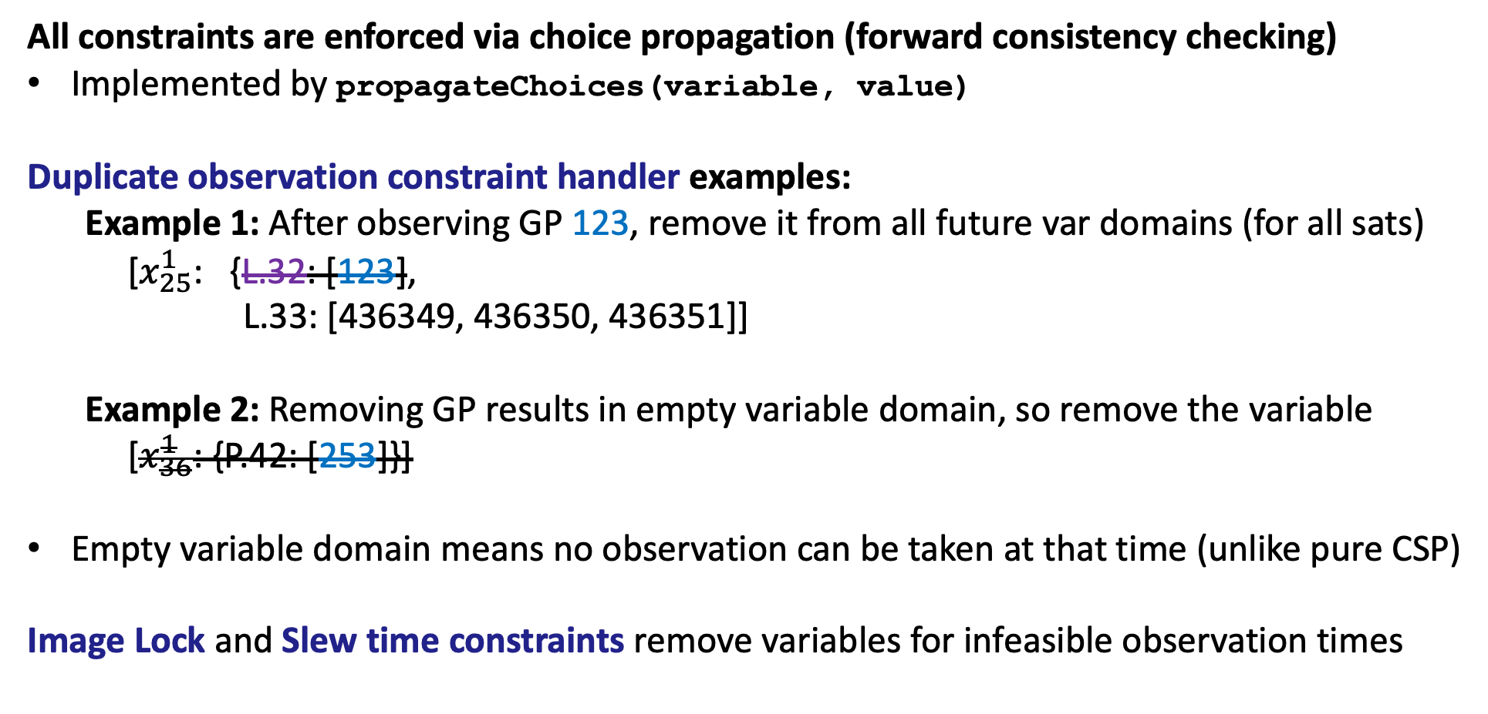
Constraint Handlers
All constraints are enforced via choice propagation (forward consistency checking)
Implemented by propagateChoices(variable, value)
Duplicate observation constraint handler examples:
Example 1: After observing GP 123, remove it from all future var domains (for all sats)
[$x_{25}^{1}$: {L.32: [123],
L.33: [436349, 436350, 436351]]
Example 2: Removing GP results in empty variable domain, so remove the variable
[$x_{36}^{1}$: {P.42: [253]}]
Empty variable domain means no observation can be taken at that time (unlike pure CSP)
Image Lock and Slew time constraints remove variables for infeasible observation times

