Slide 1

Retail Sales & Returns Analysis
A data analytics project exploring sales performance, revenue drivers, and return behaviour using Python & Tableau — based on the UCI Online Retail II dataset.
K. SREEJANI
KAGGLE . PYTHON · TABLEAU

Slide 2
Project Blueprint
What This Presentation Covers
01
02
Dataset & Context
Data Preprocessing
Source, scope, and structure of the UCI Online Retail II dataset
Cleaning, feature engineering, and separation of sales vs. returns
03
04
Exploratory Analysis
Dashboard & Insights
Sales, revenue, and returns deep-dive with key findings
Tableau visualisations, KPIs, and actionable recommendations

Slide 3

The Dataset: UK Online Retail
Why This Dataset?
1,067,371
A real-world UK-based gift retailer serving both individual consumers and wholesale buyers — making it an ideal candidate for hybrid business analysis. With over 1 million transaction records, it offers rich signal across time, geography, and customer behaviour.
Total records
8
Columns / features
UK-based
Primary market

Slide 4

Data Preprocessing Pipeline
Raw transactional data required rigorous cleaning before meaningful analysis could begin.
Remove Invalids
Handle Missing
Separate Sales
Feature Engineer
This structured pipeline ensured every downstream analysis — sales, revenue, and returns — operated on clean, purpose-built datasets, eliminating distortions from over 80,000 negative-quantity entries and erroneous pricing records.

Slide 5

Chapter 1 · Sales Analysis
Strong Seasonality, Hybrid Customer Base
Key Findings
Q4 surge: Sales spike sharply in November, driven by holiday-season demand — the single strongest month across both years.
Order volume mirrors revenue: Transaction counts closely track revenue trends, confirming volume as a primary growth lever.
Bulk transactions present: The mix of retail and wholesale buyers inflates order sizes, making average metrics less representative on their own.

Slide 6
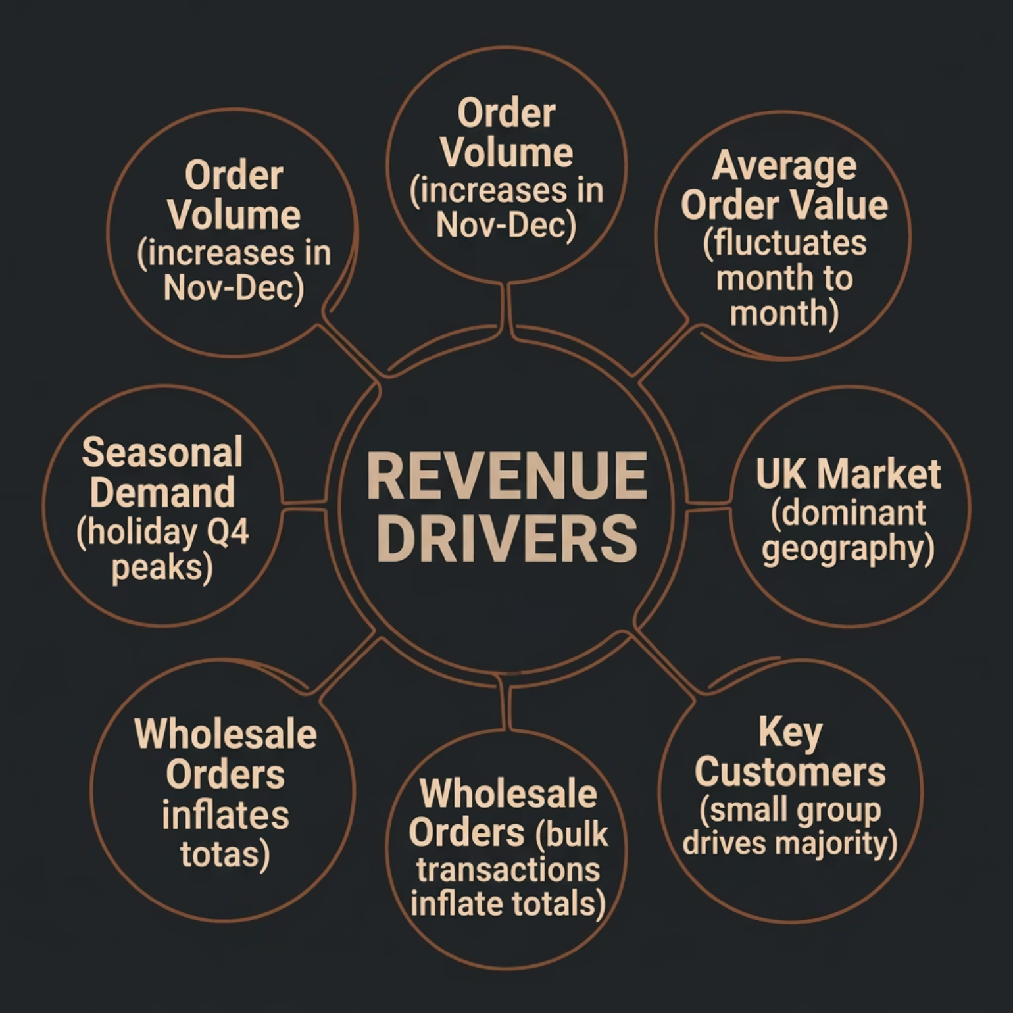


Chapter 2 · Revenue Analysis
Revenue Concentration & AOV Dynamics
What Drives Revenue?
Revenue is shaped by two forces: order volume and average order value (AOV). Peak months see both rise simultaneously, while quieter months expose AOV volatility — a signal of inconsistent spending behaviour outside the holiday cycle.
Revenue is highly concentrated — a small number of customers and the United Kingdom as a geography account for the majority of total revenue. This dual dependency is both a competitive strength and a strategic risk.

Slide 7
Chapter 3 · Returns Analysis
Returns Are Low, Stable & Proportional
3.5%
↑ Q4
≠ Top
Overall Return Rate
Peak Return Period
Distinct Return Profile
Returns as a share of total revenue — well below industry benchmarks
Returns rise during high-sales months but remain proportionally stable
Returned products and returning customers differ from top revenue contributors
The proportional stability of returns signals consistent operational performance — the business is not experiencing a systemic quality or fulfilment issue, even during high-volume periods.

Slide 8
Tableau Dashboard
An interactive dashboard was built in Tableau to consolidate all findings into a single, navigable view. Explore it live: Retail Sales & Returns Analysis Dashboard →
KPI Strip
Revenue by Country
Total Revenue · Total Orders · Total Customers · Return Rate — at a glance
Geographic concentration of revenue, dominated by the United Kingdom
Revenue & AOV Trends
Returns Trend
Monthly income and average order value tracked across the full period
Return quantities over time with Revenue vs. Returns comparison view

Slide 9

Turning Insights Into Action
Recommendations
Capitalise on Seasonality
Front-load inventory and marketing investment ahead of Q4 to maximise the November–December revenue window.
Diversify Geography
Reduce over-dependence on the UK market by targeting expansion into high-potential international markets.
Segment Customers
Distinguish wholesale from retail buyers in reporting to accurately interpret AOV and tailor pricing strategies.
Monitor Returns Proactively
Although stable at 3.5%, return root-cause analysis by product category can pre-empt quality issues at scale.

Slide 10

Project Conclusion
Key Takeaways
Tools & Stack
Data quality is foundational
Seasonality is the dominant pattern
Python
Tableau
Rigorous preprocessing — removing invalid prices, separating returns, engineering features — was critical to producing reliable insights.
Holiday-driven Q4 demand is the single largest lever in this business; planning around it is non-negotiable.
Pandas · NumPy · Matplotlib · Seaborn
Interactive dashboard & KPI visualisation
Google Colab
Cloud-based notebook environment
Concentration = risk + opportunity
Returns are under control
Future scope: Customer segmentation (RFM), predictive demand forecasting, and product-level return optimisation would meaningfully extend this analysis.
Heavy reliance on the UK and a few key customers demands both strategic protection and active diversification.
A ~3.5% return rate that scales proportionally with sales signals operational stability and consistent fulfilment quality.

Slide 11
THANK YOU!
K. SREEJANI
kukudalasreejani@gmail.com
Skillians August 2025 Batch

