Slide 1
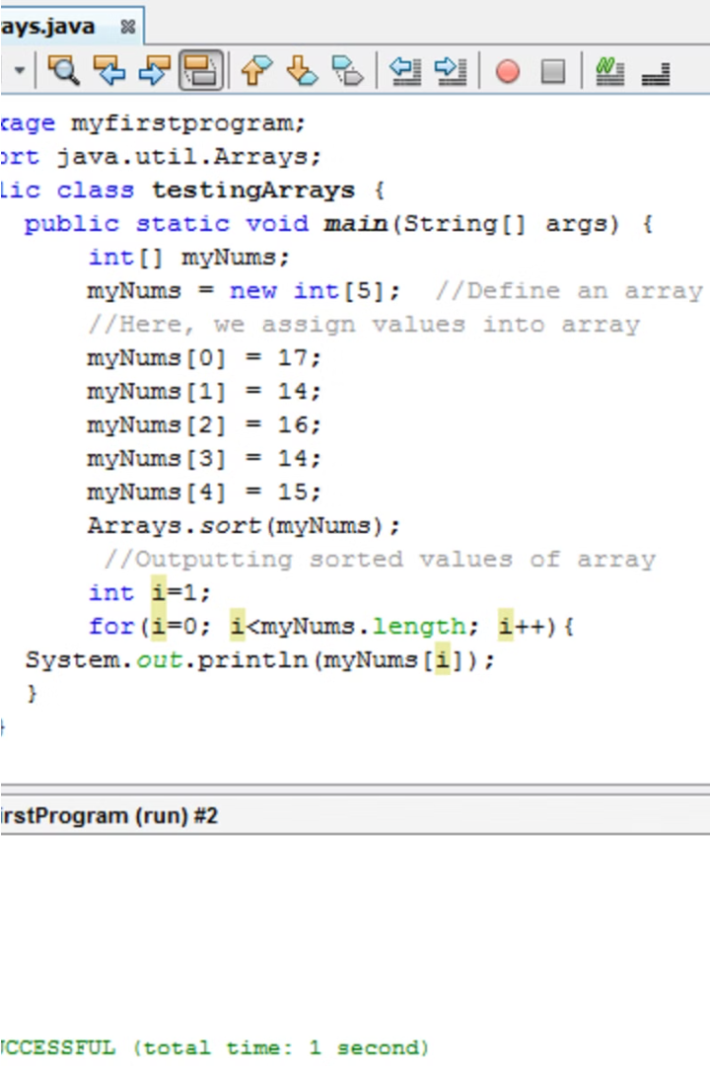

Method Overloading in Java
Method overloading is a core concept in Java that allows a class to have multiple methods with the same name, as long as they have different parameter lists. This enables more flexible and expressive code by providing multiple ways to call the same functionality.

Slide 2
Defining Overloaded Methods
Same Method Name
Different Parameters
Return Type Ignored
Overloaded methods must have the same name but different parameter lists.
The parameter lists can differ in the number, type, or order of parameters.
The return type of the method is not considered when differentiating overloaded methods.

Slide 3
Rules for Method Overloading
1
Parameters Must Differ
2
Return Type Doesn't Matter
Overloaded methods must have different parameter lists.
The return type is not considered when overloading a method.
3
Exceptions Allowed
4
Access Modifiers Can Vary
Overloaded methods can throw different exceptions.
Overloaded methods can have different access modifiers.

Slide 4
Benefits of Method Overloading
Flexibility
Readability
Maintainability
Overloading allows a class to provide multiple ways to call the same functionality.
Overloading makes code more expressive and easier to understand.
Overloading reduces duplication and makes the codebase more manageable.

Slide 5
Examples of Method Overloading
Different Parameters
Different Types
Variable Arguments
public void print(int i) { System.out.println(i); }
public int sum(int... numbers) { return Arrays.stream(numbers).sum(); }
public int add(int a, int b) { return a + b; }
public void print(String s) { System.out.println(s); }
public int add(int a, int b, int c) { return a + b + c; }

Slide 6
Overloading vs. Overriding
Overloading
Overriding
Key Difference
Occurs in the same class with different parameter lists.
Occurs in a subclass and replaces a method in the superclass.
Overloading is about providing multiple ways to call a method, while overriding is about changing the behavior of an inherited method.
Allows multiple methods with the same name.
Must have the same name, return type, and parameters.

Slide 7
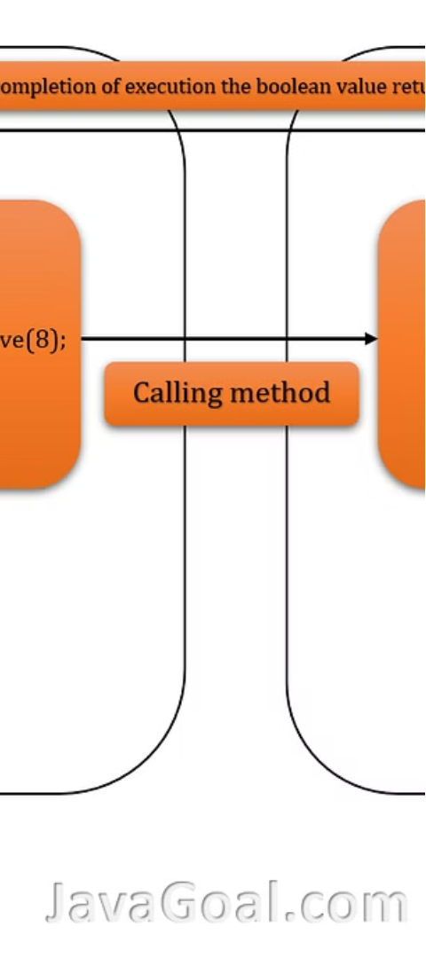



Overloading and Method Resolution
Method Call
The Java compiler must determine which overloaded method to invoke.
Parameter Matching
The compiler compares the arguments in the method call to the parameter lists of the overloaded methods.
Best Match
The most specific overloaded method with the best parameter match is selected for the invocation.

Slide 8




Best Practices for Method Overloading
Differentiate
Consistent
Document
Avoid Ambiguity
Ensure overloaded methods have clearly differentiated functionality.
Maintain consistency in the naming and parameter ordering of overloaded methods.
Clearly document the purpose and differences of overloaded methods.
Ensure there is no ambiguity in method resolution, especially with primitive types.

Slide 9
Thank you

