Slide 1
THE DATA TRIBE
Team Members
Santhosh Reddy Vantikommu
Jyothsna Eleti
Sri Harshika Sattor
Arun Sai Ram Nuvvula
Sreeja Rao Ambati

Slide 2
Agenda
Introduction
Tools and Technologies
Goals
Data Cleaning
Implementation
Visualization
Problems faced

Slide 3
Improving Safety through Big Data Analytics on Deadly Crashes from Toronto Police Services data Introduction
Overview: Analyzed Toronto Police data to enhance road safety.
Road Safety Importance: Significance of reducing traffic fatalities and injuries.
Objective: Utilize data analysis to identify crash patterns and risk factors.
Scope: Analyze time, location, weather, and driver behavior.
Impact: Develop actionable recommendations for road safety improvements.
Notes:
Overview : In our project we are analyzing the Toronto Police data for understanding the Accident patterns and provide the insights for improving safety.
In our project we will be Highlighting the significance of reducing fatalities and injuries caused by traffic accidents.
Scope: by this project we will be analysing the data and extracting the time,location,weather and driver behaviour.

Slide 4
Tools and Technologies
Overview of tools used in the project
PySpark for big data processing: Leveraging PySpark's distributed computing capabilities to handle data efficiently.
Pandas for data manipulation: Utilized Pandas for data cleaning, preprocessing, and manipulation tasks, enabling consistent data analysis workflows.
Matplotlib for data visualization: Used Matplotlib to create visualizations that communicate insights derived from the data effectively
Notes:
We used Pyspark for doing our project and extract the results for the goals

Slide 5
Goals
Highlight the district with the highest number of fatal crashes.
Identify the streets with the highest number of fatal crashes.
Determine which traffic control had the most fatal collisions.
Identify the most common state of condition among drivers in fatal collisions.
Determine the most common vehicle speed present during fatal crashes.
Notes:
By this project we will extract district with the highest number of fatal crashes
We will

Slide 6
Goals
Highlight the difference in fatal crash occurrences between day and night
Determine the impact of road condition on fatal crash occurrences
Identify the year with the highest number of fatal car crashes
Provide insights into the prevalence of speeding in fatal crashes
Highlight the significance of pedestrian safety in fatal crash incidents
Notes:
By this project we will

Slide 7
Data Cleaning
Importance of Data Quality:Clean and reliable data is essential for accurate analysis, trustworthy insights, and actionable recommendations.
techniques such as handling missing values, standardizing formats, and removing duplicates employed with Pandas to clean the dataset

Slide 8
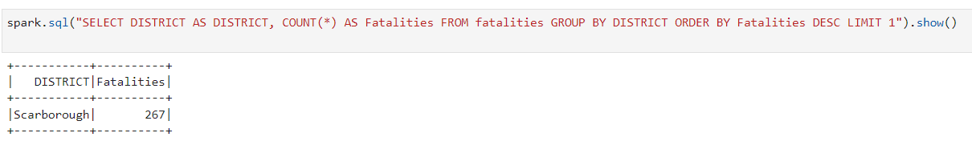
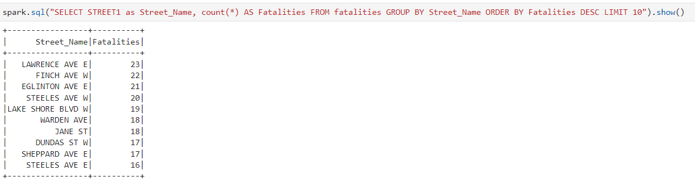
Implementation
Extracted the district with the highest number of fatal crashes.
Identified the streets with the highest number of fatal crashes.
Notes:
As we mentioned building few queries for goals these are the queries to extract the solutions.

Slide 9
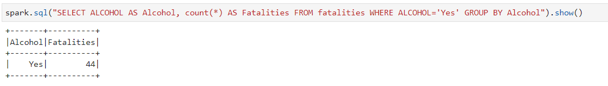
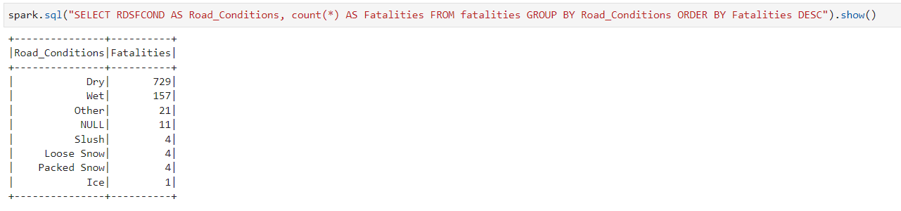
Implementation
Identifying the most common state of condition among drivers in fatal collisions
Determining the impact of road condition on fatal crash occurrences

Slide 10
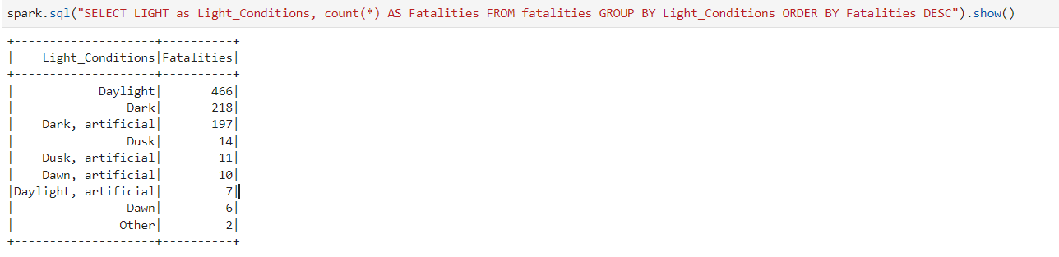
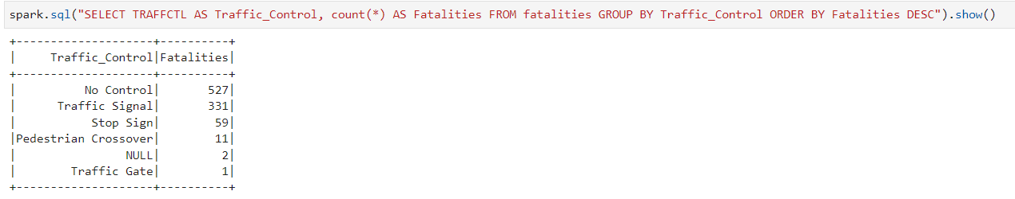
Implementation
Highlighting the difference in fatal crash occurrences between day and night
Determining which traffic control had the most fatal collisions

Slide 11
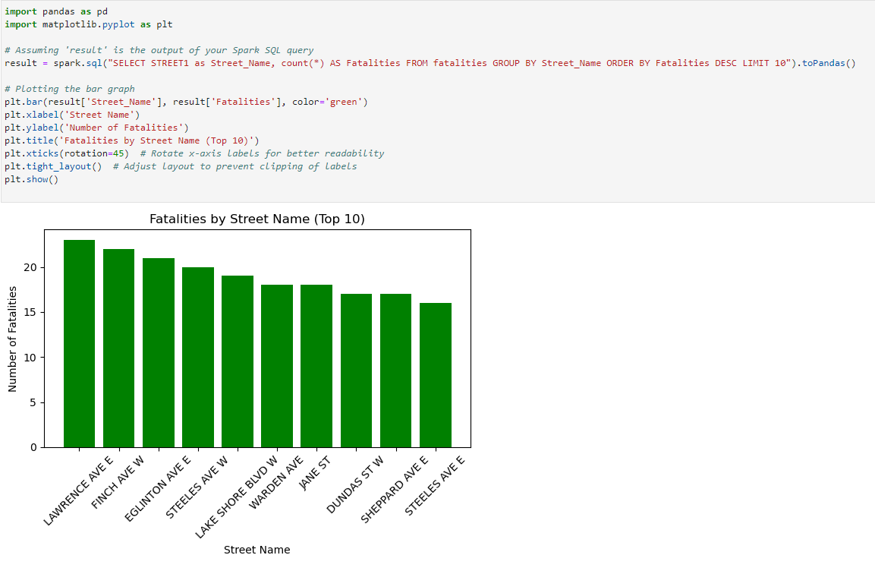
Data Visualization
Identifying the street with the highest number of fatal crashes

Slide 12
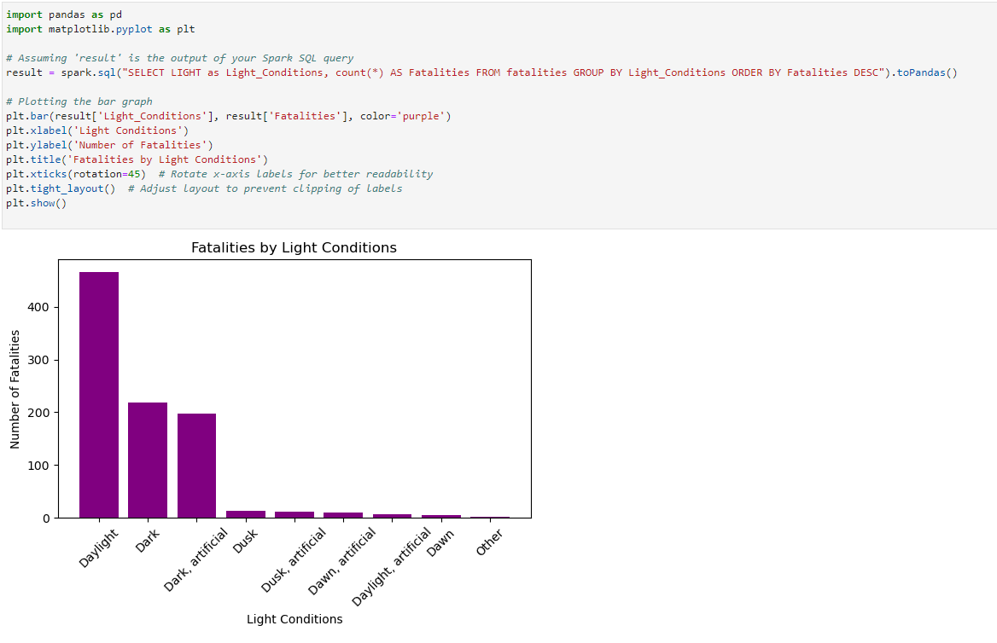
Data Visualization
Highlighting the difference in fatal crash occurrences between day and night

Slide 13
step-by-step breakdown
Downloaded dataset from Kaggle.
Install the required Python libraries, including PySpark, and Pandas.
Cleaned and preprocessed raw dataset using Pandas.
Created a notebook in Jupiter and imported the dataset.
Imported the python libraries in Jupiter Notebook.
Created queries according to our goals and started executing them.
Used Matplotlib to create visualizations that communicate insights derived from the data
Notes:
Clear formatting Remove irrelevant data, Removed duplicates, Filter missing values, Convert data type, capitalization

Slide 14
Problems Faced
Undefined references to library functions or objects.
Choosing the Right Visualization.
Dealing with Complex Data while data visualization.
Notes:
library is not imported correctly, attempts to use its functions or objects in the code resulted in errors, we imported correct library
Selecting the most appropriate type of visualization to effectively convey the insights present in the data can be challenging. Choosing an unsuitable visualization may lead to misinterpretation or difficulty in understanding the data.
Visualizing multidimensional data sets can be challenging selecting the correct graph is important here.

Slide 15
THANK YOU

