Slide 1
FINAL SUBMISSION
MaaSetu
Her care travels with her — a consent-based handover between ASHA/ANM workers when a mother moves for childbirth
TEAM NAME [Add team name]
TEAM CODE [Add team code]
Notes:
Fill in team name and team code (highlighted amber).

Slide 2
Team Overview & Background
Team members and contributions
Doctor partner
Name | Role | Expertise / contribution
[Add name] | [e.g. Product & front-end] | [Add]
[Add name] | [e.g. Firebase / offline sync] | [Add]
[Add name] | [e.g. Clinical & user research] | [Add]
[Add name] | [Add role] | [Add]
[Add name & speciality]
[Add relevant experience]
[Add role — e.g. reviews milestone template and mother-facing messages]
Organisation / institution
Amber items are placeholders — the project files do not contain team or clinician details.
[Add institution or organisation]
Student prototype team building for maternal health in India

Slide 3
Problem Statement and Supporting Evidence
The gap: when a mother moves to her natal home around childbirth, her original ASHA/ANM loses track of her — and the receiving village’s ASHA often does not know she has arrived.
Why it matters
Current challenges
What needs to improve
About 1 in 3 women in India go to their natal home around childbirth (team’s framing of the problem).
Antenatal and postnatal care is a continuum: a break in follow-up means missed visits for both mother and newborn.
[Add citation: NFHS / state HMIS / published study for the figure above]
Care history sits with the original worker; nothing travels with the mother.
No consent-based, auditable way to hand a mother over between villages.
Weak connectivity in villages, and mothers and workers who work in Hindi or Marathi.
Receiving worker has no reminder or alert that a mother is expected.
A shared journey card both workers can trust, with every change attributed.
Explicit mother consent that can be withdrawn at any time.
Notifications and a visible hand-off status so nobody is left waiting.
Works with poor or no signal, in the mother’s own language.

Slide 4
Target Users and Use Case
Original ASHA / ANM
Receiving ASHA / ANM
Mother / family member
Village A — sending worker
Village B — receiving worker
Beneficiary
Keeps the mother’s journey card up to date
Needs to hand her over safely when she moves
Wants to see what happened after the move
Needs to know a mother is arriving
Needs her history before the first visit
Needs a clear accept step before editing
Wants to know who her health worker is now
Wants control over who sees her details
Needs simple, large text in her own language
Use case and workflow fit
Setting: village-level primary care — ASHA/ANM workers on Android phones, often with patchy connectivity.
Task: the move — from “Mother is moving” to the receiving worker’s first visit — without losing her journey card.
Fits the existing flow: workers keep using milestones and visit notes; MaaSetu adds consent, hand-off, alerts and an offline fallback.

Slide 5
Solution Overview & Key Features (1/2)
MaaSetu is a mobile-first, installable PWA. It stores a mother’s journey card, shares it only with her recorded consent, notifies the receiving worker, and gives the mother a simple progress view. It is assistive only — it never diagnoses, scores risk or recommends treatment.
Journey card
Consent-first handover
Incoming list & read-only view
Milestones (upcoming / done / missed) with dates, and a visit log. Edits keep earlier versions — no silent deletion.
Consent screen records who, when and what is shared. Handover starts “pending”; without consent it cannot continue.
Receiving worker sees a badge and incoming mothers, reads the card, then accepts — only then can she edit.
Notifications & care tracker
Offline-first
Mother’s view & withdrawal
Fixed, translated alerts for request, accept, withdrawal and 48-hour overdue. A 5-stage tracker shows the move.
Changes queue on the phone and sync in order. Conflicts keep both versions. QR summary and SMS / WhatsApp preview work with no app signal.
Current village, worker, done/next milestones in English, Hindi or Marathi. She can withdraw consent — access is revoked.

Slide 6
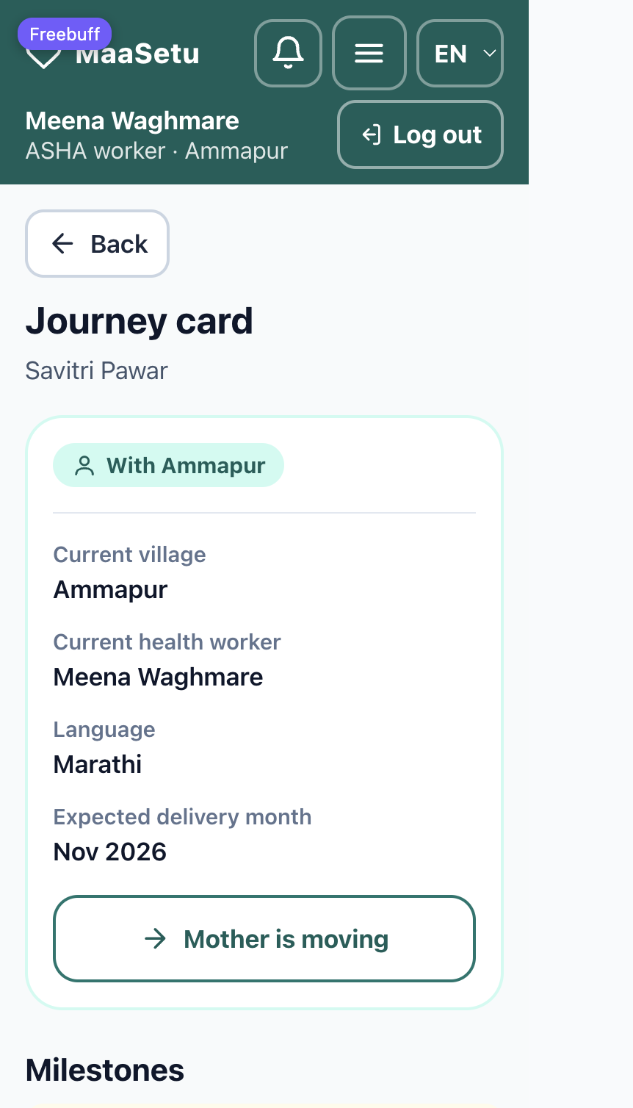
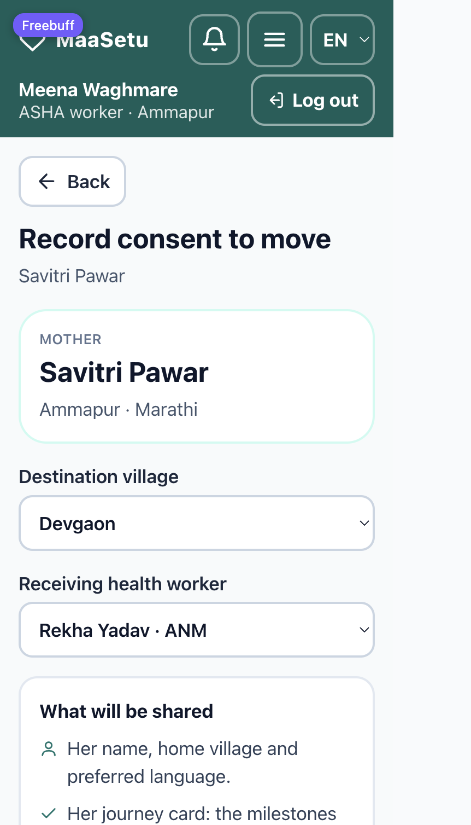
User Journey & Expected Impact (2/2)
1
Record care — ASHA marks milestones and adds visits. Input: dates, visit notes
2
Consent to move — “Mother is moving” → pick village + worker → record consent. Output: consent log, handover “pending”
3
Notify & review — Receiving worker sees the badge and a read-only summary. Output: incoming list
4
Accept — Receiving worker accepts, then adds visits. Output: status “With Devgaon”
5
Stay informed — Original ASHA sees activity; mother sees her village and worker, and can withdraw. Output: timeline, mother view
Journey card
Consent to move
Expected impact (to be validated in a pilot)
Continuity of care
Mother in control
Works on weak networks
Receiving ASHA knows she has arrived and what is already done.
Consent is explicit, timestamped and can be withdrawn.
Offline queue, QR summary and SMS fallback.

Slide 7
Technology, Tools and AI Approach
Users
MaaSetu PWA
Offline layer
Firebase
ASHA / ANM
Mother / family
EN · हिं · मरा
React 19 + Vite + TypeScript
Tailwind CSS
react-i18next (EN/HI/MR)
vite-plugin-pwa
IndexedDB queue
Ordered sync + backoff
Conflict records
QR summary (no notes)
Auth — phone OTP
Firestore + security rules
Audit log on every write
Emulator Suite (demo)
How AI is used
Data
Integrations
No generative AI at runtime — by design.
No diagnosis, risk score or normal/abnormal flag. Visit notes are stored exactly as typed.
AI coding assistance was used to build the prototype.
Synthetic data only — no real patient data.
Care-plan text is pre-written; placeholder milestones await clinician approval.
Built: Firebase Auth + Firestore, QR, SMS / WhatsApp message preview.
Planned: FCM push, Cloud Functions, ABDM / RCH registry link.

Slide 8
Build Sprint Journey and Progress
Week 1
Week 2
Week 3
Week 4
How it evolved
Scaffold, roles, data model, i18n
Idea: a consent-based handover between two workers plus a mother view.
Grew into offline-first with QR, SMS fallback, notifications and a move tracker.
Journey card & mother view
10-step consent → handover flow
Challenges and changes
Notifications & 48h overdue
Isolated screens → rewired into one end-to-end flow.
Saved role in localStorage skipped login → rebuilt entry flow on auth.
Build passed but pages broke → audit by running the app.
Entry flow, phone-OTP auth, rules
Offline queue, sync, conflicts, QR
Care tracker, SMS/WhatsApp, audit
Still incomplete
Week placement is indicative — adjust to your actual sprint dates. All bars above are functional in the prototype.
Clinician-approved milestones and messages (placeholders).
FCM push, Cloud Functions, server-signed QR.

Slide 9
Evaluation and User Validation
How it was tested (synthetic data, local emulators)
AI / model performance
Full 10-step demo script run end to end: login → journey card → consent → pending → incoming → accept → visits → mother view → withdraw → access removed.
TypeScript typecheck and production build exit 0.
Layouts captured at 360 px (phone) and 1280 px, in English, Hindi and Marathi.
Offline cases captured: reload while offline, queued edits, two-phone conflict (both versions kept), rejected accept after withdrawal.
Not applicable — no AI model runs in the product, so there is no model accuracy to report.
User testing and feedback
[Add: ASHA/ANM/mother feedback, number of testers, usability findings]
[Add: changes made from feedback]
Limitations — needs further validation
No field testing with real ASHA/ANM workers yet; milestone template and mother-facing text are placeholders pending clinical review.
QR “signature” is a checksum, not cryptographic; Firestore rules need verification against the emulator with real signed-in users.

Slide 10
Safety and Responsible AI
Privacy, consent and security
AI limitations and error handling
Synthetic data only; no real patient data is ever used.
Consent logged with timestamp and who recorded it; mother can withdraw, which revokes access.
Default-deny Firestore rules scoped by role and village; phone-OTP sign-in.
QR and notifications carry no visit notes or health details.
No generative AI at runtime, so no hallucinated medical content.
Never diagnoses, scores risk, recommends treatment or marks values normal/abnormal.
Care-plan and warning text is pre-written and clinician-approved.
Failed syncs retry with backoff; a rejected change is shown, never marked “Synced”.
Safeguards and human oversight
Bias, accessibility and inclusion
Workers record all dates — the app never calculates or suggests one.
Every write is audit-trailed; corrections keep earlier versions.
Receiving worker must accept before editing; accept is rejected if consent was withdrawn.
English, Hindi and Marathi; mother sees her chosen language.
Mobile-first at 360 px, 48 px tap targets, icons always paired with text, high contrast.
[Add: audio / low-literacy support — not yet built]

Slide 11
Deployment, Cost and Sustainability Plan
To pilot in a healthcare setting
Integrations
One block / PHC area with a small group of ASHA/ANM workers on Android phones.
Clinician sign-off on milestone template and mother-facing messages.
A production Firebase project and phone-OTP numbers; consent wording reviewed for data-protection compliance.
Short training and onboarding for workers.
Standalone for the pilot — no existing system is required.
Later: link to government registries (e.g. ABDM / RCH), FCM push, and a real SMS / WhatsApp gateway.
Scale: add villages and blocks as data; same app, per-village access rules.
Cost item | Estimate | Pricing assumptions
One-time deployment | [₹ — add] | Pilot setup, clinical review, worker training, device / SIM support
Per transaction | [₹ — add] | Cloud reads / writes and SMS per handover (if SMS gateway used)
Per doctor / facility per month | [₹ — add] | Hosting, phone-OTP, support, divided by active workers
Sustainability: low-cost serverless stack, one codebase for all villages, funding via NGO / state health programme partner [add].

Slide 12
What Next? Plans to take initiative forward
Next steps
Get clinician review of the milestone template and mother-facing messages; replace placeholder content.
Run a small field pilot with ASHA/ANM workers and capture usability feedback.
Add FCM push notifications, Cloud Functions and server-signed QR codes.
Add audio / low-literacy support and a real SMS / WhatsApp channel.
[Add: funding or partnership plans, if applicable]
Make all solution information publicly available?
[Yes / No — team to confirm]

Slide 13
Thank you
MaaSetu • [Add team name] • [Add team code]
[Contact email] | [MVP link] | [Demo video link] | [Code repository link]
Her care travels with her

