Slide 1
Git and GitHub
Sreejith P Nair

Slide 2
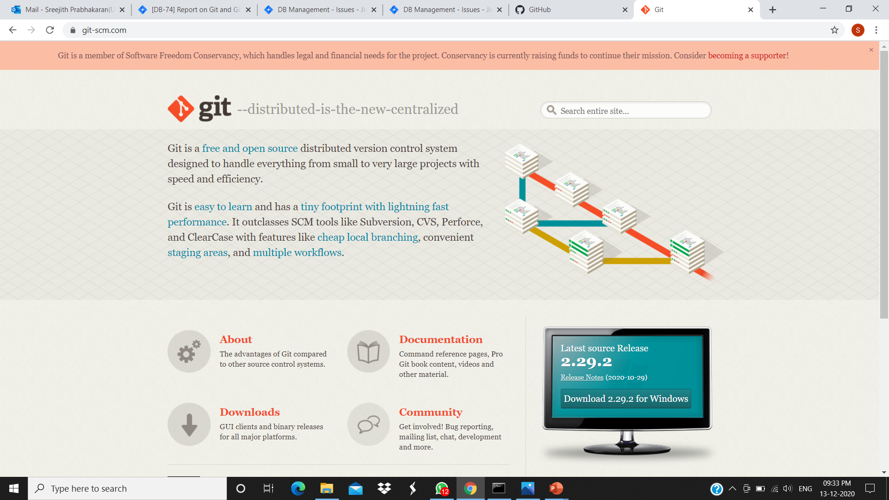
Git Website

Slide 3
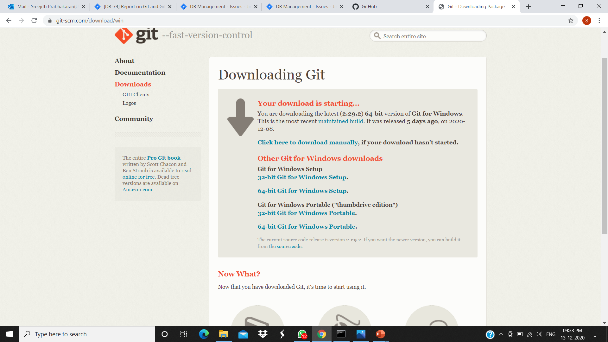
Downloading Git

Slide 4
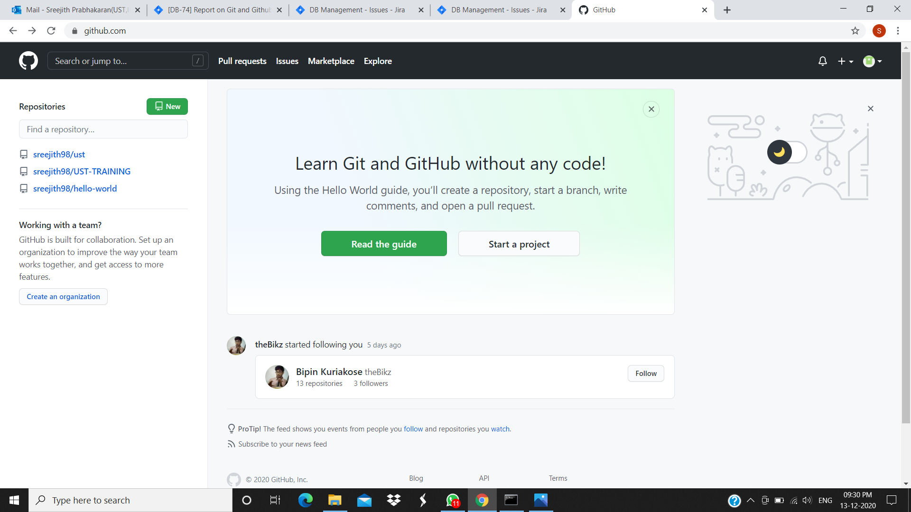
GitHub Account

Slide 5
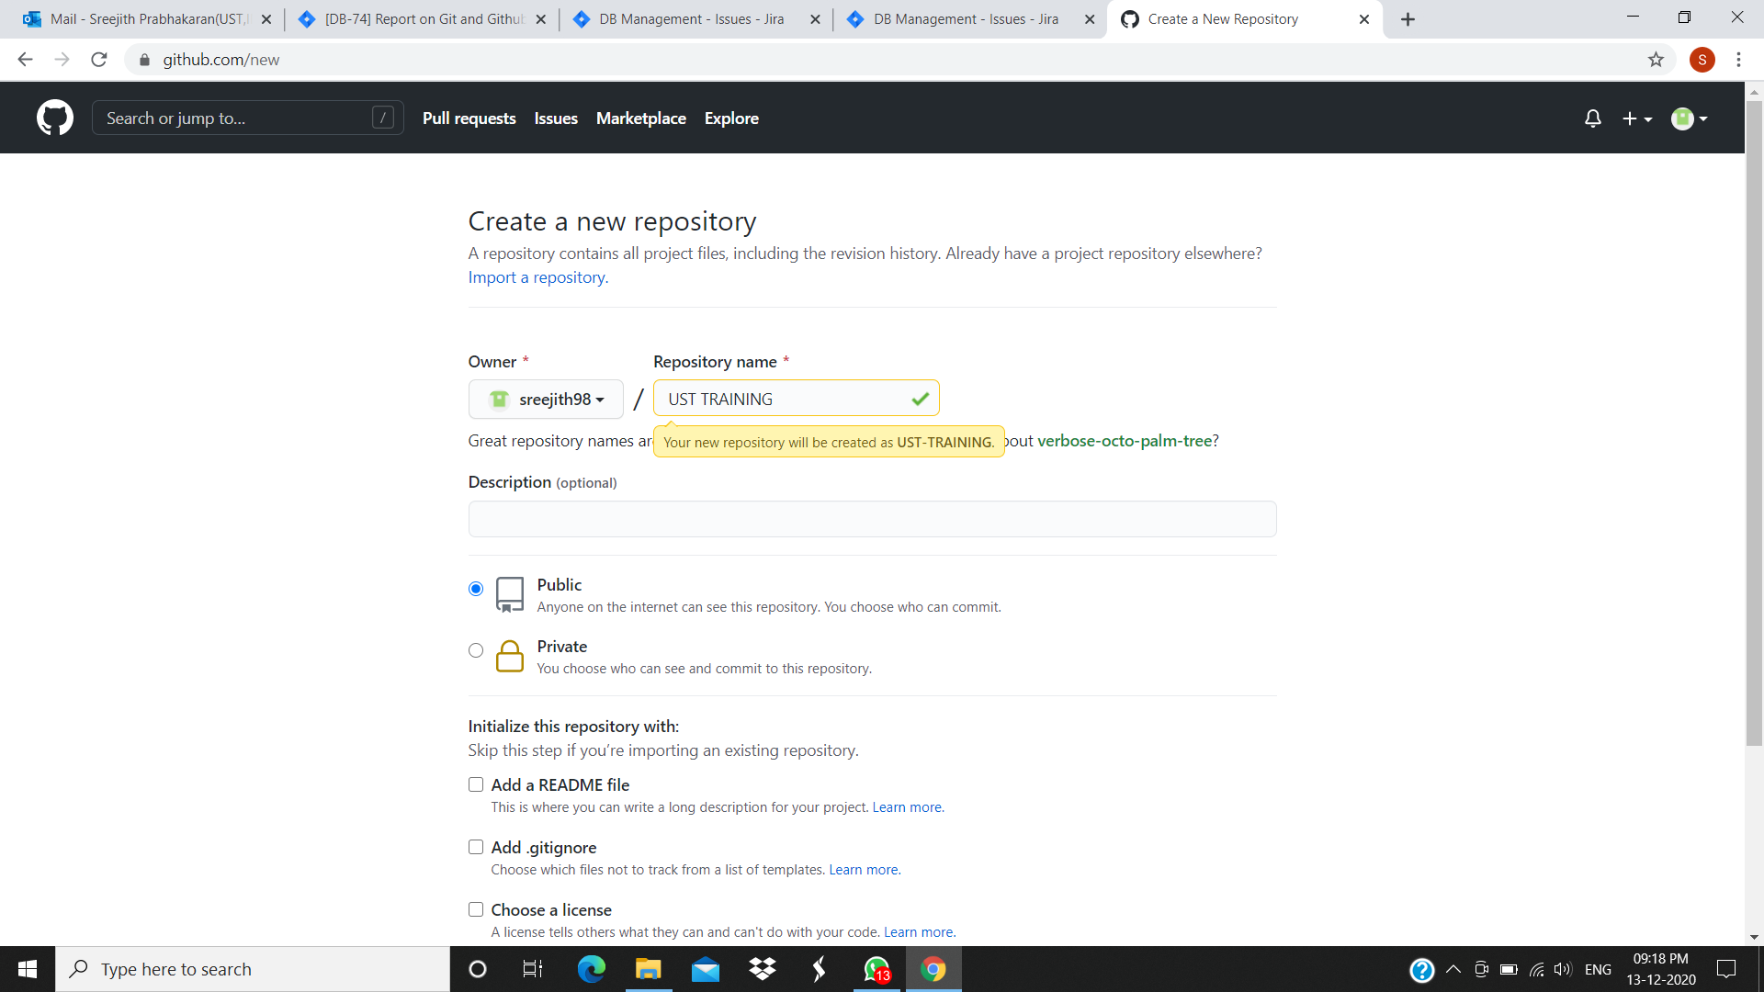
Create New Repository

Slide 6
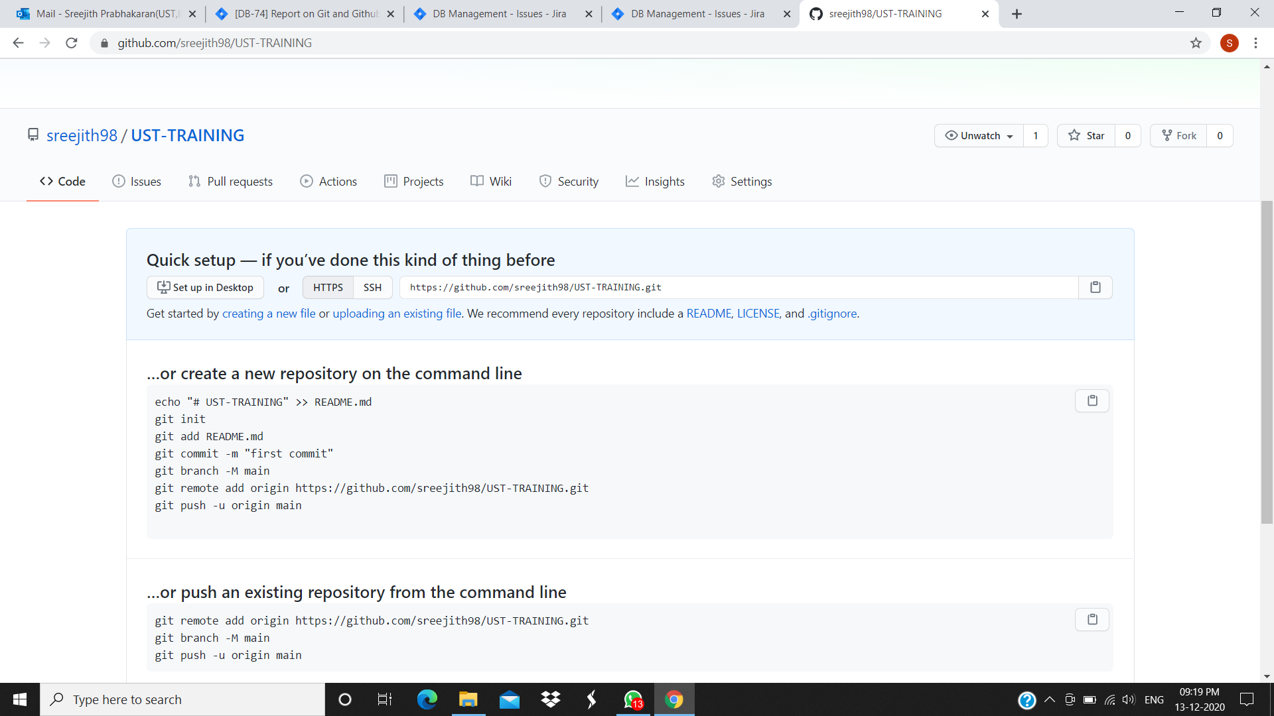
New Empty Repository

Slide 7
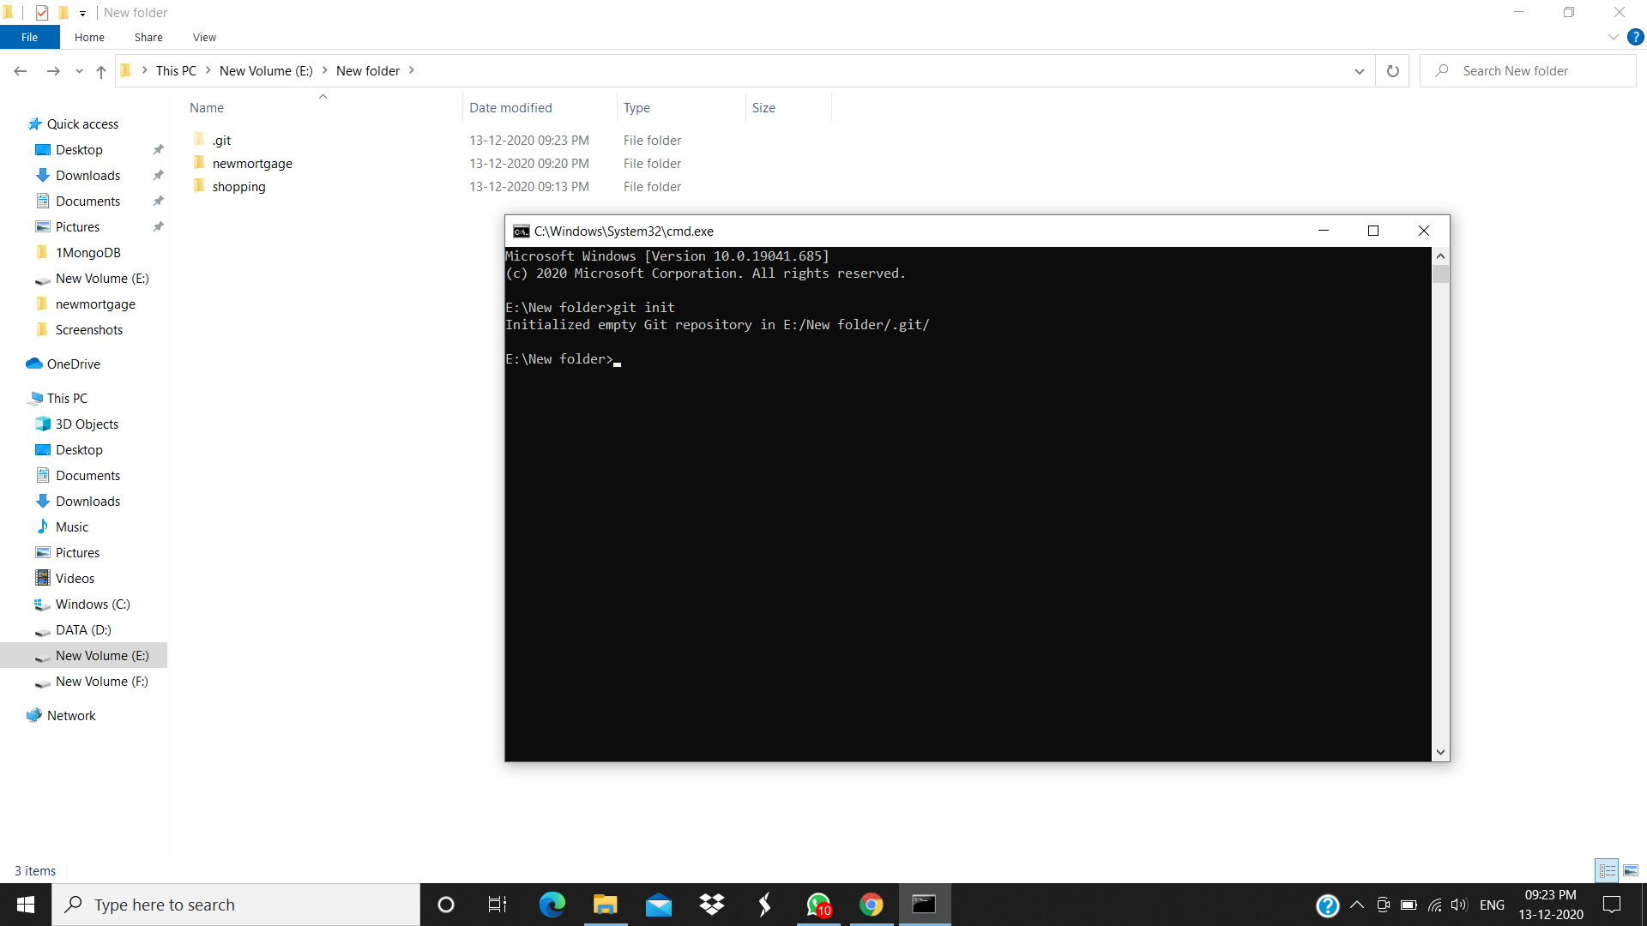
Initializing Git

Slide 8
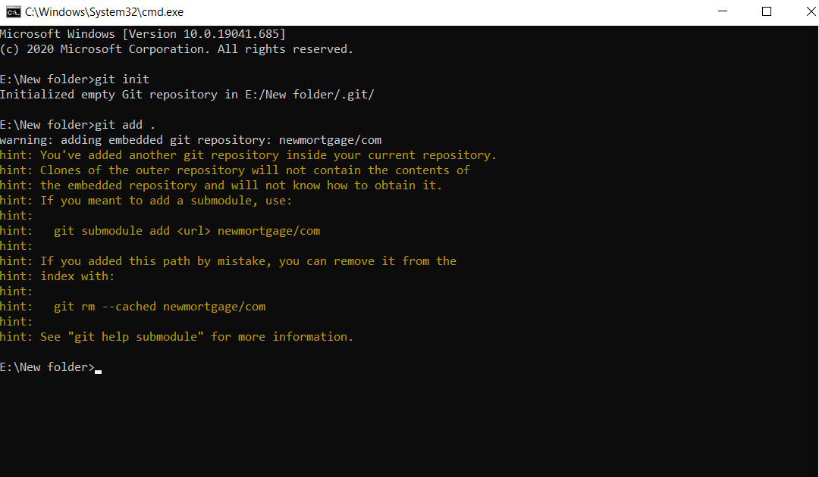
Add files to git

Slide 9
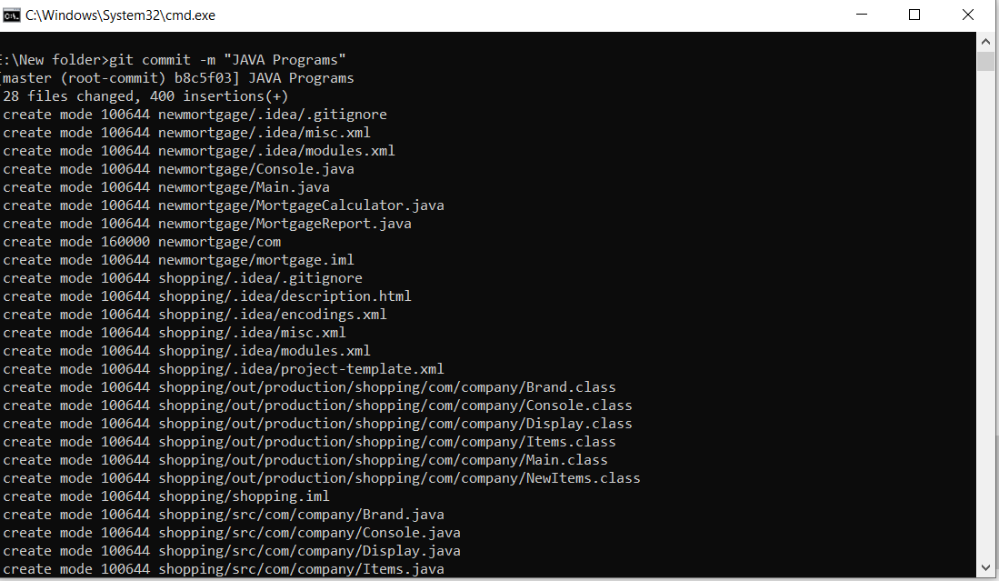
Git commit with a message

Slide 10
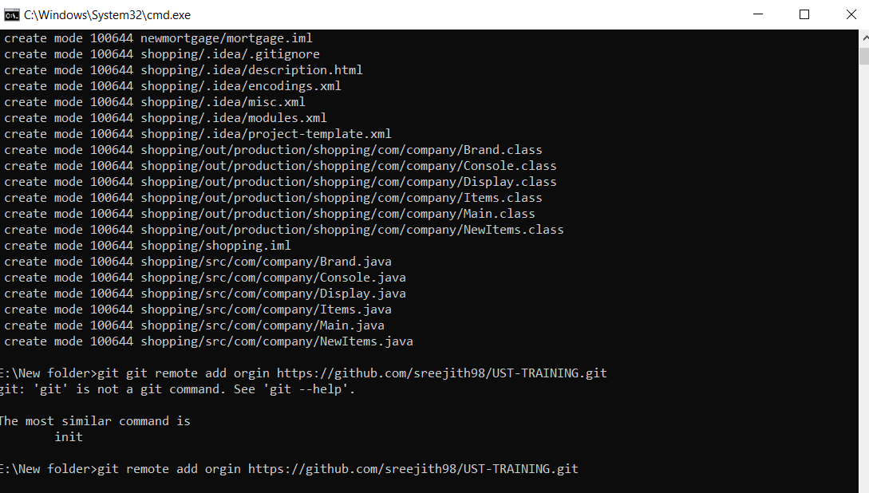
Link the repo with local system

Slide 11
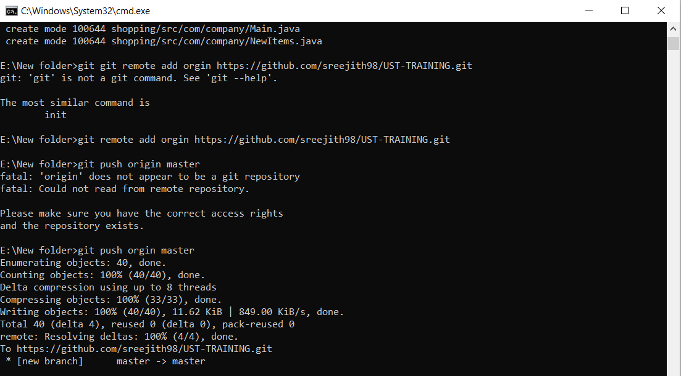
Pushing Files

Slide 12
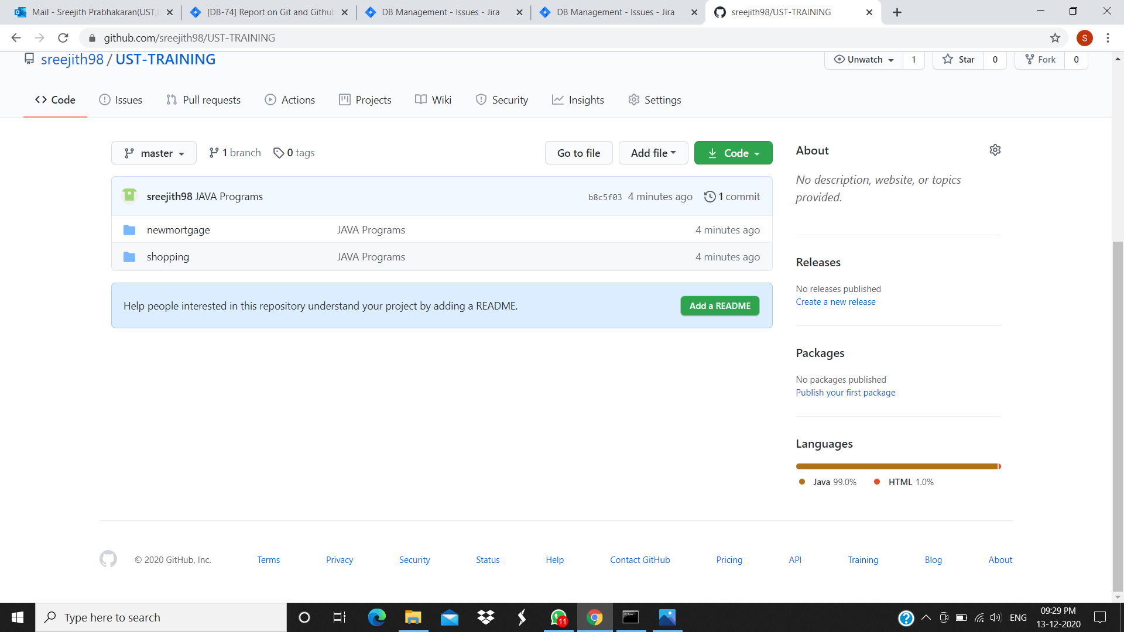
Files added in Master branch

Slide 13

Creating new branch

Slide 14
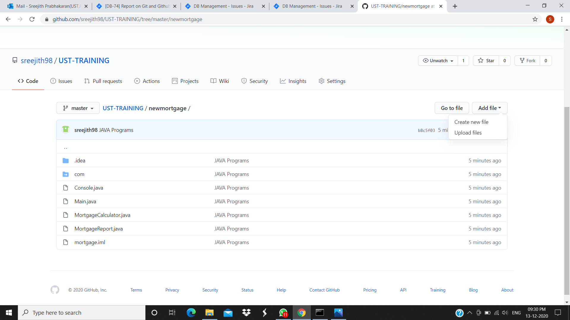
Creating and Adding new files

