Slide 1
MongoDB Index
Sreejith P Nair

Slide 2
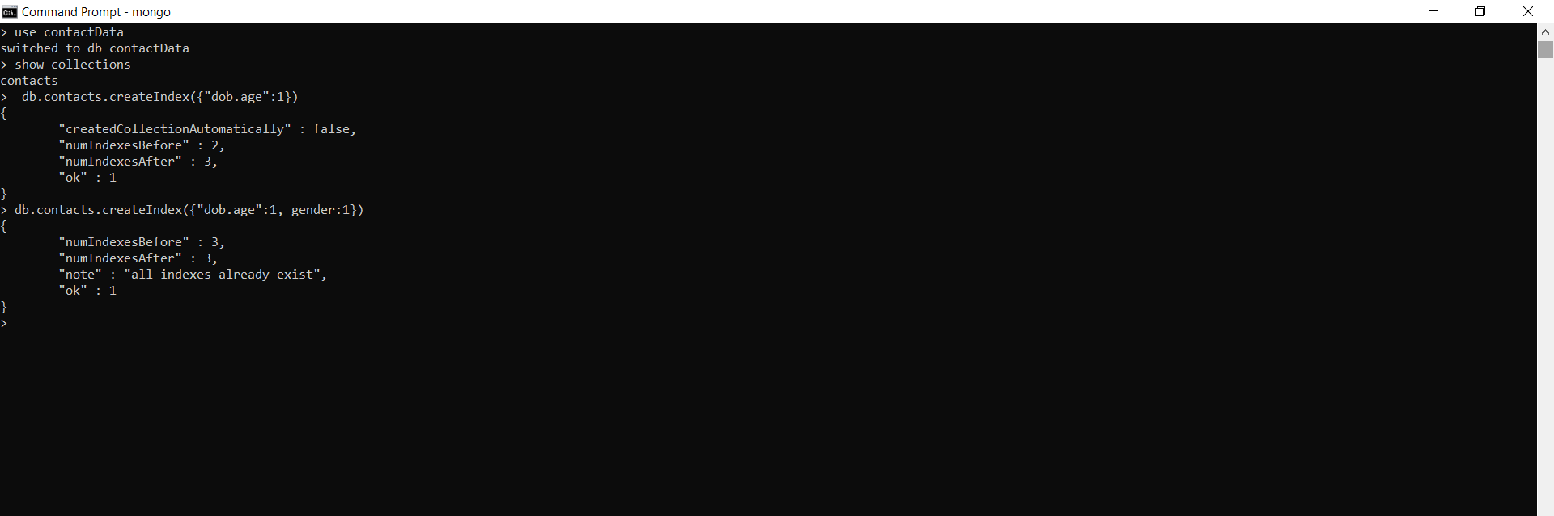
Creating Index

Slide 3
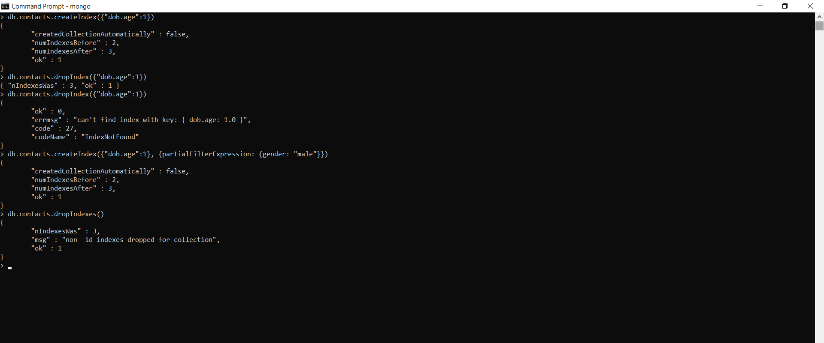
Dropping index

Slide 4
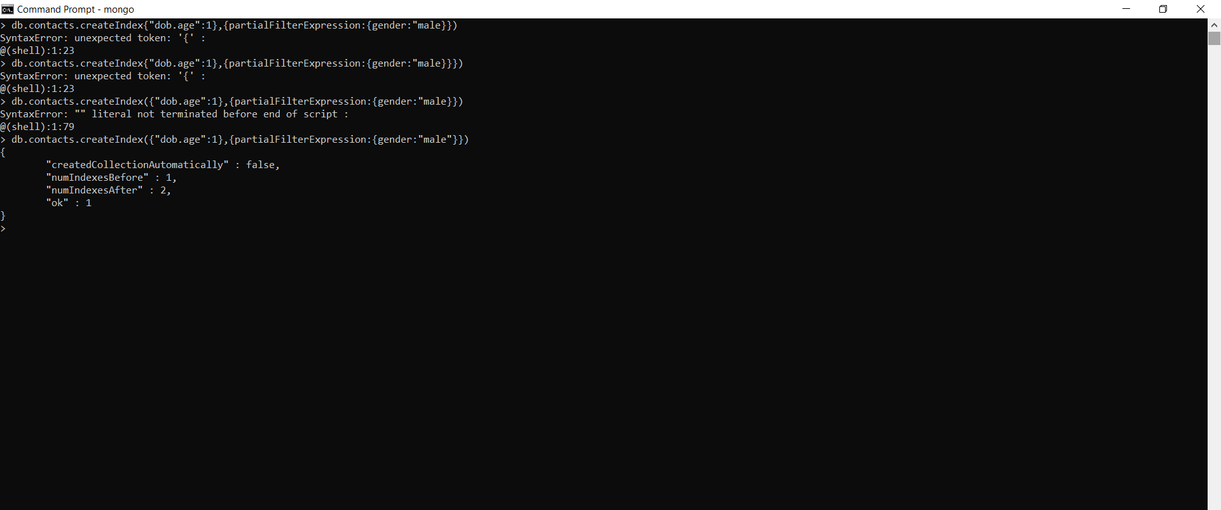
Partial Index

Slide 5

Getting Index

Slide 6
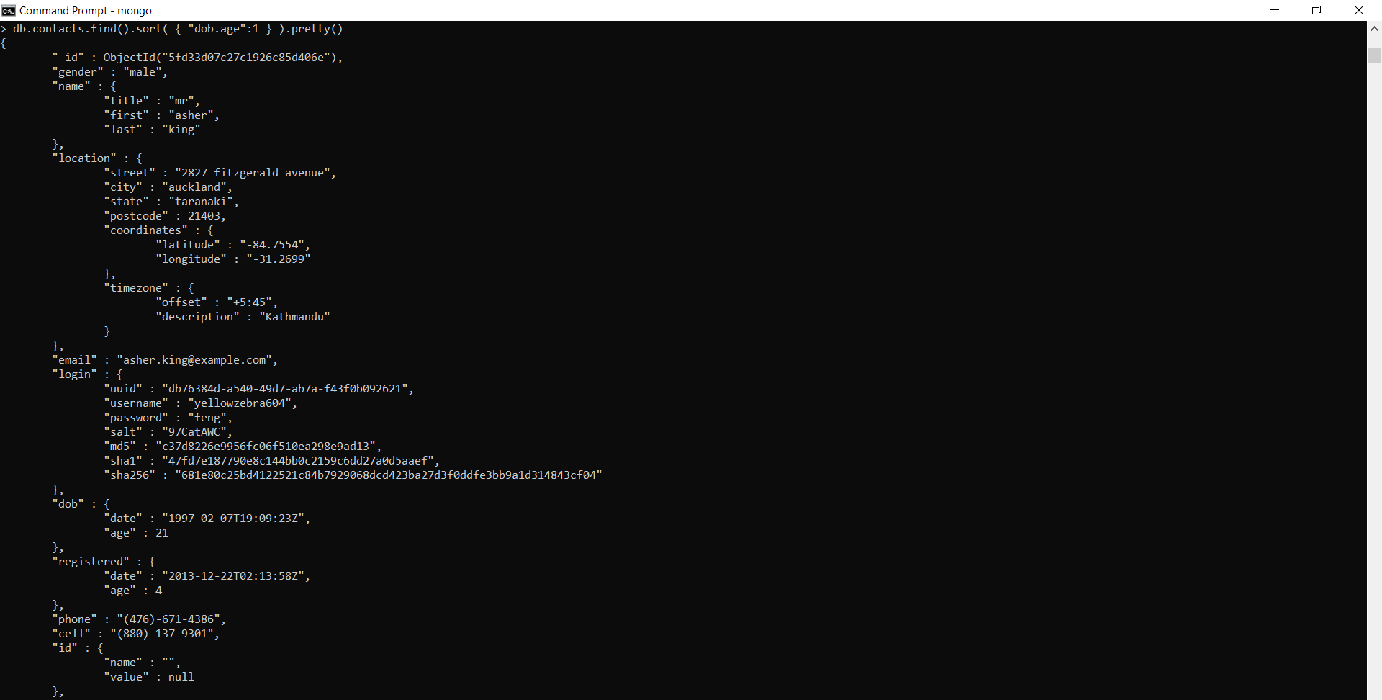
Sort with a Single Field Index

