Slide 1

Sentiment Analysis using Machine Learning
SREEJITH. K M
Department of MCA
Under the guidance of
SUMI. M
Assistant Professor, Department of MCA
NEHRU COLLEGE OF ENGINEERING AND RESEARCH CENTRE, PAMPADY, THIRUVILWAMALA, THRISSUR-680567

Slide 2
AGENDA
INTRODUCTION
EXISTING SYSTEM
PROPOSED SYSTEM
OBJECTIVES
MODULES
SYSTEM REQUIREMENTS
CONCLUSION

Slide 3
INTRODUCTION
Sentiment analysis, an important area in Natural Language Processing, is the process of automatically detecting affective states of text. Sentiment analysis is widely applied to voice-of-customer materials such as product reviews in online shopping websites like Amazon, movie reviews or social media. It can be just a basic task of classifying the polarity of a text as being positive/negative or it can go beyond polarity, looking at sentiment states etc. Sentiment analysis refers to analyzing an opinion or feelings about something using data like text or images, regarding almost anything. Sentiment analysis helps companies in their decision-making process. For instance, if public sentiment towards a product is not so good, a company may try to modify the product or stop the production altogether in order to avoid any losses. There are many sources of public sentiment e.g. public interviews, opinion polls, surveys, etc. However, with more and more people joining social media platforms, websites like Facebook and Twitter can be parsed for public sentiment.

Slide 4
EXISTING SYSTEM
The existing system works only on the dataset which is constrained to a particular topic. The existing systems also do not determine the measure of impact the results determined can have on the particular field taken into consideration and it does not allow retrieval of data based on the query entered by the user i.e. it has constrained scope. In simple words, it works on static data rather than dynamic data. Unsupervised algorithms like Vector Quantization, are used for data compression, pattern recognition, text and speech recognition etc and therefore cannot be used in determining sentiment analysis.Apriori algorithm fails to handle large datasets and as a result can generate faulty results.

Slide 5
PROPOSED SYSTEM
In the proposed system, we will retrieve each words from sentence using NLTK API based on the query. The collected words will be subjected to preprocessing. We will then apply the supervised algorithm on the stored data. The supervised algorithm used in our system is Support Vector Machine (SVM). The results of the algorithms i.e. the sentiment will be represented in graphical manner (pie charts/bar charts). The proposed system is more effective than the existing one. This is because we will be able to know how the statistics determined from the representation of the result can have an impact in a particular field.

Slide 6
OBJECTIVES
Real time sentiment analysis using a dataset.
Include lexical analysis approach to analyse positive and negative sentiments.
Implement a machine learning algorithm to perform sentiment analysis.
Understand and implement natural language processing techniques.
Achieve 80% or more in classification accuracy.
Build a web application graphical user interface for visualisation purposes.

Slide 7
MODULES
ADMIN
USER LOGIN

Slide 8
SYSTEM REQUIREMENTS
• Operating System : Windows 7 or above
• Front End : HTML,CSS
• Back End : python 3.7 or higher
• IDE : PyCharm/VS Code

Slide 9
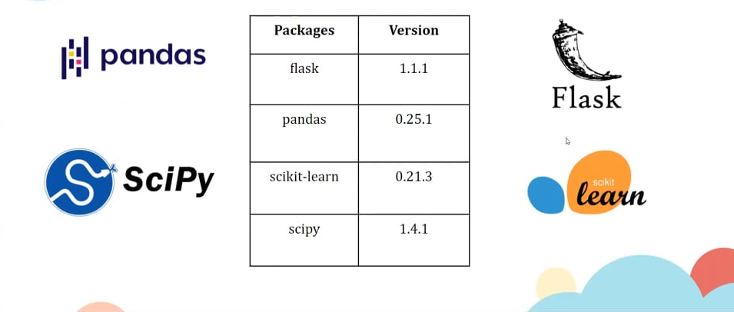

Slide 10
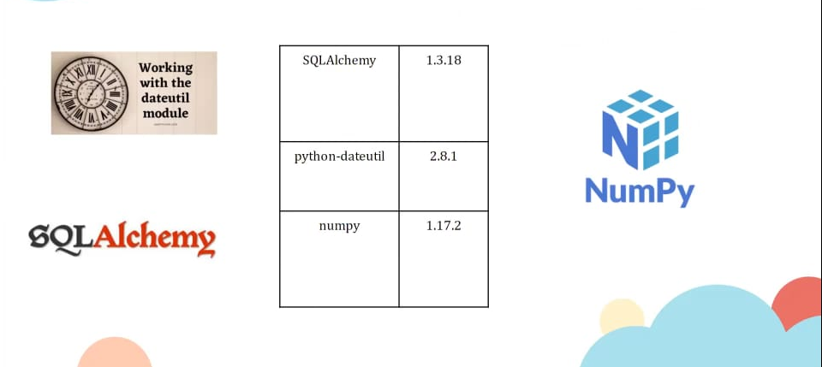

Slide 11
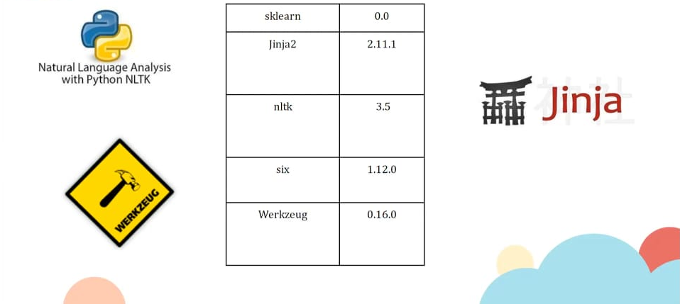

Slide 12
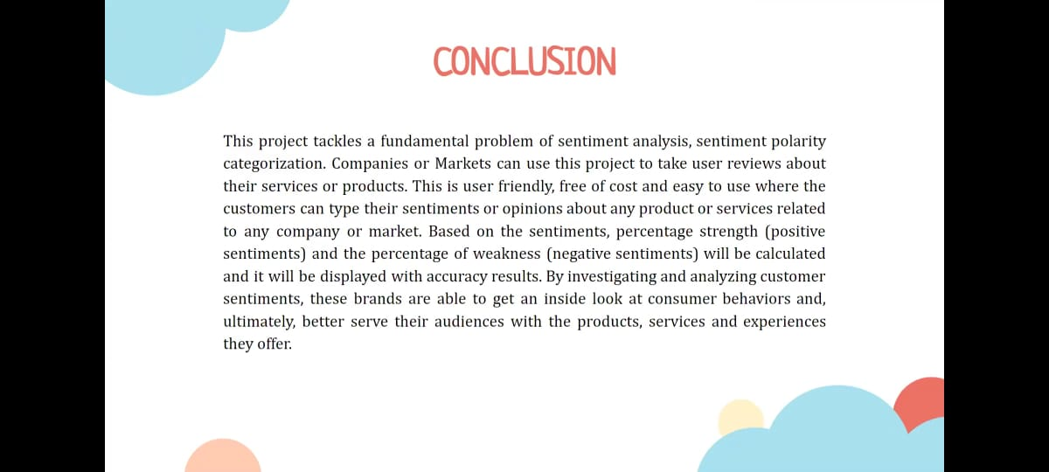
CONCLUSION

Slide 13
THANK YOU

