Slide 1
Sales Performance Dashboard using Power BI
Objective: Analyze sales performance
Dataset: Retail Sales Data
Tools: Power BI, Excel, DAX, Power Query
Interactive dashboards for business insights

Slide 2
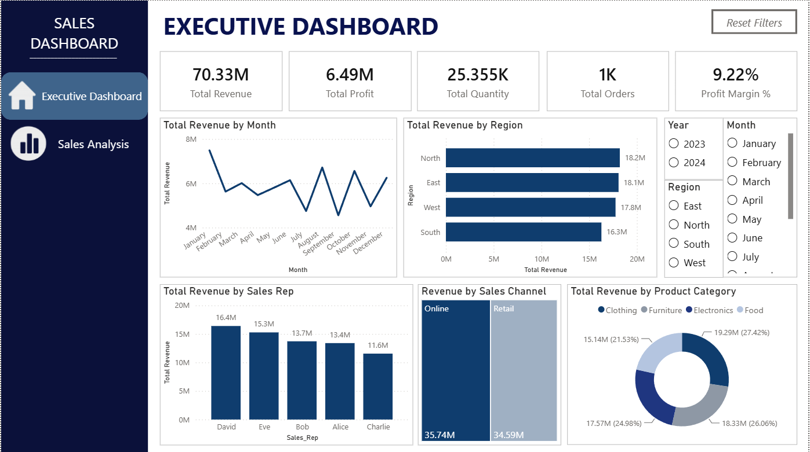
Executive Dashboard
• KPIs
• Revenue & Profit
• Regional Analysis
• Monthly Trends
• Interactive Filters

Slide 3
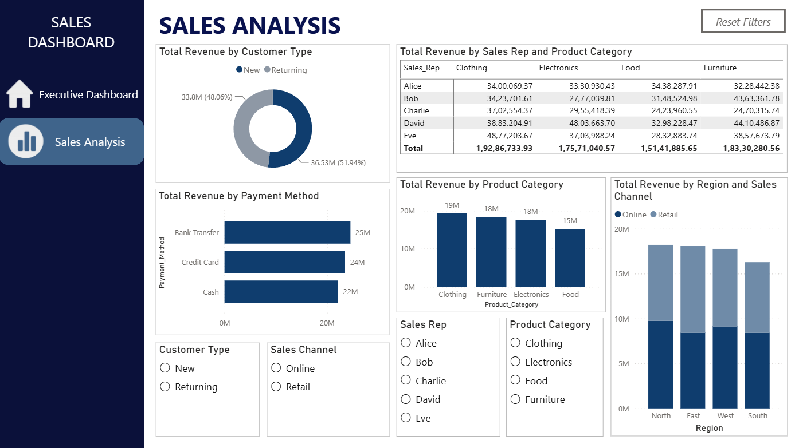
Sales Analysis
• Customer Type
• Payment Method
• Product Category
• Sales Channel
• Cross Filtering

Slide 4
CONCLUSION
• Built an interactive Power BI dashboard.
• Used DAX measures, Power Query and Excel.
• Implemented navigation buttons, slicers and reset filters.
• Provides actionable sales insights for decision making.

