Slide 1

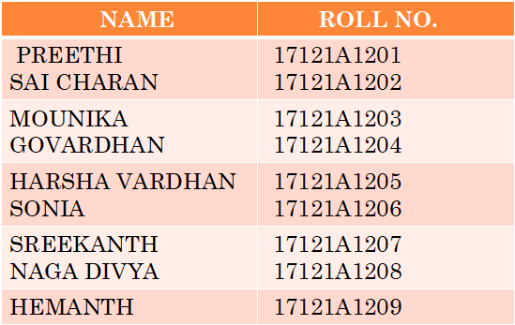
A MINI PROJECT ON
SUPER MARKET MANAGEMENT
--Pick n Pay
BATCH 1_2_3
BRANCH:INFORMATION TECHNOLOGY
batch1_2_3

Slide 2
TABLE OF CONTENT
1.ABSTRACT
2.INTRODUCTION
3.MODULES
3.1 ADMINSTRATOR
3.2 CUSTOMER
3.3 VIEW BILL
4.DESIGN
5. RESULTS
6.CONCLUSION
7.HARDWARE & SOFTWARE REQUIREMENTS
batch1_2_3

Slide 3
ABSTRACT
Supermarket is a place where customers come to purchase their daily using products and pay for that . So there is a need to calculate how many products are sold and to generate the bill for the customer . This project is designed with a goal to make the existing system more informative , reliable , fast and easier and will reduce the huge number of paper work and human effort.
batch1_2_3

Slide 4
INTRODUCTION
Supermarket management system is the system where all the aspects related to the proper management of supermarket is done. These aspects involve managing information about the various products, managers, customers, billing. This system provides an efficient way of managing the supermarket information. Also allows the customer to purchase and pay for the items purchased.
This project is based on the selling and billing of items in a supermarket. The first activity is based on adding the items to the system along with the rates, etc. This permission is given only to administrator. As the customer buys the products and the bill will be given to that products.
batch1_2_3

Slide 5
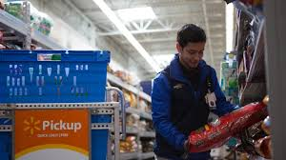
MODULE-1
ADMINSTRATOR
OBJECTIVE:
Administrator should maintain the report of all products
that are available in super market
Administrator can add, edit, remove items (name of item,
cost of the item, tax,........)
OPERATIONS:
1. Add the new product
2. Edit the existing product
3. Delete the product
4.View products
CONCEPTS:functions,loops,files,structures
batch1_2_3

Slide 6
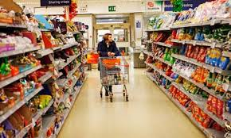

MODULE – 2
CUSTOMER
OBJECTIVE:
User is allowed to select and buy
different items present in the store.
User should be able to see the items
that he/she has bought.
OPERATIONS:
1.User should enter the product no.s that they
wish to buy.
2.The number of the products.
CONCEPTS:functions,files,loops,structures.
batch1_2_3

Slide 7
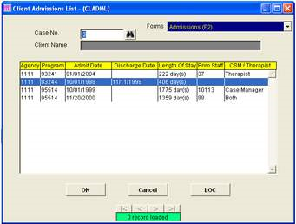
MODULE -3
VIEW BILLS
OBJECTIVE:
This displays the list of all customers who purchased and amount.
The benefit of this module is the shop owner come to know whether he/she had gained profit or not.
OPERATIONS:
1.Displays customer’s name.
2.Displays total amount of the bill.
CONCEPTS:functions,loops,files.
batch1_2_3

Slide 8
DESIGN
C:\Users\Manisha\Desktop\design.pptx : link for the design of the project
batch1_2_3

Slide 9
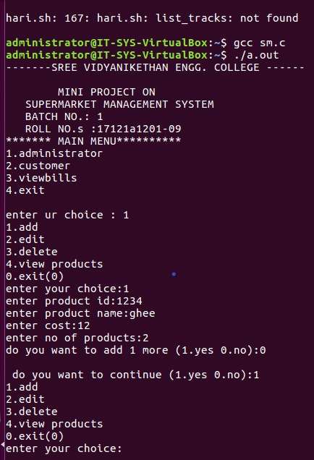
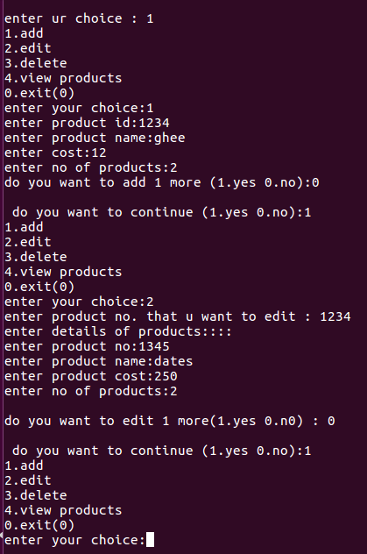
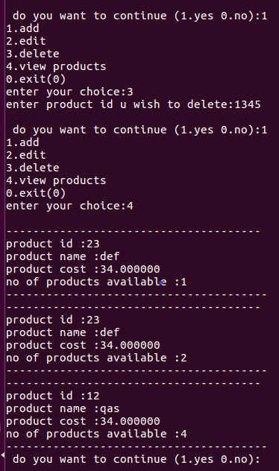
RESULTS
batch1_2_3

Slide 10
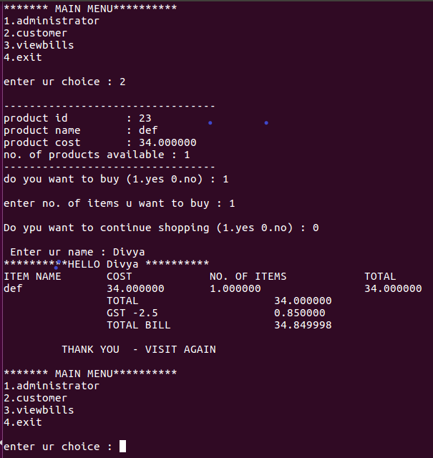
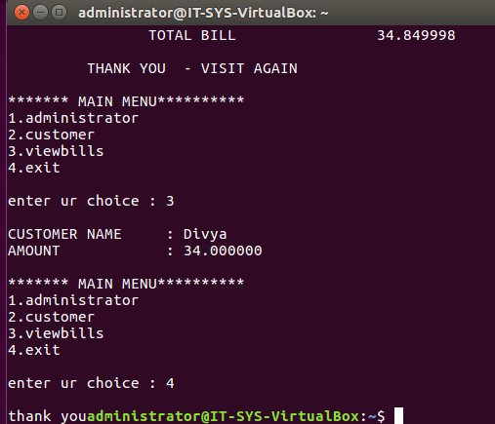
batch1_2_3

Slide 11
CONCLUSION
This project will help the shopkeeper in fast billing
This project will reduce huge amount of paper work and human effort
Freedom of selection
Shopping is very easy and quick
batch1_2_3

Slide 12
HARDWARE AND SOFTWARE REQUIREMENTS
MINIMUM HARDWARE REQUIREMENTS
RAM (8GB)
System type,x64-based processor I7
MINIMUM SOFTWARE REQUIREMENTS
Linux environment - virtual box
Editor-vi editor
batch1_2_3

Slide 13
BATCH MEMBERS & ROLES
ROLL NO. | NAME | ROLE
17121a1201 17121a1202 | PREETHI SAI CHARAN | CODING FOR MODULE-1 DESIGNING PPT & ANALYSIS OF CODE
17121a1203 17121a1204 | MOUNICA GOVARDHAN | CODING FOR MODULE -2 PRESENTATION OF PPT
17121a1205 17121a1206 | HARSHA VARDHAN SONIA | ANALYSING OF CODE CODING FOR MODULE-3
17121a1207 17121a1208 | SRI KANTH NAGA DIVYA | PPT PRESENTATION DESIGNING PPT & DEVELOPING CODE
17121a1209 | HEMANTH | PPT PRESENTATION
batch1_2_3

Slide 14
References
TITLE : LINUX
AUTHOR’s : RICHARD PETERSEN
EDITION : SIXTH EDITION
TITLE : YOUR UNIX
AUTHOR : SUMITABHA DAS
EDITION : SEVENTH EDITION
batch1_2_3

Slide 15

batch1_2_3

