Slide 1
DRAFT
Learnings: Model Performance
WHAT THE MODEL DOES
It tries to predict the bid close price in the next 4 hour cycle and also whether the price will go up or down
HOW THE MODEL WORKS
The forex prediction model was built on 4 features, and an additional more than 500 new engineered features (e.g., Various technical indicators such as momentum, trend , Volatility) were based on open, close, low and high for every four hour interval. A Ridge regressor tries to fit a regression line in sequence and computes the bid close values. Forex classification model tries to estimate whether the bid close value with go up or will go down depending upon the difference between predicted values and close value.
HOW THE MODEL PERFORMED
The model is proving effective, as it is able to correctly predict bid close values on an average RMSE score 25 in preliminary testing
It is normal for the percentages to drop during the validation test because the data (in terms of variance, mean, etc.) is different from what the model has seen, and this particular observed gap is within acceptable values.

Slide 2
DRAFT
Learnings: Model Performance
Model Metrics (Testing¹)
Model 1 regression: Model 1 contain data with features such as various technical indicators, macro economic events at particular time
as well the features with one hour lead data
Model R2 | Model Adjusted R2 | Average MAE | Average RMSE
0.999459 | 0.99923 | 19.3674 | 27.7063
Model Metrics (Testing¹)
Model 1 classification : Model 1 contain data with features such as various technical indicators, macro economic events at particular time
as well the features with one hour lead data(Calculated)
Model Accuracy | Model precision | Average recall | Average F1
0.317 | 0.38 | 0.32 | 0.33
Model 2 regression and classification: Model 2 contain data with features such as various technical indicators, macro economic events at particular time as well the features with one hour lead data and percentage change values for price indicators
Results are same as model 1
It is normal for the percentages to drop during the validation test because the data (in terms of variance, mean, etc.) is different from what the model has seen, and this particular observed gap is within acceptable values.

Slide 3
DRAFT
Learnings: Model Performance
Model 3 regression: Model 2 contain data with features such as various technical indicators, macro economic events at particular time as well the features with one ,two and three hour lead data
Model R2 | Model Adjusted R2 | Average MAE | Average RMSE
0.98834 | 0.985265 | 19.3674 | 131.21
Model 3 classification : Model 3 contain data with features such as various technical indicators, macro economic events at particular time
as well the features with one ,two and three hour lead data
Model Accuracy | Model precision | Average recall | Average F1
0.3182 | 0.40 | 0.31 | 0.32
It is normal for the percentages to drop during the validation test because the data (in terms of variance, mean, etc.) is different from what the model has seen, and this particular observed gap is within acceptable values.

Slide 4
DRAFT
Learnings: Model Performance
Model 4 regression: Model 4 contain data with features such as various technical indicators, macro economic events at particular time as well the features with one ,two and three hour lead data with stacking
Model R2 | Model Adjusted R2 | Average MAE | Average RMSE
0.99958 | ---- | 17.1282 | 24.61
Model 4 classification : Model 4 contain data with features such as various technical indicators, macro economic events at particular time
as well the features with one, two, three hour lead data with stacking
Model Accuracy | Model precision | Average recall | Average F1
0.3167 | 0.49 | 0.32 | 0.32
It is normal for the percentages to drop during the validation test because the data (in terms of variance, mean, etc.) is different from what the model has seen, and this particular observed gap is within acceptable values.
¹
⁴

Slide 5
DRAFT
Learnings: Model Performance
Model Metrics (Testing¹)
Model 5 classification : Model 5 contain data with features such as various technical indicators, macro economic events at particular time
as well the features with one ,two and three hour lead data with essembling
Model 5 regression: Model 5 contain data with features such as various technical indicators, macro economic events at particular time as well the features with one ,two and three hour lead data with essembling
Model R2 | Model Adjusted R2 | Average MAE | Average RMSE
0.9157 | --- | 282.85 | 352.8
Model Accuracy | Model precision | Average recall | Average F1
0.4169 | 0.37 | 0.42 | 0.38
It is normal for the percentages to drop during the validation test because the data (in terms of variance, mean, etc.) is different from what the model has seen, and this particular observed gap is within acceptable values.

Slide 6
DRAFT
Learnings: Model Performance- 02-04-2019
Model 6 Classification: Model 6 contains data with features such as various technical indicators, macro economic events at particular time as well the features with one, two, three hour lead data with SMOTE, Logistic Regression without feature selection and with random sampling
Model Accuracy | Model precision | Average recall | Average F1
0.775 | 0.80 | 0.78 | 0.77
Model 7 classification : Model 7 contains data with features such as various technical indicators, macro economic events at particular time as well the features with one, two, three hour lead data hyper parameter tuned Logistic Regression on Non-SMOTE data with L1 regularization random sampling of data for test & train and predicted on SMOTE data.
Model Accuracy | Model precision | Average recall | Average F1
0.70 | 0.78 | 0.71 | 0.70
It is normal for the percentages to drop during the validation test because the data (in terms of variance, mean, etc.) is different from what the model has seen, and this particular observed gap is within acceptable values.
¹
⁴

Slide 7
DRAFT
Learnings: Model Performance- 02-04-2019
Model 8 classification : Model 8 contains data with features such as various technical indicators, macro economic events at particular time as well the features with one, two, three hour lead data hyper parameter tuned Logistic Regression on Non-SMOTE data with L1 regularization random sampling of data for test & train
Model Accuracy | Model precision | Average recall | Average F1
0.75 | 0.79 | 0.78 | 0.79
It is normal for the percentages to drop during the validation test because the data (in terms of variance, mean, etc.) is different from what the model has seen, and this particular observed gap is within acceptable values.
¹
⁴

Slide 8
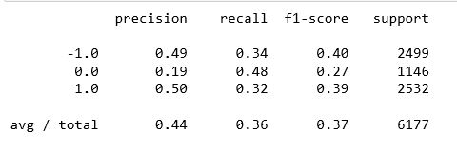
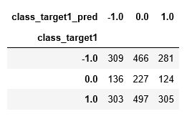
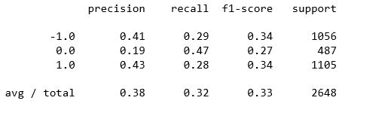
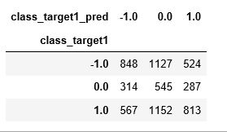


DRAFT
Learnings: Model Performance(Script name model1_aud_usd_h4)
Test
Train
Test
Train
Test r2 and adj r2
Train r2 and adj r2
It is normal for the percentages to drop during the validation test because the data (in terms of variance, mean, etc.) is different from what the model has seen, and this particular observed gap is within acceptable values.

Slide 9
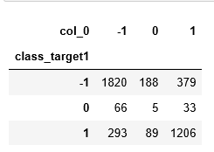
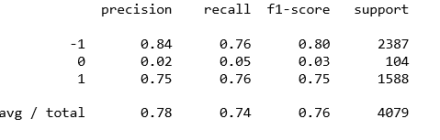
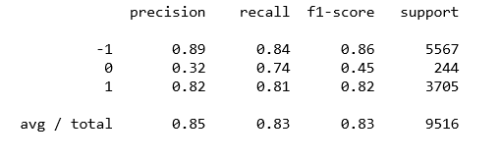
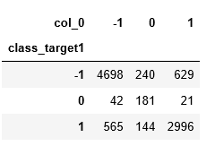
Learnings: Model6 Performance(Classification-Logistic-No Tuning-No Smote)- 02-04-2019
Test
Train
Test
Train
It is normal for the percentages to drop during the validation test because the data (in terms of variance, mean, etc.) is different from what the model has seen, and this particular observed gap is within acceptable values.

Slide 10
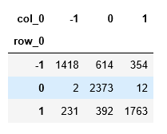
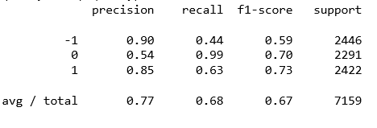
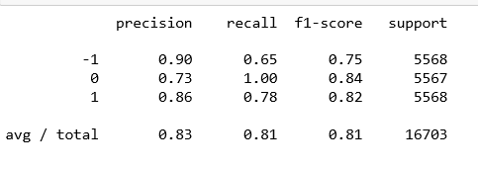
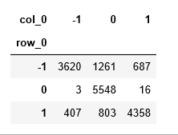
Learnings: Model7 Performance(Classification-Logistic-No Tuning-Smote)- 02-04-2019
Test
Train
Test
Train
It is normal for the percentages to drop during the validation test because the data (in terms of variance, mean, etc.) is different from what the model has seen, and this particular observed gap is within acceptable values.

Slide 11
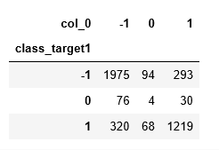
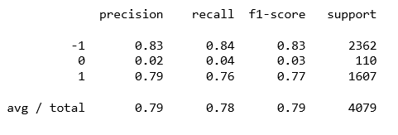
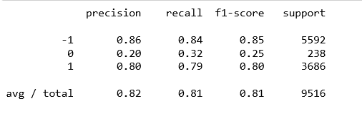
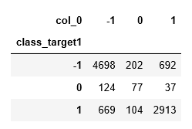
Learnings: Model8 Performance(Classification-Logistic-Tuning-No Smote)- 02-04-2019
Test
Train
Test
Train
It is normal for the percentages to drop during the validation test because the data (in terms of variance, mean, etc.) is different from what the model has seen, and this particular observed gap is within acceptable values.

