Slide 1
Unity Catalog
From Hive Metastore to Enterprise Data Governance
Metastore · Before & After · 3-Level Namespace · Row Filters · Column Masks · Lineage · Lakehouse Federation
Databricks Zero-to-Pro | Day 10 & 11 | Data Governance Module

Slide 2
Agenda
What we will cover today
1
Why do we need a Metastore?
6
Databricks Lakehouse Governance
Concept: data files + metadata must be in sync
One governance model for data + AI
2
Apache Hive Metastore
7
Admin Roles Hierarchy
The original — what it does and what it lacks
Account Admin → Metastore Admin → Workspace Admin
3
Why Unity Catalog?
8
Row Filters & Column Masks
The real problems HMS cannot solve
Native table-level security — replaces regional views
4
Before & After Unity Catalog
9
Data Lineage
Architecture comparison — workspace isolation vs account-level
Automatic lineage from files to dashboards
5
3-Level Namespace
10
Lakehouse Federation
Metastore → Catalog → Schema → Table/View/Volume
Query Snowflake/MySQL/PostgreSQL live — no copy

Slide 3
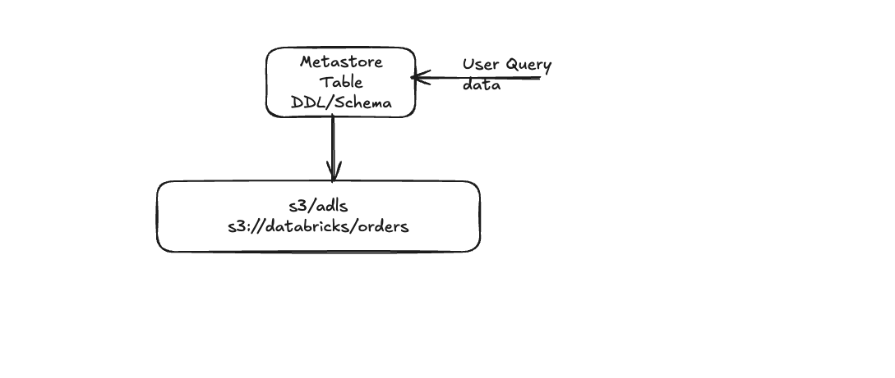
What is a Metastore?
A table = Data Files in cloud storage + Metadata in the Metastore — both must be in sync
Why does a Metastore exist?
When you store data in S3 / ADLS, you get files. But to run SQL,
→ WHERE is the file? (s3://databricks/orders)
→ WHAT is the schema? (id INT, name STRING, amount DOUBLE)
→ WHAT format? (Delta / Parquet / CSV)
→ WHO can access it? (ACLs / Row Filters / Column Masks)
⚠ If Metastore & Storage are OUT OF SYNC:
✗ Files deleted from S3, metastore not updated → query fails
✗ Files added to S3 without metastore update → data invisible to SQL
✗ Table dropped, files left in S3 → ghost files wasting storage cost
Diagram: Sreekanth Keerthipati

Slide 4
Apache Hive Metastore (HMS)
The original open-source metastore — used by Databricks before Unity Catalog
✓ What HMS provides
✗ What HMS cannot do
• Stores table DDL, schema, location, partitions, stats
• 2-level namespace: schema.table
• Open-source — compatible with Hive, Spark, Trino, Presto
• Backend: MySQL / PostgreSQL / Derby relational DB
• Supports tables, views, and functions
• GRANT / REVOKE on tables and databases
• Workspace-isolated — no cross-workspace sharing
• Users / groups must be re-created in every workspace
• No governance for files (S3 IAM = all-or-nothing)
• No data lineage — impossible to trace data origin
• No audit logs — no trail of who accessed what
• No governance for ML models or AI assets
• Regional views required for row-level filtering
• Column masking only via complex dynamic views

Slide 5
Why Unity Catalog?
The real-world problems that Hive Metastore could not solve — and Unity Catalog does
🏝 Workspace Islands
🔁 Duplicate User Management
🚫 No Cross-Workspace Sharing
Each workspace had its own HMS with separate users, groups, and ACLs. Moving between workspaces meant re-creating everything from scratch.
A team of 50 people across 5 workspaces = 250 user entries to maintain. When someone left, you had to remove them from every workspace manually.
To share a table between Dev and Prod, you had to copy the data. Two copies = double storage cost + always slightly stale.
📂 Files Had No Governance
🕵️ No Audit Trail
🔗 No Data Lineage
Files in S3 / ADLS were protected only by IAM roles — all or nothing. UC Volumes bring the same GRANT/REVOKE model to files.
If someone accessed sensitive customer data at 2am, you had no idea. UC logs every access to system.access.audit — queryable with SQL.
Teams manually maintained spreadsheets documenting data flows. UC captures lineage automatically — every query, job, dashboard.

Slide 6
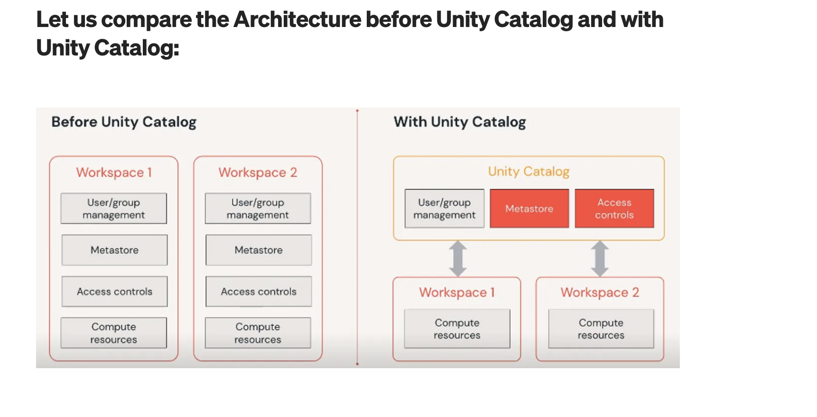
Before & After Unity Catalog
Workspace-isolated Hive Metastores → Account-level shared governance
Credit: Databricks, Inc.

Slide 7
Hive Metastore vs Unity Catalog — Feature Comparison
Capability
Hive Metastore
Unity Catalog
Scope
Per workspace (isolated)
Account-level (all workspaces)
Namespace
schema.table (2-level)
catalog.schema.table (3-level)
User management
Duplicated per workspace
Single identity, assigned to workspaces
File governance
None (IAM = all or nothing)
Volumes with GRANT/REVOKE
Row-level security
Dynamic views only
Native Row Filters on table
Column masking
Dynamic views only
Native Column Masks on column
Data lineage
None
Automatic — tables, jobs, dashboards
Audit logging
None
Full — system.access.audit
ML model governance
None
Models as governed objects
Cross-workspace
Data copy required
Native shared metastore

Slide 8
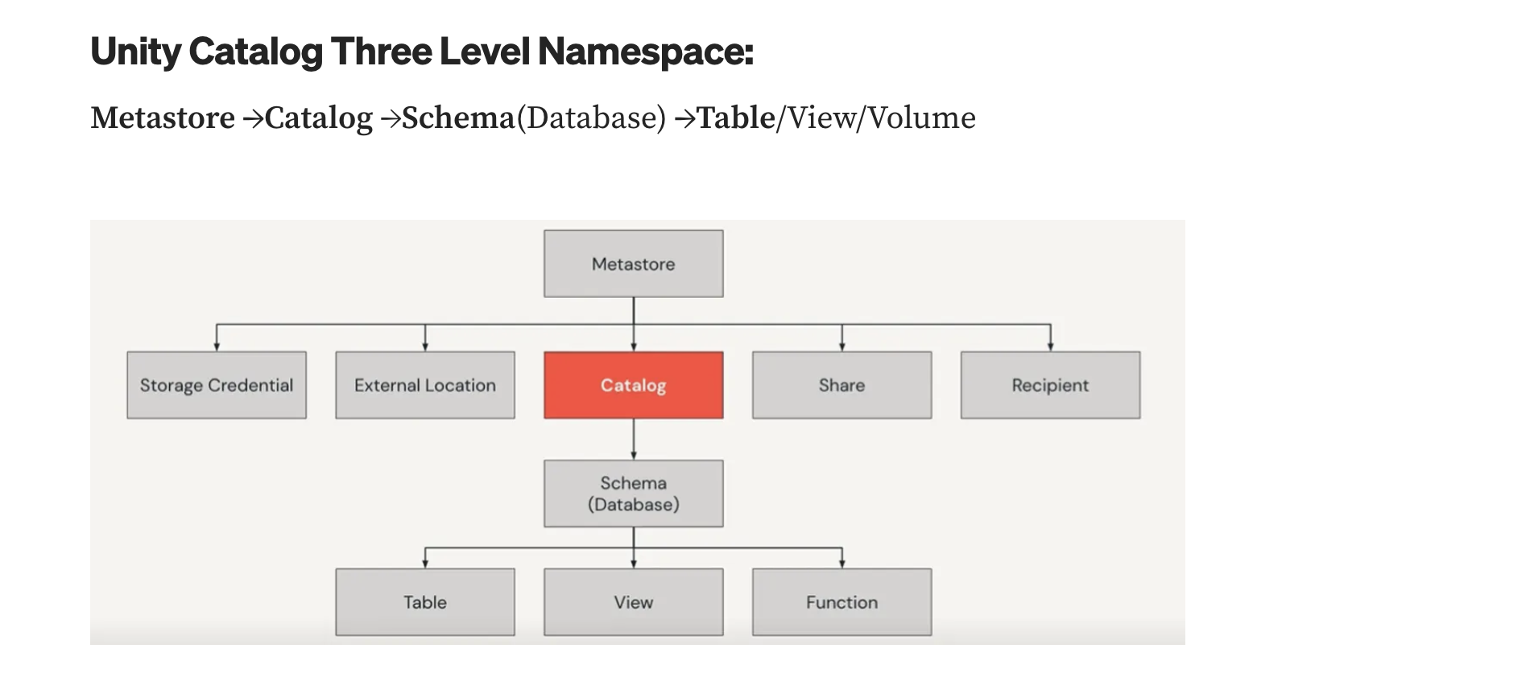
Unity Catalog — 3-Level Namespace
Metastore → Catalog → Schema (Database) → Table / View / Volume / Function
What changed?
Hive Metastore: schema.table (2 levels)
Unity Catalog: catalog.schema.table (3 levels)
Why a Catalog level?
• Separate environments: dev / staging / prod
• Separate business units: finance / marketing / hr
• Separate projects or teams
• Different storage locations per catalog
Also under Metastore:
• Storage Credential (cloud auth)
• External Location (S3/ADLS path)
• Share / Recipient (Delta Sharing)
Credit: Databricks, Inc.

Slide 9
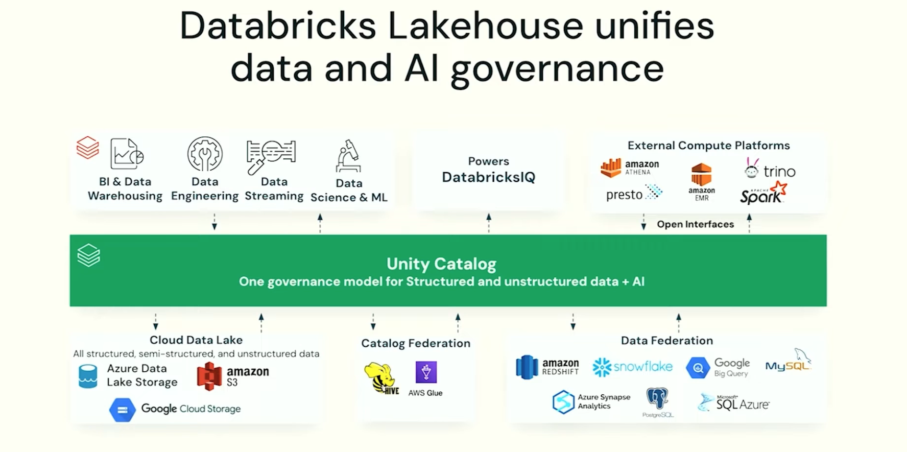
Databricks Lakehouse Unifies Data & AI Governance
Unity Catalog is the single governance layer — above: compute | below: storage & federation
Credit: Databricks, Inc.

Slide 10
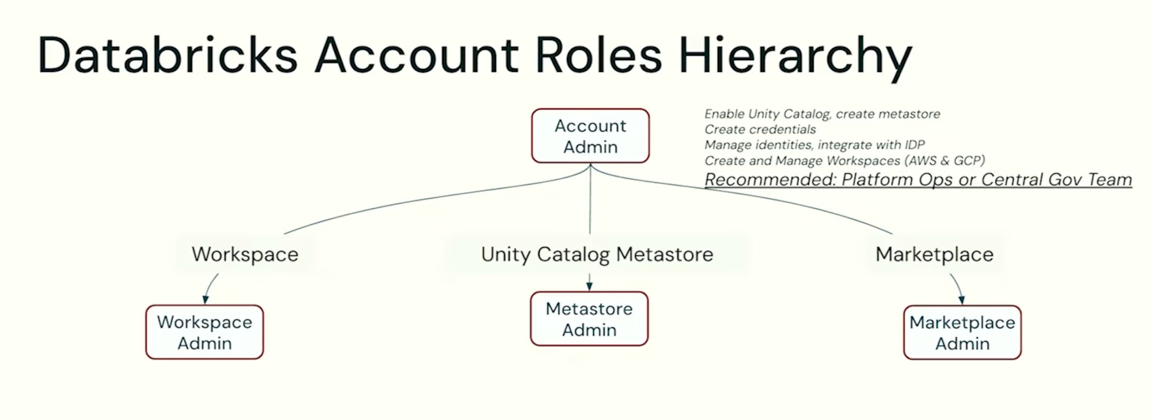
Databricks Account Roles Hierarchy
Account Admin creates metastores · Metastore Admin governs data · Workspace Admin manages compute
Account Admin
• Enable Unity Catalog, create metastores
• Create storage credentials
• Manage identities, integrate with Azure AD
• Create and manage workspaces
• Recommended: Platform Ops / Central Gov Team
Metastore Admin
• Create / manage catalogs
• Grant privileges on any object
• Create storage credentials & external locations
• Transfer ownership of any object
Workspace Admin
• Manage workspace users and groups
• Manage clusters, jobs, notebooks
• Cannot create metastores or storage creds
Credit: Databricks, Inc.

Slide 11
Row Filters & Column Masks
Native table-level security — replaces the 'create a view per region' pattern
✗ OLD: Regional Views Pattern
✓ NEW: Native Row Filters + Column Masks
CREATE VIEW apac_employees AS SELECT * WHERE region='APAC'
CREATE VIEW emea_employees AS SELECT * WHERE region='EMEA'
CREATE VIEW amer_employees AS SELECT * WHERE region='AMER'
Problems:
• N regions = N views to maintain
• Users must know WHICH view to query
• View can be bypassed if user has TABLE access
• Column masks require ANOTHER set of views
• New region added → new view required
-- Create row filter function (ONCE)
CREATE FUNCTION region_filter(region STRING)
RETURNS BOOLEAN
RETURN is_account_group_member('admins')
OR is_account_group_member(lower(region));
-- Attach to TABLE (ONCE)
ALTER TABLE employees
SET ROW FILTER region_filter ON (region);
-- Create column mask (ONCE per column)
ALTER TABLE employees
ALTER COLUMN salary SET MASK mask_salary;
-- Everyone queries the TABLE directly
SELECT * FROM employees;
-- Filter + masks applied AUTOMATICALLY

Slide 12
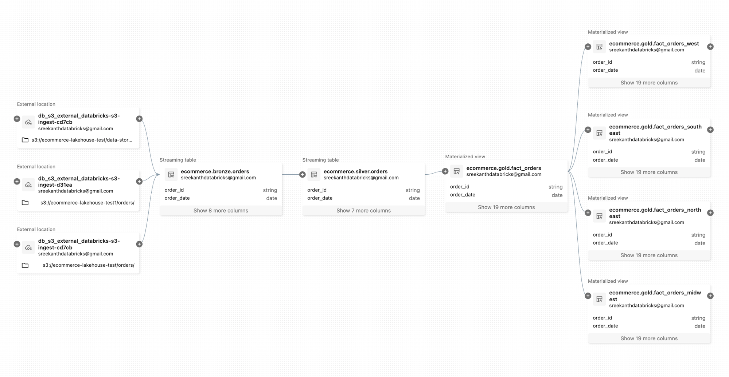
Data Lineage in Unity Catalog
Automatic lineage — from S3 files through bronze/silver/gold to materialized views
What this shows
External S3 locations as sources
→ ecommerce.bronze.orders
→ ecommerce.silver.orders
→ ecommerce.gold.fact_orders
→ 4 regional materialized views
(west / southeast / northeast / midwest)
Zero configuration needed —
UC captures this automatically
Use cases:
• Impact analysis before schema changes
• Root cause when dashboard is wrong
• Compliance: trace PII flow
Screenshot: Sreekanth Keerthipati's Databricks workspace | ecommerce lakehouse pipeline

Slide 13
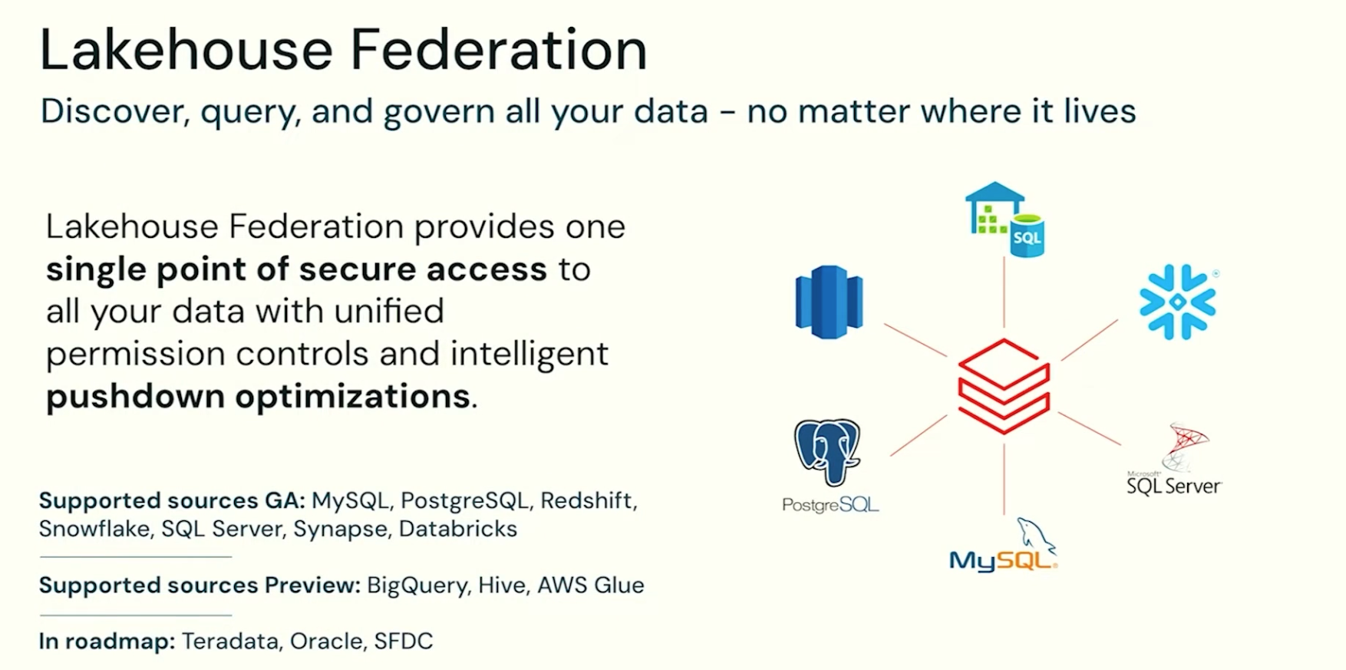
Lakehouse Federation
Discover, query, and govern all your data — no matter where it lives
Credit: Databricks, Inc.

Slide 14
Lakehouse Federation — How It Works
Three UC objects: Connection → Foreign Catalog → Foreign Table
1 CONNECTION
2 FOREIGN CATALOG
3 FOREIGN TABLE
Stores credentials to reach an external system. Lives at the Metastore level. Created by Metastore Admin.
Maps a remote database into UC namespace. Schemas and tables are auto-discovered. Governed with same GRANT/REVOKE.
Auto-discovered. Queryable via SQL. Reads live from source — no data copy. Pushdown: filters/aggregations in source.
CREATE CONNECTION snowflake_prod TYPE SNOWFLAKE OPTIONS ( host 'org.snowflake.com', user 'databricks_user', password secret('scope','key') );
CREATE FOREIGN CATALOG snowflake_cat USING CONNECTION snowflake_prod OPTIONS (database 'PROD_DB'); SHOW SCHEMAS IN snowflake_cat; SHOW TABLES IN snowflake_cat.finance;
SELECT region, SUM(revenue) FROM snowflake_cat.finance.revenue WHERE year = 2024 GROUP BY region; -- Runs IN Snowflake, returns result

Slide 15
Key Takeaways
Unity Catalog — what you need to remember
Metastore = Metadata Registry
HMS was workspace-local
Data files live in cloud storage (S3/ADLS). The metastore holds DDL, schema, location, ACLs. Both must stay in sync.
Hive Metastore gave each workspace its own isolated silo — no sharing, no cross-workspace governance, no lineage.
UC is account-level
3-Level Namespace
One metastore per region. Assign it to multiple workspaces. Define users/groups once, use everywhere.
catalog.schema.table — the catalog level organises by environment (dev/prod) or business unit.
Native Row Filters & Column Masks
Automatic Lineage
Attach a function to a TABLE — filter rows and mask columns transparently. No more N regional views.
Every SQL query, notebook, and job is tracked. See upstream sources and downstream consumers in Catalog Explorer.
Lakehouse Federation
Admin Roles
Query Snowflake, MySQL, PostgreSQL, Redshift live — no copy, no ETL. UC governs access with same GRANT/REVOKE.
Account Admin → creates metastores. Metastore Admin → governs data. Workspace Admin → manages compute.

