Slide 1

Domain: Python
Technology: Artificial Intelligence
TRANSFER LEARNING-BASED OBJECT DETECTION BY USING CONVOLUTIONAL NEURAL NETWORKS
<Name of the Students>

Slide 2
Index
Abstract
Introduction
Literature review
Existing Method
Drawbacks
Proposed method
Advantages
Implementation
Algorithms
Hardware and Software Requirements
Architecture
UML diagrams
Results
Conclusion
References

Slide 3
Abstract:
Object detection has become an important task for various purposes in our daily lives. Machine learning techniques have been used for this task from earlier but they are used for the classification of image based species to extract the feature set. This task of deciding the feature set helps to decide the desired object detection. To overcome the object classification problem, this paper proposes a transfer learning-based deep learning method. The different convolutional neural networks (CNN) are used in this work. Here for the improvement in the result, the majority voting scheme is used. Based on the high accuracy, the objects are detected using the specific model. The results obtained have shown incredible improvement in the accuracy of the proposed work when compared to the different CNN models.
Keywords: Object detection, Deep Learning, Convolution Neural Network (CNN), Transfer learning.

Slide 4
Introduction:
Biometrics are body measurements and calculations related to human characteristics. Biometrics authentication (or realistic authentication) is used in computer science as a form of identification and access control. It is also used to identify individuals in groups that are under surveillance.
Biometric identifiers are the distinctive, measurable characteristics used to label and describe individuals. Biometric identifiers are often categorized as physiological characteristics, which are related to the shape of the body. Examples include, but are not limited to fingerprint, palm veins, face recognition, DNA, palm print, hand geometry, iris recognition, retina and odor/scent. Behavioral characteristics are related to the pattern of behavior of a person, including but not limited to typing rhythm, gait, keystroke, signature, behavioral profiling, and voice. Some researchers have coined the term 'behaviometrics' to describe the latter class of biometrics.

Slide 5
Introduction:
Many different aspects of human physiology, chemistry or behaviour can be used for biometric authentication. The selection of a particular biometric for use in a specific application involves a weighting of several factors. Jain et al. (1999) identified seven such factors to be used when assessing the suitability of any trait for use in biometric authentication.
• Universality means that every person using a system should possess the trait.
• Uniqueness means the trait should be sufficiently different for individuals in the relevant population such that they can be distinguished from one another.
• Permanence relates to the manner in which a trait varies over time. More specifically, a trait with 'good' permanence will be reasonably invariant over time with respect to the specific matching algorithm.
• Measurability (collectability) relates to the ease of acquisition or measurement of the trait. In addition, acquired data should be in a form that permits subsequent processing and extraction of the relevant feature sets.
• Performance relates to the accuracy, speed, and robustness of technology used (see performance section for more details).

Slide 6
Literature Review:
S. No | Journal Type with year | Authors | Title | Outcomes
1 | . IEEE Geoscience and Remote Sensing Letters, 1–5. DOI:10.1109/lgrs.2019.2918719 | Roy, S. K., Krishna, G., Dubey, S. R., & Chaudhuri, B | HybridSN: Exploring 3-D-2-D CNN Feature Hierarchy for Hyperspectral Image Classification | Image Classification
2 | IEEE Transactions on Pattern Analysis and Machine Intelligence, 1–1.DOI:10.1109/tpami.2018.2842770 | He, R., Wu, X., Sun, Z., & Tan, T | Wasserstein CNN: Learning Invariant Features for NIR-VIS Face Recognition. | Learning Invariant Features for NIR-VIS Face Recognition
3 | 2019 International Conference on Robots & Intelligent System (ICRIS). DOI:10.1109/icris.2019.00060 | Wang, C., & Peng, Z | Design and Implementation of an Object Detection System Using Faster R-CNN | Object Detection System Using Faster R-CNN
4 | vol. 35, No 4, Dec 2003, pp.399-458 | M. Turk and A. Pentland | Face Recognition: A Literature Survey | A Literature Survey on Face Recognition

Slide 7
Existing Method:
This model emphasizes an existing method that which is designed using the RNN algorithm of deep learning. AS, object detection has become an important task for various purposes in our daily lives, that can used in the many applications. Here the dataset is considered and trained by using the RNN algorithm of deep learning and after the training process it is tested and the considered objects are detected.

Slide 8
Disadvantages in Existing Method:
• Less feature compatibility
• Fixed size input and output
• Low accuracy

Slide 9
Proposed Method:
The proposed model emphasizes a deep network architecture which is used to detect the objects. Object detection has become an important task for various purposes in our daily lives. Machine learning techniques have been used for this task from earlier but they are used for the classification of image based species to extract the feature set. This task of deciding the feature set helps to decide the desired object detection. To overcome the object classification problem, this paper proposes a transfer learning-based deep learning method. The different convolutional neural networks (CNN) are used in this work. Here for the improvement in the result, the majority voting scheme is used. Block diagram of proposed method is shown below.

Slide 10
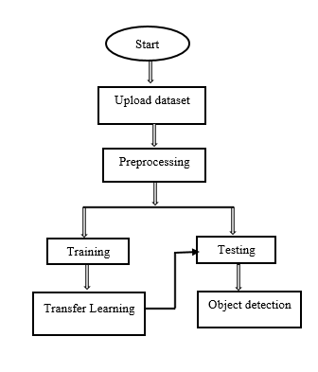
Proposed Method:
Block diagram of proposed method

Slide 11
Advantages of Proposed Method:
• High feature compatibility
• Time Saving
• Low complexities

Slide 12
Implementation
System:
Takes the data
Preprocessing the dataset
Training
User:
Registration
Login into website
Object detection
Logout

Slide 13
Algorithm:
CNN:
In deep learning, a convolutional neural network (CNN, or ConvNet) is a class of deep neural networks, most commonly applied to analyzing visual imagery.
A convolutional neural network consists of an input layer, hidden layers and an output layer. In any feed-forward neural network, any middle layers are called hidden because their inputs and outputs are masked by the activation function and final convolution. In a convolutional neural network, the hidden layers include layers that perform convolutions. Typically this includes a layer that does multiplication or other dot product, and its activation function is commonly ReLU. This is followed by other convolution layers such as pooling layers, fully connected layers and normalization layers.

Slide 14
Hardware & Software Requirements:
H/W Configuration:
• Processor - I3/Intel Processor
• Hard Disk -160GB
• RAM - 8Gb
S/W Configuration:
• Operating System : Windows 7/8/10 .
• Server side Script : HTML, CSS & JS.
• IDE : Pycharm.
• Libraries Used : Numpy, IO, OS, Flask, keras.
• Technology : Python 3.6+.

Slide 15
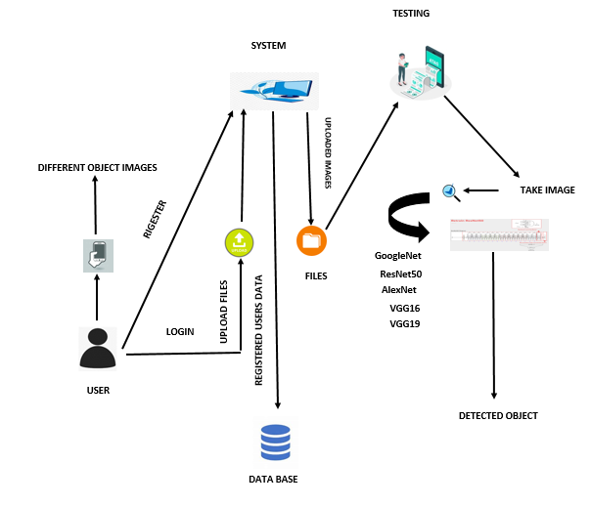
Architecture:

Slide 16
Use Case Diagram
A use case diagram in the Unified Modeling Language (UML) is a type of behavioral diagram defined by and created from a Use-case analysis. Its purpose is to present a graphical overview of the functionality provided by a system in terms of actors, their goals (represented as use cases), and any dependencies between those use cases. The main purpose of a use case diagram is to show what system functions are performed for which actor. Roles of the actors in the system can be depicted.

Slide 17
Use Case Diagram

Slide 18
Class Diagram
In software engineering, a class diagram in the Unified Modeling Language (UML) is a type of static structure diagram that describes the structure of a system by showing the system's classes, their attributes, operations (or methods), and the relationships among the classes. It explains which class contains information.

Slide 19
Sequence Diagram
A sequence diagram in Unified Modeling Language (UML) is a kind of interaction diagram that shows how processes operate with one another and in what order. It is a construct of a Message Sequence Chart. Sequence diagrams are sometimes called event diagrams, event scenarios, and timing diagrams.

Slide 21
Collaboration Diagram
In collaboration diagram the method call sequence is indicated by some numbering technique as shown below. The number indicates how the methods are called one after another. We have taken the same order management system to describe the collaboration diagram. The method calls are similar to that of a sequence diagram. But the difference is that the sequence diagram does not describe the object organization where as the collaboration diagram shows the object organization.

Slide 23
Deployment Diagram
Deployment diagram represents the deployment view of a system. It is related to the component diagram. Because the components are deployed using the deployment diagrams. A deployment diagram consists of nodes. Nodes are nothing but physical hardware used to deploy the application.

Slide 24
Activity Diagram
Activity diagrams are graphical representations of workflows of stepwise activities and actions with support for choice, iteration and concurrency.
In the Unified Modeling Language, activity diagrams can be used to describe the business and operational step-by-step workflows of components in a system.
An activity diagram shows the overall flow of control.

Slide 26
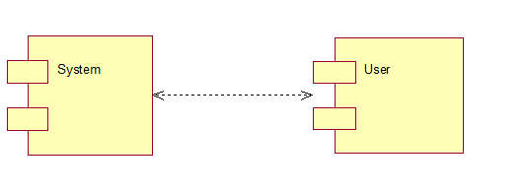
Component Diagram
A component diagram, also known as a UML component diagram, describes the organization and wiring of the physical components in a system. Component diagrams are often drawn to help model implementation details and double-check that every aspect of the system's required functions is covered by planned development.

Slide 27
Results
In this application, we have considered the dataset of objects and trained using CNN models using Transfer Learning
In the testing the object image is uploaded and the object is detected.

Slide 28


Results:
Home Page
Registration Page

Slide 29

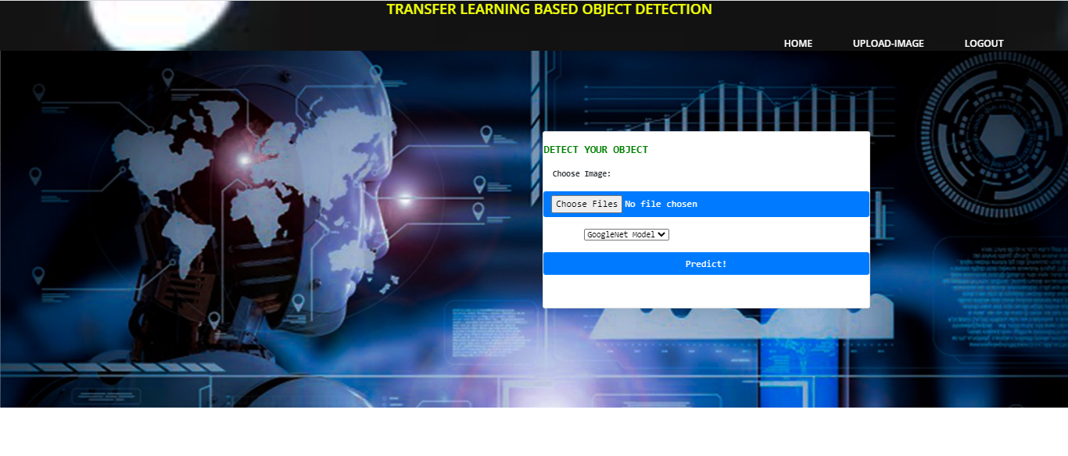
Results and Discussions:
Login Page
Image Uploading

Slide 30
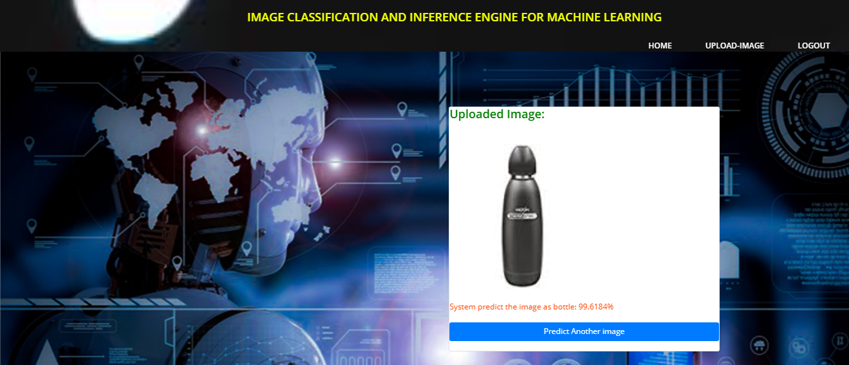
Results and Discussions:
Object detection

Slide 31
Conclusion:
The proposed work has the convolutional neural network with transfer learning and the majority voting scheme works well in comparison with the actual work. In this work, we mainly focused on detecting the objects. We used transfer learning method where we considered GoogleNet, AlexNet, ResNet50, VGG16 and VGG19 as our models. In the testing, the detection of objects were performed along with the accuracies of the considered model.

Slide 32
References:
[1] Roy, S. K., Krishna, G., Dubey, S. R., & Chaudhuri, B. B. (2019). HybridSN: Exploring 3-D-2-D CNN Feature Hierarchy for Hyperspectral Image Classification. IEEE Geoscience and Remote Sensing Letters, 1–5. DOI:10.1109/lgrs.2019.2918719
[2] He, R., Wu, X., Sun, Z., & Tan, T. (2018). Wasserstein CNN: Learning Invariant Features for NIR-VIS Face Recognition. IEEE Transactions on Pattern Analysis and Machine Intelligence, 1–1.DOI:10.1109/tpami.2018.2842770
[3] Ümit BUDAK, Abdulkadir ŞENGÜR, Aslı Başak DABAK and Musa ÇIBUK, Transfer Learning-Based Object Detection and Effect of Majority Voting on Classification Performance, 2019 International Artificial Intelligence and Data Processing Symposium (IDAP)
[4] Wang, C., & Peng, Z. (2019). Design and Implementation of an Object Detection System Using Faster R-CNN. 2019 International Conference on Robots & Intelligent System (ICRIS). DOI:10.1109/icris.2019.00060
[5] Qian, L., Fu, Y., & Liu, T. (2018). An Efficient Model Compression Method for CNN Based Object Detection. 2018 IEEE 9th International Conference on Software Engineering and Service Science (ICSESS). DOI:10.1109/icsess.2018.8663809.

