Slide 1
LANDMARK RECOGNITION
Submitted to:
Dr Nagamani
Submitted by :
Sreekanth -19MCMI34
Pradeep - 19MCMI33
Sravani S- 19MCMB14

Slide 2
What is Machine Learning ?
Machine learning is an application of artificial intelligence (AI) that provides systems the ability to automatically learn and improve from experience without being explicitly programmed.

Slide 3
Applications of Machine Learning
financial services
marketing and sales
government
Healthcare
Transport
Machine Learning is everywhere . . . . .

Slide 4
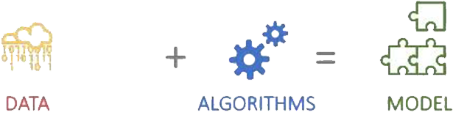
What is Machine Learning model ?
A Machine Learning model intends to determine the optimal structure in dataset to achieve an assigned task. It results from learning algorithms applied on a training dataset.

Slide 5
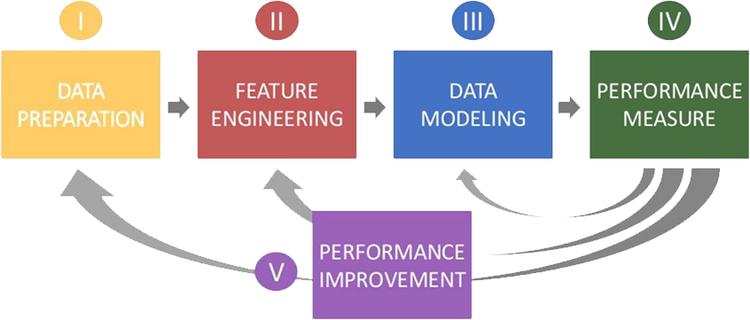
Design phases
It is a highly iterative process, to repeat until model reaches satisfying model

Slide 6
Problem statement
Landmark Recognition and Retrieval:
For a given query image, we are expected to retrieve all database images containing the same landmarks (if any).
To achieve the above we will be creating the data model using ML where it takes input training dataset to train the model and the data model will be validated based on test dataset.

Slide 7
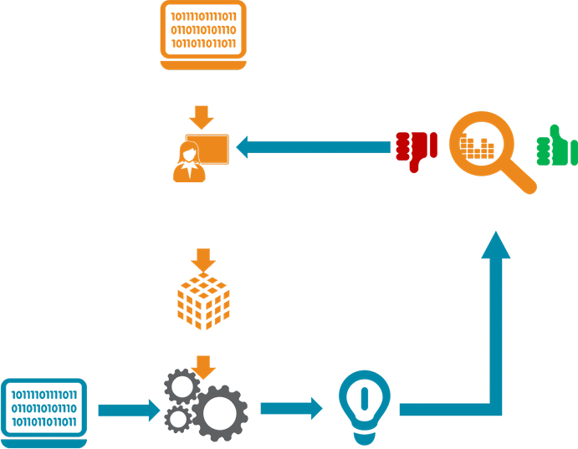
Steps Involved
“Train the model on your data using learning algorithm”
Data + Algorithm = Model
Training Data
Train the machine learning
algorithm
Evaluate
Model
Input data
Machine learning
algorithm
Prediction

Slide 8
Data cleaning
Automated data cleaning using
- Global descriptors - the image as a whole to the generalize the entire object
- Spatial verification - verify a spatial correlation between certain points of a pair of images.

Slide 9
Recognition
We use the full amount of data to train the classification model.
Main network used
- ResNet152 (Residual Network)
- Inception V4
Notes:
ResNet :
Residual Networks is a classic neural network used as a backbone for many computer vision tasks.
A residual neural network is an artificial neural network of a kind that builds on constructs known from pyramidal cells in the cerebral cortex. Residual neural networks do this by utilizing skip connections, or short-cuts to jump over some layers.
https://towardsdatascience.com/an-overview-of-resnet-and-its-variants-5281e2f56035
About image : analyzing point correspondences between the reference image and the target image

Slide 10
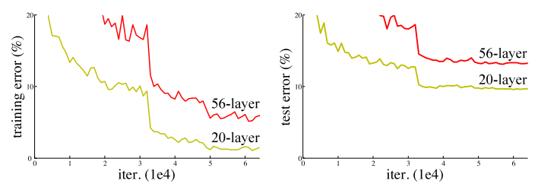
ResNet
ResNet, short for Residual Networks is a classic neural network used as a backbone for many computer vision tasks. This model was the winner of ImageNet challenge in 2015.
Why ResNet :
There is a saying “Deeper the better” in case of traditional convolutional neural networks.
Practically, as the network goes deeper, its performance gets saturated or even starts
degrading rapidly due to vanishing gradient problem.

Slide 11
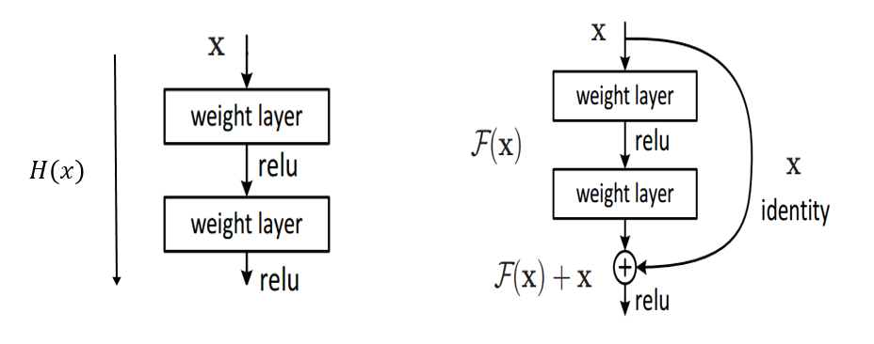
The core idea of ResNet is introducing a so-called “identity shortcut connection”
that skips one or more layers
Now, stacking layers shouldn’t degrade the network performance, because we could simply stack identity mappings (layer that doesn’t do anything) upon the current network, and the resulting architecture would perform the same.

Slide 12
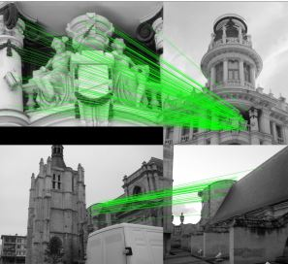
Recognition
If returned Max_score(Retrieved) > 0.85
Then
requested image is considered to be category with max
voting number
Samples with local feature matching
Notes:
Images with the similar voting number is categorized
ResNet :
Residual Networks is a classic neural network used as a backbone for many computer vision tasks.
A residual neural network is an artificial neural network of a kind that builds on constructs known from pyramidal cells in the cerebral cortex. Residual neural networks do this by utilizing skip connections, or short-cuts to jump over some layers.
https://towardsdatascience.com/an-overview-of-resnet-and-its-variants-5281e2f56035
About image : analyzing point correspondences between the reference image and the target image

Slide 13
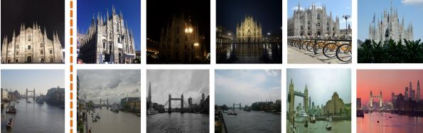
Retrieval
Query image
Top 5 matched Images

Slide 14
Technical stack
Soft wares and libraries:
- Python {
pandas,
numpy,
tensorflow }
- JuPyter notebook
- Anaconda

Slide 15
References
[PART-1] Deep Residual Learning for Image Recognition
(link to the paper from Microsoft research)
[PART-2] Identity mappings in Deep Residual Networks
(link to the paper from Microsoft Research)
[PART-2] Aggregated Residual Transformation for Deep Neural Networks
(link to the paper from Facebook AI Research)

Slide 16
Training Model
------Thank you------

