Slide 1

MovieLens Recommendation System
Department of Computer Science & Engineering
Madanapalle Institute of Technology & Science
P. Sreekanth
E. Srihari Keerthi
M. Praneetha
D. Swetha
Under the Guidance of:
Dr. Diwakar Prasad Tripathi

Slide 2
Existing System:
Existing system recommends the user based on the past history of the user.
It doesn’t consider the timestamp based recommendations.
Drawbacks:
Accuracy cannot be achieved

Slide 3


Proposed System
Recommendation of Movies considering:
Higher Rating Time Stamp

Slide 4
Movie Lens Recommendation System
Recommended system seek to predict the “preference” that a user would give to an item.
It helps a user to decide which movie to watch and shows the list of movies based on the user’s preference.
It limits the search space

Slide 5
Task of Recommendation system
The main task of recommended system is to produce best ranked list of items based on user’s preference.
Movies are recommended to the user consider the timestamp and rating by applying the method of collaborative filtering.

Slide 6
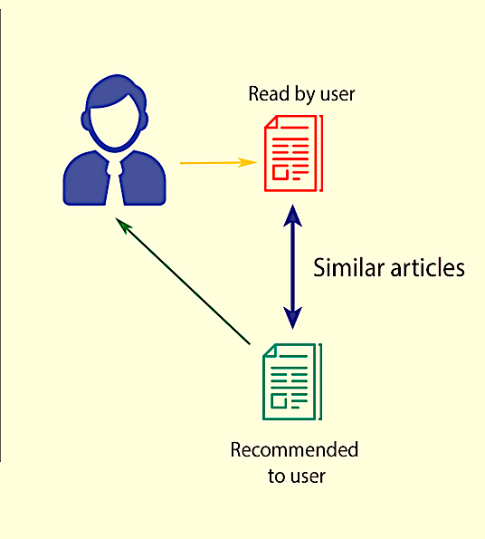
Content-based Filtering:
Content-based filtering, also referred to as cognitive filtering, recommends items based on a comparison between the content of the items and a user profile.
The content of each item is represented as a set of descriptors or terms, typically the words that occur in a document.

Slide 7
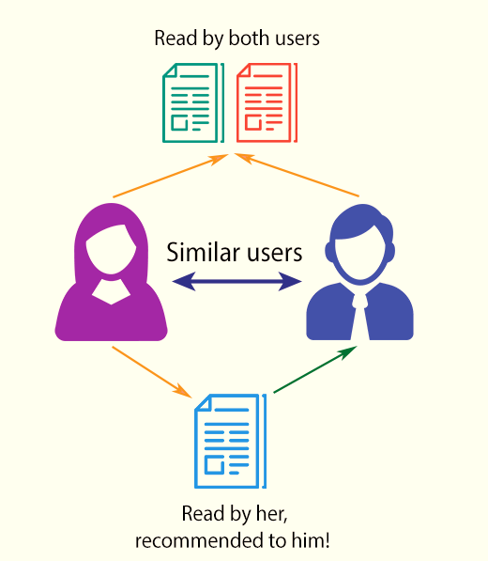
Collaborative Filtering
It is the process of filtering the information or patterns using techniques involving collaboration among multiple agents, viewpoints, data sources, etc.
For recommended system collaborative filtering is a method of making automatic predictions about the interests of a user by collecting preferences information from many users.

Slide 8
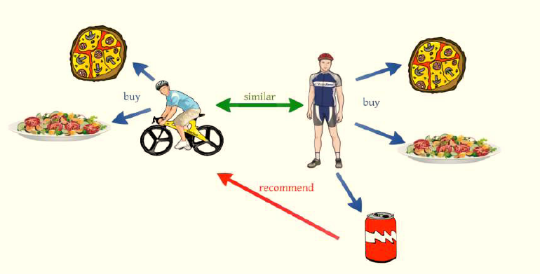
Difference between content and collaborative filtering

Slide 9
Dataset Description
Movie Lens dataset consists of 100837 ratings given by 610 users for 9743 movies.
This dataset is downloaded from UCI Repository, where each user has rated for more than 20 movies.
The dataset consists of movie details such as movie id, movie name, genre, movie link and user details such as user id, movie id, rating and timestamp.
This dataset is collected during Apr 1996 to Dec 2018.

Slide 10
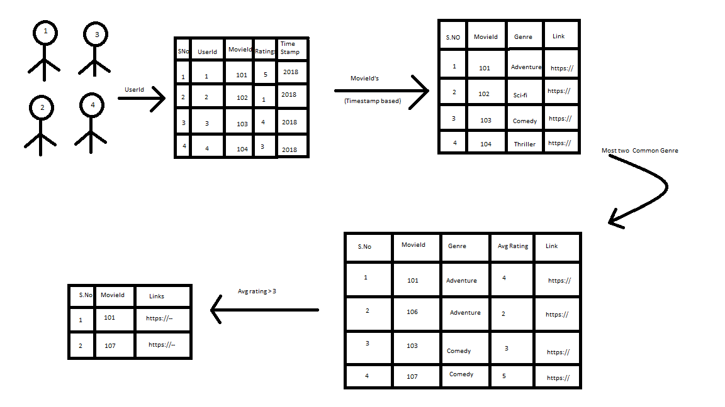
Working Procedure:

Slide 11

Cold Start Problem
Cold start problem is the problem of providing preference when there is no data available.
It occurs when a new movie Item or new User enters into the dataset

Slide 12
Approach to Cold Start
When a new user is added then user preferences will be taken and movies will be recommended according to that preferences.
When a new movie is added then it is recommended to some users and their ratings are noted

Slide 13
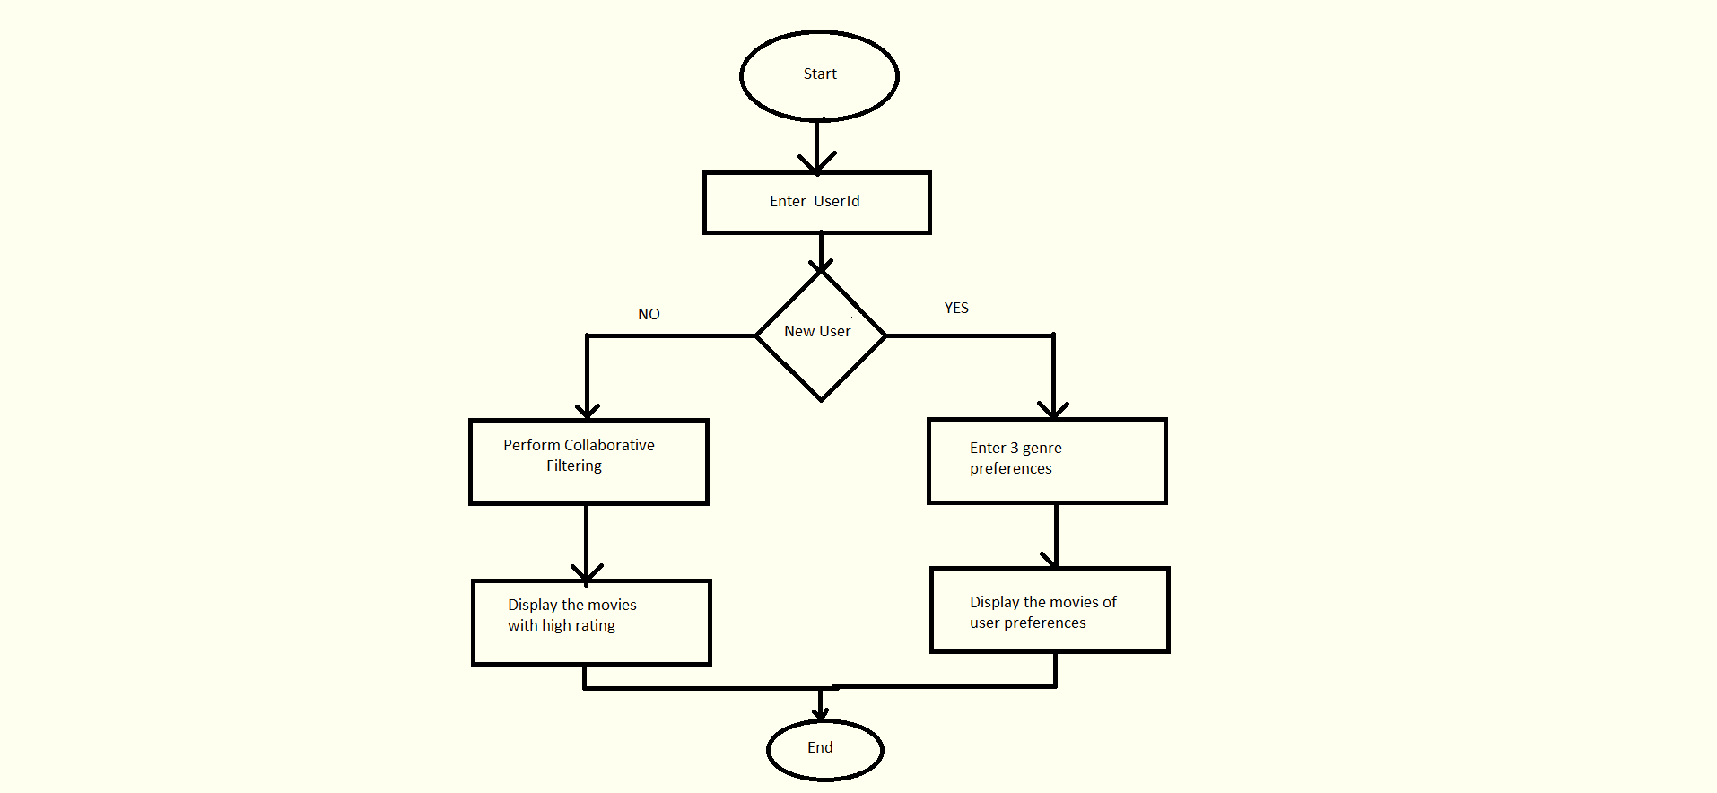
Flowchart

Slide 14
Results
Number Of Movies Listed In Recommendation System for user 123
Algorithm | Without Time Stamp Consideration | Considering Time Stamp
Content Based Filtering | 9040 | 8803
Collaborative based Filtering | 4795 | 160

Slide 15
Applications
e-Commerce
e-Government
e-Business
e-Library
e-Learning
e-Tourism
e-Resource Services
e-Group Activities

Slide 16
Conclusion
Preferred List of recommendation can be provided to an existing or new user by the consideration of time stamp and collaborating filtering algorithm.

Slide 17


