Slide 1
Angular
Advantages of Angular
Strong framework
Type safety
High performance
Scalable applications
Official Google support

Slide 2
1. Introduction to Angular
    Angular is a TypeScript-based front-end framework developed by Google
    Used to build Single Page Applications (SPA)
    Angular follows component-based architecture
    Angular (2+) is different from AngularJS (1.x)
2. Features of Angular
Component-based architecture
Two-way data binding
Dependency Injection
Directives
Services
Routing
RxJS and Observables
Cross-platform support & Strong TypeScript support

Slide 3
3. Angular Architecture
Main building blocks:
    Modules
    Components
    Templates
    Services
    Directives
    Pipes

Slide 4
4. Modules
Main building blocks:
Root module is called AppModule
Decorated with @NgModule
Organizes application into logical blocks
5. Components
Main building blocks:
HTML (Template), CSS (Styles),
TypeScript (Logic)
Component Decorator:
Selector , templateUrl ,styleUrls

Slide 5
6. Templates
Main building blocks:
    Written using HTML
    Supports Angular expressions
    Used for displaying data
    Example:
    {{ title }}

Slide 6
7. Data Binding
Data binding connects component and template.
Types:
Interpolation
Property Binding
Event Binding
Two-way Data Binding
8. Directives
Directives modify DOM behavior.
Types of Directives:
Structural Directives
*ngIf, *ngFor, *ngSwitch
Attribute Directives
ngClass, ngStyle
Custom Directives

Slide 7
9. Services
Used to store business logic
Helps in code reusability
Created using @Injectable()
10. Dependency Injection
Design pattern used by Angular
Injects services into components
Promotes loose coupling

Slide 8
11. Routing
Enables navigation without page reload
Uses RouterModule
<router-outlet> displays routed component
Routing Features:
Lazy loading
Route guards
Route parameters
12. Angular Forms
Types of Forms:
a) Template-Driven Forms
  Easy to use
  Uses ngModel
  Less control
b) Reactive Forms
  More powerful
  Uses FormGroup, FormControl
  Better validation

Slide 9
13. Pipes
Used to transform data in templates
Built-in Pipes:
Date
Uppercase
Lowercase
Currency
Percent
Custom Pipes:
Created using @Pipe
14. Lifecycle Hooks
Methods called during component lifecycle.
Common hooks:
ngOnInit
ngOnChanges
ngOnDestroy
ngAfterViewInit

Slide 10
15. RxJS and Observables
Handles asynchronous operations
Observables emit data over time
Used in HTTP calls and events
16. HTTP Client
Uses HttpClientModule
Supports REST APIs
HTTP Methods:
  GET
  POST
  PUT
  DELETE

Slide 11
17. Angular CLI
Command-line tool for Angular development.
Common Commands:
  ng new
  ng serve
  ng generate
  ng build
  ng test
Conclusion
Angular is a powerful framework suitable for large-scale, enterprise-level applications with structured development and long-term maintenance.

Slide 12
Steps to Install and Run the application
a) Install Node.js
Download and install Node.js
Verify installation:
node -v
npm -v
c) Create a New Angular Application
Run:
ng new my-angular-app
Open in Browser
Goto
http://localhost:4200/
b)Install Angular CLI
Angular CLI is used to create and run Angular apps.
npm install -g @angular/cli
Check installation:
ng version
d) Run the Angular Application
Move into the project folder:
cd my-angular-app
Start the development server:
ng serve

Slide 13
Angular 1st application
>ng new my-app
src/main.ts - Boots the app with bootstrapApplication.
src/app/app.component.ts - Root component (if used). You can also define the root inline in main.ts.
src/app/ - Where you add your components and features.
src/index.html - Host page that contains <app-root>.
src/styles.css - Global styles for the app.
angular.json - Angular workspace configuration (build, serve, test).
package.json - Scripts and dependencies.

Slide 14
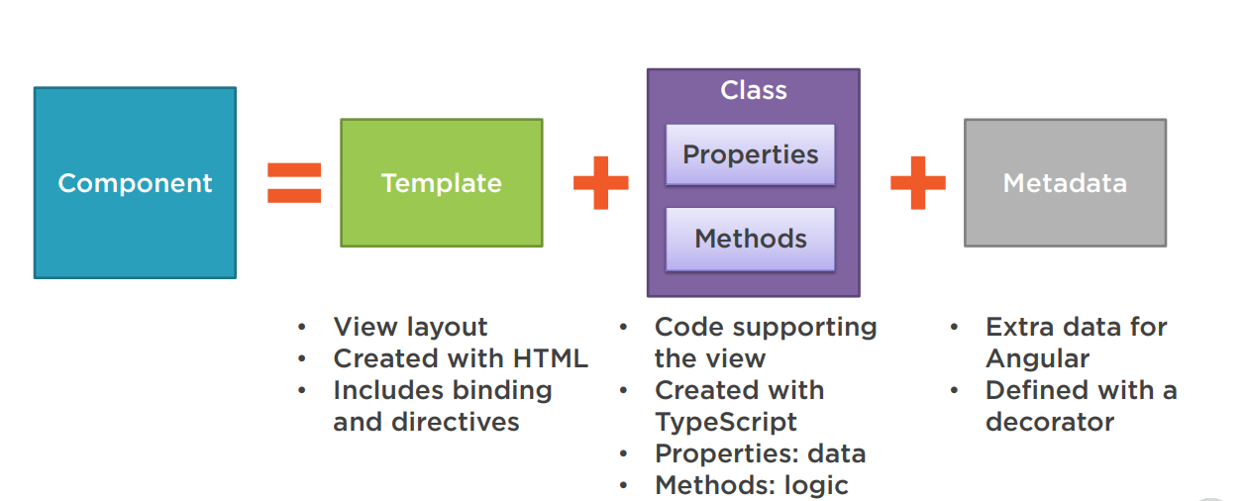
What is Component
The core idea behind Angular is to build components.
They make your complex application into reusable parts which you can reuse very easily.

Slide 15
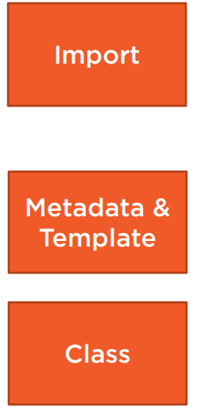
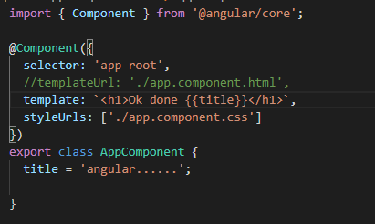
Code

Slide 16
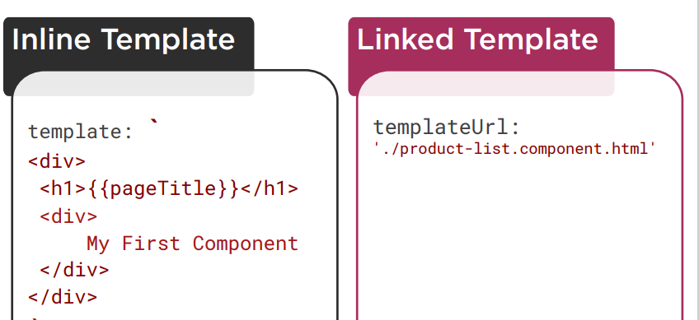
Decorator
A function that adds metadata to a class, its members, or its method arguments.
Prefixed with an @. Angular provides built-in decorators. @Component()

Slide 17
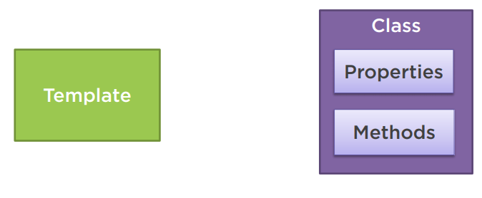
Binding
Coordinates communication between the component's class and its template and often involves passing data.

Slide 18
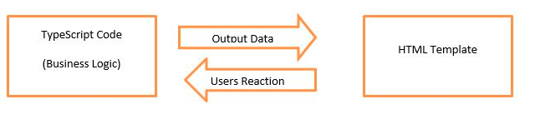
There is two type of databinding:
One-way databinding
One way databinding is a simple one way communication where HTML template is changed when we make changes in TypeScript code.
Two-way databinding
In two-way databinding, automatic synchronization of data happens between the Model and the View.
change is reflected in both components. Whenever you make changes in the Model, it will be reflected in the View and when you make changes in View, it will be reflected in Model.

Slide 19
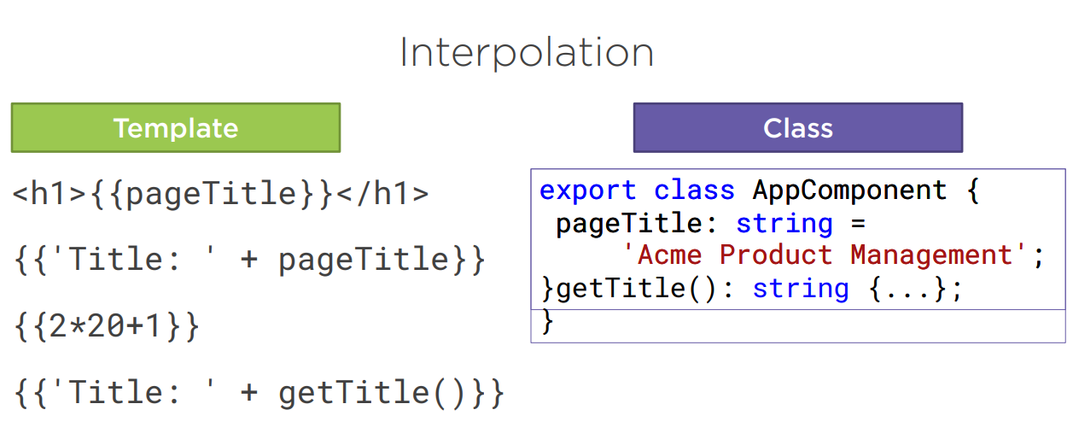
Interpolation
It facilitates you to make changes on component.ts file and fetch data from there to HTML template (component.html file).

Slide 20
Data Binding Essentials
Connect component state and template markup.
Use interpolation for text, property binding for DOM properties, and event binding for user actions.
Use two-way binding for form inputs that both display and update state.
Bind attributes with [attr.*], and classes/styles with [class.*]/[style.*].
{{ value }}
[prop]="value"
(event)="handler($event)"
[(ngModel)]="value"
{{pageTitle}}
<input type="text" [(ngModel)]="inputValue" placeholder="Enter text here">
<button [disabled]='isButtonDisabled()' (click)="ale()">Disable Me</button>

Slide 21
Property Binding
Property Binding is a one-way data-binding technique. In property binding, we bind a property of a DOM element to a field which is a defined property in our component TypeScript code. Actually, Angular internally converts string interpolation into property binding.
Property binding flows a value in one direction, from a component's property into a target element property.
import { Component } from '@angular/core';
@Component({
selector: 'my-app',
template: `<div>
<button [disabled]='isDisabled'>Disable Me</button>
</div>`
})
export class AppComponent {
isDisabled: boolean = true/false;
}
<element [property]= 'typescript_property'>

Slide 22
Example
<input style = "color:green;
margin-top: 40px;
margin-left: 100px;"
[value]='title’>
import { Component } from '@angular/core';
@Component({
selector: 'app-root',
templateUrl: './app.component.html',
styleUrls: ['./app.component.css']
})
export class AppComponent {
title = 'GeeksforGeeks';
}
<img [src]='src’>
@Component({})
export class AppComponent {
src = 'https://www.geeksforgeeks.org/wp-content/uploads/gfg_200X200-1.png';
}
<button [disabled]='bool' style="margin-top: 20px;">GeekyButton</button>
@Component({})
export class AppComponent {
bool = 'true';
}

Slide 23
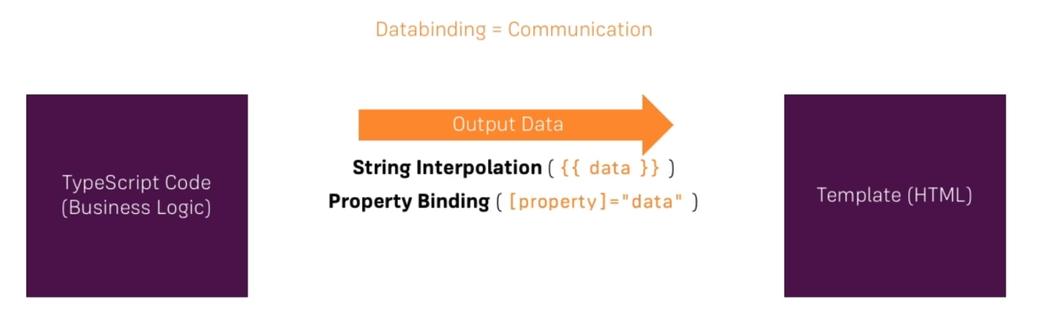

Slide 24

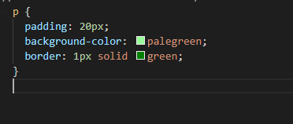
Exercises
Create two new Components (manually or with CLI): WarningAlert and SuccessAlert
Style the Components appropriately (maybe some red/ green text?)

Slide 25
Event Binding
In an event binding, Angular sets up an event handler for the target event. When the event is raised, the handler executes the template statement.
<button class="btn btn-primary"
[disabled]="!allowNewServer"
(click)=“displayAlert()">Add Server</button>
Ts file
displaAlert(){
Alert(“Ok done”);
}

Slide 26
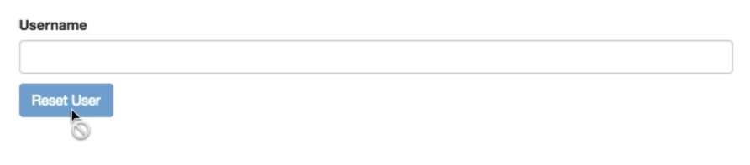
W.a.p to display this action
Enter Yourname<input type="text" [(ngModel)]="username" ><br>
<button class="btn btn-info" (click)="resetUsername()">Reset</button>
username:string=""
resetUsername():void{
this.username="";
}

Slide 27
Directives

Slide 28
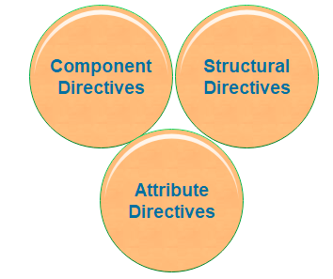
Directives are instructions in the DOM (Document Object Model). It specifies how to place our business logic in Angular.
By using Angular directives, you can change the appearance, behavior or a layout of a DOM element. It also helps you to extend HTML.
There are three kinds of directives:
1. Component Directives
2. Structural Directives
3. Attribute Directives

Slide 29
Component Directives
Components are the most common of the directives.
It contains the details of how the component should be processed, instantiated, and used at runtime.
The component comprises meta-data.

Slide 30



Structural Directives
These directives are used to manipulate and change the structure of the DOM elements.
Structural directives have a star (*) sign before the directive.
Like as,* ngIf, *ngFor, and *ngSwitch directive.
*ngIf Directive: The *ngIf allows us to Add/Remove DOM Element.
*ngSwitch Directive: The *ngSwitch will enable us to Add/Remove DOM element.
*ngFor Directive: The *ngFor directive is used to repeat a part of HTML template once per each item

Slide 31
@if(flag){
<p >this is true condtion</p>
}@else{
<p>this is false condition</p>
}
<p *ngIf="flag; else elseBlock">this is ngif condition</p>
<ng-template #elseBlock>this is elseBlock condition</ng-template>
ngSwitch
<div [ngSwitch]="role">
<p *ngSwitchCase="'admin'">Admin</p>
<p *ngSwitchDefault>Guest</p>
</div>

Slide 32

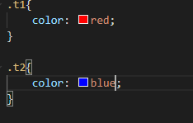


Attribute Directive
It deals with changing the look and behavior of the DOM element. For example: ngClass, ngStyle etc.
NgClass Directive: The ngClass Directive is used to add or remove CSS classes to an element.
ngStyle
The ngStyle Directive facilitates you to modify the style of an HTML

Slide 33
Practise
Add A button which says 'Display Details‘
Add a paragraph with any content of your choice (Hello User)
Toggle the displaying of that paragraph with the button created in the first step
Create other button which displays the values one by one from other array for every click
Starting at the 5th log item, give all future log items a blue background (via ngStyle) and white color (ngClass)

Slide 34
<p>practise works!</p>
<button (click)="displayDetais()">DisplayDetails</button>
<button (click)="displayValues()">DisplayInfo</button>
<p *ngIf="flag">Hello User</p>
<p [ngStyle]="{background:color}">{{data}}</p>
<div *ngFor="let v of value2; let i= index">
<p [style.background-color]="i>=4 ? 'blue' : 'white'">{{v}}</p>
</div>
export class Practise {
value2:string[]=[];
values=['abc','xyz','pqr','lmn','obc','xyzq'];
data:string="";
count:number=0;
flag:boolean=false;
displayDetais():void{
this.flag=!this.flag;
}
color:string="";
displayValues():void{
this.data=this.values[this.count++];
this.value2.push(this.data);
if(this.count>=5){
this.color="blue";
}else{
this.color="";
}
if(this.count==this.values.length+1){
this.count=0;
this.value2=[];
}
}
}

Slide 35
Custom Directive

Slide 36
An attribute directive minimally requires building a controller class annotated with @Directive,
Syntax: ng generate directive <directivename>
Ex: ng generate directive highlight
The import statement specifies an additional ElementRef symbol from the Angular core library:
You use the ElementRef in the directive's constructor to inject a reference to the host DOM element, the element to which you applied appHighlight.
ElementRef grants direct access to the host DOM element through its nativeElement property.
This first implementation sets the background color of the host element to yellow.
import { Directive, ElementRef } from '@angular/core';
@Directive({ selector: '[appHighlight]' })
export class HighlightDirective {
constructor(el: ElementRef) {
el.nativeElement.style.backgroundColor = 'yellow';
}
}
<p appHighlight>Highlight me!</p>

Slide 37
constructor(private el: ElementRef) {
el.nativeElement.style.backgroundColor = 'yellow';
}
@HostListener('mouseenter') onMouseEnter() {
this.highlight('yellow');
}
@HostListener('mouseleave') onMouseLeave() {
this.highlight(null);
}

Slide 38
Pipes

Slide 39
Use pipes to transform strings, currency amounts, dates, and other data for display. Pipes are simple functions you can use in template expressions to accept an input value and return a transformed value
Angular provides some built-in pipes:
Lowercasepipe → {{title | lowercase}}
Uppercasepipe →{{title | uppercase}}
Datepipe → {{todaydate | date:'d/M/y'}} {{todaydate | date:'shortTime'}}
Currencypipe → Gold value{{90 | currency:"USD"}}
Jsonpipe → {{ jsonval | json }}
Percentpipe → {{(360/600) | percent}}
Decimalpipe → {{ 600.78787814 | number: '3.4-4' }}
Slicepipe → {{months | slice:2:6}}

Slide 40
Pre-defined format options
Examples are given in en-US locale.
'short': equivalent to 'M/d/yy, h:mm a' (6/15/15, 9:03 AM).
'medium': equivalent to 'MMM d, y, h:mm:ss a' (Jun 15, 2015, 9:03:01 AM).
'long': equivalent to 'MMMM d, y, h:mm:ss a z' (June 15, 2015 at 9:03:01 AM GMT+1).
'full': equivalent to 'EEEE, MMMM d, y, h:mm:ss a zzzz' (Monday, June 15, 2015 at 9:03:01 AM GMT+01:00).
'shortDate': equivalent to 'M/d/yy' (6/15/15).
'mediumDate': equivalent to 'MMM d, y' (Jun 15, 2015).
'longDate': equivalent to 'MMMM d, y' (June 15, 2015).
'fullDate': equivalent to 'EEEE, MMMM d, y' (Monday, June 15, 2015).
'shortTime': equivalent to 'h:mm a' (9:03 AM).
'mediumTime': equivalent to 'h:mm:ss a' (9:03:01 AM).
'longTime': equivalent to 'h:mm:ss a z' (9:03:01 AM GMT+1).
'fullTime': equivalent to 'h:mm:ss a zzzz' (9:03:01 AM GMT+01:00).

Slide 41
{{ dateObj | date }} // output is 'Jun 15, 2015'
{{ dateObj | date:'medium' }} // output is 'Jun 15, 2015, 9:43:11 PM'
{{ dateObj | date:'shortTime' }} // output is '9:43 PM‘
{{ dateObj | date:'mm:ss' }} // output is '43:11'

Slide 42
Create Custom Pipe
Create custom pipes to encapsulate transformations that are not provided with the built-in pipes.
import {Pipe, PipeTransform} from '@angular/core';
@Pipe ({
name : 'sqrt'
})
export class SqrtPipe implements PipeTransform {
transform(val : number) : number {
return Math.sqrt(val);
}
}
Here PipeTransform is an interface and we need to update in app.modules.ts
<h2>Square root of 625 is: {{625 | sqrt}}</h2><br/>

Slide 43
@Input, @Output and EventEmitter
(or)
Components Communication

Slide 44
→To communicate from parent to child component we use @Input decorator to pass data from parent to child component
Send back data from child to parent we use @Output decorator.
The @Output emits the data using the EventEmitter method
to the parent component.
Use in components with the @Output directive to emit
custom events synchronously or asynchronously
Parent Component
@Input
Child Component
@Output

Slide 45
Parent Component
Value get updated from Child to Parent
Button
Button
Value get Updated from parent {{Value}}

Slide 46
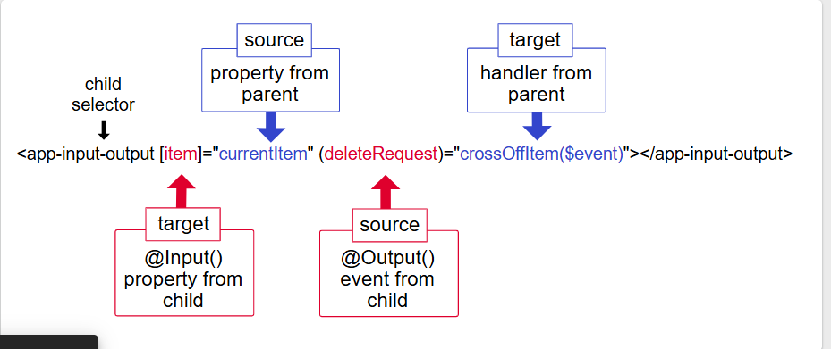

Slide 47
Parent.html
<button (click)="updateValueToChild()">ParentButton</button>
<!-- Child Component <app-child></app-child> -->
<!-- Pass pvalue to child and listen for child's event -->
<app-child [cvalue]="pcvalue" (cvalueChange)="updateValueFromChild($event)"></app-child>
Parent.ts
export class Parent {
pcvalue: number = 0;
pvalue:number =0;
updateValueToChild():void {
this.pcvalue++; // increment parent value and send to child
}
updateValueFromChild(childVal: number): void {
this.pvalue = childVal; // update parent when child emits
}
}

Slide 48
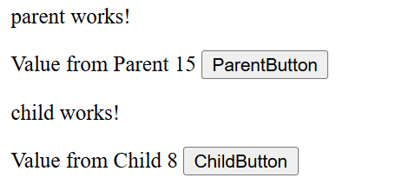
Child.html
Value from Child {{cvalue}}
<button (click)="updateValueToParent()">ChildButton</button>
Child.ts
export class Child {
@Input() cvalue: number = 0; // receive value from parent
@Output() cvalueChange = new EventEmitter<number>();
pvalue:number=0;
// emit to parent
updateValueToParent(): void {
this.pvalue++;
this.cvalueChange.emit(this.pvalue); // send updated value to parent
}
}
Result

Slide 49
Practise
-----------
a)Parent component should have text fields for employeename,salary,address
b)Once we submit with details Child component should take values as json object and update in Array
c)Display all values from Array in child componet
Employee Name
Salary
Address
Employee Details
Parent Component
Submit
Name Salary Address
ABC 5000 Hyd
Child Component

Slide 50
Angular Routing

