Slide 1
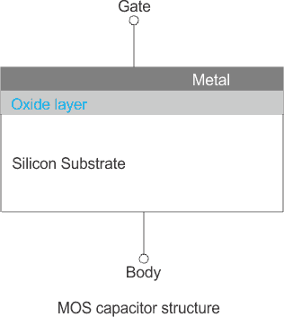
FET (Field Effect Transistor)
FET uses Electric field to control flow of current through the channel.
First FET to be built was the JFET and working practical was built in 1953.
There are more than 30 different major types of FETs, and most widely used is MOSFET.
MOSFET (MOS Capacitor controls the current flow)
Insulator b/n Gate and Body act as Capacitor.
Capacitance of MOS Cap: C= ε A/ d
(ε-permittivity b/n plates, A-area ,d-dis b/n plates)

Slide 2
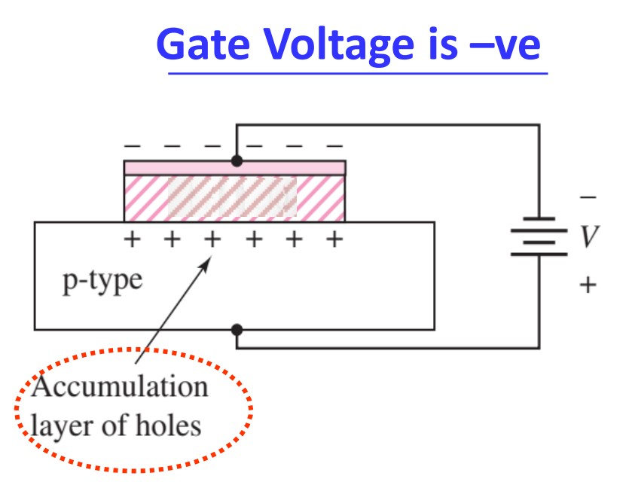
Variation in Gate voltage is directly proportional to MOS capacitance.
MOS Capacitor works in 3 different modes:
1. Accumulation (in nmos)
Flat band voltage is the voltage at which there is no charge on the capacitor plates and i.e; E=0 across oxide.
When Gate voltage < Flat band voltage i.e;
Negative gate voltage attract holes from
the p-type to the surface and thus results
in the accumulation of holes at the oxide
semiconductor interface.

Slide 3
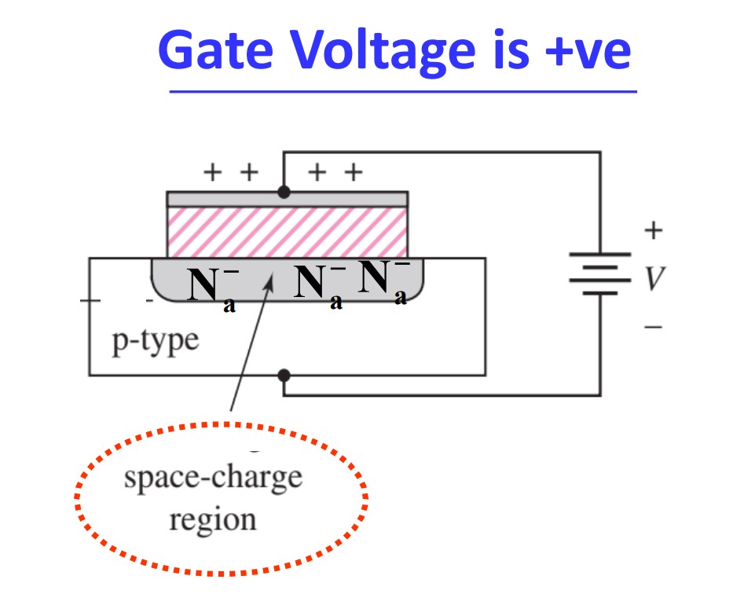
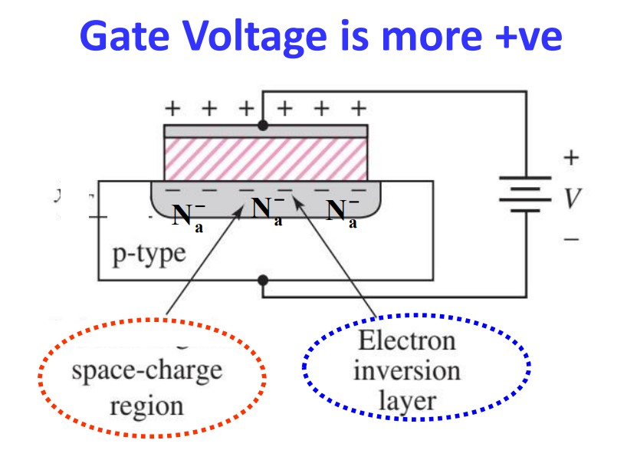
2. Depletion
When Gate voltage > Flat band voltage i.e;
Positive gate voltage pushes holes away
from the interface and thus depletion
layer is formed at the interface because of
acceptor impurity atoms.
3. Inversion
When Gate voltage > Threshold voltage i.e;
Larger positive gate voltage attract
even more electrons to the oxide
semiconductor interface and thus
creates an electron inversion layer.

Slide 4
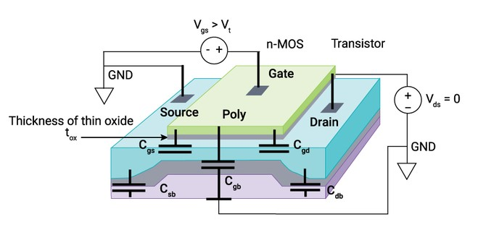
There are 5 capacitances that can be formed in the MOSFET.
1. Cgs = Cox(w.L) where Cox = εox/tox
2. Cgd = Cox(w.L)
3. Csb = Csidewall + Cbottom
Csw = εsilicon/tdep(2Aface+1Aside)
= εsi/td(2Hs.Ls+w.Hs)
= εsi/td(Hs)(2Ls+w)
= Cjsw(2Ls+w) where Cjsw is Junc’n cap/unit area = εsi/td(Hs)
Cbot = εsi/td(w.Ls)
= Cj(w.Ls) where Cj = εsi/td
But as Vsb increases, td increases i.e; td is not constant. Thus capacitance decreases by the factor of (1+Vsb/Vbi)^1/2 or (1+Vsb/Vbi)^1/3.

Slide 5
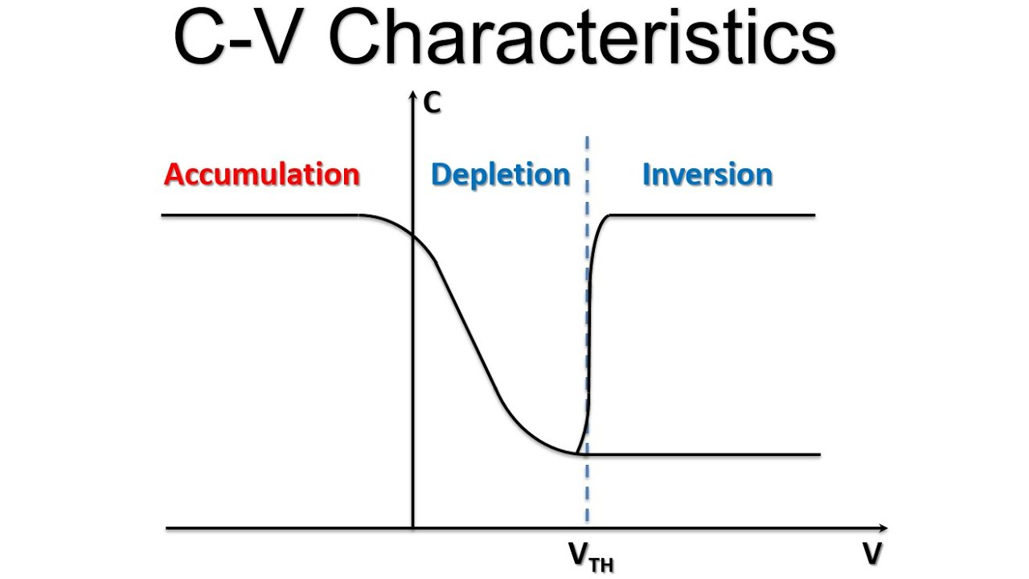
Csb = (Csw + Cbot) / factor
Csb = (Cjsw(2Ls+w) + Cj(w.Ls)) / (1+Vsb/Vbi)^1/2
4. Cdb = (Cjsw(2Ls+w) + Cj(w.Ls)) / (1+Vdb/Vbi)^1/2
5. Cgb : It has oxide cap (C1) & depletion cap (C2) in series
Cgb = (C1.C2/C1+C2).A
= {(εox/tox).(εsi/td)/(εox/tox)+(εsi/td)}.A
= {(εox/tox)/(1+(εox/tox).(td/εsi))}.A
Cgb = {Cox/(1+(εox/εsi).(td/tox))}.A
This gives CV curve
Let Cmax is capacitance at the
Accumulation, it gradually decreases
due to increase in depletion thickness

Slide 6
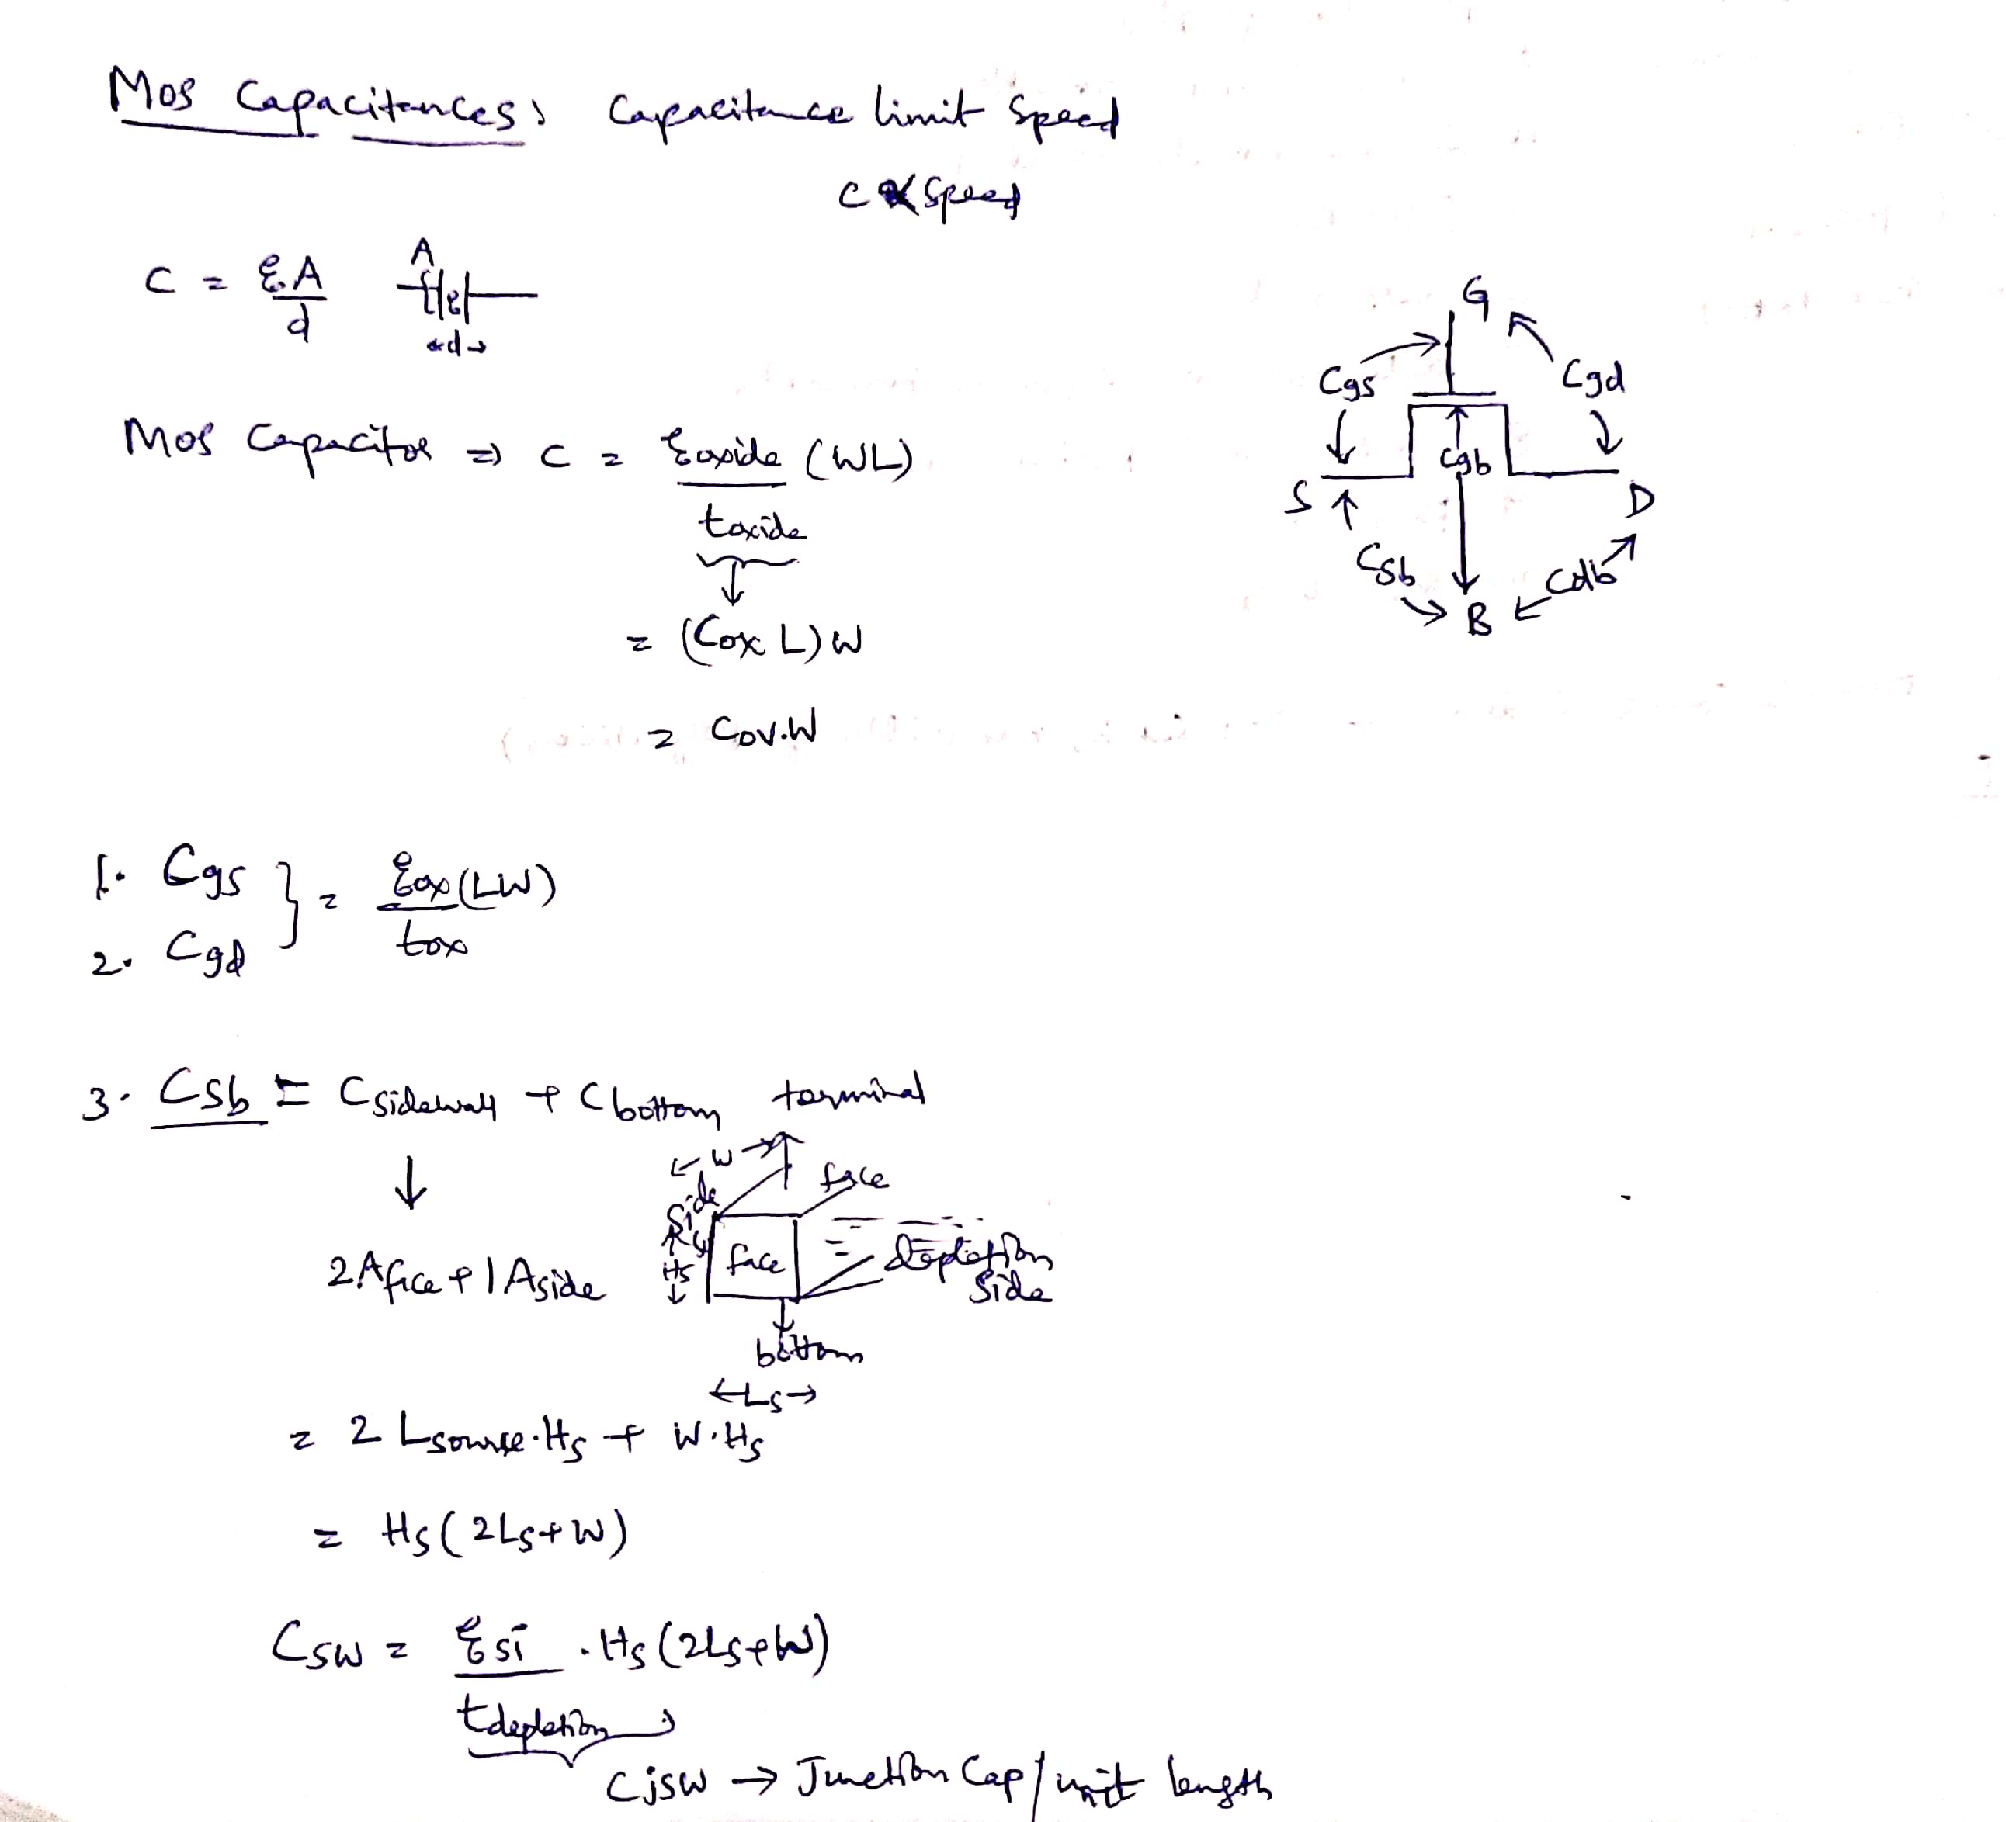
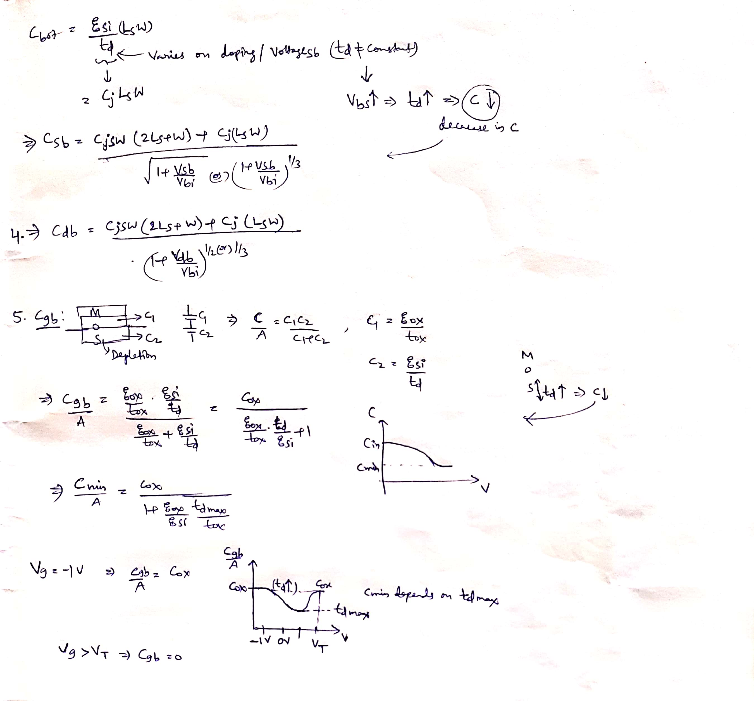
It reaches to Cmin where td is max and depletion mode ends.
Keep on increasing voltage, capacitance increases again & reaches to Cmax at Vthreshold.
Cgb becomes constant when Vg > Vthreshold.

Slide 7
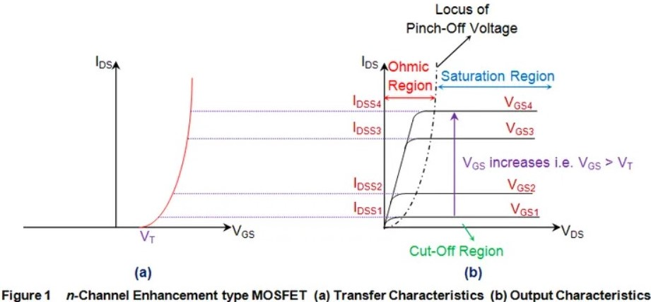
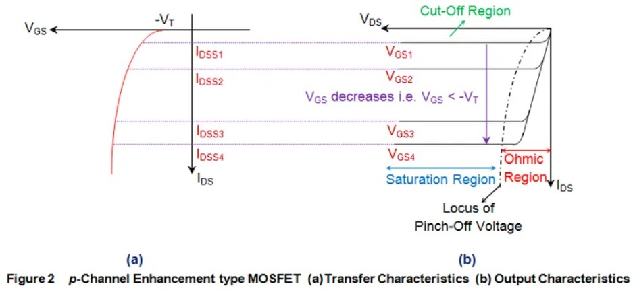
Since current flow is controlled by gate voltage, MOSFET is voltage-controlled, unipolar, high input impedance device.
IV Characteristics:
MOSFET is classified into Enhancement and Depletion mode.
Any MOSFET exhibits 3 operating regions known as Cutoff, Linear and Saturation regions.

Slide 8
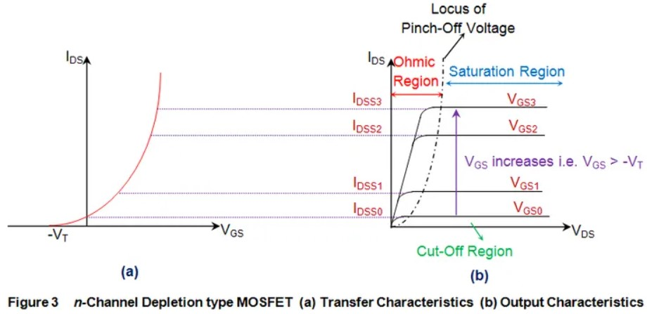
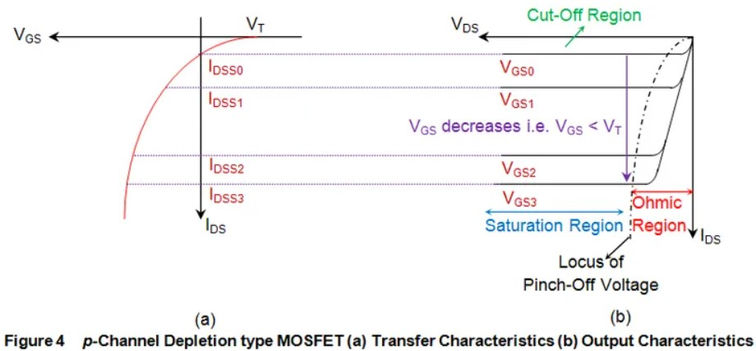
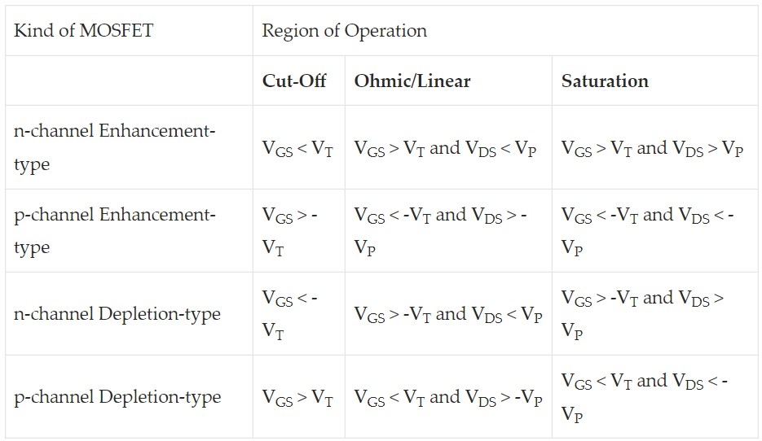

Slide 9
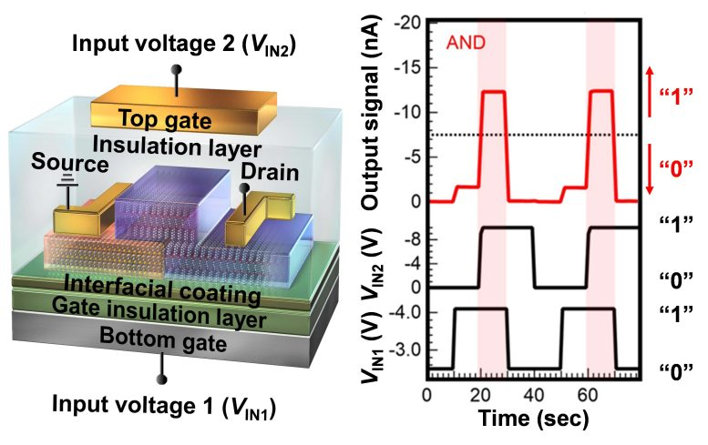
Latest FET Technology:
Organic Dual-gate Anti-ambipolar Transistor
Ryoma Hayakawa of National Institute for Materials Science and the Tokyo University of Science developed this Organic MOSFET structured transistor.

Slide 10
Capable of performing any one of the five logic gate operations (AND, OR, NAND, NOR, or XOR) by adjusting the input voltages to its dual gates.
This type of single transistor is enough to produce XOR gate by contrast with 12 traditional transistors.
It enables higher density circuit integration for High-Performance Mobile devices beyond Moore’s law.
It is more Power Efficient and Area Efficient.
It also develops Electrically Reconfigurable Organic Logic Gates & Integrated circuits to be used in future using this new transistor.
Reference : https://scitechdaily.com/new-organic-transistor-enables-higher-density-circuit-integration-for-high-performance-mobile-devices/

Slide 11
Manufacturing of MOSFET
Sequence of Fabrication process :
1. Manufacture of Silicon
2. Wafer processing
3. Lithography
4. Growth (oxidation) and elimination (etching) of Oxidants
5. Ion Implantation & Diffusion
6. Annealing
7. Silicon deposition
8. Metallization
9. Testing
10. Assembly & Packaging

Slide 12
Materials Used
Theoretical Composition :
Gate : Metal
Insulator : Oxide
Substrate : Semiconductor
Terminals : Metal contacts
Traditional Composition :
Gate : Polycrystalline silicon
Insulator : SiO2
Substrate : Si (selectively doped in various regions)
Gate Terminal : Aluminum
Source, Drain Terminal : Al
Substrate Terminal : palladium, platinum, iridium, rhodium
But Gate- Metal is replaced with Polysilicon because it is same composition as silicon channel. In inversion, the work-function difference is close to zero, making the threshold voltage lower and ensuring the transistor can be turned on

Slide 13
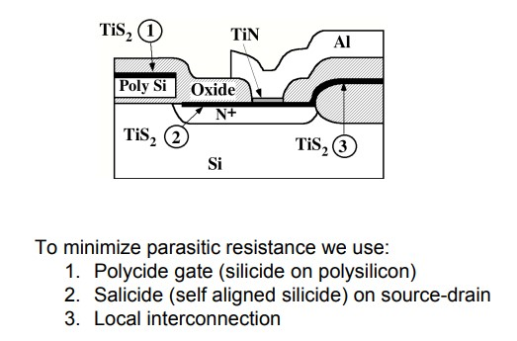
Modern Composition :
Gate : High-K Metal Gate (HKMG)
Insulator : SiO2 or HfO2 or ZrO2
PMMA–SiO2 for FE-TFT (field-effect thin film transistors)
Substrate : Si (selectively doped in various regions)
Gate Terminal : Aluminum on Silicide
Source, Drain Terminal : Al on Salicide (self aligned silicide)
Substrate Terminal : palladium, platinum, iridium, rhodium

Slide 14
Evolution of MOSFET
1. Planar (classical)
2. UTB (ultra thin body) Planar
3. Double Gate
4. FinFET
5. Tri-Gate
6. Pi-Gate
7. Ω-Gate
8. GAAFET (gate all around)
Latest :
Intel & Samsung introduced same structure with respective names called “RibbonFET” and “MBCFET” (multi bridge channel).
IBM introduced “VTFET” (vertical transport).

Slide 15
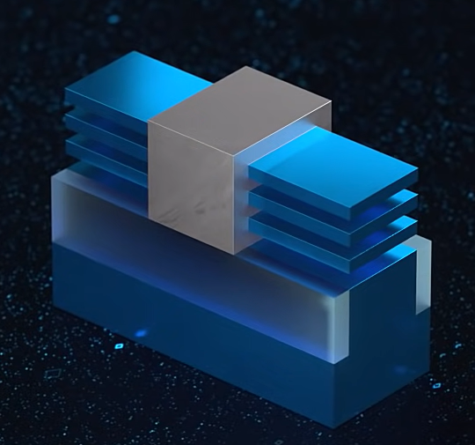
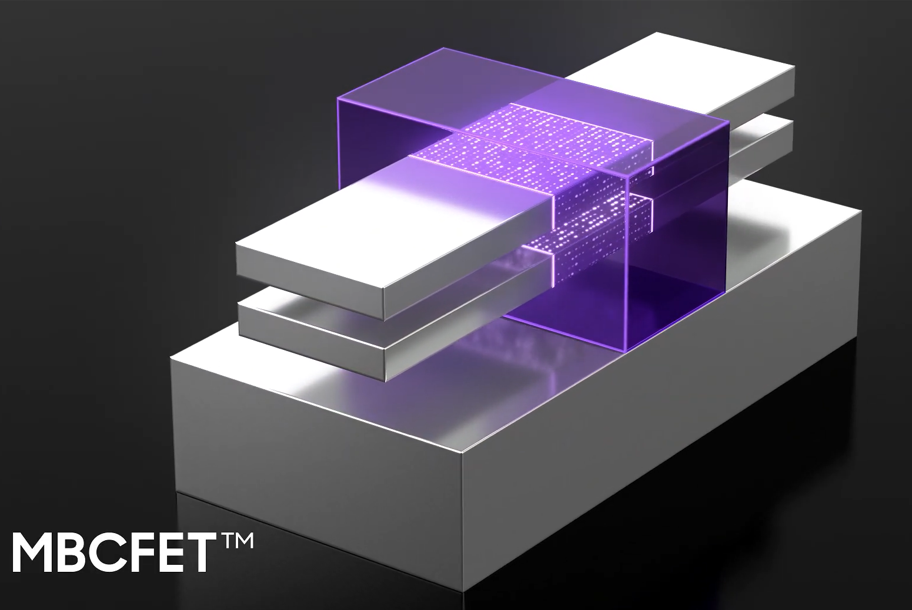
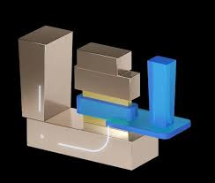
RibbonFET
VTFET
S SREEKAR
ECE

