Slide 1
Smart Battery Management System for Li-ion Batteries
Authors:
Singarayacheruvu Sreekar - 846217
Karthick Sri Sreniketh - 856968
Akanksha Undale - 837125
Kanchana Nagakumar - 862624
Project LAB Embedded Systems SS-2025
Final Presentation
CHEMNITZ. Date:- 02.07.2025

Slide 2
List of Contents
Introduction
Project Description
Task Overview
SoC and SoH Estimation
System Design and Simulation
Hardware and Software Implementation
Results
Conclusion
Future Scope

Slide 3
Introduction
Lithium-ion batteries have high energy density, but they require precise monitoring to ensure safety and performance.[9]
A Battery Management System (BMS) is essential for regulating voltage, current, and temperature, while protecting the battery from unsafe conditions.[10]
BMS relies on basic electrical parameters, which may not detect early signs of degradation.[3]
Our project aims to develop a smart BMS that uses Impedance measurement to gain deeper insights into battery health and predict failures earlier.
This approach enhances safety, reliability, and extends the overall lifespan of lithium-ion batteries, using parameters such as SoC and SoH.[8]

Slide 4
Project Description
Objective: Develop a smart BMS for Li-ion batteries on a robot car using Arduino.
Key Features: Real-time monitoring of voltage, current, SoC, and remaining runtime.
Safety & Efficiency: Enhances battery safety, lifespan, and energy efficiency.
Impedance Analysis: Integrates basic EIS concepts for battery health diagnostics.
Application: Serves as a scalable testbed for mobile robotics and energy systems.

Slide 5
Tasks Overview
Task 1: Assembly of the robot car
Task 2: Current and Voltage Measurement Circuit Design
Task 3: Coulomb counting for SoC
Task 4: Theoretical Implementation of Impedance spectroscopy for SoH
Task 5: Documentation

Slide 6
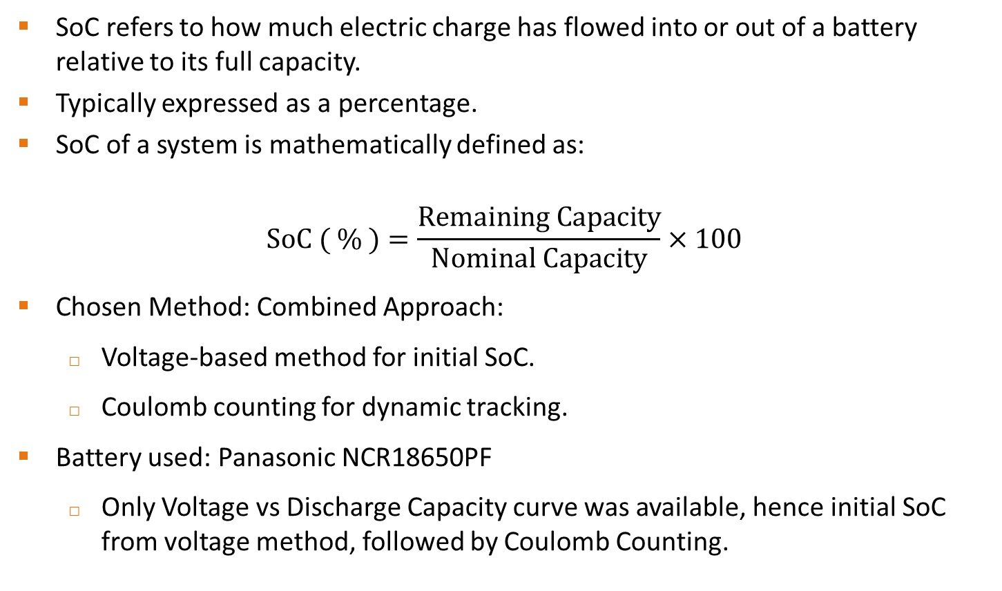
SoC Estimation
SoC refers to how much electric charge has flowed into or out of a battery relative to its full capacity.
Typically expressed as a percentage.
SoC of a system is mathematically defined as:
$$\text{SoC}\text{ ( \% )}=\frac{\text{Remaining} \text{Capacity}}{\text{Nominal} \text{Capacity}}×100$$
Chosen Method: Combined Approach:
Voltage-based method for initial SoC.
Coulomb counting for dynamic tracking.
Battery used: Panasonic NCR18650PF
Only Voltage vs Discharge Capacity curve was available, hence initial SoC from voltage method, followed by Coulomb Counting.

Slide 7
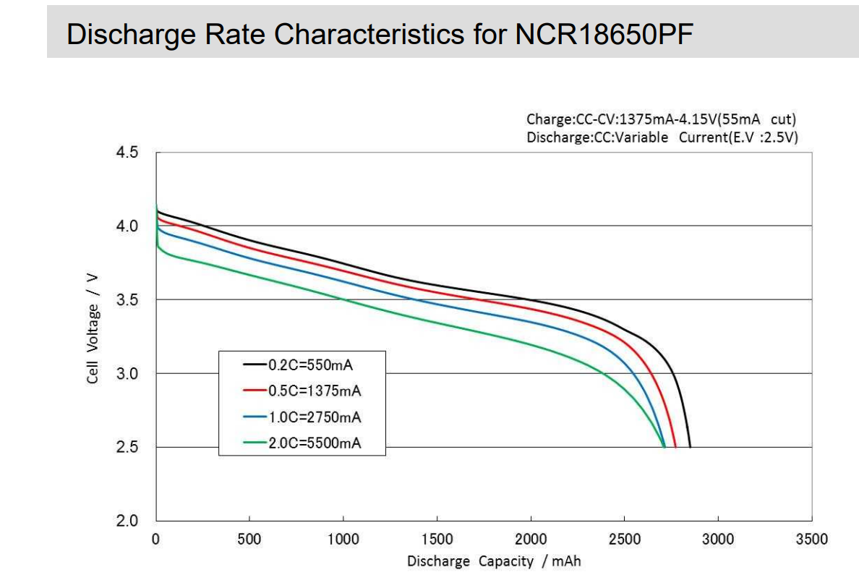
SoC Estimation
Determination of Initial SoC:
Coulomb counting requires an accurate initial SoC.[1] This is typically determined using the battery's voltage vs discharge capacity curve provided in the manufacturer’s datasheet.
Using Manufacturer's Discharge Curve:

Slide 8
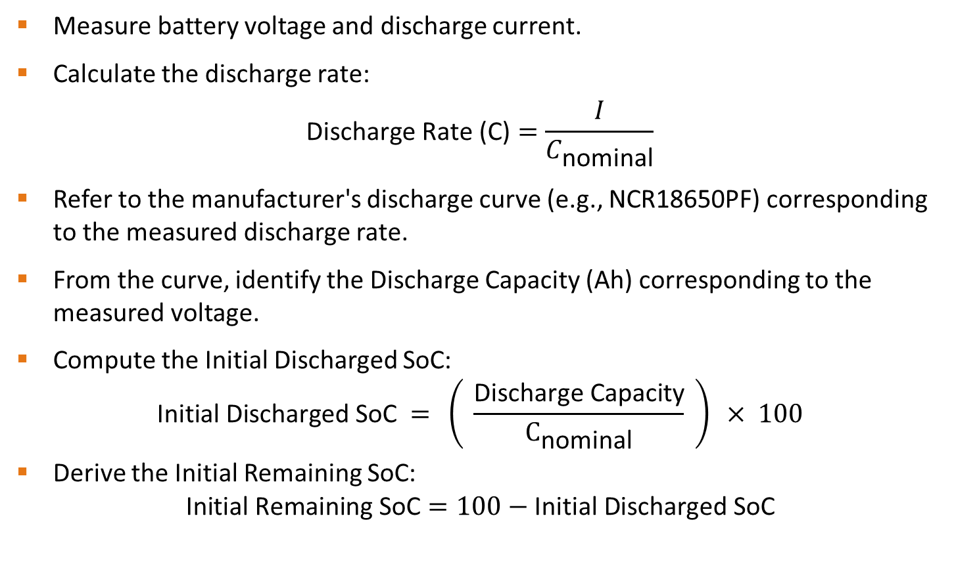
SoC Estimation
Measure battery voltage and discharge current.
Calculate the discharge rate:
$$\text{Discharge} \text{Rate}\text{ (}\text{C}\text{)}=\frac{I}{C_{\text{nominal}}}$$
Refer to the manufacturer's discharge curve (e.g., NCR18650PF) corresponding to the measured discharge rate.
From the curve, identify the Discharge Capacity (Ah) corresponding to the measured voltage.
Compute the Initial Discharged SoC:
$$\text{Initial} \text{Discharged} \text{SoC} = \left( \frac{\text{Discharge} \text{Capacity}}{C_{\text{nominal}}} \right) × 100$$
Derive the Initial Remaining SoC:
$$\text{Initial} \text{Remaining} \text{SoC}=100−\text{Initial} \text{Discharged} \text{SoC}$$

Slide 9
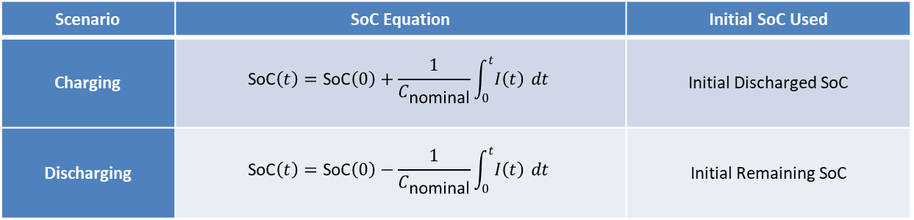

SoC Estimation
If the battery is charging, use: -
$\text{SoC}\left(0\right)=\text{Initial} \text{Discharged} \text{SoC}$
If the battery is discharging, use: -
$\text{SoC}\left(0\right)=\text{Initial} \text{Remaining} \text{SoC}$
Use in Coulomb Counting:
$$\text{SoC}\left(t\right)=\text{SoC}\left(0\right)±\frac{1}{C_{\text{nominal}}}\int_{0}^{t}{I\left(t\right)} dt$$
Scenario | SoC Equation | Initial SoC Used
Charging | $$\text{SoC}\left(t\right)=\text{SoC}\left(0\right)+\frac{1}{C_{\text{nominal}}}\int_{0}^{t}{I\left(t\right)} dt$$ | Initial Discharged SoC
Discharging | $$\text{SoC}\left(t\right)=\text{SoC}\left(0\right)−\frac{1}{C_{\text{nominal}}}\int_{0}^{t}{I\left(t\right)} dt$$ | Initial Remaining SoC

Slide 10
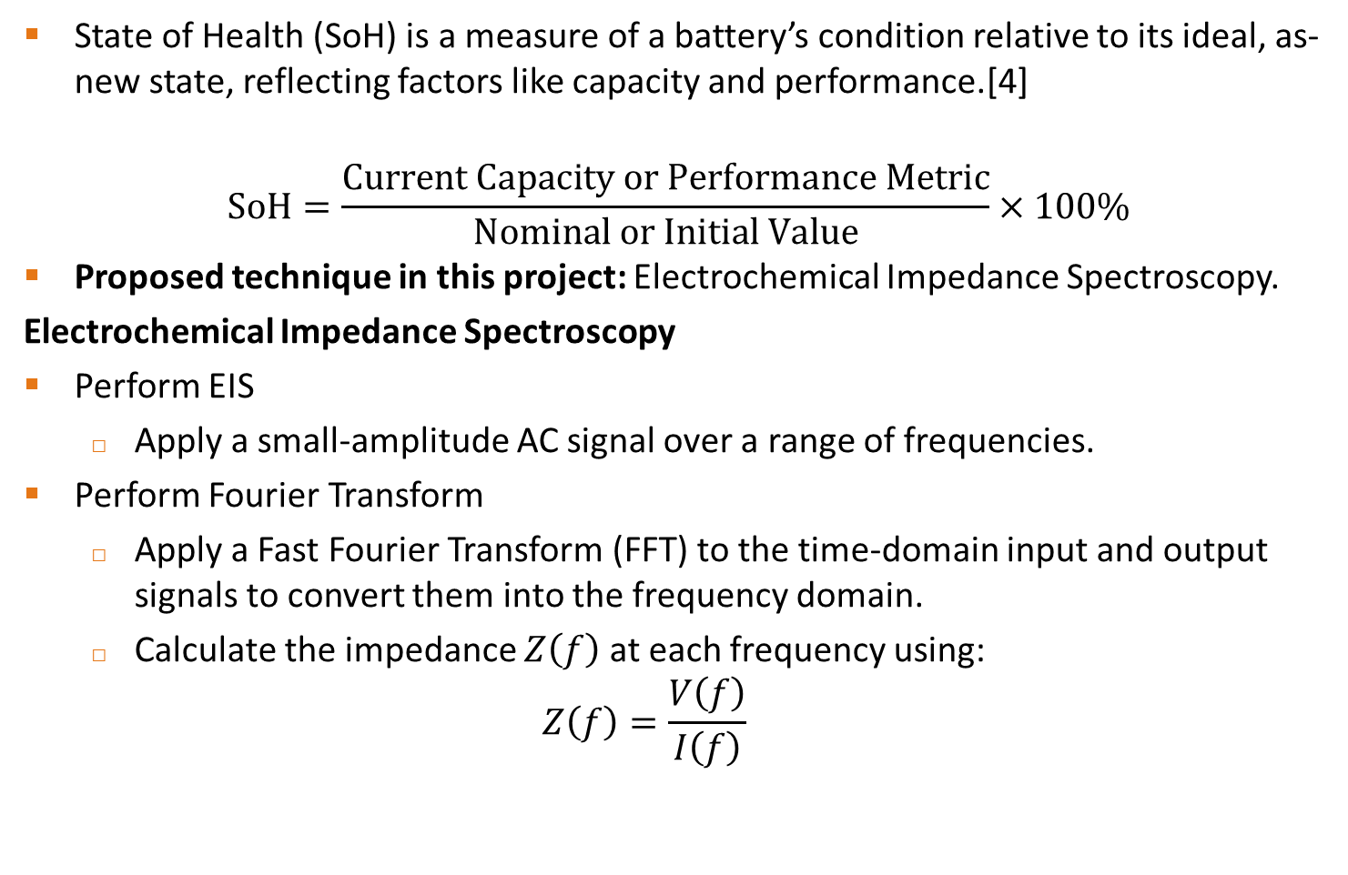
SoH Estimation
State of Health (SoH) is a measure of a battery’s condition relative to its ideal, as-new state, reflecting factors like capacity and performance.[4]
$$\text{SoH}=\frac{\text{Current} \text{Capacity} \text{or} \text{Performance} \text{Metric}}{\text{Nominal} \text{or} \text{Initial} \text{Value}}×100\%$$
Proposed technique in this project: Electrochemical Impedance Spectroscopy.
Electrochemical Impedance Spectroscopy
Perform EIS
Apply a small-amplitude AC signal over a range of frequencies.
Perform Fourier Transform
Apply a Fast Fourier Transform (FFT) to the time-domain input and output signals to convert them into the frequency domain.
Calculate the impedance $Z\left(f\right)$ at each frequency using: $Z\left(f\right)=\frac{V\left(f\right)}{I\left(f\right)}$

Slide 11
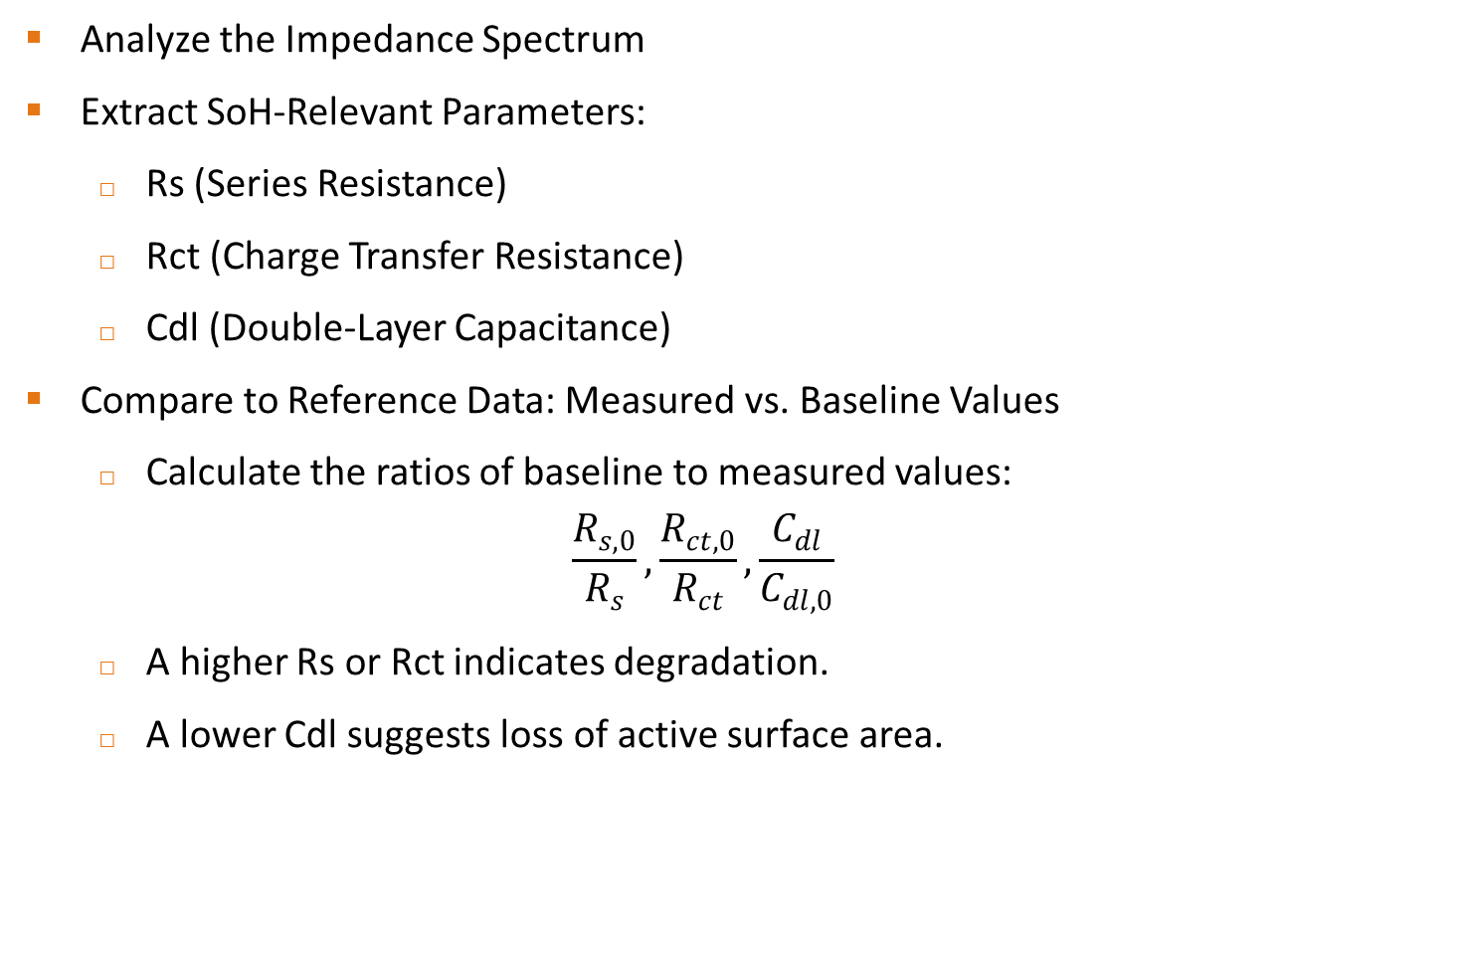
SoH Estimation
Analyze the Impedance Spectrum
Extract SoH-Relevant Parameters:
Rs (Series Resistance)
Rct (Charge Transfer Resistance)
Cdl (Double-Layer Capacitance)
Compare to Reference Data: Measured vs. Baseline Values
Calculate the ratios of baseline to measured values:
$$\frac{R_{s,0}}{R_{s}},\frac{R_{ct,0}}{R_{ct}},\frac{C_{dl}}{C_{dl,0}}$$
A higher Rs or Rct indicates degradation.
A lower Cdl suggests loss of active surface area.

Slide 12
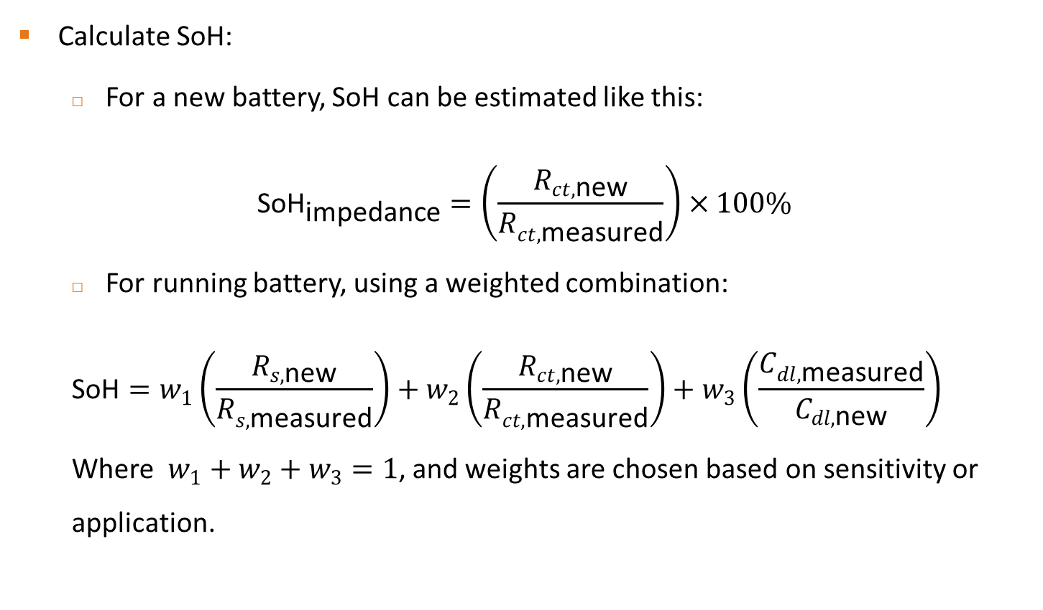
SoH Estimation
Calculate SoH:
For a new battery, SoH can be estimated like this:
$${\text{SoH}}_{\text{impedance}}=\left(\frac{R_{ct,\text{new}}}{R_{ct,\text{measured}}}\right)×100\%$$
For running battery, using a weighted combination:
$$\text{SoH}=w_{1}\left(\frac{R_{s,\text{new}}}{R_{s,\text{measured}}}\right)+w_{2}\left(\frac{R_{ct,\text{new}}}{R_{ct,\text{measured}}}\right)+w_{3}\left(\frac{C_{dl,\text{measured}}}{C_{dl,\text{new}}}\right)$$
Where $w_{1}+w_{2}+w_{3}=1$, and weights are chosen based on sensitivity or application.

Slide 13
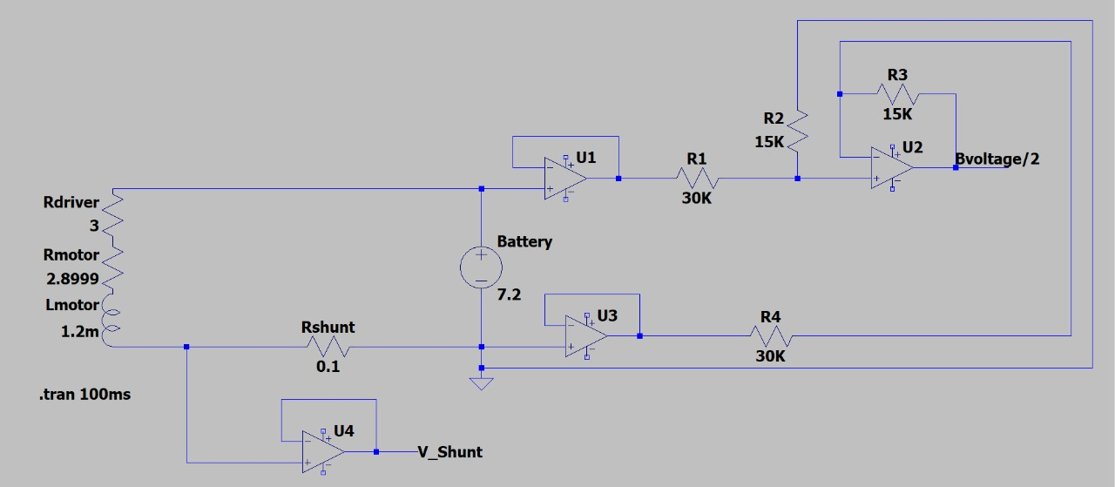
System Design and Simulation
Tools Used:
LTspice: Simulated voltage & current circuits (e.g., subtractor, shunt resistor). [7]
Key Circuits:
Voltage measurement: Op-amp subtractor with gain 0.5.
Current measurement: Shunt resistor (0.1Ω) + op-amp buffer.

Slide 14
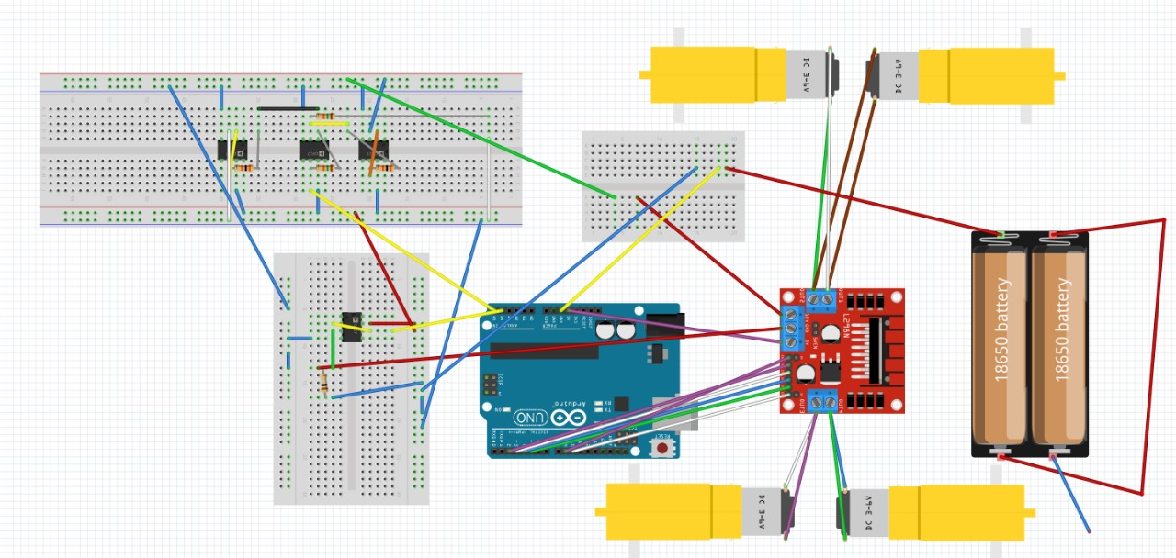
System Design and Simulation
Fritzing: Used breadboard schematics for hardware prototyping. [7]

Slide 15
Hardware Implementation
To implement accurate voltage and current sensing in our intelligent BMS, we use the following key hardware components:
Sensors (current, voltage)
Microcontroller (Arduino)
Signal conditioning circuits (op-amps, filters)
Operational Amplifier (TL051CP):
Configured with a gain of 0.5 using resistor values R1 = R2 = 30kΩ and R3 = R4 = 15kΩ, this op-amp serves two purposes:
Subtractor with a gain of 0.5.
Buffer for Voltage Measurement.

Slide 16
Hardware Implementation
Shunt Resistor (0.1Ω, 5W):
Used for current measurement. The voltage drop is then amplified and read by the ADC to calculate real-time current.
Panasonic NCR18650PF:
High-capacity 3.6V Li-ion battery with typical capacity of 2900mAh, arranged in series for 7.2V Nominal voltage output. It provides power for all the components involved in this operation.
L298N Motor Driver:
A Dual-H Bridge Motor Driver which can control the DC Motor’s Speed and Direction rated upto 46V and 4A of current.

Slide 17
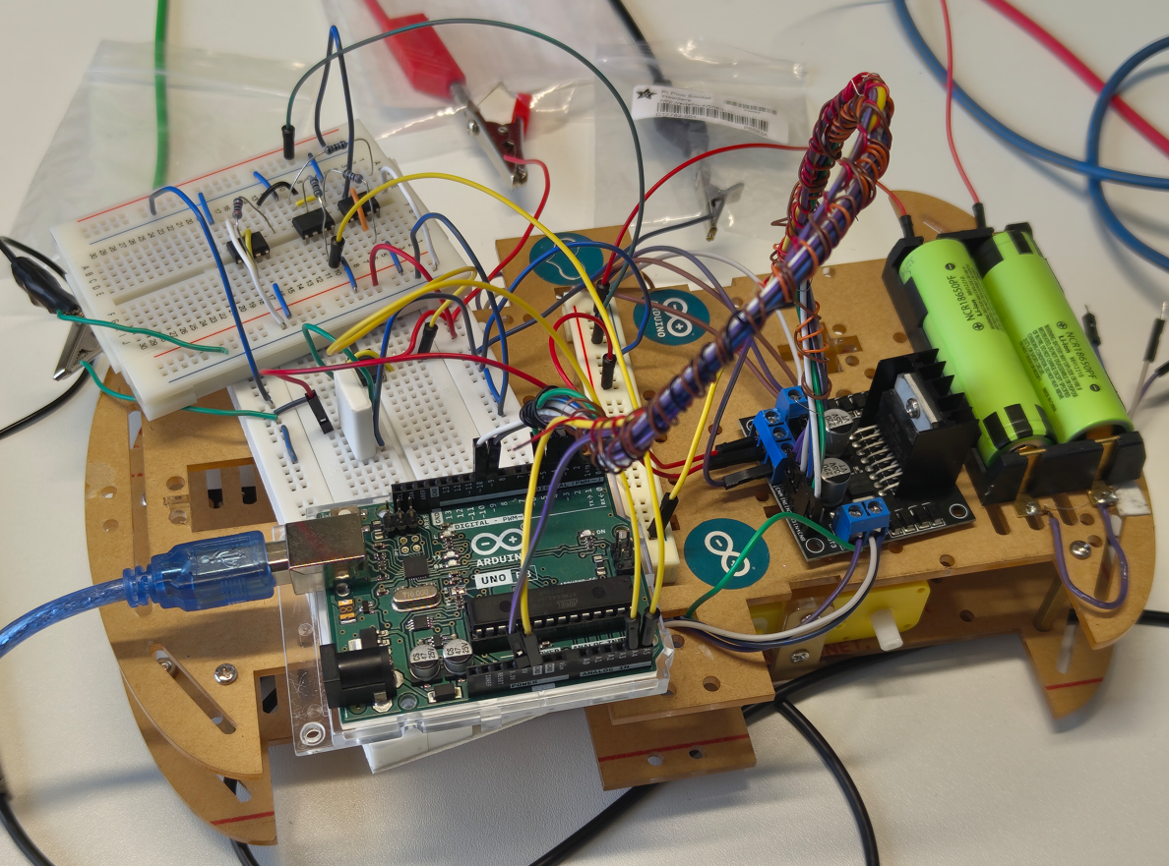
Hardware Implementation
Overall Hardware Setup:

Slide 18

Software Implementation
Developed using C/C++ on Arduino Uno R3 for real-time battery monitoring and control using Pin assignments and void functions.
Processes analog inputs from TL051CP op-amps for voltage and current sensing.
Implements Coulomb counting algorithm for State of Charge (SoC) estimation.

Slide 19
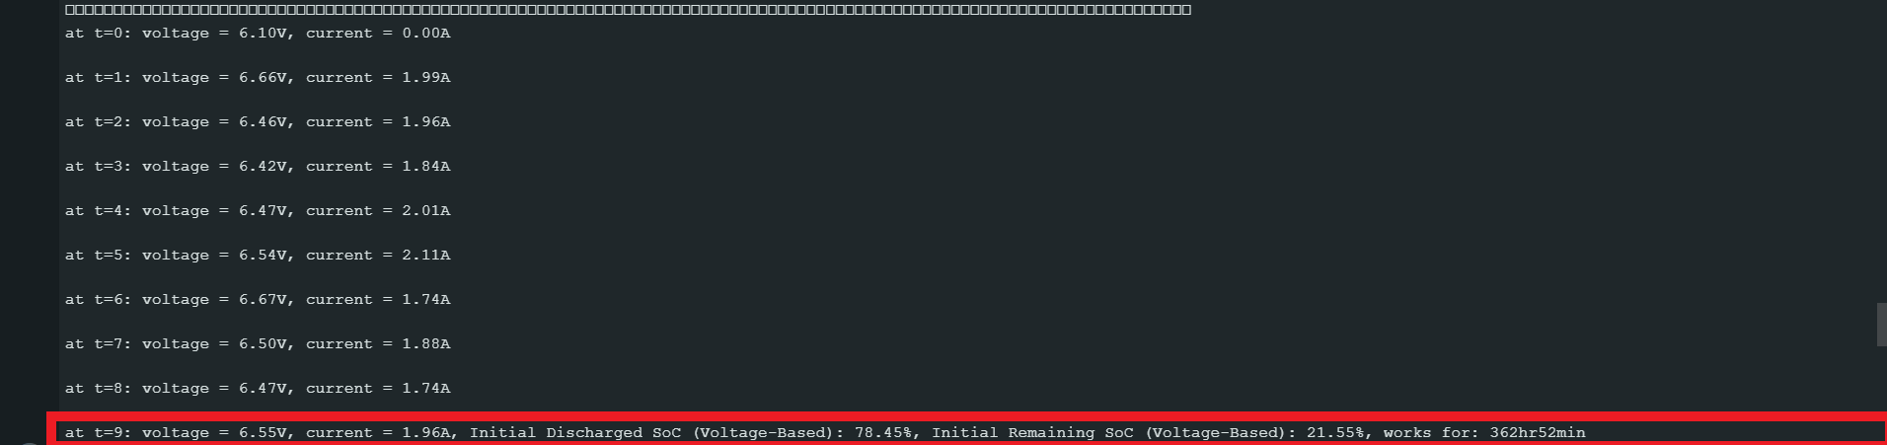
Results
SoC Estimation (Voltage + Coulomb Counting )
At t=9 sec: voltage = 6.55V ,Current = 1.96A, Initial Discharged SoC (Voltage-based): 78.45% , Initial Remaining SoC (Voltage-based): 21.55%, works for time: 362hr52min.

Slide 20
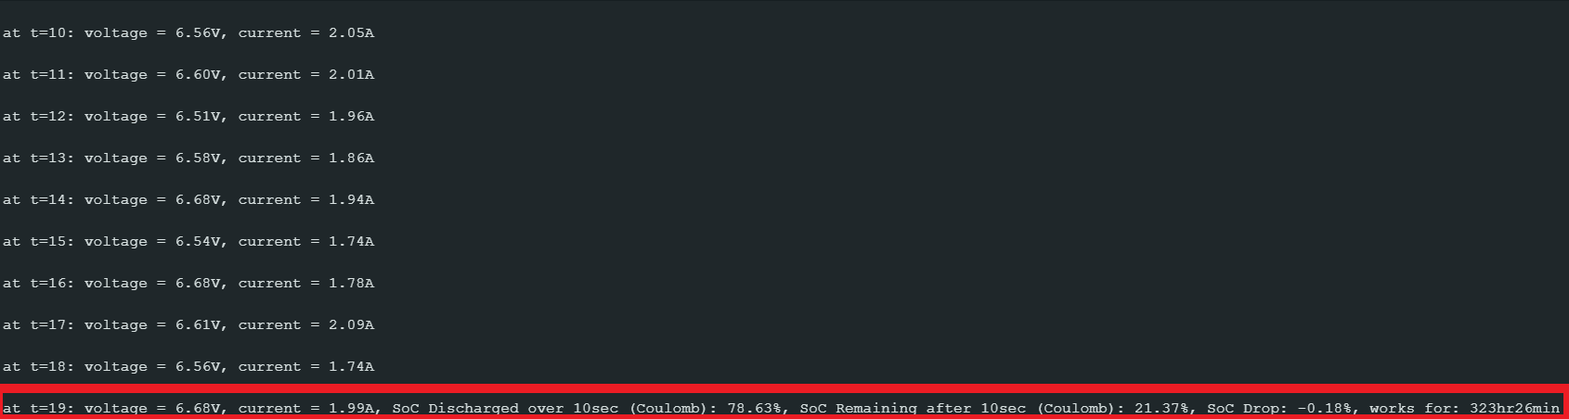
Results
SoC Estimation (Voltage + Coulomb Counting )
At t=19 sec: voltage = 6.68V ,Current = 1.99A, SoC Discharged over 10 sec (Coulomb): 78.63% , SoC Remaining after 10 sec(Coulomb): 21.55%,SoC Drop: -0.18%, works for : 323hr26min.

Slide 21
Conclusion & Future Scope
Successfully developed an Arduino-based Smart BMS for Li-ion batteries integrated into a robot car.
Combined Coulomb Counting and Voltage Method for accurate SoC estimation.
Initiated Electrochemical Impedance Spectroscopy (EIS) for battery SoH analysis.
Utilized LTspice and Fritzing for simulation and hardware design support.
Achieved real-time battery diagnostics, laying groundwork for scalable BMS solutions.

Slide 22
Conclusion & Future Scope
Advanced SoC Estimation: Implement Kalman Filters (EKF/UKF) for noise-robust, sensor-fused charge tracking.[1]
SoH Prediction with ML: Use machine learning (e.g., SVM, Random Forest) on historical data for accurate aging diagnostics.[2]
Deep Learning Models: Employ LSTM/CNN for modeling non-linear dynamics and forecasting battery health trends.[6]
Multi-cell & Regenerative Support: Extend system to manage multi-cell packs and handle bidirectional energy flow.[5]
Cloud & Safety Integration: Enable remote monitoring, predictive maintenance, and thermal failure prevention using AI.

Slide 23
References
[1] Fahmy, H. M., Swief, R. A., Hasanien, H. M., Alharbi, M., Maldonado, J. L., & Jurado, F. (2023). Hybrid state of charge estimation of lithium-ion battery using the Coulomb counting method and an adaptive unscented Kalman filter. Energies, 16(14), 5558. https://doi.org/10.3390/en16145558 [2] Wang, C., Zhang, X., Yun, X., & Fan, X. (2023). A novel hybrid machine learning Coulomb counting technique for state of charge estimation of lithium-ion batteries. Journal of Energy Storage, 63, 107081. https://doi.org/10.1016/j.est.2023.107081 [3] Liu, Y., Wang, L., Li, D., & Wang, K. (2023). State-of-health estimation of lithium-ion batteries based on electrochemical impedance spectroscopy: A review. Protection and Control of Modern Power Systems, 8, 41. https://doi.org/10.1186/s41601-023-00314-w
[4] Li, A. G., Fahmy, Y. A., Wu, M. M., & Preindl, M. (2022, June). Fast time-domain impedance spectroscopy of lithium-ion batteries using pulse perturbation. In 2022 IEEE Transportation Electrification Conference and Expo (ITEC) (pp. 155–160). IEEE. https://doi.org/10.1109/ITEC53557.2022.9813868
[5] Carkhuff, B. G., Demirev, P. A., & Srinivasan, R. (2018). Impedance-based battery management system for safety monitoring of lithium-ion batteries. IEEE Transactions on Industrial Electronics, 65(8), 6497–6505. https://doi.org/10.1109/TIE.2017.2786199

Slide 24
References
[6] Sangiri, J. B., Kulshreshtha, T., Ghosh, S., Maiti, S., & Chakraborty, C. (2022). A novel methodology to estimate the state-of-health and remaining-useful-life of a Li-ion battery using discrete Fourier transformation. Journal of Energy Storage, 46, 103849. https://doi.org/10.1016/j.est.2021.103849
[7] Telmasre, T. K., Goswami, N., Concepción, A., Kolluri, S., Pathak, M., Morrison, G., & Subramanian, V. R. (2022). Impedance response simulation strategies for lithium ion battery models. Current Opinion in Electrochemistry, 36, 101140. https://doi.org/10.1016/j.coelec.2022.101140 [8] Carthy, K. M., Gullapalli, H., & Kennedy, T. (2021). Review—Use of impedance spectroscopy for the estimation of Li ion battery state of charge, state of health and internal temperature. Journal of The Electrochemical Society, 168(8), 080517. https://doi.org/10.1149/1945-7111/ac1a85
[9] Zhang, M., Liu, Y., Li, D., Cui, X., Wang, L., Li, L., & Wang, K. (2023). Electrochemical Impedance Spectroscopy: A New Chapter in the Fast and Accurate Estimation of the State of Health for Lithium-Ion Batteries. Energies, 16(4), 1599. https://doi.org/10.3390/en16041599
[10] Alba, M., & Rossi, G. (2022). Critical review and functional safety of a battery management system for large-scale lithium‑ion battery pack technologies. International Journal of Coal Science & Technology, 9(3), 295–312. http://dx.doi.org/10.1007/s40789-022-00494-0

Slide 25
THANK YOU

