Slide 1
Context-Aware Rating System for T20 Cricket
Identifying match-winners beyond average & strike rate
Sreekar Regulavalasa

Slide 2
The Problem in T20 Cricket
Traditional stats treat all runs and wickets equally
They ignore pressure, timing, and match situation
This leads to misjudging player impact
We need a context-aware evaluation system

Slide 3
What This Project Does
Evaluates impact at ball-by-ball level
Separates batting and bowling influence
Extends logic to tournaments
Identifies true MVPs

Slide 4
Batting Metrics Used
Phase-Weighted Runs – runs scored when they matter most
Boundary Impact Score – ability to shift momentum
Dot Ball Cost – pressure created by non-scoring deliveries
Unified Pressure Index – difficulty of match situation
Final Batting Rating – overall match impact

Slide 5
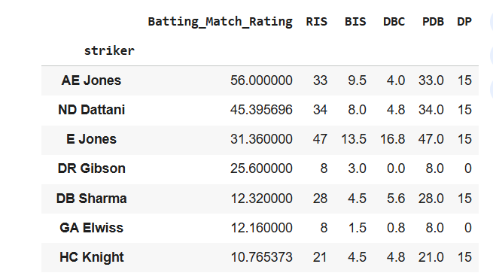
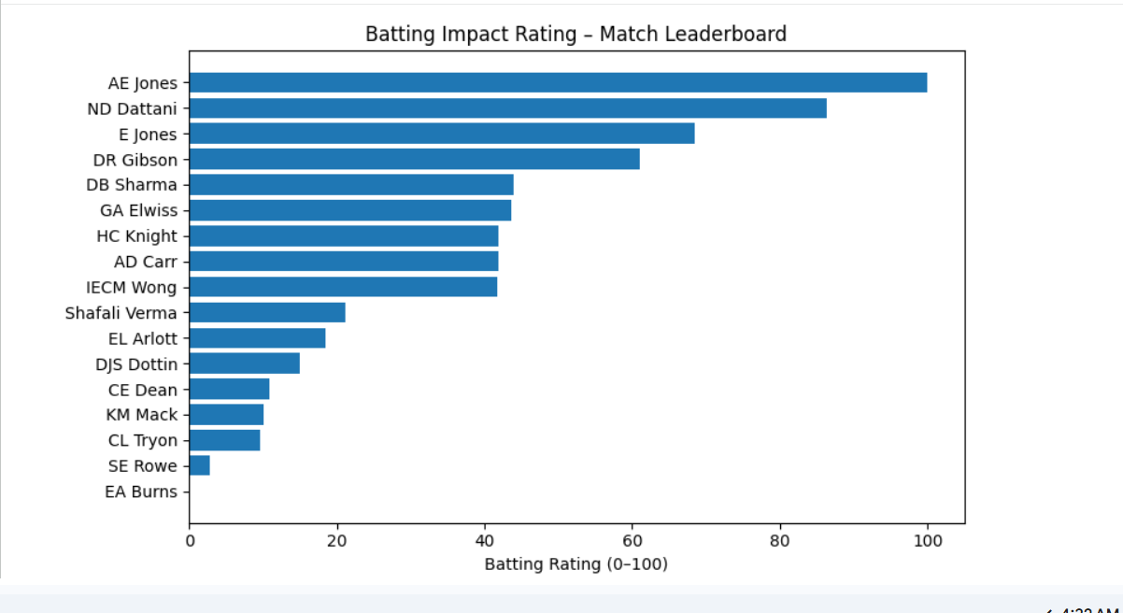
Batting Impact Results

Slide 6
Bowling Metrics Used
Wicket Impact Score – value of wickets by phase
Run Pressure Index – bowling below match run rate
Dot Ball Pressure – forcing batting errors
Control Metrics – discipline and consistency
Final Bowling Rating – overall match control

Slide 7
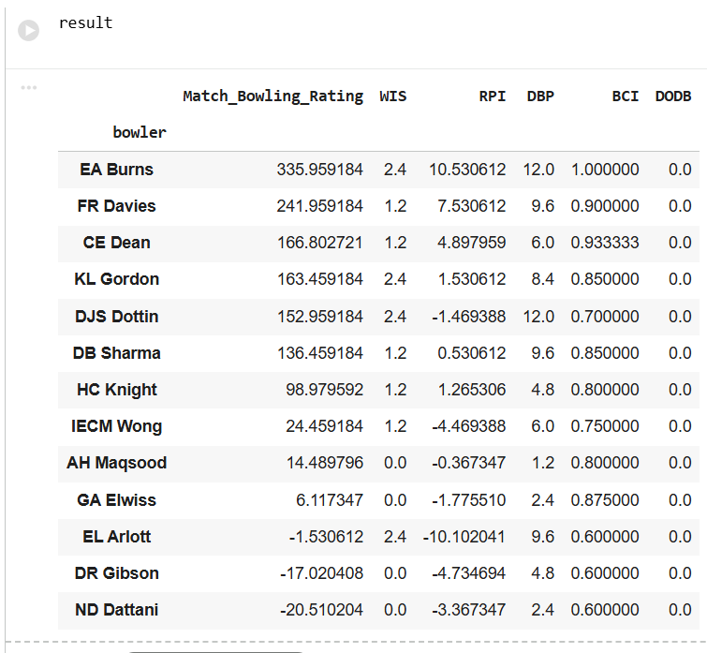
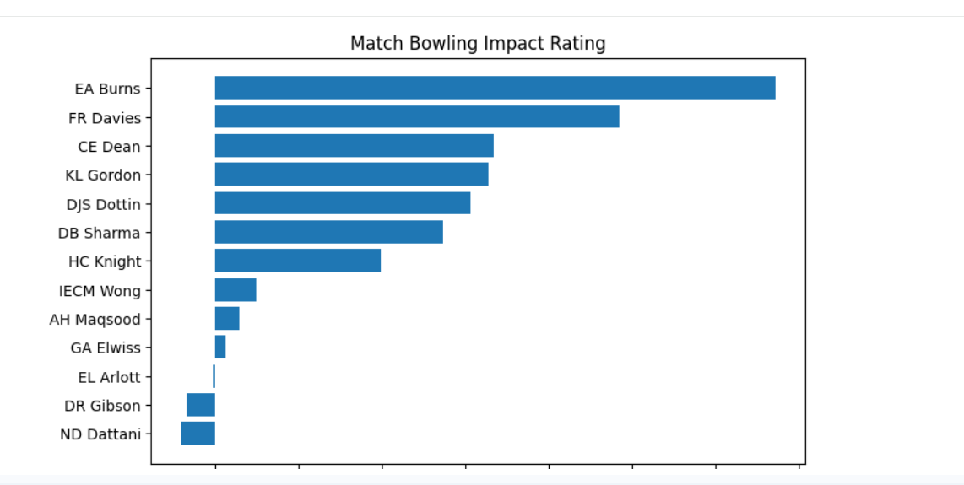
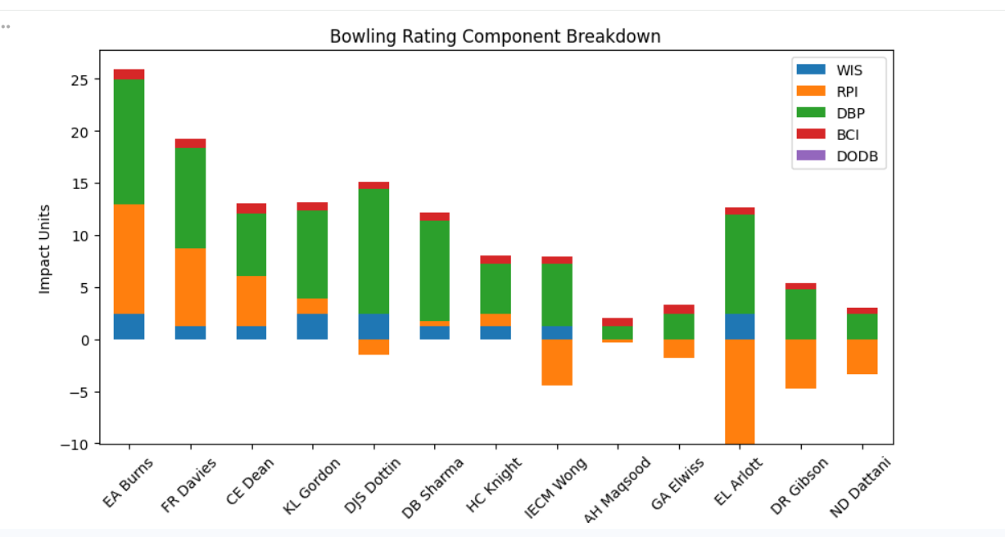
Bowling Impact Results

Slide 8
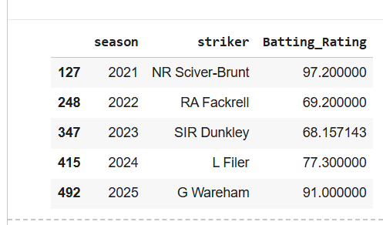
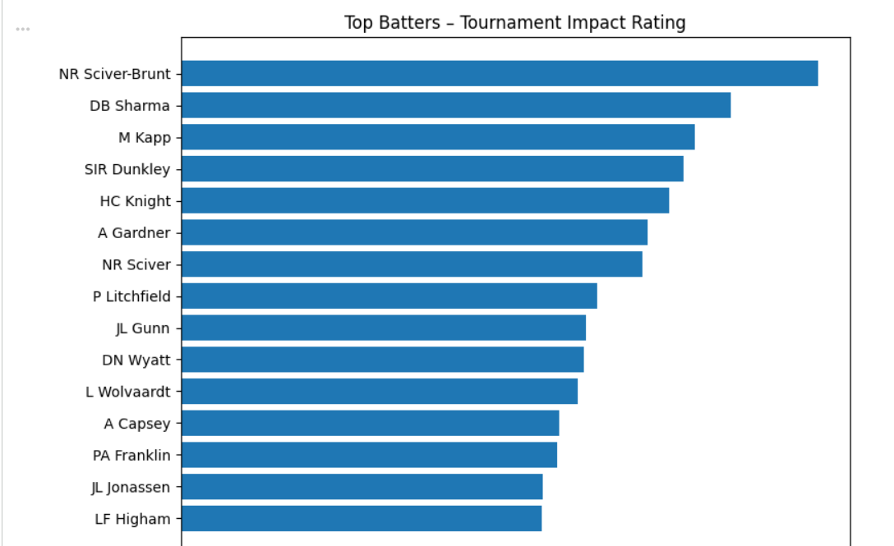
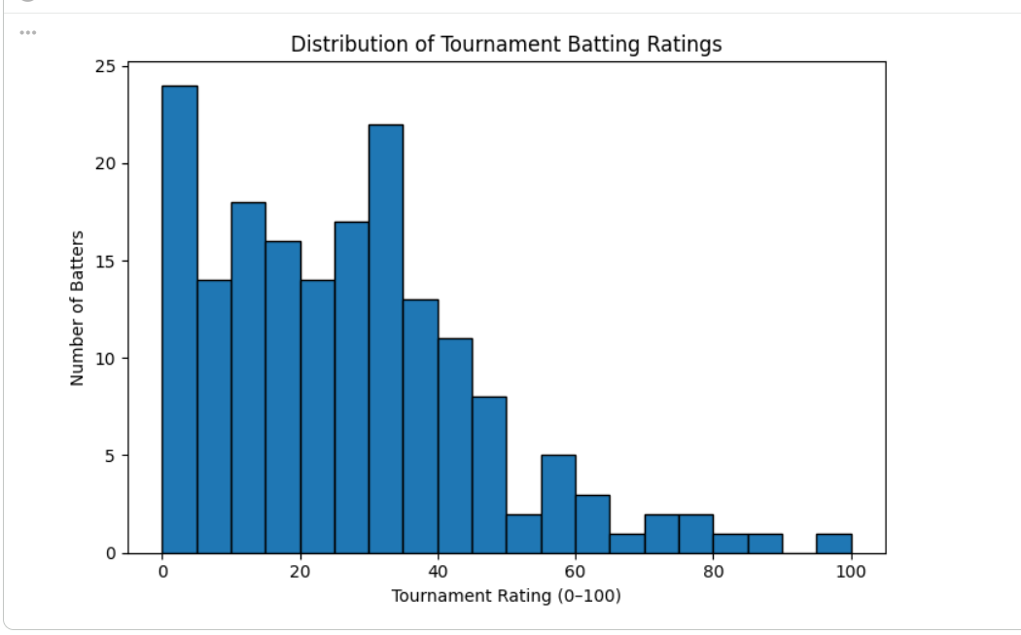
Tournament-Level Consistency

Slide 9
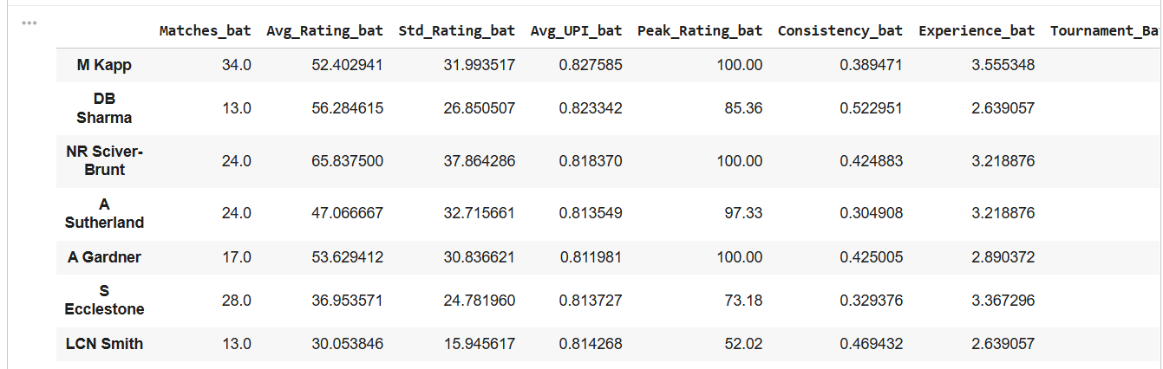
MVP Identification (Cricinfo-Style)

Slide 10
What IPL Owners & Teams Gain
Objective identification of match-winners
Separation of hype vs real impact
Better auction and retention decisions
Scalable system across seasons

