Slide 1

JOIN THE GREEN SIDE

Slide 2
Introduction:
Now A Days we are facing the problem “Deforestation”. To get rid of this type of typical problem, we are going to develop an Android Application. By using this application, we encourage the Plantation by giving Money to the planter.
Modules :
User Module
Admin Module
Payments Module
Delivery Module
Verification Module
Awareness Module

Slide 3
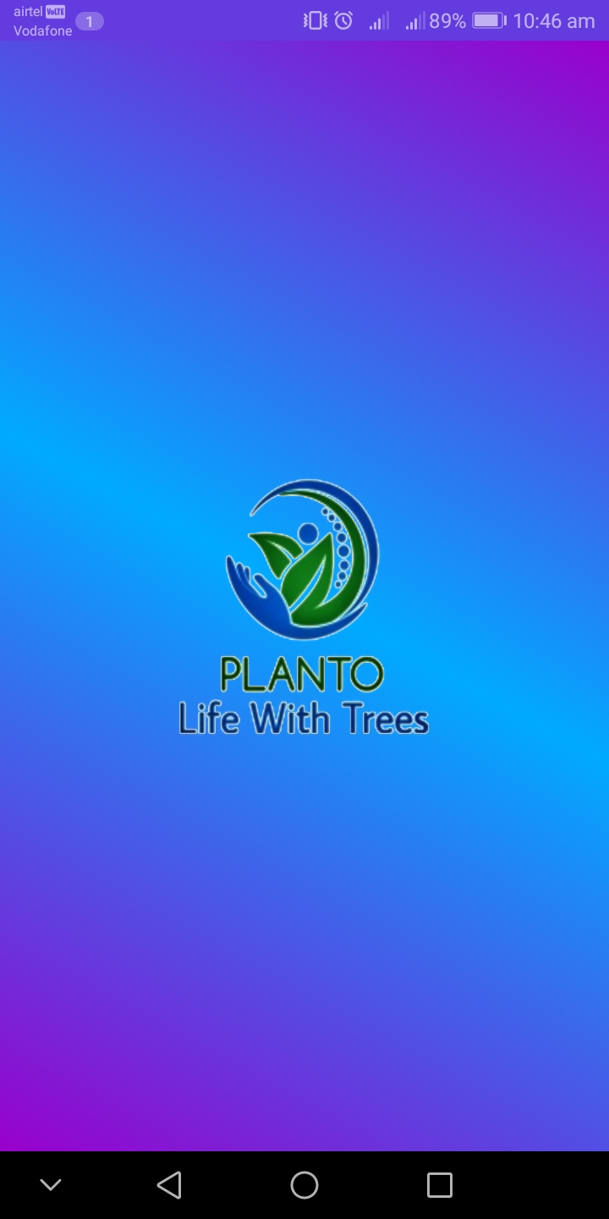
USER MODULE
User module allows users to Register , Login and Logout. Here the users can Access the Whole Application.
WELCOME SCREEN

Slide 4
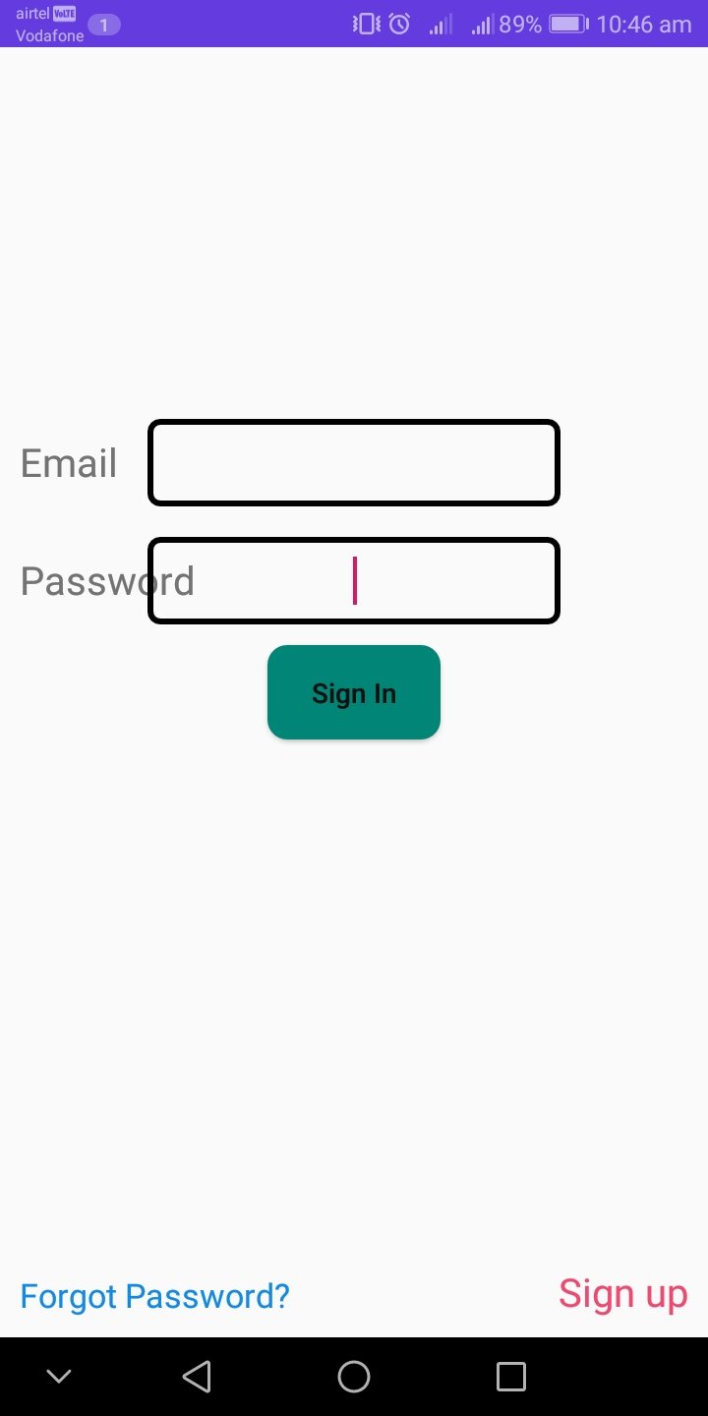
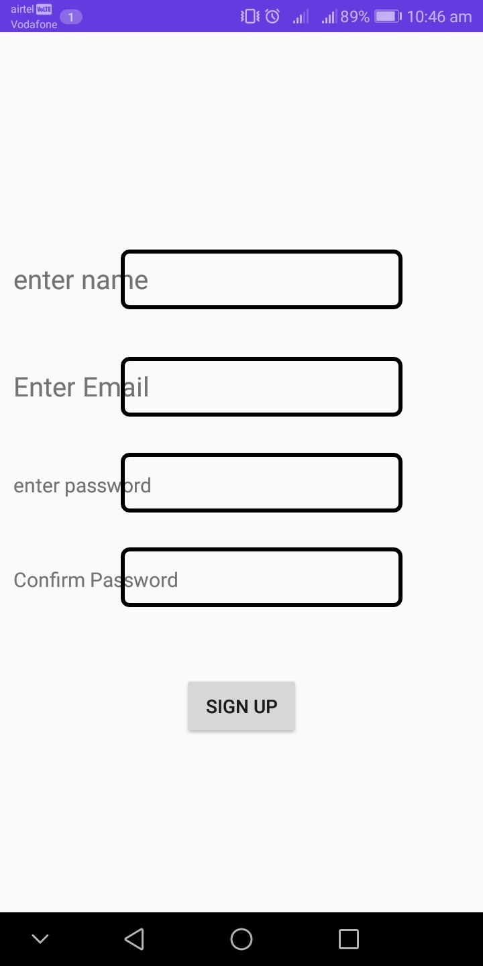
USER MODULE
SIGN IN
SIGN UP

Slide 5
ADMIN MODULE
Admin Module allows administrator to set up back-end of the system and perform basic system configuration.
AWARENESS MODULE
Awareness module is part of this Application organizes the Environment
Awareness programs and Awareness Videos for the Society.

Slide 6
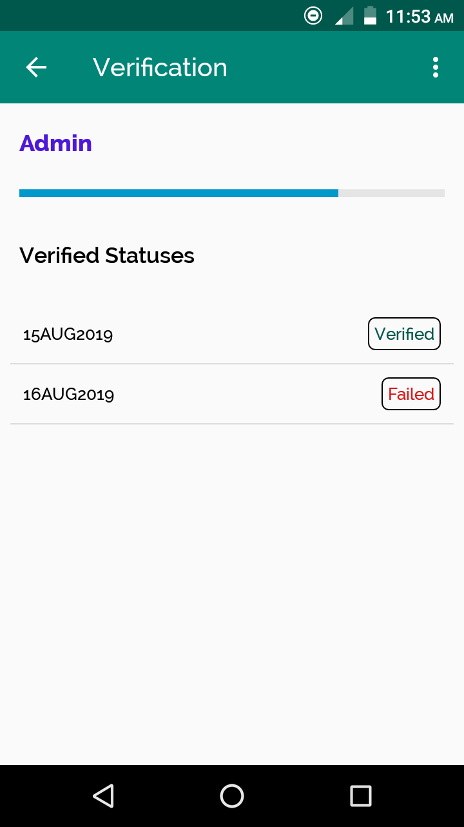
VERIFICATION MODULE
Here the Organization verifies the user credentials and formalities. If the
Credentials are Satisfying with Terms and Conditions of the Organization , then the User get Paid.

Slide 7
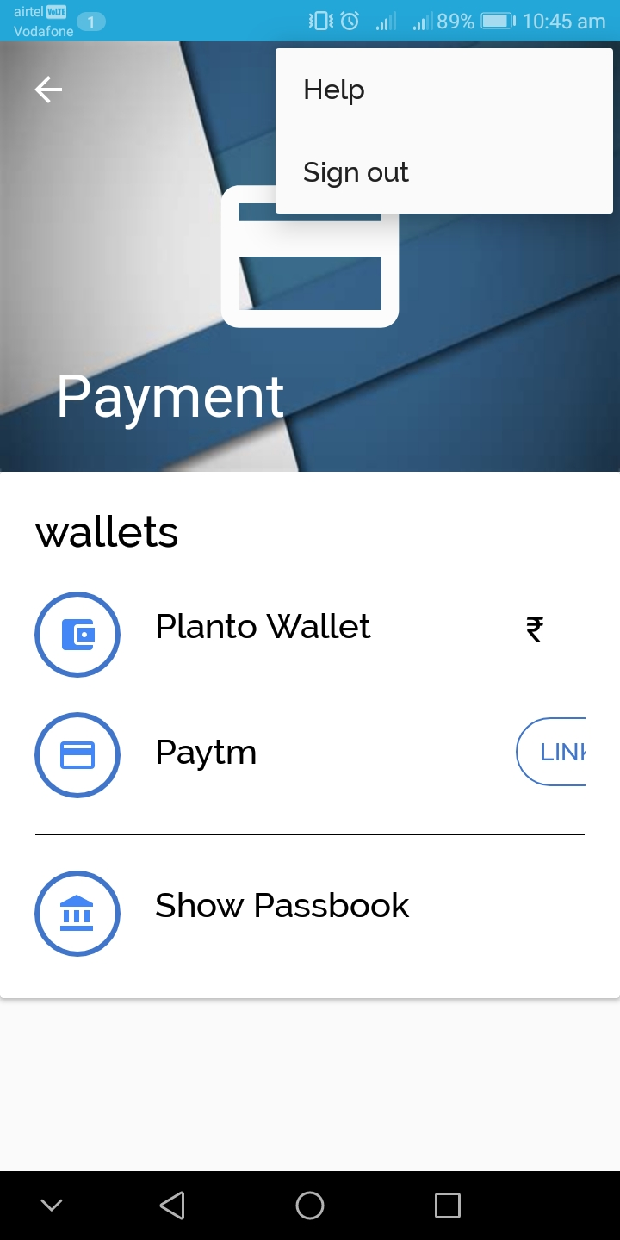
PAYMENTS MODULE
Payments Module is a generic payment platform which allows other modules to use any of the payment methods.

Slide 8
THANK YOU

