Slide 1
STAT 639 Project
Sreekar Annaluru
832001030
Group 37

Slide 2

Problems
Performing a classification on y of class_data.RData as the response variable and using x as predictors or covariants.
Performing clustering on cluster_data.RData and finding appropriate clusters within the dataset.

Slide 3
Setting (Classification)
What?
How?
Reducing collinearity.
Performing variable selection.
Reduction of dimension.
Capturing most variability.
Building correlation plot.
Performing Lasso Regression @ optimal L.
Eliminating high collinear pairs.
Performing principal component analysis.
Pre processing steps before building models

Slide 4
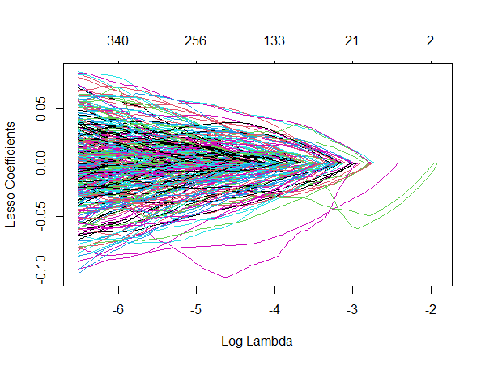
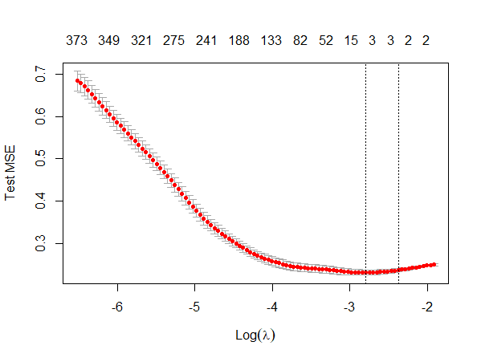
Lasso plots for Classification Models

Slide 5
Numbers
Input data of size: 400, 500.
Optimal lambda of 0.00234 for Lasso.
Reduced data size: 400, 350.
First 200 PC —> 92% variability.
2 variables of high collinearity (0.4).
Final data of size 400, 348.
4 models at different split ratios.

Slide 6
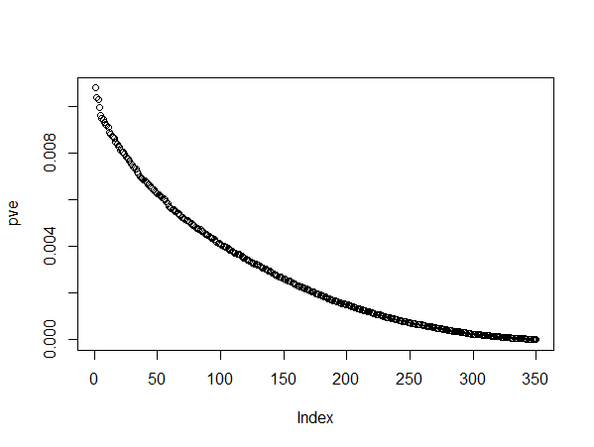
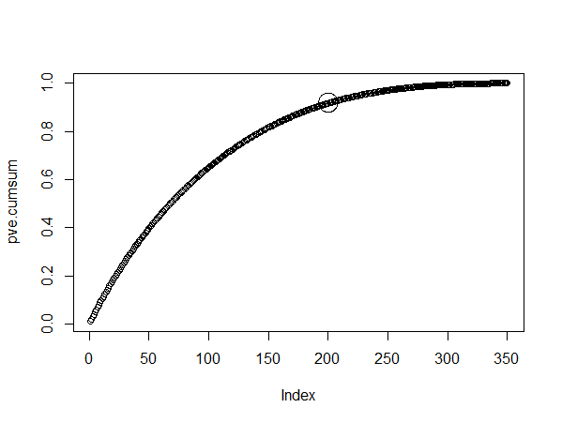
Principal Component Plots for Classification Data

Slide 7
Classification Models
“Proposed Neural Network as my final model for predicting ‘ynew’ using xnew”.
LDA was a very close competitor (as the input data is a gaussian distribution) but I thought NN can perform better this is a higher dimension dataset.
NN
LDA
KNN
RF
caret, and neuralnet libraries
75% and 25% split
Test Accuracy : 58%
I used MASS library
75% and 25% split
Test Accuracy : 54%
I used class library
75% and 25% split
Test Accuracy : 61%
I used randomForest library
75% and 25% split
Test Accuracy : 71%

Slide 8
“ After pre-processing the dataset, I built 4 models to perform the classification task and proposed Neural Networks as my final model owing to the dimension of the dataset. The details of the models can be found in the corresponding R file.”
Classification Conclusion

Slide 9
Setting (Clustering)
What?
How?
Identify trends.
Statistical Learning.
Capturing most variability and dimension reduction
Identifying clusters.
Building plots like scatter, plotrix.
Quantile analysis.
Performing principal component analysis and filtering important ones.
K means, Hierarchical, and GMM
Pre processing steps before clustering

Slide 10
Numbers
Input data of size: 1000, 784..
First 200 PC —> 91% variability.
80% of values below 50.
12% of values above 210.
Normal Distributions with means 0, 125, 220, 250.
3 clustering methods.

Slide 11
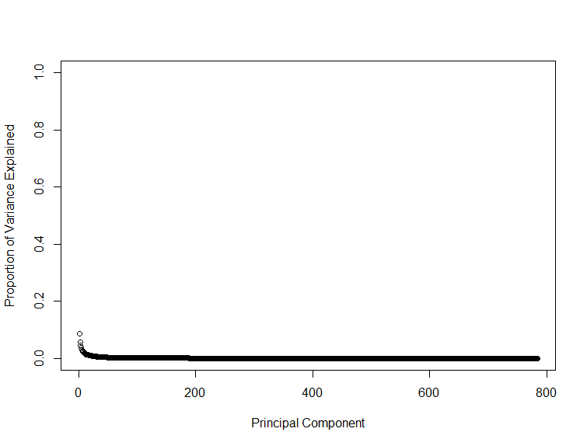
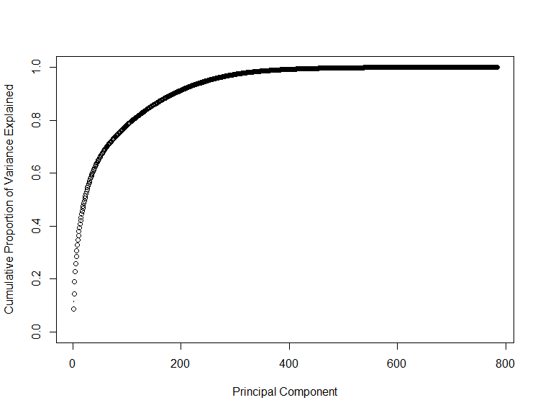
Principal Component Plots for Clustering Data

Slide 12
Clustering Models
“Proposed 4 clusters in the data set but a very good possibility of having 5 clusters”.
Dataset has bunch of normal distributions with mean around 0, 125, 220, 250 (models validated this).
K Means
Hierarchical
GMM
Used k-means method
Elbow method
Reduction stagnates after 5 clusters
Used hclust method.
Performed complete, single, and average linkages
Results close to kmeans.
Used mclust library
Checked for 4 and 5 clusters
Results similar to k-means and hierarchical

Slide 13
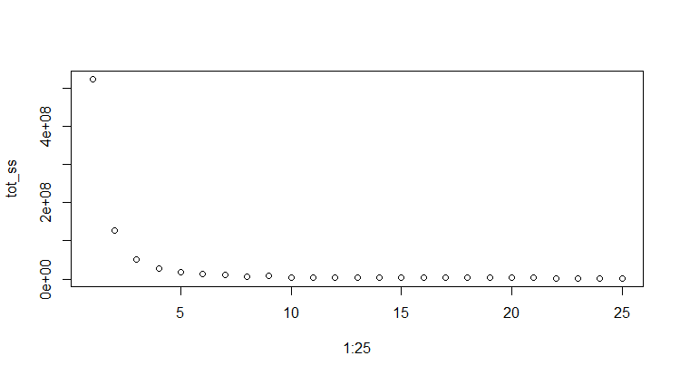
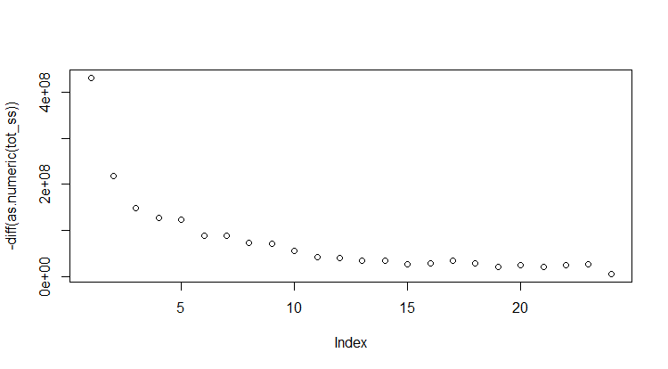
Sum of squares plot(s)

Slide 14
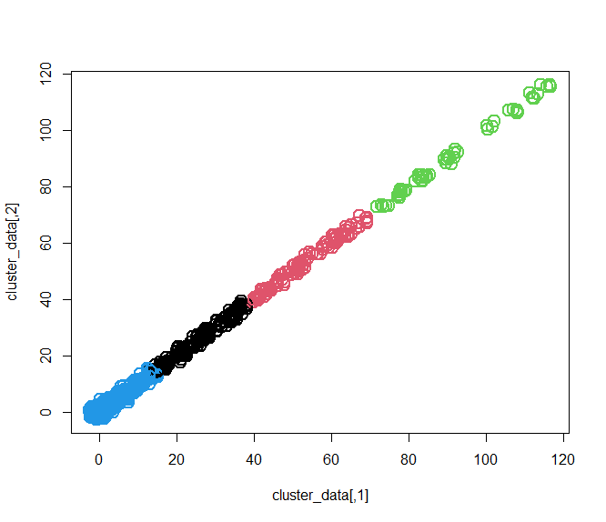
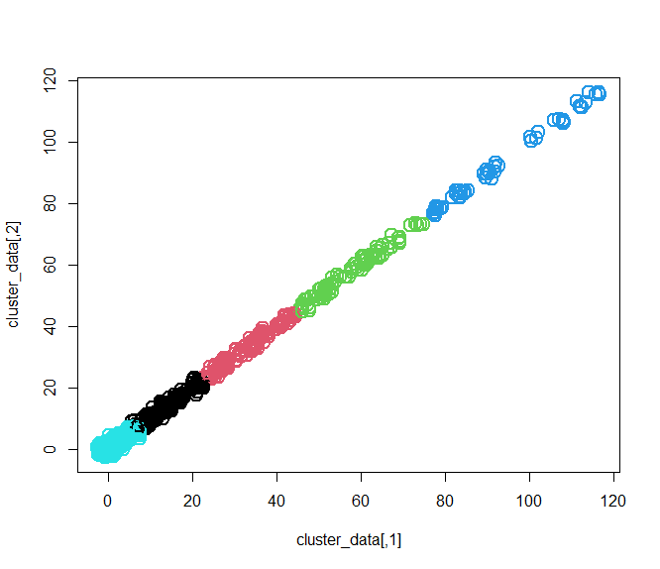
GMM plots

Slide 15
“ After pre-processing the dataset, I performed 3 methods to identify clusters. All the methods generated similar results and I validated this by doing some statistical analysis. The details of the models can be found in the corresponding R file.”
Clustering Conclusion

Slide 16
“ Following the guidelines I produced realistic results. However, the classification models can be improved and I will be working on improving the test accuracy of my models.”
Conclusion

