Slide 1
PROJECT REPORT on Car Price Prediction project
By Sreekari I

Slide 2
Overview
Business Objective
01
Data Exploration
02
Data Preprocessing
03
Modeling
04
Conclusions
05

Slide 3
Business Objective

Slide 4
Business Objective
INTRODUCTION:
With the covid 19 impact in the market, we have seen lot of changes in the car market. Now some cars are in demand hence making them costly and some are not in demand hence cheaper. With the change in market due to covid 19 impact, there are changes in the car price valuation.
OBJECTIVE:
To make a car price valuation model to predict the car price.

Slide 5
Data Exploration

Slide 6
Exploration - Overall
Data source
Data is collected from cardekho website. The details include the various features of the cars that are helpful to predict the price of the car.
Data Exploration
Shape of dataset (7000 rows, 14 columns) -[before removing Unnamed :o column]
Data issue – There are null values in Price, Kms driven, Engine displacement, RTO, Insurance type, Mileage, Max power and Torque columns.
Filled null values in Price, Kms driven, Engine displacement, Mileage, Max power and Torque columns with mean.
For RTO column, I have replaced null values with ‘NA’.
Shape of dataset –[after removing the null values and columns that are not useful in model creation]
6994 rows, 13 columns

Slide 7
Dataset Variables
There are 6 columns of float type and 7 columns of object datatype.
Datatype Object
'Name’, 'Year’, 'Fuel’, 'RTO’, 'No Of Owners’, 'Transmission’, 'Insurance Type’,
Datatype float64
'Mileage’, 'Max Power’, 'Torque’ , 'Price(in Rs.)’, 'Engine Displacement’, 'No Of Owners’, 'KMs Driven’,

Slide 8
Data Pre-Processing

Slide 9
Handling null values:
There are null values in Price, Kms driven, Engine displacement, RTO, Insurance type, Mileage, Max power and Torque columns.
I have dropped the null values in Insurance type since there are only 6 null values.
I have filled null values in Price, Kms driven, Engine displacement, Mileage, Max power and Torque columns with mean.
For RTO column, I have replaced null values with ‘NA’.
Now, we have removed all the null values. The shape of the data after removing null values in 6994 rows and 13 columns.

Slide 10
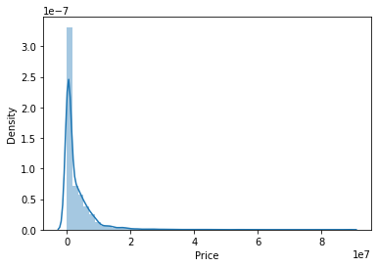
We can see the Price column distribution from the below distplot

Slide 11
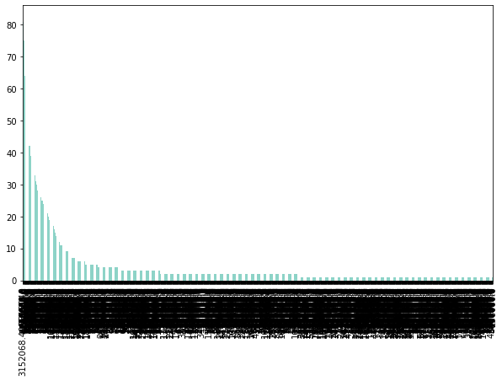
The below image is the barplot showing the number of cars available in various price range.

Slide 12
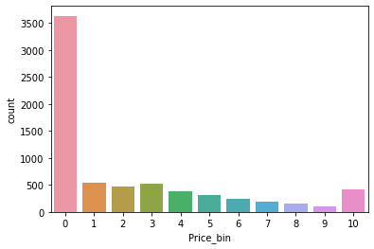
I have created bins(0-10) for Price less than 1000000 as bin-0, 1000000-2000000 as bin-1 and so on till 9000000-10000000 as bin-9 and price above 10000000 as bin-10.

Slide 13
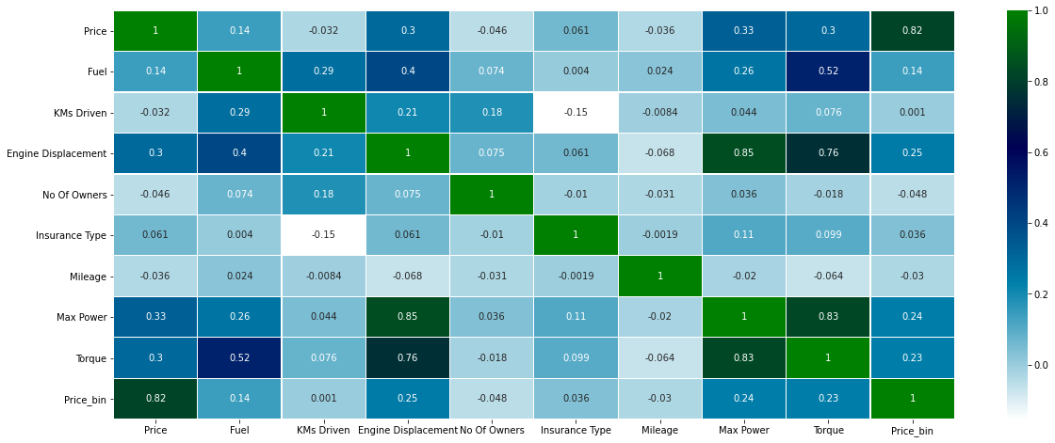
The below image is the heat map. We can see the correlation between the columns of the dataset with this heat map.

Slide 14
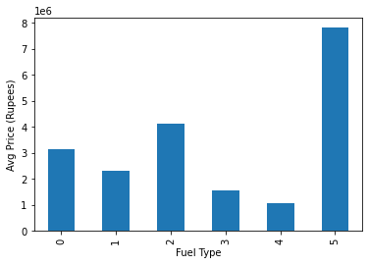
We can see how the fuel type and Price are related to each other from the below image.

Slide 15
Model Creation
Firstly, divide the data into X and y sets for the model building. Next, splitting the data into training and test data test.
Next, split the data into training and test data test. We specify this so that the train and test data set always have the same rows, respectively.
Now, we can move to building the models. I have used linear regression model and random forest model and applied hyper parameter tuning using grid search cv on random forest model.

Slide 16
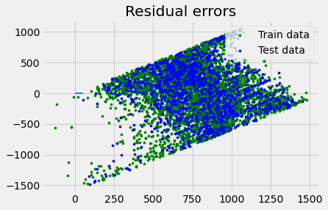
LINEAR REGRESSION MODEL
Accuracy is 75.05.
Regression Coefficients are [ 3.57174617e+01 2.97252817e+01 -8.95962500e-03 -1.10160589e-01 -2.37282034e+01 -2.33252153e-02 1.06051891e+00 -2.74244380e+00
5.02138530e-01 9.39486536e-02 -1.90581270e+00 4.69114244e+01 -1.54695821e+00]
Variance score: 0.27136831275125595
Regression intercept : 160.20766244703452

Slide 17
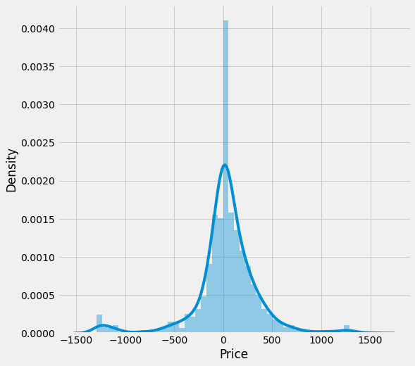
RANDOM FOREST MODEL
RandomForestClassifier(max_depth=5, n_jobs=-1, oob_score=True, random_state=42)
OOB Score: 0.08954423592493298
Grid search best score: 0.2865039508089265
MAE: 204.64403145103645
MSE: 110955.76626161544
RMSE: 333.1002345565302

Slide 18
CONCLUSION
From the above analysis we can see that various features of the cars affect the price of the cars. If it has more features, the price of the car will be more when compared to the car with less number of features. So the car price can be predicted based on these factors.

Slide 19
THANK YOU..!!!

