Slide 1
Ratings Prediction Project
By Sreekari I

Slide 2
Overview
Business Objective
01
Data Exploration
02
Data Preprocessing
03
Modeling
04
Conclusions
05

Slide 3
Business Objective

Slide 4
Business Objective
INTRODUCTION:
We have a client who has a website where people write different reviews for technical products. Now they are adding a new feature to their website i.e. The reviewer will have to add stars(rating) as well with the review. The rating is out 5 stars and it only has 5 options available 1 star, 2 stars, 3 stars, 4 stars, 5 stars. Now they want to predict ratings for the reviews.
So, we have to build an application which can predict the rating by seeing the review
OBJECTIVE:
Predict a product ratings for the reviews which were written in the past and they don’t have a rating.

Slide 5
Data Exploration

Slide 6
Exploration - Overall
Data source
Data is collected from reviews and rating of various products like phones, laptops, headphones, monitors, watches etc from www.amazon.in
Data Exploration
Shape of dataset (20,000 rows, 3 columns) -[before removing Unnamed :o column]
Data issue 1 – Null values in Product_Reviews
Replaced with ‘No Review’
Data issue 2 - Unnamed :0 column
Removed this column as it is not useful in data modelling
Shape of dataset –[after removing the columns that are not useful in model creation]
20,000 rows, 2 columns

Slide 7
Dataset Variables
Product_Rating – Continuous (Range = 1.0 to 5.0)*
Product_Reviews – String
length – integer
(This columns was added to know the length of the review)

Slide 8
Data Pre-Processing

Slide 9
No. of ratings (in each rating range 1.0 to 5.0)
Rating | No. of Ratings
1.0 | 4665
2.0 | 1379
3.0 | 2229
4.0 | 4169
5.0 | 7558

Slide 10
Visualizing the Most Frequent Words in all rating ranges

Slide 11
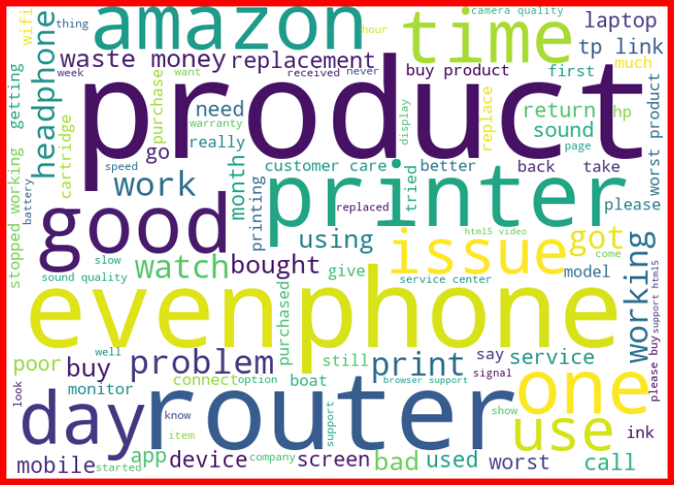
Loud words in Rating 1.0
1

Slide 12
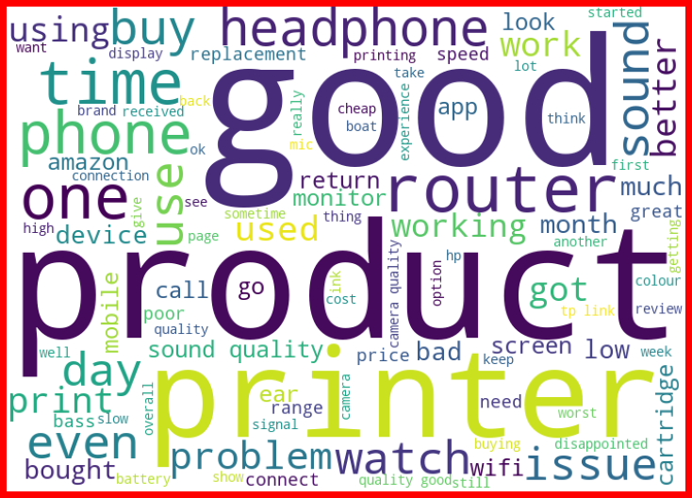
Loud words in Rating 2.0
2

Slide 13
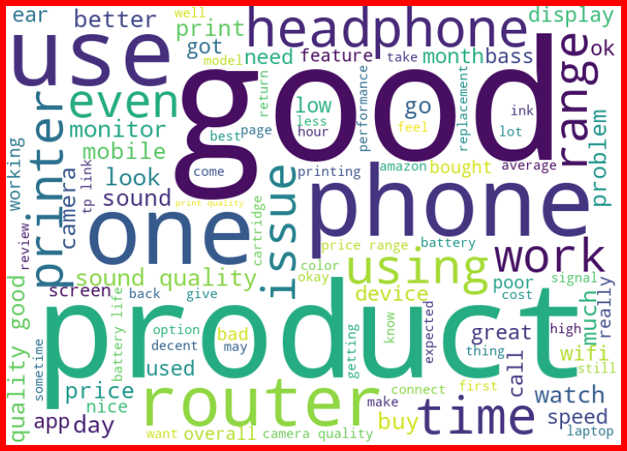
Loud words in Rating 3.0
3

Slide 14
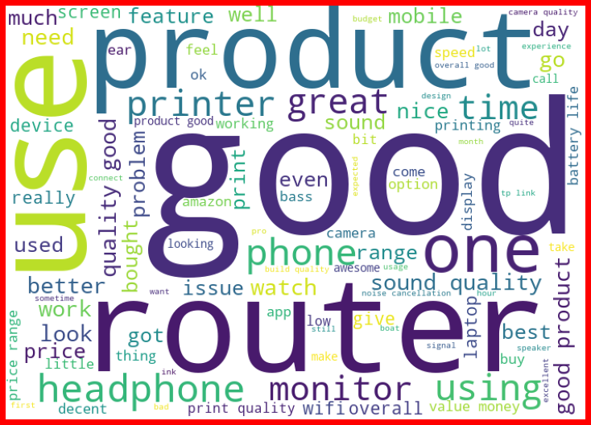
Loud words in Rating 4.0
4

Slide 15
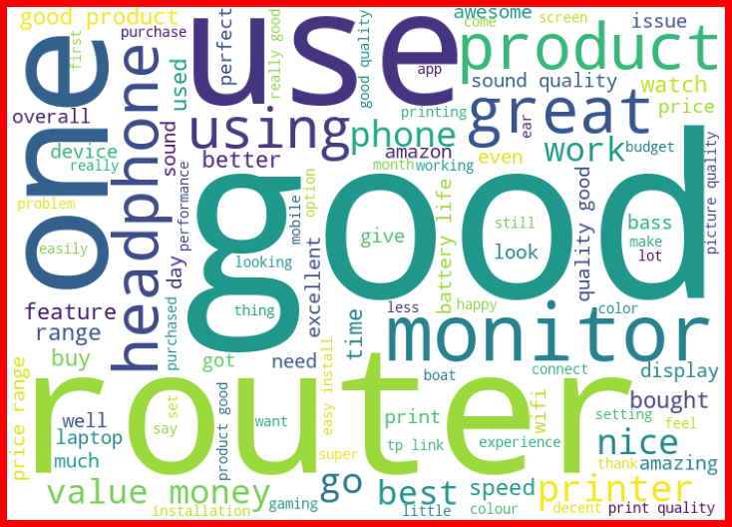
Loud words in Rating 5.0
5

Slide 16
NLTK
Data required cleaning -> converted text to lowercase, removed stop words, punctuation, special characters
# Remove punctuation
data_ratings['Product_Review’] = data_ratings['Product_Review'].str.replace(r'[^\w\d\s]', ' ‘)
# Replace whitespace between terms with a single space data_ratings['Product_Review'] = data_ratings['Product_Review'].str.replace(r'\s+', ' ‘)
# Remove leading andtrailing whitespace data_ratings['Product_Review'] = data_ratings['Product_Review'].str.replace(r'^\s+|\s+?$', ' ')

Slide 17
# Removing stop words
import string
import nltk from nltk.corpus
import stopwords stop_words = (stopwords.words('english’))
data_ratings['Product_Review'] = data_ratings['Product_Review'].apply(lambda x: ' '.join(
term for term in x.split() if term not in stop_words))

Slide 18


Preprocessing Models
Scikit-learn’s count vectorizer
1. Sentences into numerical features
2. TD-IDF to determine importance of each word
Word2Vec
1. 1-layer neural network predicting probability words appear near each other
2. Extract word embeddings (weights in hidden layer)
3. Constructed the feature matrix using the mean of each word’s vector
Notes:
We took two different approaches to preprocessing in order to clean the data

Slide 19
Modeling

Slide 20
Model Overview
Naive Bayes, KNN, Linear SVM
Scikit Learn models were tuned with a 3 fold gird search
Models were evaluated on their training data using 3 fold & 10 fold cross validation

Slide 21
Models Performance

Slide 22
Naive Bayes Model
precision recall f1-score support
1.0 0.70 0.74 0.72 1197
2.0 0.00 0.00 0.00 353
3.0 0.00 0.00 0.00 551
4.0 0.40 0.02 0.05 997
5.0 0.50 0.97 0.66 1902
accuracy 0.55 5000
macro avg 0.32 0.35 0.28 5000
weighted avg 0.44 0.55 0.43 5000

Slide 23
KNN Model
precision recall f1-score support
1.0 0.68 0.08 0.14 1197
2.0 0.80 0.11 0.19 353
3.0 0.16 0.31 0.21 551
4.0 0.27 0.28 0.28 997
5.0 0.42 0.61 0.50 1902
accuracy 0.35 5000
macro avg 0.47 0.28 0.26 5000
weighted avg 0.45 0.35 0.32 5000

Slide 24
Linear SVC Model
precision recall f1-score support
1.0 0.71 0.71 0.71 1197
2.0 0.40 0.34 0.37 353
3.0 0.42 0.36 0.39 551
4.0 0.46 0.44 0.45 997
5.0 0.68 0.75 0.71 1902
accuracy 0.61 5000
macro avg 0.54 0.52 0.53 5000
weighted avg 0.60 0.61 0.60 5000

Slide 25
Conclusions

Slide 26



Results
We can see that the Linear SVC model performed well when compared to other two models and is expected to perform well in predicting the ratings for reviews.
In order to improve the model more training data should be acquired, particularly in the under represented classes.

