Slide 1




MedBot-An NLP based ChatBot for Diabetes Prediction
Research Methodology Review - 1
ASWIN V CB.SC.P2AIE23001
cb.sc.p2aie23001@cb.students.amrita.edu
SREEKAR K CB.SC.P2AIE23004
cb.sc.p2aie23004@cb.students.amrita.edu
VISHNU NARAYANAN S CB.SC.P2AIE23015
cb.sc.p2aie23015@cb.students.amrita.edu
T. Senthil Kumar, Amrita School of Engineering, Amrita Vishwa Vidyapeetham,
Coimbatore, India, t_senthilkumar@cb.amrita.edu
GITHUB URL: https://github.com/sreekark99/MedBot_Amrita

Slide 2
Group Members and Contribution
NAME | ROLL NUMBER | CONTRIBUTION
ASWIN V | CB.SC.P2AIE23001 | Abstract, Introduction, Motivation, Literature Review, Methodology, Results and Discussion, Conclusion and Future scope.
SREEKAR K | CB.SC.P2AIE23004 | Abstract, Introduction, Motivation, Literature Review, Methodology, Results and Discussion, Conclusion and Future scope.
VISHNU NARAYANAN S | CB.SC.P2AIE23015 | Abstract, Introduction, Motivation, Literature Review, Methodology, Results and Discussion, Conclusion and Future scope.

Slide 3
Agenda
Introduction
Literature survey
Challenges
Methodology
Problem Statement
Motivation
Dataset description
Model Design
Data analysis
ML model
DL model
Explainable AI
Conclusion
Future Enhancement

Slide 4
Introduction
Diabetes, a chronic condition affecting millions globally, arises from disruptions in insulin production or its effectiveness in regulating blood glucose levels. Insulin, released by the pancreas, plays a crucial role in utilizing sugars and fats from food. When the pancreas fails to produce sufficient insulin or the body becomes resistant to its effects, diabetes ensues. With a staggering 366 million cases worldwide, including 77 million in India alone, diabetes demands constant attention for those diagnosed.
Dr. Michael Dansinger emphasizes the vital role of insulin, which maintains blood glucose levels by facilitating the transport of glucose to cells. Failure in this process leads to diabetes, diagnosed when fasting blood glucose exceeds 126 mg/dL. The condition is classified into types, including type-1 with absent beta-cells requiring insulin, type-2 marked by insufficient insulin absorption, prediabetes indicating elevated glucose, and gestational diabetes during pregnancy. Early detection is pivotal to prevent severe complications. This paper aims to delve into dataset preparation, preprocessing, feature selection, and classification techniques, emphasizing the significance of timely diagnosis for effective treatment and overall well-being.

Slide 5
List of Products similar to this project
APPLICATION NAME | URL
Healthily | https://www.livehealthily.com/
ADA | https://ada.com/
Florence | https://florence.chat/

Slide 6
List of Research Labs
Name of the lab​ | URL​ | Name of the Professor​ | Institute​ | Country​
Health Informatics Centre​ | https://ki.se/en/lime/health-informatics-centre-hic​ | Prof. Gunnar Cedersund​ | ​Karolinska Institutet | Sweden​
​Department of Biomedical Informatics | https://www.dbmi.columbia.edu/​ | ​Dr. George Hripcsak | ​Columbia University | United States​
​Department of Computer Science | https://warwick.ac.uk/fac/sci/dcs/​ | Prof. Artur d'Avila Garcez​ | University of Warwick​ | United Kingdom​
Diabetes Technology Research Group | https://shorturl.at/rDOY4 | Prof. David O'Neal | University of Melbourne | Australia

Slide 7
Acknowledgement
Amrita Viswa Vidyapeetham’s faculty and the research lab – Multicore Ware Academia Global Innovation Centre (MAGIC) at Amrita School of Computing, Coimbatore campus, Amrita Vishwa Vidyapeetham University India
We thank the team for providing the necessary infrastructure for carrying out the work

Slide 8
Literature Survey

Slide 9
Ref No. | Dataset | Algorithm | Methodology | Research Gap
[3] | Manually curated clinical and ethnographic data pertaining to population in Africa and US | A thorough review is presented analyzing various attributes that pose a challenge in diagnosing Type 1 diabetes. | The review synthesized evidence to aid in diagnosing type 1 diabetes (T1D) across various ethnic groups, emphasizing the importance of correct classification for identifying etiologies, developing specific prevention strategies, and addressing challenges in interpreting commonly used diagnostic results for diabetes types. | The paper's research gap is the need for a thorough analysis and synthesis of the available data to enhance Type 1 Diabetes (T1D) diagnosis across a range of ethnic groups. This analysis should concentrate on resolving difficulties in interpreting commonly used diagnostic results and highlighting the significance of early identification to reduce the morbidity associated with postponed insulin treatment.
[4] | Drug Review Dataset from the University of California | Latent Dirichlet Allocation (LDA), Support Vector Machine (SVM), Artificial Neural Network (ANN), Logistic Regression | The study utilized publicly-available data from medicine review websites, employing lexicon-based sentiment analysis, unsupervised machine learning (LDA) for topic identification, and three supervised machine learning algorithms (regularized logistic regression, SVM, ANN) to predict drug review sentiments, presenting reproducible code for broader application. | The paper's research gap is the need for more investigation and improvement of natural language processing (NLP) techniques applied to unstructured medical text data, particularly in enhancing the efficacy of supervised machine learning algorithms for sentiment analysis of drug reviews and tackling the difficulties involved in predicting drug ratings in a variety of datasets gathered from various sources. This will help to advance the field's practical and repeatable methodologies.
[9] | PIMA Indian Diabetes Dataset | ANNs, Decision Trees, Naïve Bayes and DL Networks. | The study employed diverse machine learning algorithms, including Artificial Neural Network (ANN), Naive Bayes (NB), Decision Tree (DT), and Deep Learning (DL), utilizing the PIMA dataset to develop a methodology for diabetes prediction, with DL demonstrating the highest accuracy of 98.07%. | To improve the precision and efficacy of early detection and prognosis tools, the research gap in the report focuses on the necessity of more research into the integration of varied data types, such as omics data, in machine learning algorithms for diabetes prediction.

Slide 10
[10] | Diabetes data from 2009–2012 derived from the National Health and Nutrition Examination Survey (NHANES) | Logistic regression (LR), Naïve Bayes (NB) , Decision Tree (DT), AdaBoost (AB), and Random Forest (RF) | The study utilized logistic regression (LR) for identifying diabetes risk factors, adopted four classifiers (naïve Bayes, decision tree, Adaboost, random forest) to predict diabetic patients, employed three partition protocols (K2, K5, K10) in 20 trials, and evaluated model performance based on accuracy (ACC) and area under the curve (AUC) using a diabetes dataset from the National Health and Nutrition Examination Survey. | The paper's research gap is the need for additional investigation and improvement of machine learning-based systems for diabetes prediction, with an emphasis on finding the best combinations of classifiers and feature selection strategies as well as resolving issues related to risk factor identification in order to improve the predictive models' overall applicability and accuracy.
[11] | PIMA Indian Diabetes Dataset | Naive Bayes classifier, random forest classifier, and J48 decision tree models | The study implemented an e-diagnosis system for diabetes using three interpretable supervised machine learning models (Naïve Bayes, random forest, J48 decision tree) trained and tested on the Pima Indians diabetes dataset in R, analyzing their performance in terms of accuracy, precision, sensitivity, and specificity, with a focus on refining feature selection for optimal model outcomes. | By highlighting the significance of interpretability and offering a comparative analysis of interpretable supervised ML models, the paper fills a research gap related to addressing the trust issues surrounding machine learning applications in healthcare, specifically in the context of diagnosing diabetes. However, it also leaves room for additional investigation and decision process refinement to improve overall model performance and acceptance within healthcare sectors.
[12] | Around 174,000 clinical notes were collected from Seoul National University Hospital outpatient clinic. | Random Forest (RF), Gradient Boosting Machine (GBM), and Extreme Gradient Boosting (XG-Boost). | The study utilized 174,427 clinical notes from the Seoul National University Hospital outpatient clinic, employing latent Dirichlet allocation (LDA) topic modeling to develop a machine-learning model predicting Diabetes Mellitus (DM) complications, where topics served as key features, and achieved acceptable predictive performance using extreme gradient boosting (XGBoost) with F1 scores for diabetic retinopathy, diabetic nephropathy, nonalcoholic fatty liver disease, and cerebrovascular accident. | The study's research gap is the need for more investigation and development of machine learning models, particularly topic modeling like latent Dirichlet allocation (LDA), to forecast the development of complications related to diabetes mellitus (DM). This research should be focused on enhancing predictive performance and generalizability across different kinds of complications.

Slide 11
[13] | Kaggle EyePACS dataset with 35,126 retinal pictures has been used. | A new SE-ResCA-GTNet model is proposed and Gazelle Optimization (GO) algorithm is used to fine-tune the proposed classifier | The study employed publicly accessible fundus image datasets, including Kaggle's EyePACS, and real-time datasets to train and test a transformer network for automated classification of Diabetic Retinopathy (DR) stages, utilizing a D2_UNet approach for accurate segmentation of critical areas in pre-processed images, and proposing a new SE-ResCA-GTNet model fine-tuned with the Gazelle Optimization algorithm, achieving superior accuracy, recall, and f1-measures of 99.8%, 99.4%, and 99.3%, respectively, outperforming state-of-the-art methods. | The study's research gap is in the need for improved techniques and strategies for the early detection and classification of diabetic retinopathy (DR). These techniques should integrate transformer networks, precisely segment important features, and apply the Gazelle Optimization algorithm in order to outperform current state-of-the-art techniques and increase accuracy in diagnosing the disease's various severity levels.
[14] | A custom dataset has been garnerd from Reddit. The dataset contain comments of January, year 2015. The format of data is in JSON format. | BRNN with Attention model | The study employed Tensorflow's Neural Machine Translation (NMT) model, specifically Bidirectional Recurrent Neural Networks (BRNN) with attention layers, trained on a Reddit dataset for English to English translation, aiming to enhance perplexity and learning rate, evaluate Bleu Score for same-language translation, and conducted experiments on Tensorflow using Python 3.6, achieving perplexity, learning rate, Bleu score, and average time per 1000 steps of 56.10, 0.0001, 30.16, and 4.5, respectively, while exploring the performance on a MacBook Air system for neural network and deep learning. | The study fails to specifically identify and discuss the difficulties or constraints associated with using Bidirectional Recurrent Neural Networks (BRNN) with attention layers for an Assistant Conversational Agent. It also fails to address possible areas for future research and development related to Chat-Bot performance and English-to-English translation.
[15] | A survey based on electronic health records. | This paper explores all the existing methods used in this area | The study reviewed recent literature on the application of deep learning technologies in the health care domain, emphasizing their potential to handle complex and heterogeneous biomedical data without the need for extensive feature engineering, while acknowledging the need for improved methods development and the creation of interpretable architectures to facilitate understanding by domain experts and citizen scientists. | This paper's research gap is the need for better deep learning methods development and applications in the healthcare industry. It focuses on developing comprehensive and meaningful interpretable architectures to improve the bridge between human interpretability and deep learning models, and it addresses issues related to ease of understanding for domain experts and citizen scientists.

Slide 12
Conclusion for Literature Survey
Machine learning (ML) techniques play a significant role in diabetes classification. Diverse approaches include deep learning frameworks like Keras and PyTorch, as well as traditional methods such as decision trees and logistic regression.
Studies demonstrate the effectiveness of ML models in predicting diabetes based on various datasets. Emphasizes the importance of explainable AI for medical personnel's understanding.
Exploration of chatbots for medical applications showcases a shift from rule-based to neural network-based methodologies. Highlights the evolving nature of conversational agents in human-computer interaction.
Integration of sophisticated natural language processing and machine learning in chatbot development is discussed. It paves the way for personalized responses and improved user experiences.
Overall, the literature underscores the potential of ML and AI technologies in transforming healthcare, particularly in diabetes diagnosis and interactive medical applications.

Slide 13
Conclusion for Research Gap
Enhancing Type 1 Diabetes diagnosis across ethnic groups
Improving natural language processing techniques for sentiment analysis in drug reviews
Integrating varied data types for more precise diabetes prediction
Optimizing machine learning models for risk factor identification
Addressing trust issues in interpretable supervised ML models for diabetes diagnosis
Advancing predictive performance in forecasting diabetes-related complications
Refining techniques for early detection of diabetic retinopathy
Developing more robust deep learning methods to bridge the interpretability gap in healthcare applications

Slide 14
Methodology (Data Preprocessing)
The preprocessing methodology involves identifying and addressing inconsistent and erroneous zero-values in attributes such as 'Insulin', 'SkinThickness', 'Glucose', and 'BloodPressure' by imputing them with mean values calculated from non-zero instances, and strategically removing less significant features like 'BMI', 'SkinThickness', and 'Age' to enhance the dataset's integrity and streamline its focus for diabetes prediction.
Feature | Description | Data Type | Range
Pregnancies | Number of times the patient was pregnant. | Integer (64) | 0 – 17
Glucose | Blood-Glucose concentration in an oral glucose tolerance test (GTIT) for 2 hours. | Integer (64) | 0 – 199
BloodPressure | Blood Pressure (mm/Hg). | Integer (64) | 0 – 122
SkinThickness | Skin fold thickness measured at the triceps muscle (mm). | Integer (64) | 0 – 99
Insulin | Level of insulin in 2 hours during the Glucose test. | Integer (64) | 0 – 846
BMI | Weight of the person in kg / Height of the person in meters. | Float (64) | 0 – 67.1
DiabetesPedigreeFunction | The likelihood of a person getting diabetes based on his/her family history. | Float (64) | 0.078 – 2.42
Age | Age in years. | Integer (64) | 21 – 81
Outcome | A binary value representing if the person tested is diabetic positive or not. | Integer (64) | 0 – 1

Slide 15
Methodology (Algorithms)
Logistic Regression: Utilized for binary classification, particularly in diabetes prediction, due to its simplicity and interpretability.
Decision Trees: Provide an intuitive and interpretable approach, extending to medical diagnosis and risk assessment.
K-Means clustering explored alongside Convolutional Neural Networks (CNNs) to enhance convergence and performance in image classification tasks.
Integration of K-Means with K Nearest Neighbors (KNN): Establishes a robust classification technique, leveraging K-means for data grouping and KNN for classification within each cluster.
Fuzzy C-Means (FCM) clustering combined with KNN: FCM excels in creating fuzzy clusters, and KNN refines predictions based on nearby instances, providing accuracy and nuanced insights in classification tasks within each cluster.
Overall, the methodology involves a diverse combination of machine learning approaches tailored to address specific challenges and enhance predictive performance across various classification tasks.

Slide 16
Methodology (For Machine Learning models )
The methodology encompasses the application of various machine learning techniques for classification tasks. Logistic Regression is utilized for binary classification, specifically in diabetes prediction, due to its simplicity and interpretability.
Decision Trees provide an intuitive and interpretable approach, and their applications extend to medical diagnosis and risk assessment. K-Means clustering is explored in conjunction with KNN for improved pattern identification.

Slide 17
Challenges
Lack of light-weight models: Our application involves employing a prediction algorithm that will be further integrated with a Telegram based chat-bot. Hence, it is essential to have a light-weight model which is both efficient and easy to deploy. This would make the model more portable, also without hindering its efficacy.
Data Quality and Imbalance: The PIMA Indian Diabetes Dataset may have missing values or outliers that need careful handling. Additionally, the dataset might be imbalanced, with fewer instances of diabetic cases, which could impact the model's ability to generalize well.
Feature Selection and Relevance: Identifying the most relevant features for diabetes prediction from the dataset is crucial. Selecting the right set of features and understanding their impact on the prediction model is a challenge that requires domain knowledge.
Integration with Healthcare Systems: Seamless integration of the chatbot with existing healthcare systems and electronic health records poses a challenge. Ensuring that the chatbot complements rather than disrupts the healthcare workflow is crucial for widespread adoption.

Slide 18
Problem Statement
Develop a medical chatbot named "MedBot" utilizing the Telegram API to address user queries and provide predictions regarding diabetes risk. The chatbot will consist of two primary components
Query Resolution Component: Employ natural language processing (NLP) techniques to understand and respond to user inquiries regarding various medical topics. The chatbot will access a database containing relevant medical information to provide accurate and informative responses to user queries.
Diabetes Prediction Component: Utilize logistic regression and the Pima Indian Diabetes dataset to predict the likelihood of a user having diabetes based on input data provided by the user. The prediction model will analyze relevant health parameters such as Pregnancy, glucose, Blood Pressure, Insulin, DiabetesPedigreeFunction to provide a risk assessment for diabetes.
Scope: MedBot will handle general medical inquiries within its domain of expertise, including symptoms, treatments, and general health advice.
The chatbot will operate exclusively within the Telegram messaging platform, utilizing the Telegram API for user interaction.

Slide 19
Motivation
Accessibility to Medical Information:
Users need easy access to accurate medical information.
MedBot simplifies complex medical knowledge for users.
Timely Health Assistance:
Users often seek immediate health guidance and this MedBot can offer quick and convenient responses to health queries.
Diabetes Risk Assessment:
Early detection is crucial for managing diabetes.
MedBot's prediction component helps users assess their diabetes risk promptly.

Slide 20
Motivation
Dataset:
The PIMA Indian Diabetes dataset serves as a valuable resource in addressing real-world health challenges by predicting diabetes onset in women. Its relevance lies in the potential for early identification of individuals at risk, facilitating timely interventions. With diverse health-related features, the dataset poses a complex problem, making it a challenging benchmark for machine learning algorithms. The results obtained have direct applications in clinical settings, contributing to improved health outcomes. Moreover, the dataset aids in understanding the importance of different factors in diabetes prediction, serving as an educational tool and facilitating algorithm benchmarking. Easy accessibility enhances its widespread use in research and reinforces its significance in the development of predictive models for healthcare.

Slide 21
Dataset
The Pima Indian Diabetes dataset, originating from the National Institute of Diabetes and Digestive and Kidney Diseases, focuses on predicting the likelihood of diabetes in female patients of Pima Indian heritage who are at least 21 years old. The dataset includes specific diagnostic measurements, and various constraints were applied in selecting instances, such as the exclusive inclusion of females from the mentioned demographic. The dataset comprises both numerical and categorical features related to health, with the objective of predicting the onset of diabetes based on these factors.
● Pregnancies: Number of times pregnant.
● Glucose: Plasma glucose concentration.
● BloodPressure: Diastolic blood pressure.
● SkinThickness: Triceps skinfold thickness.
● Insulin: 2-Hour serum insulin.

Slide 22
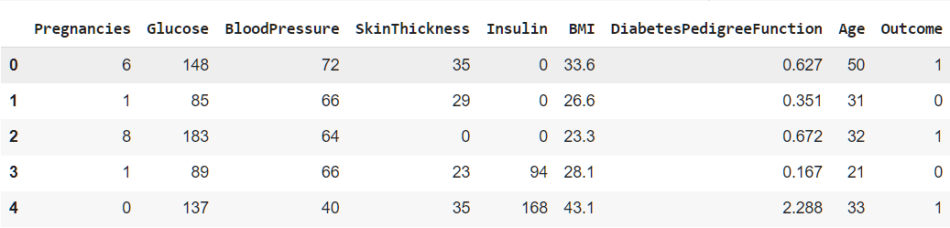
Dataset
● BMI (Body Mass Index): Weight in kg/(height in m)^2.
● DiabetesPedigreeFunction: A function that scores the likelihood of diabetes based on family history.
● Age: Age in years.
● Outcome: Binary variable indicating the presence or absence of diabetes (1 for diabetes, 0 for no diabetes).

Slide 23
Custom Dataset
To create a custom dataset for this project, one could collaborate with healthcare institutions or clinics to collect relevant health data from patients. The data collection process would involve obtaining consent from participants and gathering information such as glucose levels, BMI, age, family history of diabetes, lifestyle factors, etc. This data could be anonymized to ensure patient privacy and confidentiality.
Data cleaning : Clean the data by handling the missing values and make sure that the data is suitable for analysis and modelling
Labelling and splitting : If the dataset was not labelled we need to label the data . Split the datasets into training and testing sets.
Data Exploration: Explore the dataset to gain insights into the distribution of features, correlations, and any patterns that may be relevant to predicting diabetes.

Slide 24
Justifications of Dataset
The PIMA Indian Diabetes Dataset holds significant relevance in the realm of healthcare and data-driven research due to its focus on diabetes, a widespread chronic condition with global health implications. Compiled from the PIMA Indian community, the dataset provides valuable insights into the factors influencing diabetes prevalence, especially in populations with a higher genetic predisposition. This dataset stands out for its inclusion of various health-related features such as glucose levels, blood pressure, and body mass index, offering a comprehensive profile for analysis. Its contribution extends beyond basic prediction tasks, fostering a deeper understanding of the complex interplay between genetic, lifestyle, and environmental factors in diabetes onset. As a result, the PIMA dataset serves as a pivotal resource for developing and refining predictive models, guiding healthcare interventions, and informing public health strategies aimed at mitigating the impact of diabetes on vulnerable populations.

Slide 25
Citations of Papers using this Dataset
Abedini, M., Bijari, A., & Banirostam, T. (2020). Classification of Pima Indian diabetes dataset using ensemble of decision tree, logistic regression and neural network. international Journal of Advanced Research in Computer and Communication Engineering, 9(7), 1–4. https://doi.org/10.17148/ijarcce.2020.9701
Classifcation and prediction of diabetes disease using machine learning paradigm Md. Maniruzzaman1,2*, Md. (n.d.). In Jahanur Rahman2 , Benojir Ahammed1 and Md. Menhazul Abedin1.
Classification of Pima Indian Diabetes Dataset using Ensemble of Decision Tree, Logistic Regression and Neural Network Mani Abedini General Electric. (n.d.).
Deep learning approach for diabetes prediction using PIMA Indian dataset Huma Naz1 & Sachin Ahuja1. (n.d.).
Knowler, W. C., Pettitt, D. J., Savage, P. J., & Bennett, P. H. (1981). Diabetes incidence in Pima indians: contributions of obesity and parental diabetes. American Journal of Epidemiology, 113(2), 144–156. https://doi.org/10.1093/oxfordjournals.aje.a113079
Pima Indians diabetes mellitus classification based on machine learning (ML) algorithms Victor Chang1 • Jozeene Bailey2 • Qianwen Ariel Xu2 • Zhili Sun3. (n.d.).

Slide 26
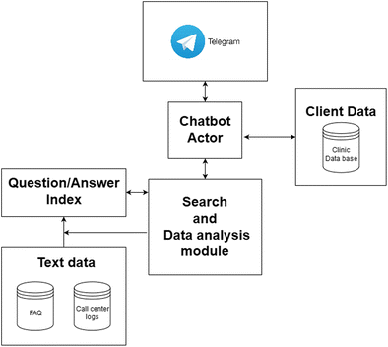
Model Design

Slide 27
Model Design
In the realm of developing a medical chatbot, the standardization of data plays a crucial role in ensuring fair consideration of diverse health-related features. Its main objective is to prevent health parameters with larger numerical values from having a disproportionate influence on the chatbot compared to those with smaller values. Z-score standardization, a specific method, transforms health attribute values into standard scores, effectively centering the data around a mean of 0 and a standard deviation of 1. This normalization process establishes a solid foundation for unbiased model training and guarantees that all health features contribute equally to the learning process.
To thoroughly evaluate the performance of the medical chatbot, I employ K-fold Cross Validation. This technique involves dividing the health dataset into k subsets, training the chatbot iteratively on k-1 subsets, and assessing its performance on the remaining subset. For model training, I explore various classification algorithms suitable for medical data, such as Support Vector Machines (SVM), Logistic Regression, and k-nearest Neighbors (KNN). Each algorithm brings unique strengths to the medical chatbot, contributing to a well-rounded and adaptable predictive model specifically designed for healthcare applications.

Slide 28
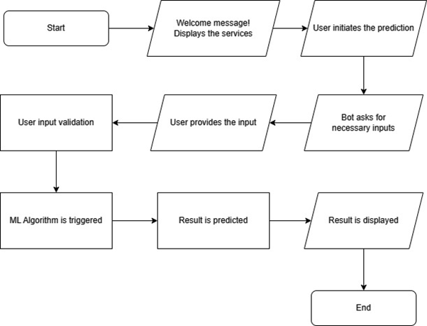
Model Design
To measure the effectiveness of the trained medical chatbot, I utilize a range of performance metrics, including accuracy, recall, and validation accuracy. This comprehensive evaluation approach provides a thorough understanding of the chatbot's proficiency in different aspects of health-related classification. By employing this robust evaluation approach, we ensure that the medical chatbot is not only accurate but also reliable across various health scenarios, thereby enhancing its potential in supporting healthcare professionals and improving patient interactions.

Slide 29
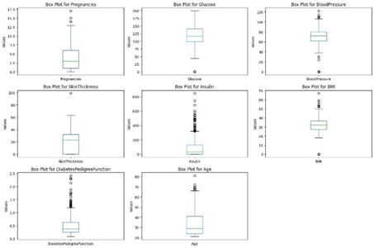
Data Preprocessing
Effective preprocessing methods are essential for improving diabetes detection systems' accuracy. The main preprocessing procedures—Noise Identification and Handling, Zero-Value imputation, Outlier Analysis.
It was observed that the ML models performed well when few features namely - ‘Age’, ‘BMI’, and ‘SkinThickness’ were dropped from the input dataset. So, these features were dropped to obtain a better, higher accuracy with reliable results.
Outlier Analysis
When we plot a box-whisker plot, as in Figure 2, we can see that there are some outliers that need to be handled, which generally would be zero-values or missing values

Slide 30
Data Preprocessing
Noise Identification and Handling
Likewise, some features like as 'BMI', 'SkinThickness', and 'Age' may not significantly contribute to the predictive task at hand or may introduce unnecessary noise into the modeling process. As a result, these attributes are strategically removed from the dataset using the
'drop' function in the pandas library.
Zero-Value imputation
This dataset has no records having missing or null values, however it has some inconsistent values corresponding to features such as 'Insulin', 'SkinThickness', 'Glucose', and 'BloodPressure'. It has some zero-values instances which are practically erroneous. Instances where such values are zero are identified and replaced with the mean value corresponding to that feature calculated from non-zero instances.
Normalization
Normalization methods that are used in this study to change feature values to a particular range. As we have numerical features corresponding to different feature, we normalized it to avoid any unwanted bias over any feature

Slide 31
Machine Learning Models
Classification Models :
Logistic Regression
Decision Trees
K-Means Clustering with KNN
Fuzzy C-Means with KNN
Algorithm Name | Student contributed
Logistic Regression , K-Clustering with KNN, Fuzzy C-Means with KNN Decision Trees | CB.SC.P2AIE23001
Logistic Regression , K-Clustering with KNN, Fuzzy C-Means with KNN Decision Trees | CB.SC.P2AIE23004
Logistic Regression , K-Clustering with KNN, Fuzzy C-Means with KNN Decision Trees | CB.SC.P2AIE23015

Slide 32
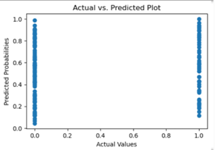
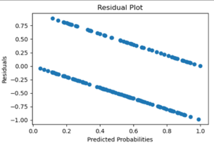
Logistic Regression
Parameter Name | Purpose | Value
Penalty | Specifies the type of regularization to be applied. 'l2' refers to L2 regularization | 12
C | Inverse of regularization strength. Smaller values of C result in stronger regularization. | 1.0
Random State | Provides seed for random number generation. | None
max_iter | Maximum number of iterations taken for the solvers to converge. | 100

Slide 33
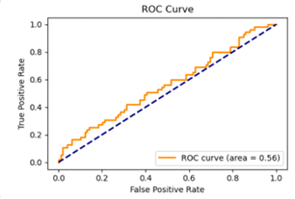
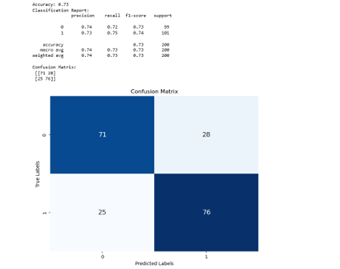
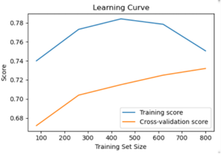
Logistic Regression
Parameter Name | Purpose | Value
Precision | measures the proportion of true positives among all positive predictions. | 0.77(0), 0.71(1)
Recall | measures the proportion of true positives among all actual positive instances. | 0.67(0), 0.80(1)
F1 Score | is the harmonic mean of precision and recall. | 0.71(0), 0.75(1)
Accuracy | measures the proportion of correct predictions among all predictions. | 0.73

Slide 34
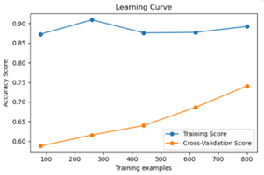
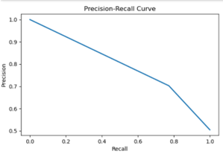
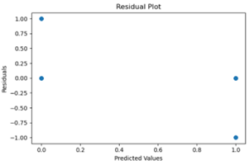
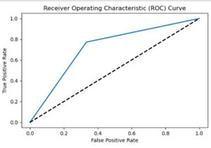
Decision Trees
Parameter Name | Purpose | Value
Test size | To split the dataset into training and testing in a ratio | 0.2
Random State | This parameter sets the seed for the random number generator used by the data splitter. By using a fixed seed, the random splitting process becomes deterministic, allowing for result reproducibility. | 42
Grid Search CV | The grid search explores various alpha values using 5-fold cross-validation. | 5-fold cross-validation
Accuracy | Accuracy is a metric that measures how often a machine learning model correctly predicts the outcome | 0.72

Slide 35
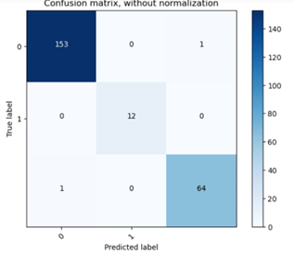
K-means with KNN
Hyperparameter Tuning approach used:
Parameter Name | Purpose | Value
Test size | To split the dataset into training and testing in a ratio | 0.3
Random State | This parameter sets the seed for the random number generator used by the data splitter. By using a fixed seed, the random splitting process becomes deterministic, allowing for result reproducibility. | 42
No. of Clusters | Number of the centroid which will be formed | 3
No. of Neighbors | Its specifies the number of neighbors to consider when making predictions for a data point | Sqrt (no of clusters)
Accuracy | Accuracy is a metric that measures how often a machine learning model correctly predicts the outcome | 0.99

Slide 36
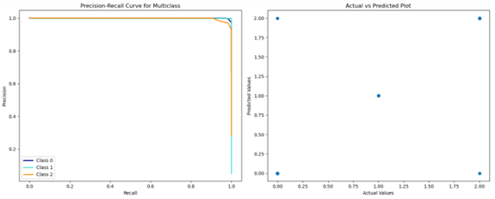
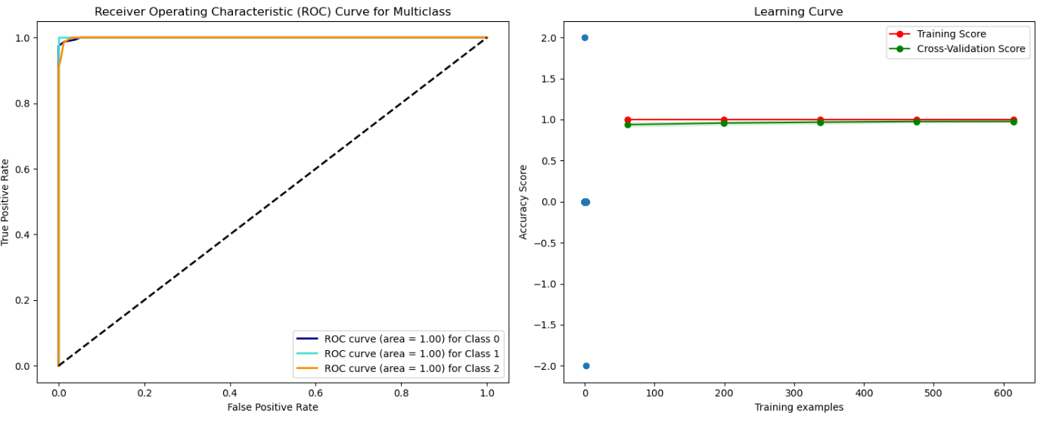
K-means with KNN

Slide 37
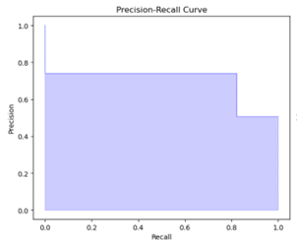
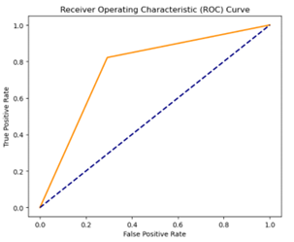
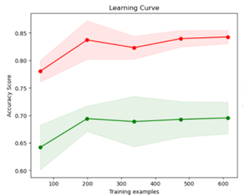
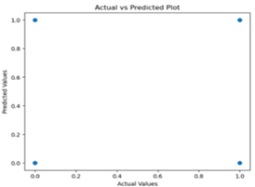
Fuzzy C-means with KNN
Hyperparameter Tuning approach used: Grid Search CV
Parameter Name | Purpose | Value
Test size | To split the dataset into training and testing in a ratio | 0.2
Random State | This parameter sets the seed for the random number generator used by the data splitter. By using a fixed seed, the random splitting process becomes deterministic, allowing for result reproducibility. | 42
No. of Clusters | Number of the centroid which will be formed | 2
Grid Search CV | The grid search explores various alpha values using 5-fold cross-validation. | No
Accuracy | Accuracy is a metric that measures how often a machine learning model correctly predicts the outcome | 0.76

Slide 38

Deep Learning Models
Deep Learning Models :
CNN
Ensemble Learning Algorithms with Deep Learning:
K-Means Clustering with CNN
Algorithm Name | Student contributed
K-Means Clustering with CNN | CB.SC.P2AIE23001
K-Means Clustering with CNN | CB.SC.P2AIE23004
K-Means Clustering with CNN | CB.SC.P2AIE23015

Slide 39
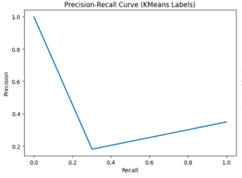
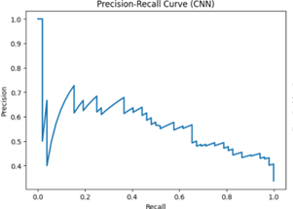
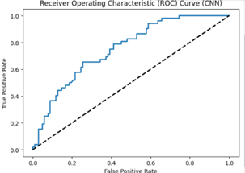
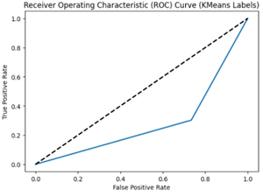
K-means with CNN
S. No | Parameter Name | Value
1 | Epochs | 50
2 | Accuracy | 72.07%
3 | Precision | 77%
4 | Recall | 83%
5 | F1 Score | 80%
6 | Confusion Matrix | [[85, 17][26, 26]]
7 | Grid Search CV | No-

Slide 40
Model Comparision Table
Model | Split-Ratio | Accuracy | Precision
Logistic Regression | 80:20 | 0.76 | 0.70
Decision Trees | 80:20 | 0.72 | 0.70
K-Means Clustering with CNN | 80:20 | 0.72 | 0.71
K-Means Clustering with KNN | 70:30 | 0.99 | 0.99
Fuzzy C-Means with KNN | 80:20 | 0.76 | 0.74

Slide 41
Split Ratio of the Dataset
Training set : 80%
Test Set:20%
The dataset has been split into training and test set. We have also employed K-Fold Cross-validation to get the best possible split of the dataset.

Slide 42
EMIC Analysis
EMIC Analysis:
In the context of a diabetes prediction project, an EMIC analysis would involve understanding the perspectives and experiences of individuals within the target population (e.g., individuals at risk of or diagnosed with diabetes from the PIMA Indian community).
Researchers would seek to explore how the community itself defines and perceives diabetes, its risk factors, and the impact of the condition on daily life. This may involve conducting interviews, surveys, or focus group discussions within the community to gather qualitative data.
The goal is to incorporate the local, cultural, and individual nuances related to diabetes, ensuring that the predictive model and any subsequent interventions are sensitive to the unique context of the PIMA Indian community.

Slide 43

ETIC Analysis
ETIC Analysis:
On the other hand, an ETIC analysis would involve an external, objective examination of diabetes and its predictors using standardized, scientific criteria and measurements. This may include analyzing the dataset using established biomedical indicators such as blood glucose levels, BMI, blood pressure, and genetic markers.
Researchers would apply existing medical knowledge and global health standards to identify risk factors and patterns associated with diabetes. The focus here is on universal, objective criteria that are applicable across different populations.
The ETIC perspective ensures that the analysis and predictive model align with broader medical and scientific understanding, allowing for generalizability and comparison with findings from other populations.

Slide 44
Explainable AI
Explainable AI (XAI) can significantly enhance the utilization of machine learning (ML) and deep learning (DL) techniques for predicting diabetes, especially when implemented within a system such as a chat-bot that utilizes logistic regression. XAI is very important in the context of a proposed Logistic Regression-based Natural Language Processing (NLP) chat-bot to forecast diabetes, since it can greatly improve the system's efficacy and user acceptability. Here's how XAI may be used to enhance user engagement and the chat-bot's prediction abilities.
The chat-bot can provide clear and understandable forecasts, explaining to customers the reasoning behind risk evaluations based on variables such as age, body mass index, and family history. Furthermore, XAI helps determine which characteristics have the most influence on diabetes risk, enabling users to rank health indicators for follow-up and treatment. Through the identification of biases and mistakes, XAI guarantees accuracy and fairness across a range of user demographics, promoting confidence and openness in the chat-bot's decision-making process. Additionally, by including users in the prediction process and offering insightful explanations, XAI encourages user involvement and increases trust and adherence to the chat-bot's suggestions. XAI makes it easier to continuously develop models by integrating fresh insights and user feedback, which eventually improves prediction accuracy. By offering open and responsible AI systems, protecting user privacy, and encouraging ethical AI activities, XAI guarantees regulatory compliance and ethical concerns.

Slide 45
Results
We elucidate the relative performances of the applied Machine Learning and Deep Learning models by comparing them using various standard metrics. We have considered some key metrics like accuracy and precision, but also focused on the ease of deployment of the models. As the application needs to be portable, the model would have a trade-off between portability and model complexity.
Model | Split-Ratio | Accuracy | Precision
Logistic Regression | 80:20 | 0.76 | 0.70
Decision Trees | 80:20 | 0.72 | 0.70
K-Means Clustering with CNN | 80:20 | 0.72 | 0.71
K-Means Clustering with KNN | 70:30 | 0.99 | 0.99
Fuzzy C-Means with KNN | 80:20 | 0.76 | 0.74

Slide 46
Comparison of Results
Algorithms like Logistic Regression and Fuzzy C-Means with KNN have performed almost similarly with an accuracy of 76%. We have deployed Logistic Regression for the chat-bot integration as it involves simple mathematical functions that can be run over any light-weight server.
We have chosen Logistic Regression in lieu of its light-weight nature and simple classifying function. As we have numerical attributes, it would be better to analyze and handle the underlying patterns and give us a binary classifier. Also, we have deployed the model over a server that is connected with a chat-bot running using Telegram API implemented using NLTK framework.

Slide 47
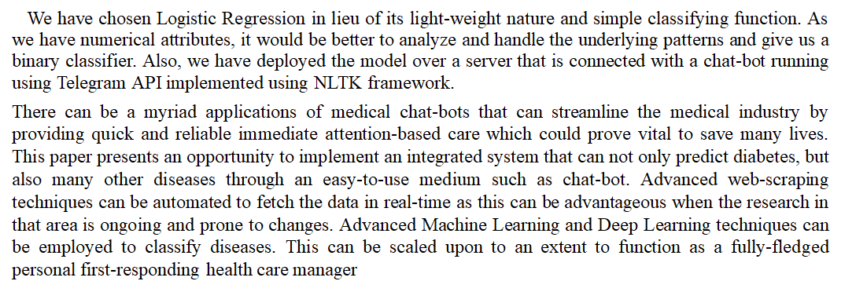
Conclusion and Future Works

Slide 48
References
S.No | Title of the paper | Type of Publication(Conference/Journal) | Name of the Journal / Conference | Cite score | Impact Factor
1 | Pima Indians diabetes mellitus classification based on machine learning (ML) algorithms | journal | Neural Computing and Applications | 42 | 6
2 | Classification and prediction of diabetes disease using machine learning paradigm | Journal | Health Information Science and Systems | 156 | 6
3 | Deep learning approach for diabetes prediction using PIMA Indian dataset | Journal | Journal of Diabetes & Metabolic Disorders | 133 | 2.8
4 | Prediction of complications in diabetes mellitus using machine learning models with transplanted topic model features | Journal | Biomedical Engineering Letters | 69 | 4.6

Slide 49
S.No | Title of the paper | Type of Publication(Conference/Journal) | Name of the Journal / Conference | Cite score | Impact Factor
5 | Towards Deep Conversational Recommendations | Conference | NIPS'18: Proceedings of the 32nd International Conference on Neural Information Processing Systems | 13 | A*
6 | AI-Based Conversational Agents: A Scoping Review From Technologies to Future Directions | Journal | IEEE Access | 21 | 3.9
7 | Review of State‑of‑the‑Art Design Techniques for Chatbots | Journal | SN Computer Science | 24 | 3.78
8 | Diagnosis and Classification of the Diabetes Using Machine Learning Algorithms | journal | SN Computer Science | 7 | 3.78

Slide 50
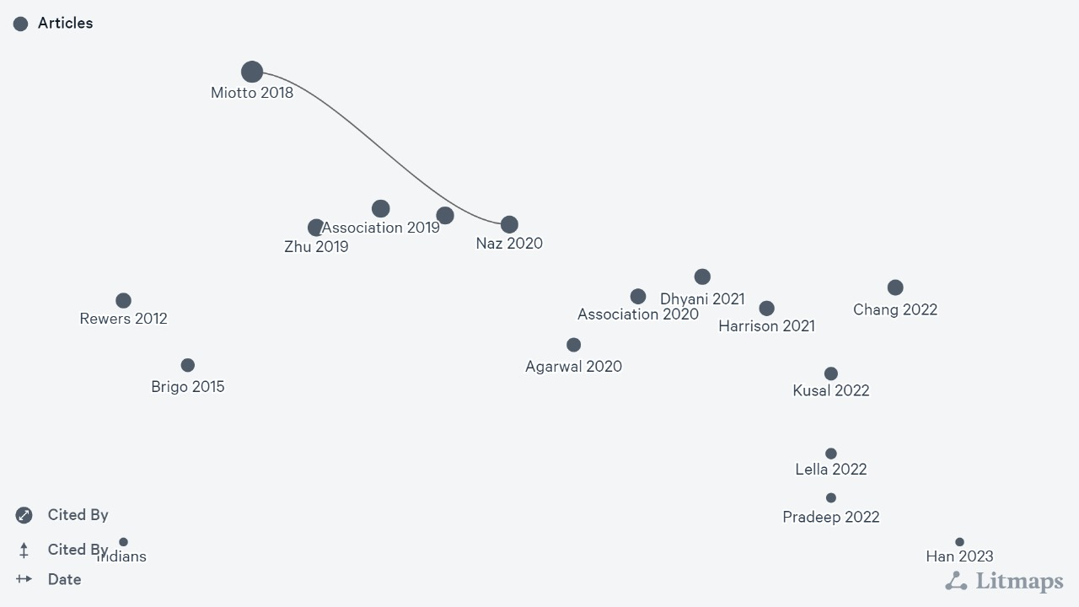
Lit-Map

Slide 51
Evaluation Rubrics
Rubric Name | Weightage
Problem Statement/Introduction | 5
Motivation | 5
Dataset Analysis | 10
Related papers review | 30

Slide 52
THANK YOU

