Slide 1


Evaluation-Driven RAG Framework for Grounded Research Paper Analysis. Application Field : Academic Research
Department of Information Technology
V R Siddhartha Engineering College
B.Tech in Information Technology
MAJOR Project Review Presentation
Presented by
Ms. Manasa Kolusu (228W1A1229)
Mr. Sreekar Movva (228W1A1259)
Under the guidance of
Dr. M. Suneetha, Head of the Department

Slide 2
AGENDA
Introduction and Problem Statement
Objectives and Outcomes
Literature Review
Dataset and Requirements
Algorithms Used
Architecture Diagram
Implementation and Execution
Results and Analysis
Conclusion and Future Work
References

Slide 3
INTRODUCTION
Large Language Models (LLMs) have significantly advanced the field of natural language processing by generating fluent and contextually relevant responses across a wide range of domains. These models are trained on vast amounts of data and are capable of understanding and producing human-like text. However, despite their capabilities, LLMs operate based on pre-trained knowledge and do not inherently possess access to specific documents or real-time data. This limitation becomes critical when dealing with domain-specific content such as research papers, where precise and context-aware understanding is essential.

Slide 4
PROBLEM STATEMENT
In academic and research environments, the use of LLMs presents a major challenge due to their tendency to generate hallucinated or unverifiable information. Since these models lack direct grounding in user-provided documents, their responses may not accurately reflect the actual content of the source material. Additionally, the absence of traceability and source attribution reduces trust in the generated outputs. To address these issues, there is a need for a system that can generate responses strictly based on document context while ensuring accuracy, transparency, and reliability. This motivates the development of an Evaluation-Driven Retrieval-Augmented Generation framework for grounded research paper analysis.

Slide 5
Objectives and Outcomes of the Project
Objectives | Ooutcomes
Preprocess, segment, and embed research papers for semantic understanding | Structured vector representations enabling efficient and accurate similarity-based retrieval
Design and implement an Evaluation-Driven RAG framework for document-grounded question answering | A reliable research assistant capable of generating context-aware and source-backed responses
Evaluate system performance using BERTScore, ROUGE, and LLM-as-a-Judge metrics | Measurable improvements in accuracy, groundedness, and reduction of hallucinations

Slide 6
Literature Review
Title & Publication | Datasets Used | Algorithms Used | Result
Legal AI for All: Reducing Perplexity and Boosting Accuracy in Normative Texts With Fine-Tuned LLMs and RAG (IEEE Access, 2025) | Ecuadorian Data Protection Law corpus, legal QA benchmark datasets | Fine-Tuned LLMs (QLoRA), Retrieval-Augmented Generation (RAG), Milvus Vector DB, Dense Embeddings | RAG outperformed fine-tuned models in factual accuracy and reduced hallucination while improving reliability in domain-specific QA
Evaluation of Vector Database and LLM Models in RAG Systems (UBMK 2025) | Turkish language document datasets for retrieval benchmarking | FAISS, Qdrant, Chroma DB, Cosine & Euclidean similarity measures, LLM-based QA | Identified optimal vector database and similarity configurations improving retrieval efficiency and RAG system reliability
Dynamic Query Handling with RAG Fusion for PDF-Based Knowledge Retrieval Systems (OTCON 2025) | Domain-specific PDF document collections | RAG Fusion, Multi-Query Retrieval, LangChain orchestration, Chroma Vector DB | Improved contextual relevance and reduced hallucination through multi-query retrieval and dynamic query handling

Slide 7
Literature Survey
Title & Publication | Datasets Used | Algorithms Used | Result
Evaluating Hallucinations in Large Language Models: Metrics and Mitigation (INDISCON 2025) | Benchmark text generation datasets across LLM models | BLEU Thresholds, Semantic Similarity, Confusion Matrix, Factual Accuracy Metrics, RAG-based mitigation | Proposed quantitative hallucination detection metrics and mitigation strategies improving trustworthiness of LLM outputs
AI-Driven Solution for Analyzing and Interpreting Data from PDFs Using RAG and Hybrid Retrieval Models (RMKMATE 2025) | Multi-document PDF datasets with metadata | Hybrid Retrieval (Vector Embeddings + Knowledge Graphs), Semantic Search, Metadata Extraction | Enabled multi-document reasoning, source traceability, and contextually rich responses with citation support

Slide 8
Literature Survey
The reviewed studies demonstrate that Retrieval-Augmented Generation (RAG) significantly improves the factual accuracy and reliability of Large Language Models in domain-specific applications. The work in [1] shows that RAG-based systems outperform fine-tuned LLMs by reducing hallucinations and enhancing precision in legal question answering tasks. Similarly, [3] highlights that advanced retrieval strategies such as RAG Fusion and multi-query retrieval further improve contextual relevance in document-based systems.
Research in [2] emphasizes the importance of vector databases and similarity measures, identifying optimal configurations that enhance retrieval efficiency and overall system performance. The study in [4] focuses on hallucination detection and evaluation metrics, reinforcing the need for quantitative methods to assess LLM outputs. Additionally, [5] demonstrates that hybrid retrieval approaches combining semantic search and metadata extraction enable multi-document reasoning and improve source traceability.
Overall, these works establish that combining efficient retrieval mechanisms, robust evaluation strategies, and advanced RAG architectures is essential for developing accurate, reliable, and grounded AI systems for research paper analysis.

Slide 9
Dataset and RequirementsDataset
Dataset
Input: User-uploaded research paper PDFs (single document per session)
Document Type: Academic journal and conference papers
Content Scope: Technical and domain-specific research content
Preprocessing: Text extraction, section-wise segmentation, and semantic chunking (500-token chunks with overlap)
Evaluation Dataset: 25 custom queries (in-domain and out-of-domain) for performance benchmarking
Requirements
Backend: Flask (API handling and system orchestration)
LLM: Llama 3.3 70B via Groq API (high-speed inference)
Embedding Model: all-MiniLM-L6-v2
Vector Database: FAISS (efficient storage and retrieval)
PDF Processing: PyPDF2
Framework: LangChain (RAG pipeline orchestration)
Frontend: Next.js & React

Slide 10
Algorithms used in the Project
Algorithm 1 – Document Indexing and Embedding
Objective: Convert research paper into structured vector representations
Input:
Document set D, chunk size c, overlap o, embedding model f(x)
Process:
Extract text from PDF
Perform section-aware semantic chunking
Generate embeddings for each chunk
Core Representation:
eij = f(Cij)
Output:
Vector index V stored in vector database.

Slide 11
Algorithms used in the Project
Algorithm 2 – Semantic Retrieval
Objective: Retrieve most relevant document chunks for a query
Input:
User query q, vector index V, Top-K parameter K
Process:
Convert query into embedding
Compute similarity with stored vectors
Rank and select top relevant chunks
Core Formula:
si = (qv dot ei) / (norm(qv) * norm(ei))
Output:
Top-K relevant chunk set R

Slide 12
Algorithms used in the Project
Algorithm 3 – Retrieval-Augmented Generation
Objective: Generate grounded responses using retrieved context
Input:
Query q, retrieved chunks R, prompt template T(), LLM M()
Process:
Construct context from retrieved chunks
Build constrained prompt
Generate response using LLM
Core Representation:
C = concatenate(R1, R2, ..., RK)
y = M(T(q, C))
Output:
Grounded response with source references

Slide 13
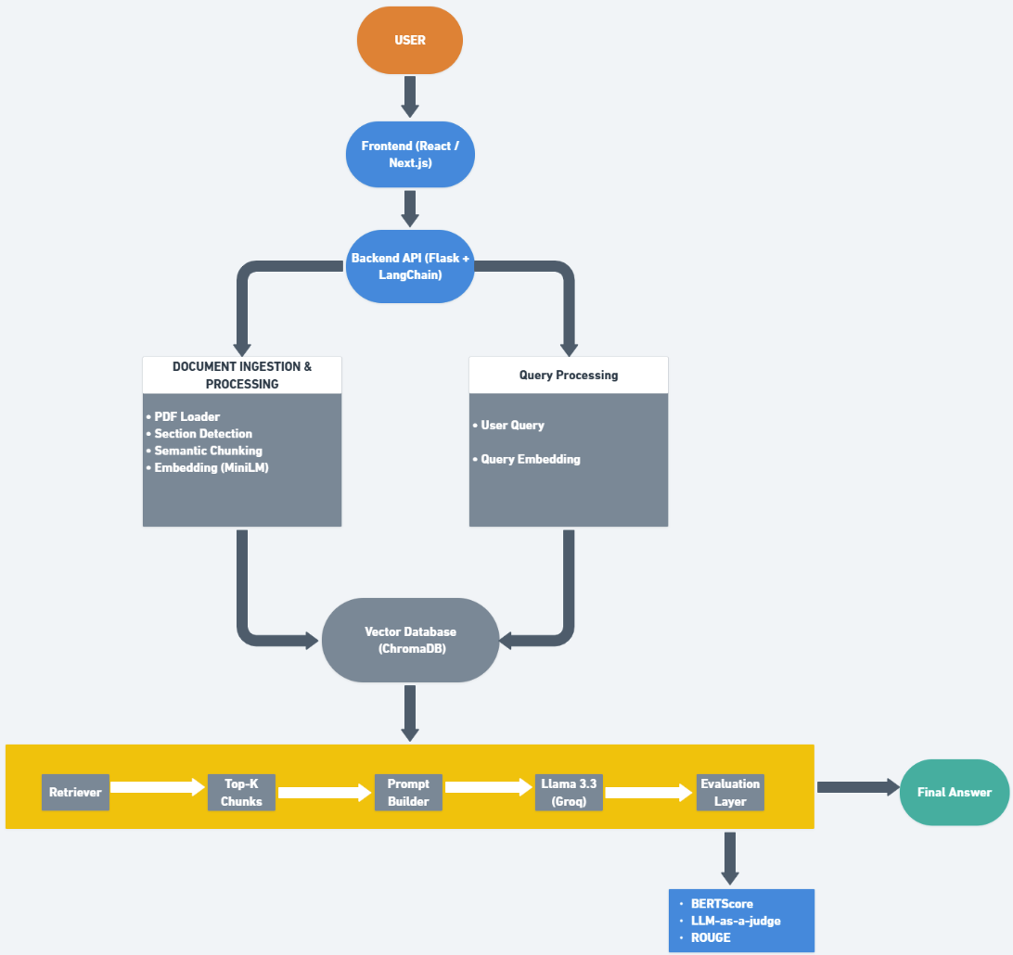
Architecture/Project flow diagram

Slide 14
Implementation steps
Upload research paper in PDF format through the frontend interface
Extract raw textual content from the PDF using PyPDF2
Identify and refine logical sections using LLM-based processing
Organize extracted content into structured section-wise data
Perform semantic chunking with fixed size and overlap to preserve context
Convert each chunk into dense vector embeddings using all-MiniLM-L6-v2 model
Prepare embedding data for storage in vector database

Slide 15
Execution Flow
Store generated embeddings in FAISS DB for efficient retrieval
Accept user query related to the uploaded research paper
Convert user query into embedding using the same embedding model
Compute cosine similarity between query and stored embeddings
Retrieve top-K most relevant chunks based on similarity scores
Construct a structured prompt combining query and retrieved context
Generate response using Llama 3.3 via Groq API
Attach source references corresponding to retrieved chunks
Evaluate response quality using BERTScore, ROUGE, and LLM-as-a-Judge metrics
Return final grounded and concise response to the user

Slide 16
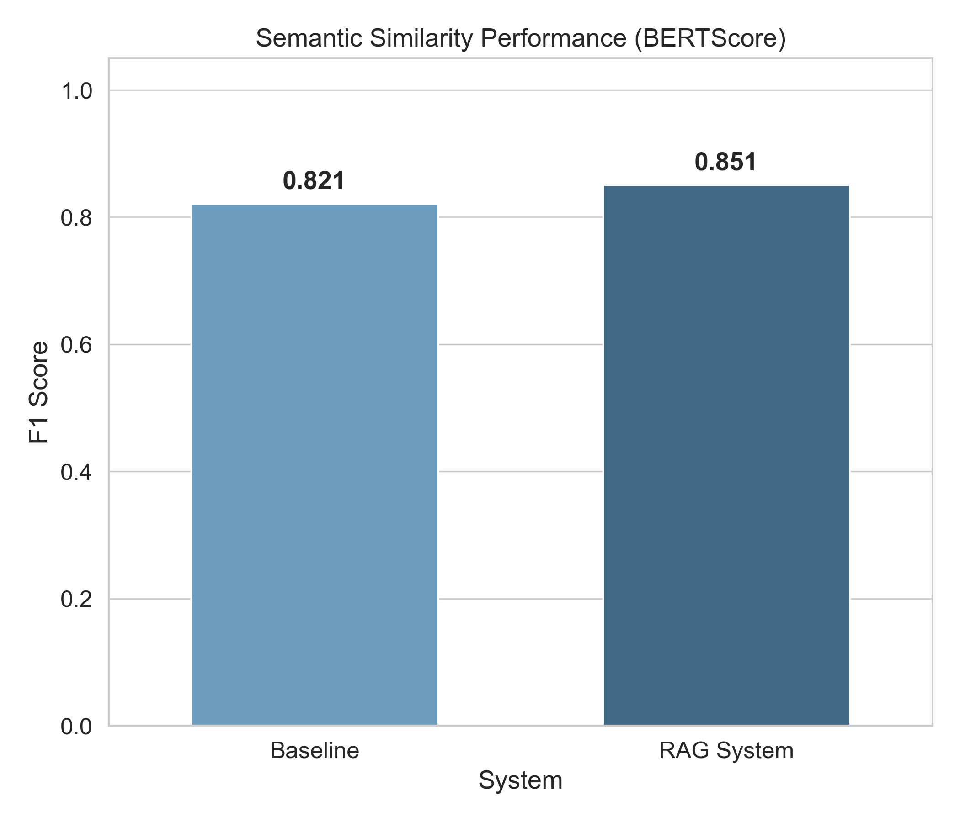
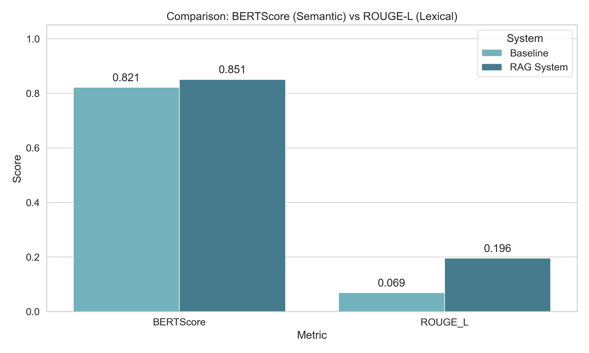

Results obtained
The RAG-based system shows a clear improvement in semantic similarity, with BERTScore increasing from 0.821 (Baseline) to 0.851
Lexical similarity (ROUGE-L) also improves significantly, indicating better alignment with reference answers
The combination of semantic and lexical gains demonstrates enhanced contextual understanding and response quality.

Slide 17
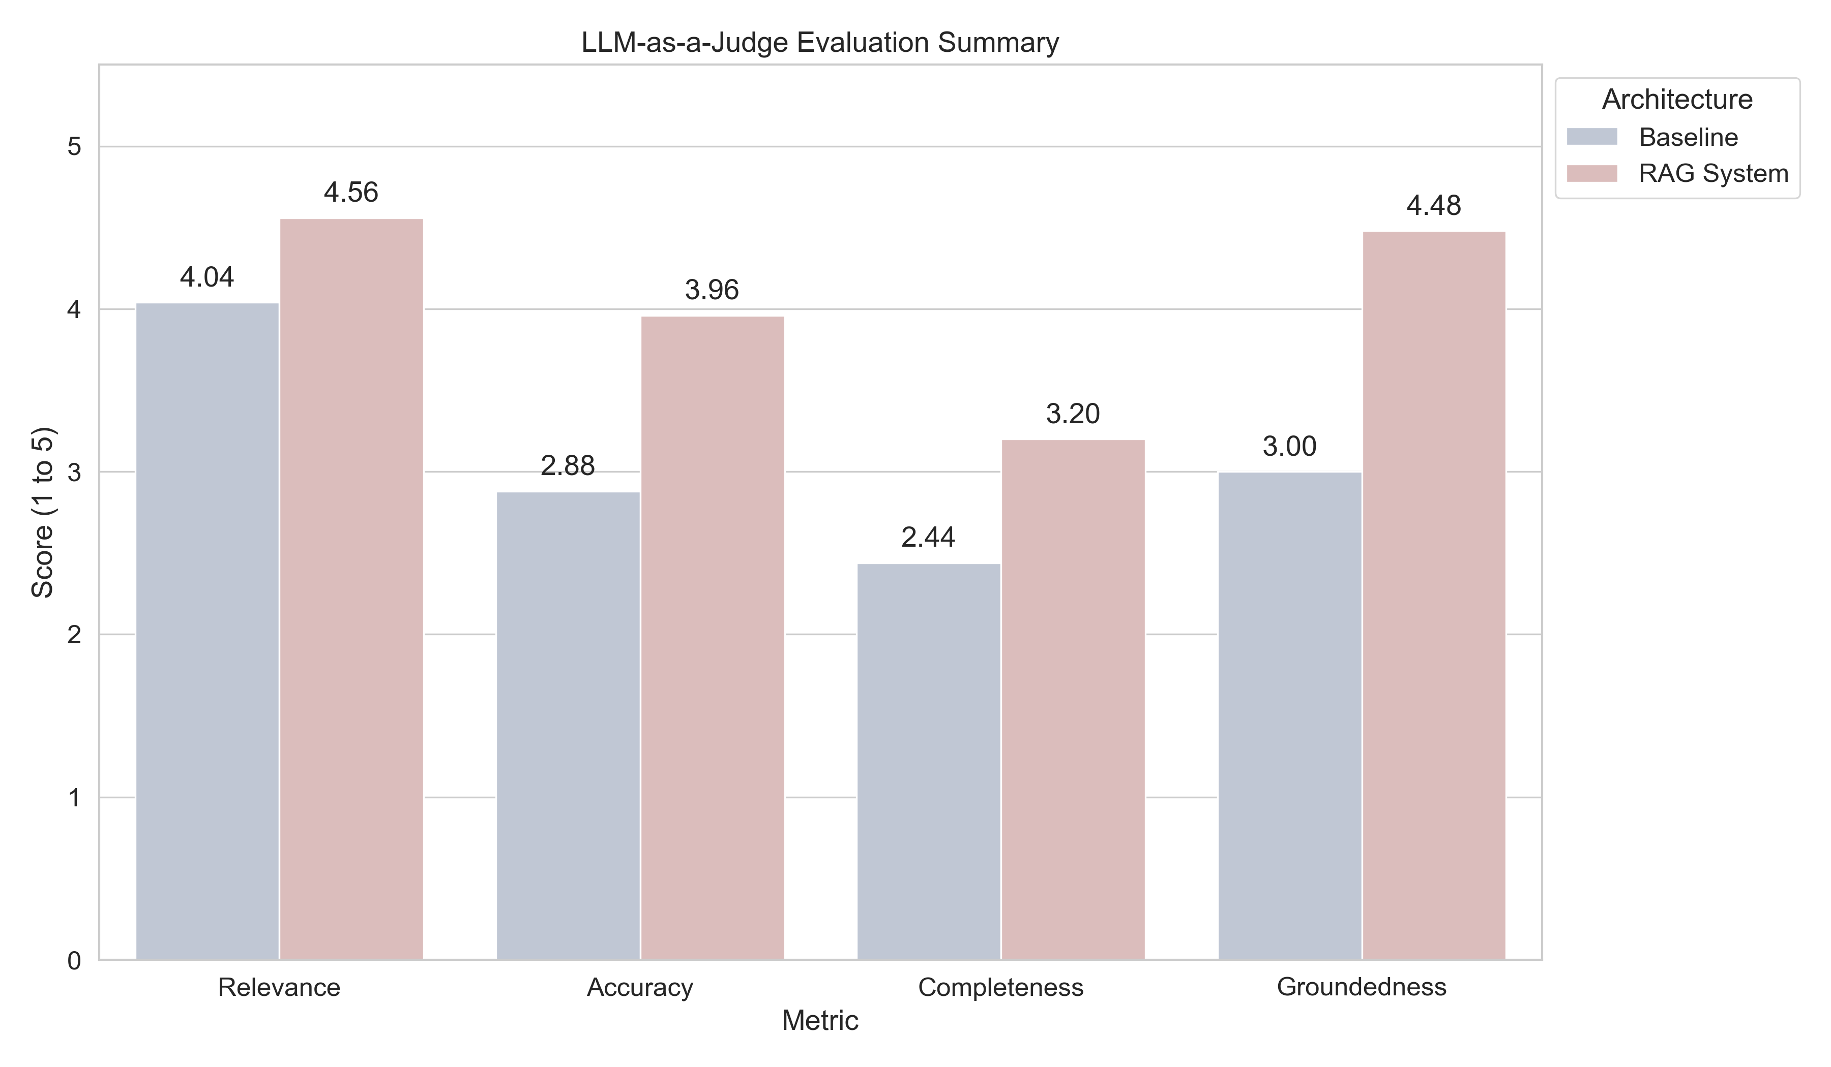
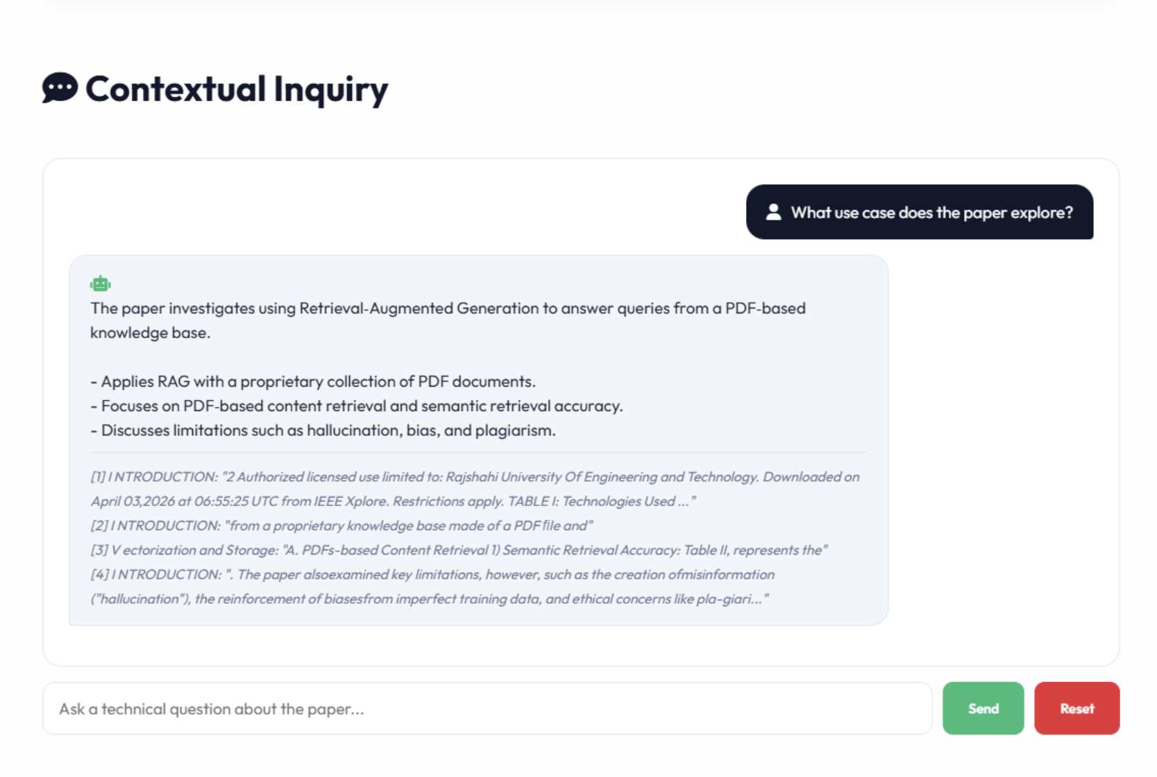
Results obtained
The RAG system outperforms the baseline across all qualitative metrics.
Relevance improved from 4.04 → 4.56, showing better alignment with user queries.
Accuracy increased from 2.88 → 3.96, indicating more correct responses.
Groundedness improved significantly from 3.00 → 4.48, confirming reduced hallucinations.
Completeness also improved, though slightly lower compared to other metrics.

Slide 18
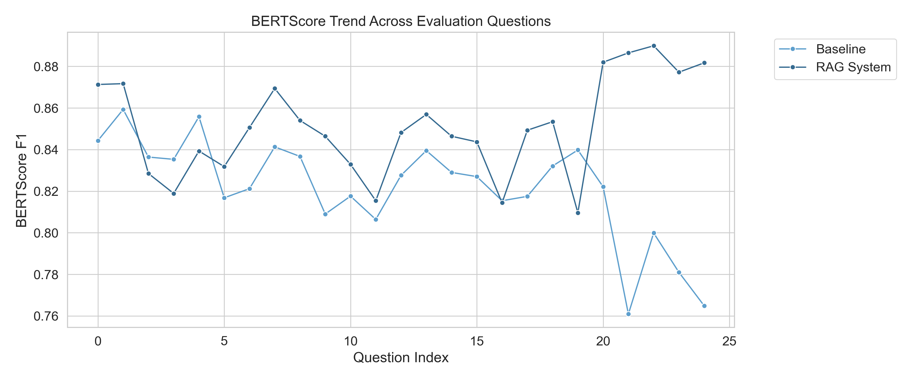
Result analysis with charts
The RAG system consistently outperforms the baseline across most evaluation queries.
BERTScore trends indicate improved semantic understanding and contextual alignment.
The performance gap becomes more significant in complex queries, showing better handling of deeper context.
ROUGE-L trends align with BERTScore improvements, confirming both semantic and lexical enhancement.
Minor fluctuations indicate sensitivity to query complexity and document structure.

Slide 19
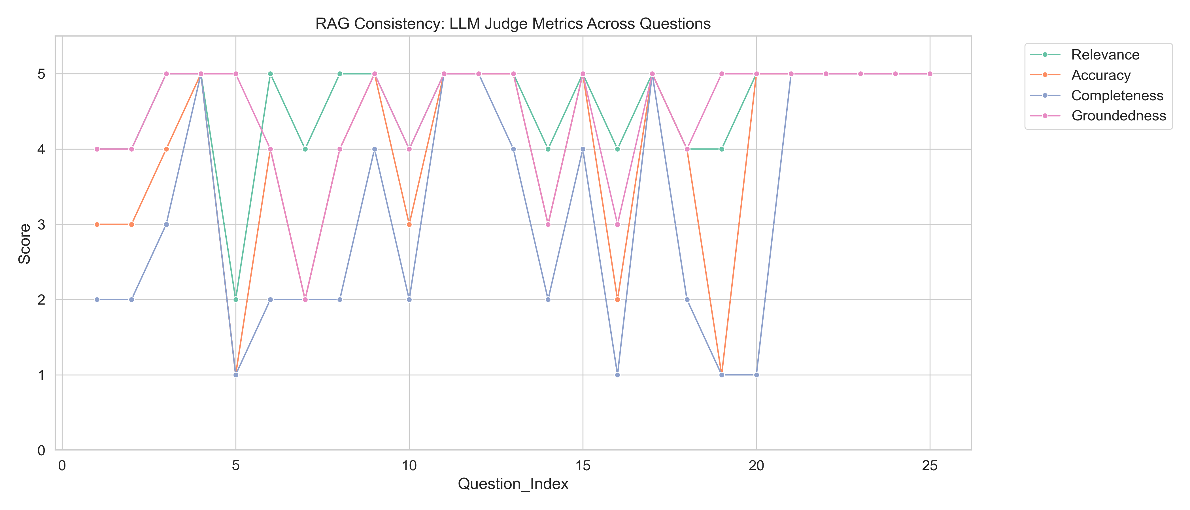
Result analysis with charts
The RAG system demonstrates high consistency across evaluation metrics such as relevance and groundedness
Most responses achieve top scores, indicating stable and reliable performance
Significant improvement in groundedness confirms reduction in hallucinated outputs
Accuracy improvements show better factual correctness in generated responses
Variations in completeness suggest occasional trade-offs between brevity and detail

Slide 20
Conclusion and Future work
Conclusion
The proposed Evaluation-Driven Retrieval-Augmented Generation framework effectively addresses the limitations of traditional Large Language Models in document-based question answering. By integrating semantic retrieval with LLM-based generation, the system produces context-aware and grounded responses directly from research documents. The inclusion of an evaluation layer further ensures the reliability of outputs by measuring semantic similarity, lexical overlap, and qualitative performance. Experimental results clearly demonstrate improvements in accuracy, relevance, and groundedness, while significantly reducing hallucinated responses.
Future Work
Future enhancements can focus on improving both the scalability and intelligence of the system. Extending the framework to support multi-document retrieval and cross-document reasoning would enable more comprehensive analysis of large datasets. Additionally, incorporating hybrid retrieval techniques and advanced embedding models can further enhance retrieval precision. Optimizing chunking strategies and system performance for real-time applications will also be important. These improvements can make the system more robust and suitable for practical deployment in academic and research environments.

Slide 21
References
[1] P. Santiago García-Montero, P. Vizcaíno, I. Galo Reyes-Chacón and M. Eugenio Morocho-Cayamcela, “Legal AI for All: Reducing Perplexity and Boosting Accuracy in Normative Texts With Fine-Tuned LLMs and RAG,” IEEE Access, vol. 13, pp. 179759–179775, 2025, doi: 10.1109/ACCESS.2025.3622138.
[2] H. Tekgöz, H. Erdoğan, H. Uz and H. Altınok, “Evaluation of Vector Database and LLM Models in Retrieval-Augmented Generation (RAG) Systems,” in Proceedings of the 2025 10th International Conference on Computer Science and Engineering (UBMK), Istanbul, Turkiye, 2025, pp. 572–576, doi: 10.1109/UBMK67458.2025.11206778.
[3] A. Sonkar, S. P. Singh, K. Sahu, A. Sahu and S. Mishra, “Dynamic Query Handling with RAG Fusion for PDF-Based Knowledge Retrieval Systems,” in Proceedings of the 2025 4th OPJU International Technology Conference (OTCON), Raigarh, India, 2025, pp. 1–6, doi: 10.1109/OTCON65728.2025.11070378.

Slide 22
References
[4] T. Koll, T. Babu and R. R. Nair, “Evaluating Hallucinations in Large Language Models (LLM): Metrics and Mitigation,” in Proceedings of the 2025 IEEE 6th India Council International Subsections Conference (INDISCON), Rourkela, India, 2025, pp. 1–7, doi: 10.1109/INDISCON66021.2025.11252341.
[5] G. Regina Elwin J, R. Narayanan B, R. R. K. S and M. R, “AI-Driven Solution for Analyzing and Interpreting Data from PDFs and Other Textual Resources Using RAG and Hybrid Retrieval Models,” in Proceedings of the 2025 2nd International Conference on Research Methodologies in Knowledge Management, Artificial Intelligence and Telecommunication Engineering (RMKMATE), Chennai, India, 2025, pp. 1–6, doi: 10.1109/RMKMATE64874.2025.11042348.

