Slide 1
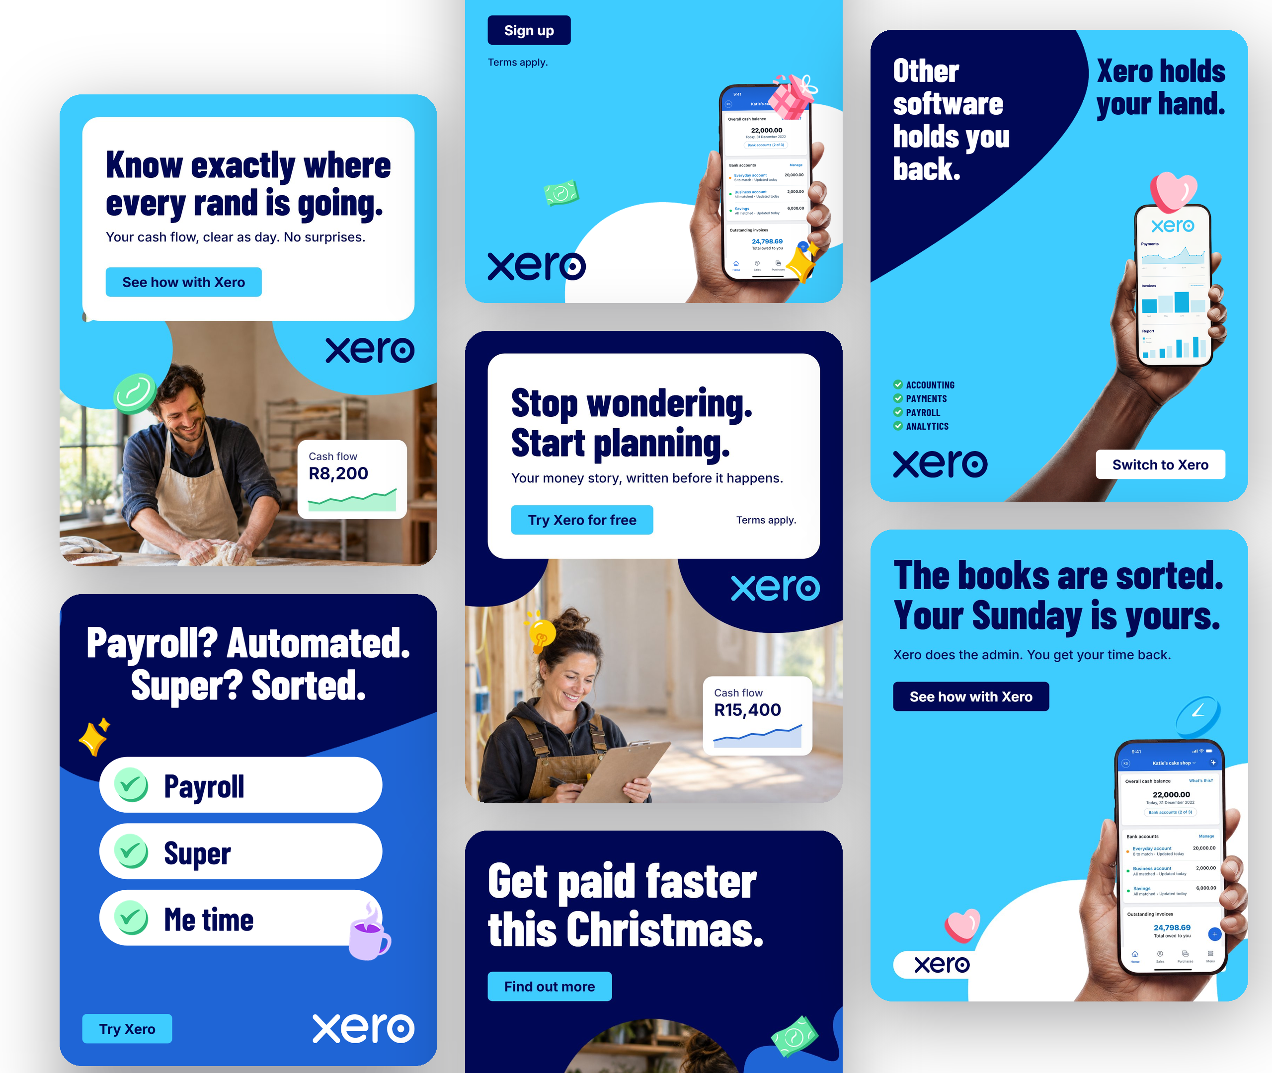
GETCRUX AI HACKATHON | 17 OCT 2026
Xero
Copilot
An agentic, on-brand AI image editor
Every result is a layered, editable design that follows the brand kit, not a flat picture.
Cruxlabs, Bangalore
Notes:
Open with the brief's own example: 'Create 4 different images like this'. Every ad on the right was generated by the product.

Slide 2






From brand rules to editable ads
THE PROBLEM
Great ads. One missed rule. Off-brand.
Blank to design
More like this
Chat + hands-on edits
Describe the ad. Get copy, layout, photos and charms.
Recreate any ad as layers, then “Create 4 like this”.
“Make it dark”, drag, resize, undo.
Designers build many branded ads by hand. One missed rule ships an off-brand ad.
PSD and SVG import
Live brand guard
Resize and export
Arrive as editable text and layers.
18 rules checked as you work. One-click Fix all.
4:5, 1:1, 9:16. PNG, JPG or editable JSON.

Slide 3
The AI never places pixels
The model decides what to say (Slots) and what to change (Ops). Deterministic code decides where it goes.
Browser editor
Design engine
AI backend
React + Konva canvas with copilot chat
→
5 templates, 18 brand rules, ops engine, shape-aware photo fit
→
FastAPI, DeepSeek Pro + Flash, GPT Image Flare for photos only
20
5
18
325
149
reference ads
templates
brand rules
3D charms
tests

Slide 4
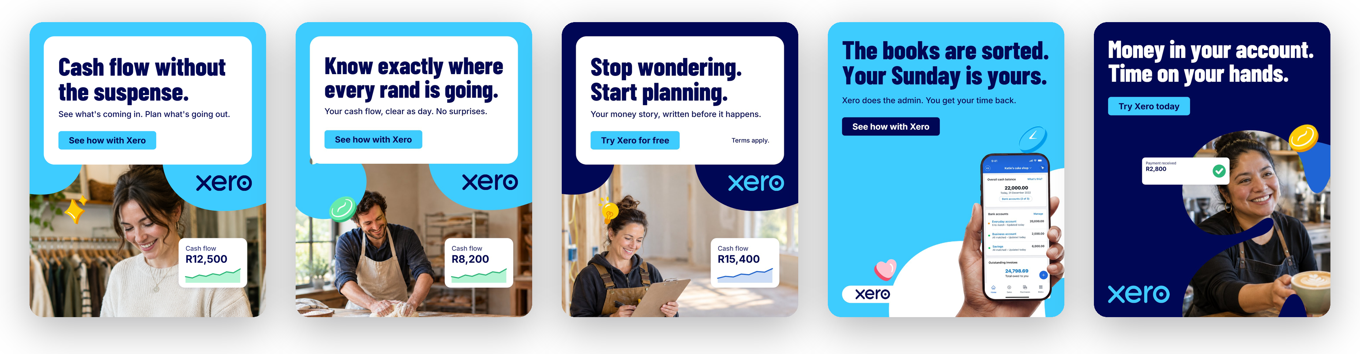
Create 4 different images like this
Reference
Variation 1
Variation 2
Variation 3
Variation 4
Same structure, new angles
Recreate is instant
Every variation is editable
Copy, photo, colourway and layout change while brand rules hold.
The 20 reference ads are stored as Slots. No AI call needed.
Each output is layered, never a flat image.

Slide 5
Two workflows, one toggle
DIRECT
1
Message
2
Route
3
One call
4
Build
Default. One message in, one model call, result on the canvas.
Typed in chat, or a chip like “Make it dark”
Plain rules pick new design, edit, resize or fix. No AI yet
Pro writes Slots for new ads; Flash returns Ops for edits
Layout code applies it: editable, undoable layers
›
›
›
AGENTIC
1
Understand
2
Act
3
Review
4
Suggest
Opt-in toggle. Plans, builds, then checks its own work.
Strategist asks up to 3 one-click questions, or Just go
Producer runs the Direct pipeline: create, vary, edit, resize
Art Director renders, scores with vision, fixes, keeps the best
2 to 3 next-step chips tailored to the result
›
›
›

Slide 6
Why we need both
 | Direct | Agentic
Model calls | 1 | Planner, build, then a vision review
Speed | Seconds | Adds a review of up to 45 s per design
Vague brief | Acts on what it is given | Asks first, one round at most
Checks its work | Live brand rules | Brand rules plus vision critique, keep-best
Best for | Clear asks, quick edits | Campaigns, multi-step, unclear briefs
WHY NOT JUST ONE?
Speed and cost: a clear request should not wait for a review or extra model calls
Trust: the designer opts in. With Agent off, behaviour is exactly the plain editor
Safety net: if the planner fails, the agent hands over to Direct, so an edit never blocks
Value: only vague or multi-step work needs questions and self-review

Slide 7
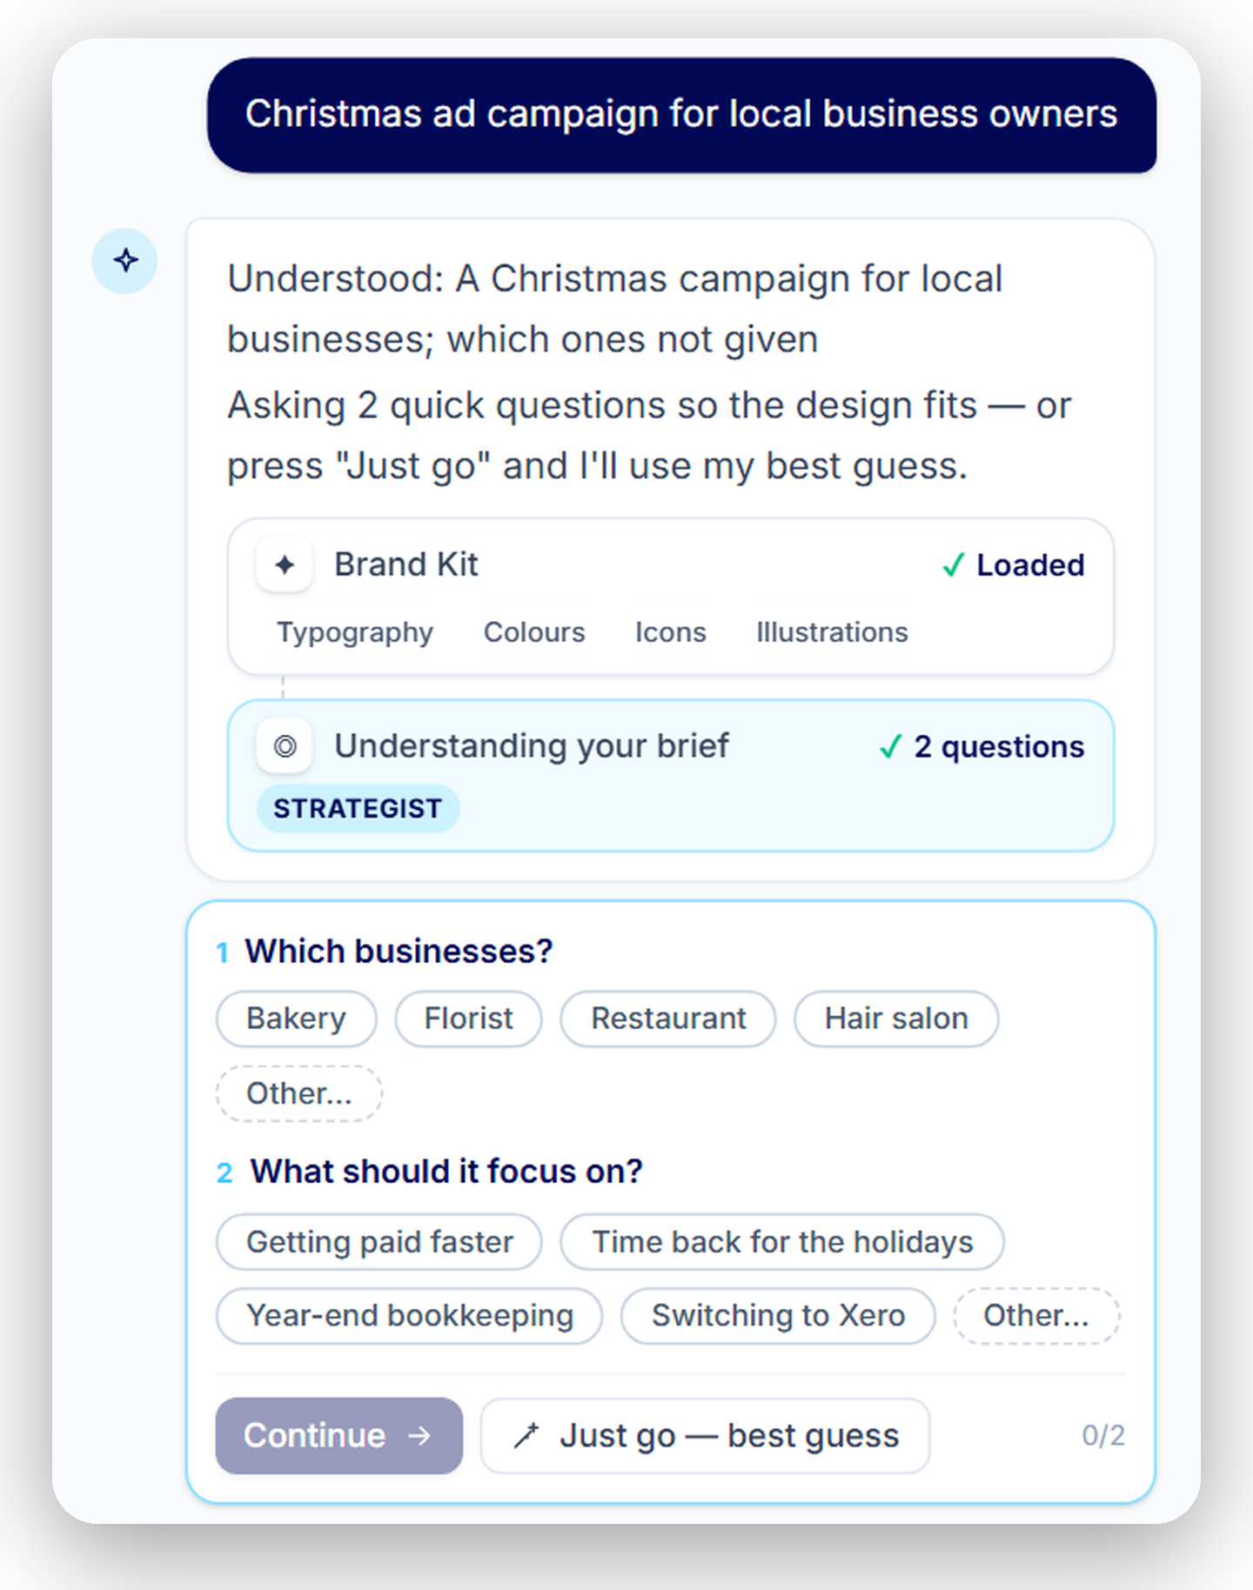



A creative team inside the editor
Strategist
Reads the brief · asks what is missing · sets the must-haves
Producer
Writes copy · builds editable layers · makes themed photos
Art Director
Renders designs · scores with vision · fixes, keeps the best
Inspired by GetCrux's Creative Strategist and Creative Producer. We added the Art Director as the quality gate. Every run starts from a Brand Kit card: typography, colours, icons, illustrations.

Slide 8
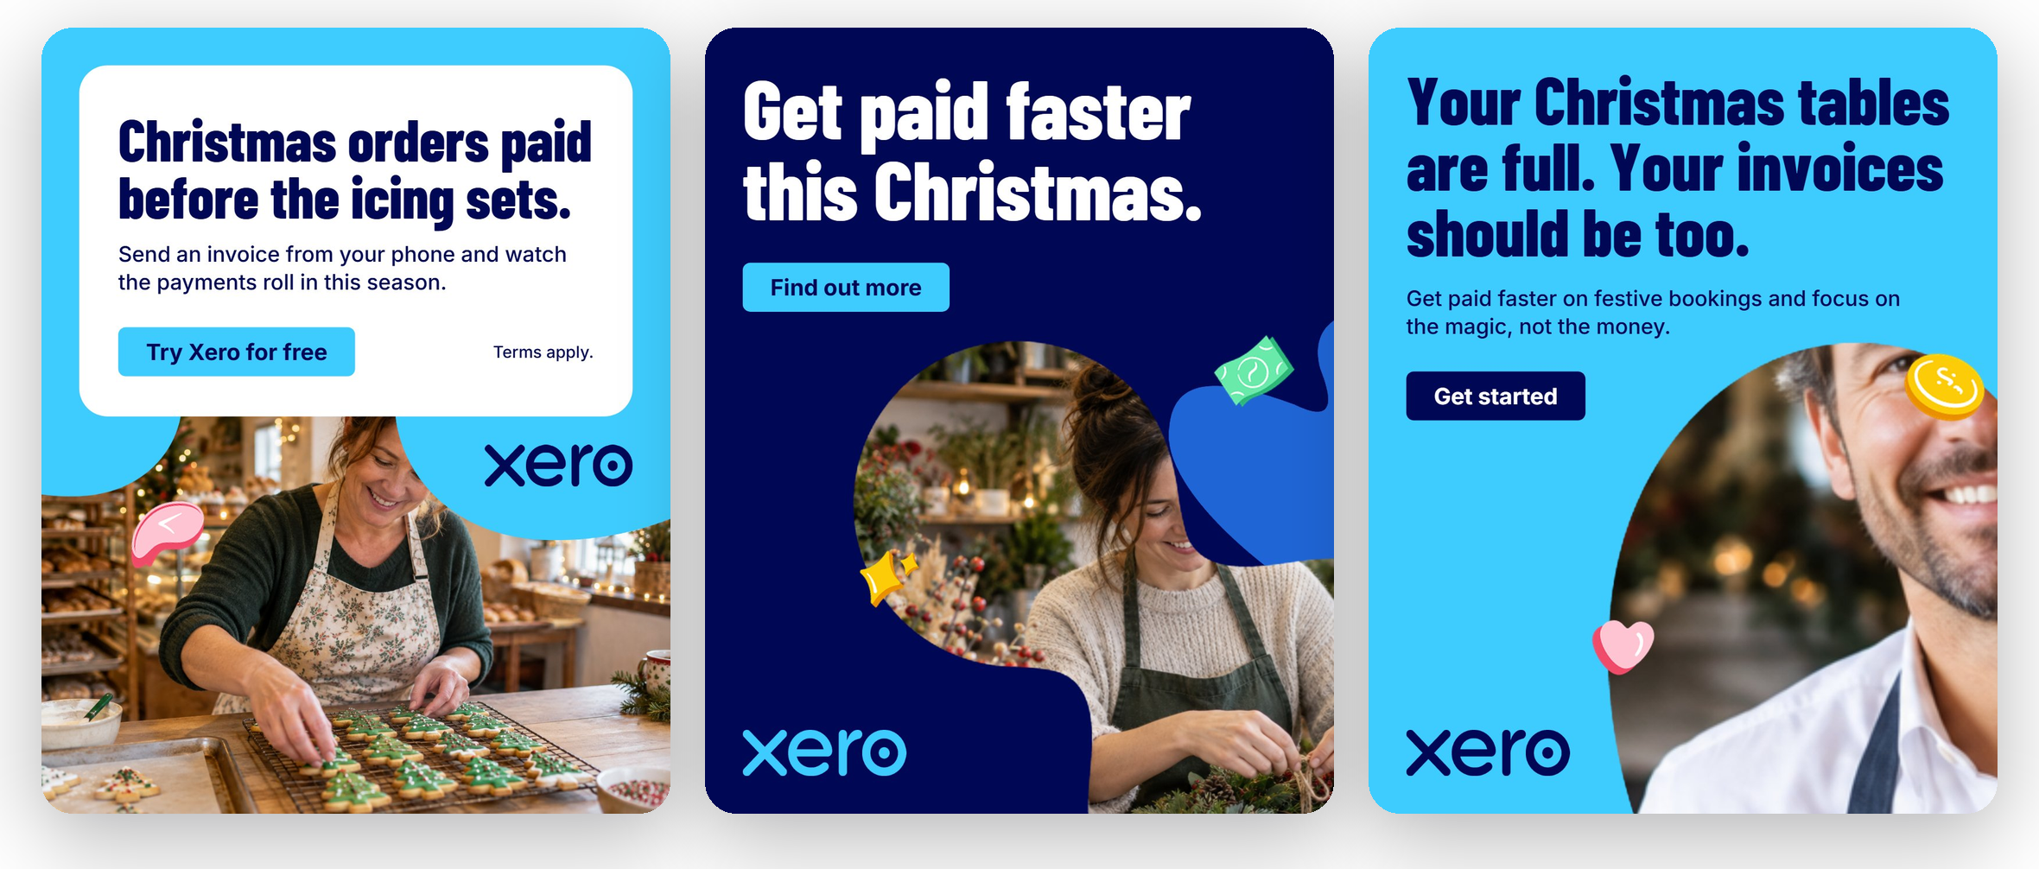
Quality, measured
REAL RUN: CHRISTMAS CAMPAIGN FOR LOCAL BUSINESSES
THE SCORING LOOP
1 Generate on-brand concepts
2 Critique: must-haves and brand rules
3 Score, fix, re-score
THE FORMULA
Score = vision score − 8 per brand error − 3 per brand warning
Bakery · 88 pass
Florist · 58 → 72
Restaurant · 62 flagged
What we learned: run 1 passed every design, but Christmas was only in the copy. Now the critic checks each must-have, and a miss forces a themed photo. Photos are fitted to their shape: the whole head stays visible, or the mask switches, or the photo is regenerated.
Pass at 85

Slide 9
Safe by design, nothing good lost
GUARDRAILS
NOTHING GOOD GETS LOST
1
Brand guard: 18 live rules; every agent fix passes auto-fix
1 Snapshot
2 Fix
Design saved before any change
Art Director applies its edits
2
Copy checks: Schema-validated JSON plus a repair pass for copied, over-long or invented claims
3
Off-brand asks: Red text? Declined, with an on-brand alternative
3 Re-score
4 Keep best
Rendered and scored again
Score dropped? Reverted automatically
4
Agent limits: 1 question round, 2 review rounds, 45 s per design, max 8 designs
Also kept: starred versions you can restore, a 42-photo bank, 20 reference ads stored as Slots, your edits survive rebuilds, and each photo keeps its subject box.
5
Reliability: Retries with backoff; Pro and Flash cover for each other

Slide 10
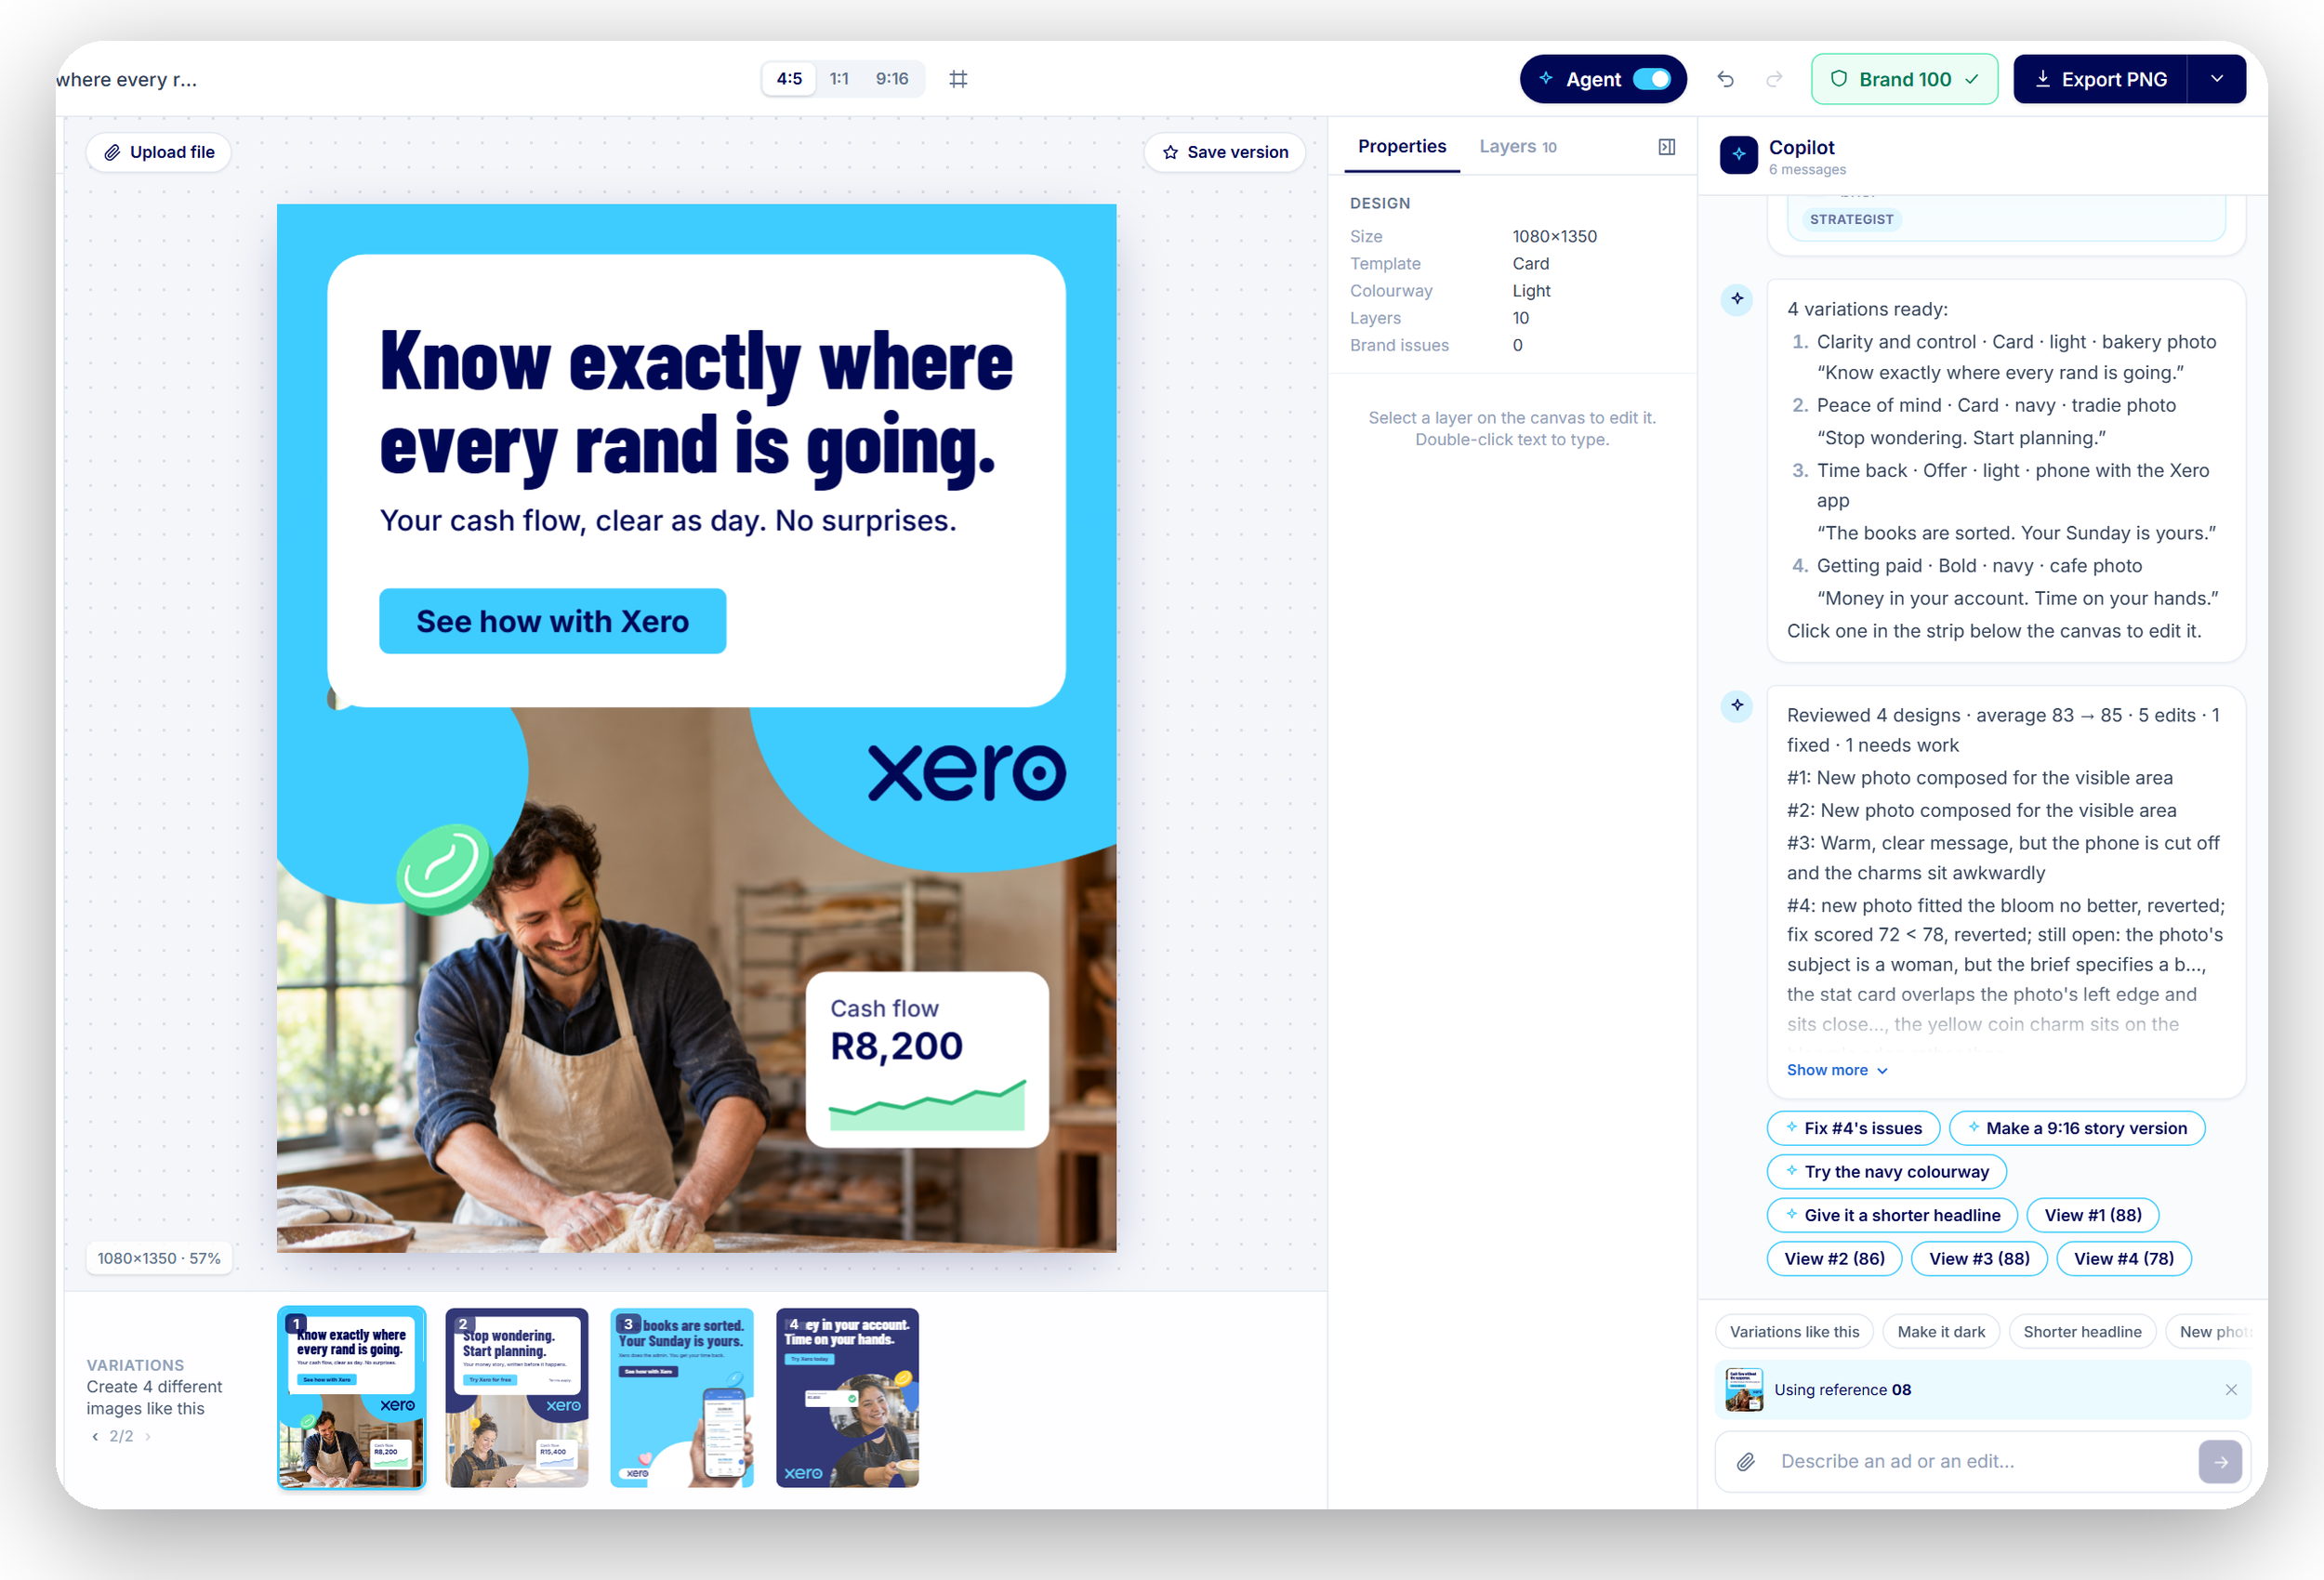
A real editor, fast enough to demo live
Instant
Photo bank, instant Recreate, designs reviewed in parallel
Visible
Live step cards with role tags, one-click question chips
Reversible
Layers, undo and redo, saved versions; every edit is an op

Slide 11
Left behind, and what's next
LEFT BEHIND ON PURPOSE
NEXT: CAMPAIGN THEMES
MORE IMPROVEMENTS
Open-ended tool loop: fixed caps keep the demo from looping
Multi-agent framework and tool-calling API: one JSON contract instead
Memory beyond the chat history
Agent picking “the best” design: the designer decides
Edit history and an MCP server, cut for time
Seasonal theme packs: Christmas in red and green, with matching blooms, charms and backgrounds.
Market Researcher agent, as in GetCrux
Ad performance fed back to the Strategist
Localise per market: currency and terms
Co-brand lockups with partner logos
Learn from the designer's edits
Publish straight to ad platforms
Christmas
Black Friday
Summer
Each pack is an approved extension of the brand kit, so the brand guard checks it too. For example: the palette rule would allow red and green only inside the Christmas pack.
Notes:
Be explicit that the left-behind list was a choice, not an oversight. Themes are the first next step because Christmas red and green would be off-brand today.

Slide 12
Thank you
KNOWN LIMITS TODAY
Free stand-in fonts for the brand font
Charm art upscaled from small sources
One comparison layout shown as rows
Live demo and Q&A
Brand rules in code. Creativity in the model. Every layer editable.
Notes:
Close on the principle: brand rules in code, creativity in the model.

