Slide 1
MOST POPULAR LANGUAGES USED WITH GIT
https://github.com/

Slide 2
GIT SUPPORTS THE FOLLOWING LANGUAGES
JAVA
HTML
CSS
JAVASCRIPT
C#
C
C++
RUBY
SHELL SCRIPTING
PYTHON
SCALA
ASP
PERL
PHP

Slide 3
GITHUB IS NOT AS USEFUL FOR
IMAGES
MOVIES
MUSIC

Slide 4

LETS SEE HOW WE CAN WORK WITH GITHUB
First of all we need to create GitHub account

Slide 5
WHAT IS REPOSITORY
“repo” = repository
usually used to organize a single project
repos can contain folders and files, images, videos, spreadsheets, and data sets – anything your project needs

Slide 6
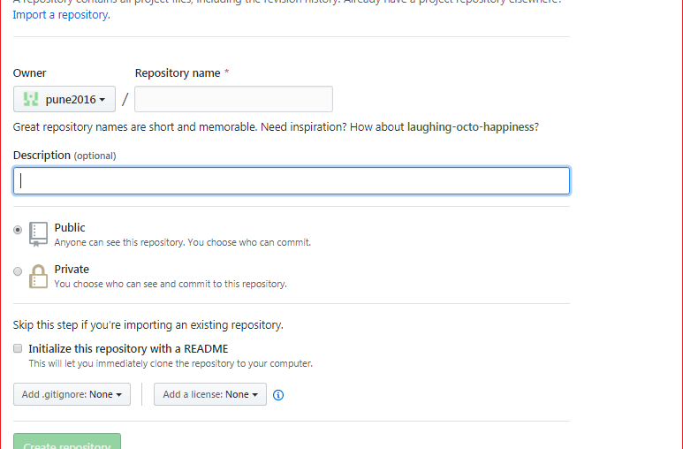
CREATING THE REPOSITORY
1.Give the repository name
2.Give the specific description about repository

Slide 7
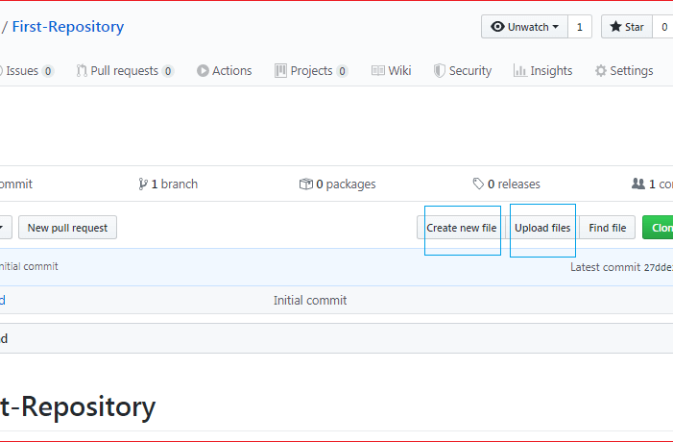
Create a File && Upload files
1.We can directly create the file using create new file option
2.We can directly upload the files using upload file option

Slide 8
MODES OF PUSHING FILES INTO GITHUB
Adding a file to a repository using the GIT BASH
We can push the files with GitHub desktop application as well

Slide 9
HOW WE CAN PUSH THE FILE INTO GITHUB
git init // It initiates a new git repository
git add . // git add command adds file into
staging area
git commit -m "first commit" //commit uses for
tracking purpose
git branch -M master
git remote add origin https://github.com/sreekarsunny/corejava.git
git push -u origin master

Slide 10
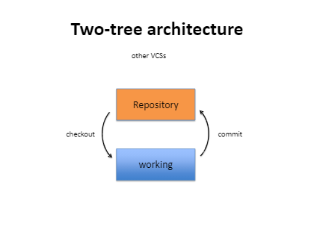

Slide 11
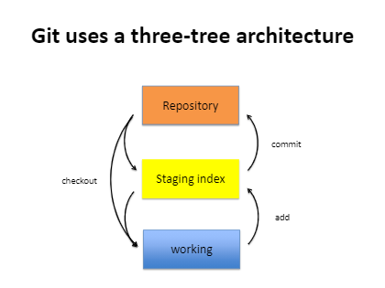

Slide 12
How to create GIT new Branch
The master branch is the default branch of the repository.
create a new 'feature' branch, drag the branch option under the repository.

Slide 13
How to fork a repository?
Login to the GitHub account.
Find the GitHub repository which you want to fork.
Click the Fork button on the upper right side of the repository's page.
NOTE:-We can't fork our own repository. Only shared repositories can be a fork.

Slide 14
Git Pull Request
Pull request is created when you committed a change in the GitHub project, and you want it to be reviewed by other members. You can commit the changes into a new branch or an existing branch.
Once you've created a pull request, you can push commits from your branch to add them to your existing pull request.

Slide 15
Git conflicts?
Conflicts generally arise when two people have changed the same lines in a file, or if one developer deleted a file while another developer was modifying it. In these cases, Git cannot automatically determine what is correct. ... Git will mark the file as being conflicted and halt the merging process.

Slide 16
is clone and pull is same in GitHub?
Clone is generally used to get remote repo copy. Pull is used to view other team mates added code, if you are working in teams. git clone is used for just downloading exactly what is currently working on the remote server repository and saving it in your machine's folder where that project is placed.

