Slide 1
BANK DATA ANALYSIS
-BY TEAM WORKOHOLICS

Slide 2
WHAT EXACTLY IS IT ?
Banking is getting branch-less, contemporary and digital at a very fast pace. As banks compete to gain competitive advantage, the need for managing big data and analytics becomes more relevant.
The data collected in banks is so complex that it is beyond the ability of any traditional data software tool to manage it.
The goal of this project is to classify and predict whether the client will subscribe ( yes/no), a term deposit to improve the strategy for the next market campaign, to draw business insights from the data.

Slide 3
What does it give?
The main purpose behind the bank profiters is to make sure that every customer must feel safe to deposit money in their respective banks.
Using this data analysis , the banks will be able to provide an assurance about the safety in their deposits.
So the main classification goal is to predict if the client will subscribe a term deposit ( variable y)

Slide 4
Input variable
Inputs also known as predictors like:
Successful outcome of the previous marketing campaign
Last contact duration
A person with a housing loan
Other predictors include: -------------------->
Age
Job( type of job)
Marital status
Education
Default
Balance
Housing
Loan
Contact
Last contact day of the month
Last contact month of the year
Duration
pdays
Previous
poutcome

Slide 5
OUTPUT VARIABLE
The target of this analysis is the ‘y’ variable, whether the client deposits in the bank or not.
Our main aim now is create a good model which shows a perfect and significant relationship between any predictor and the fixed targetor

Slide 6
modelS
Our main aim now is to create and analyse a perfect model among all , indicating a significant relationship between any predictor and the fixed target.
This relationship provides us details, about which one among the predictors, is most responsible, which impacts the target in a significant way
WHY MACHINE LEARNING ?
This model is found out using the machine learning concept which includes various kinds of regressions used for finding out the highest accuracy among all the models.

Slide 7
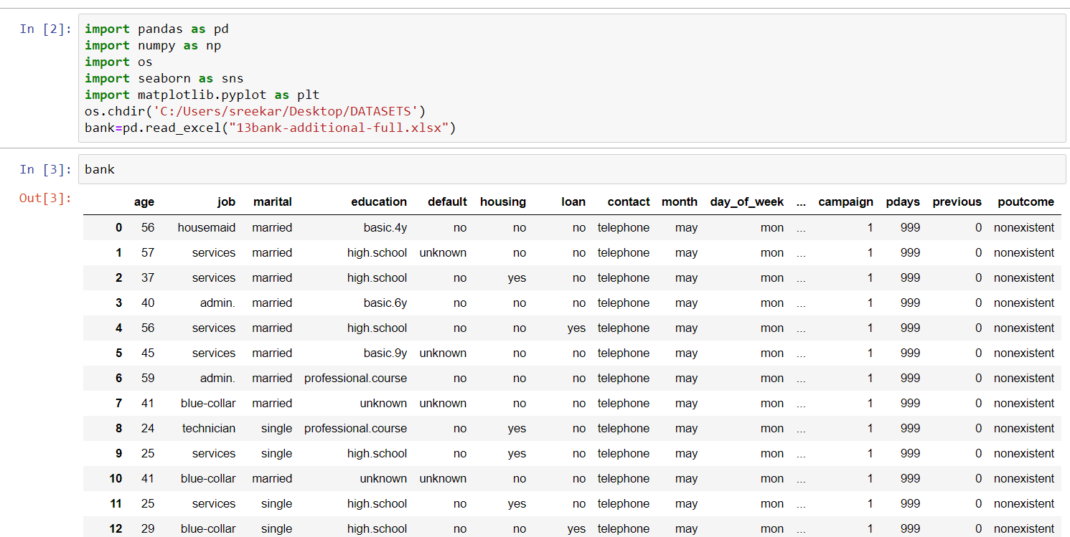
IMPORTING THE DATA
Data is being imported using different modules, it is being read through the excel office using ‘read_excel’
Os needs to be imported for system level communication.
‘bank’ is the data frame that is created for referring it later to explore the data
We can now view the data in the Jupiter notebook using the data frame.

Slide 8

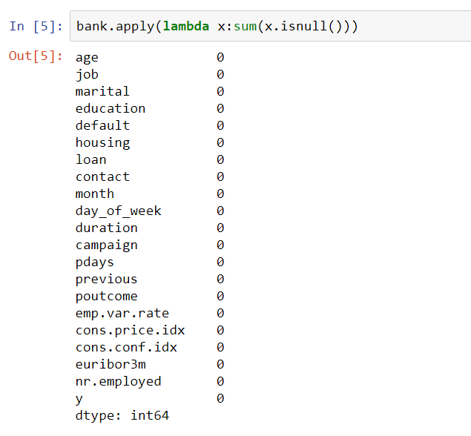
DATA CLEANING
Before exploring or analysing the data we need to clean or munge the data.
Cleaning is done by removing all the null values from the data set.
In this data set there are no null values so cleaning isn’t required anymore.
In case of any null values we can use imputer to replace the null with their respective column mean or mode or median.

Slide 9
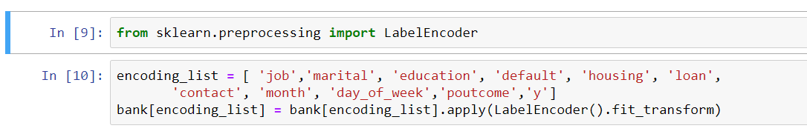
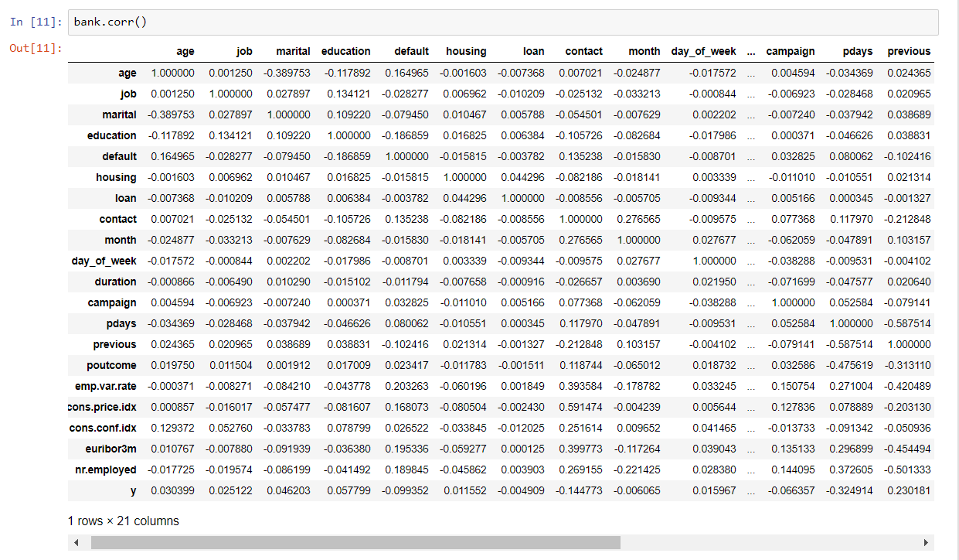
DATA EXPLORING
We need to find out the correlation table to analyse the correlation between each predictor and target
To include the target in the table as well as to label it with only limited numbers we use label encoder as shown in first picture
We obtain a correlation table where each relation Is being analysed
If value> 0.5 => positive & good relationship
directly proportional
If value< 0.5 & >0 => positive rel but not that good, directly proportional
If value<0 then -ve relation , inversely proportional .

Slide 10
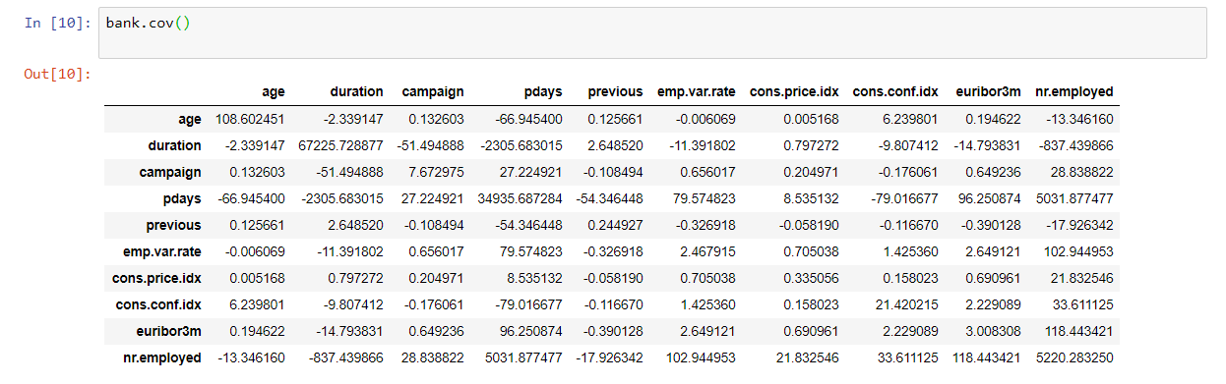
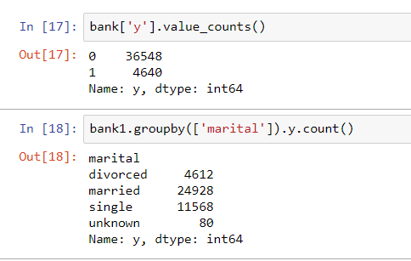
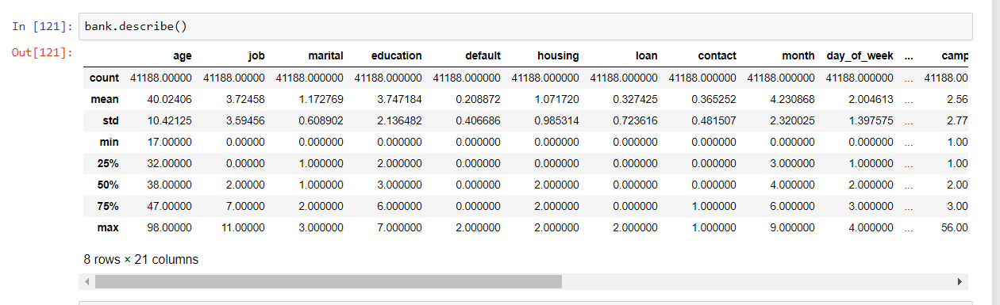
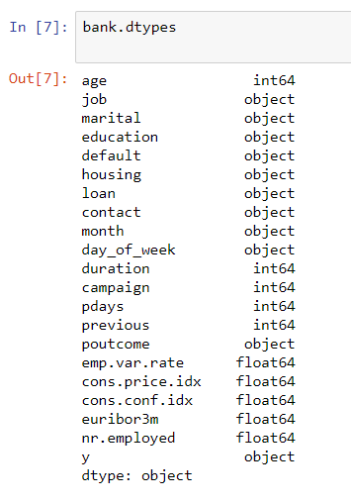

Slide 11
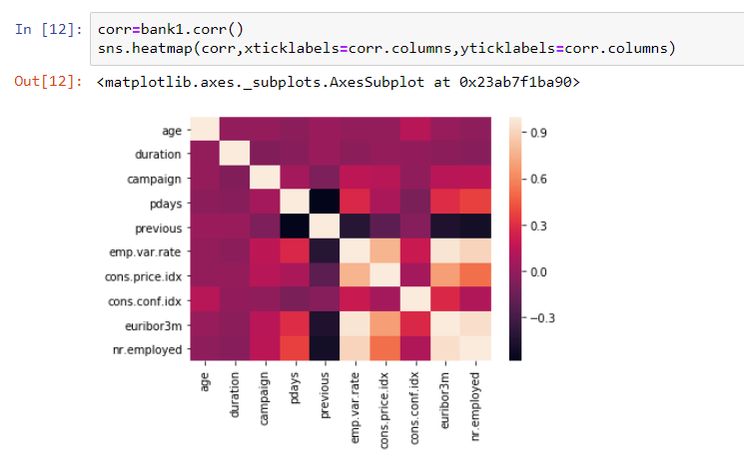
HEATMAPS
Heatmap is used for finding the co-relationship between every column
Dark colours represents stronger relationship where as light colour represents weaker relationship.

Slide 12
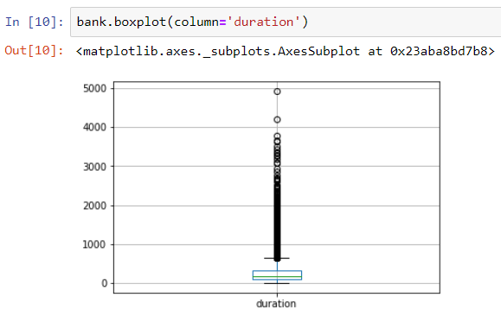
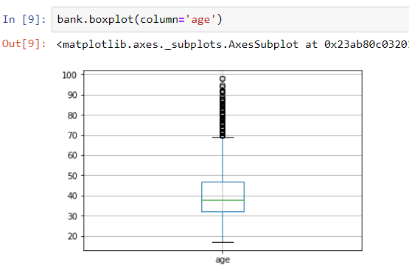
BOXPLOTS
Boxplots are the measure of how well data is distributed in a data set.
This graph represents the set into 3 quartiles- lower ,upper and middle quartile with lower and
upper whiskers
Maximum values are present in the inner quartile region(IQR)-(box)
An Outlier is a point which falls more than 1.5 times the IQR above the lower quartile or below the first quartile , values here are far away to IQR ( few may be useful whereas few may not be useful )

Slide 13
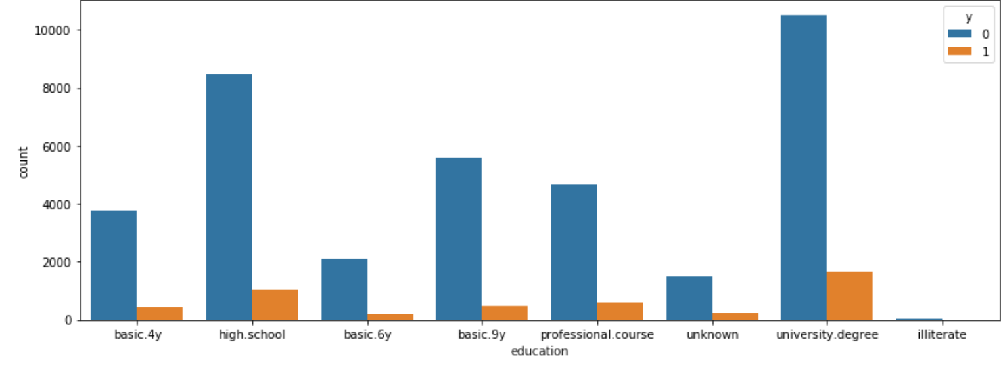
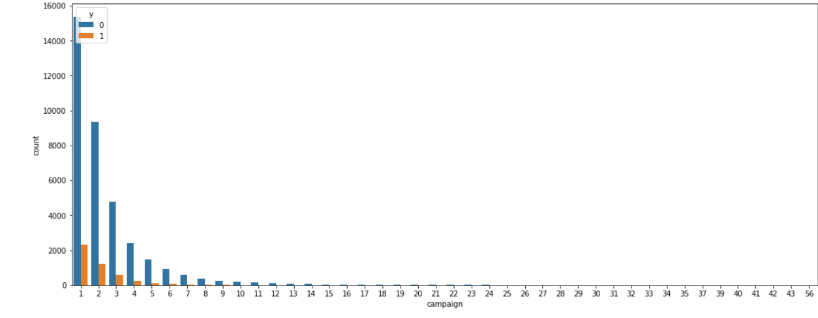
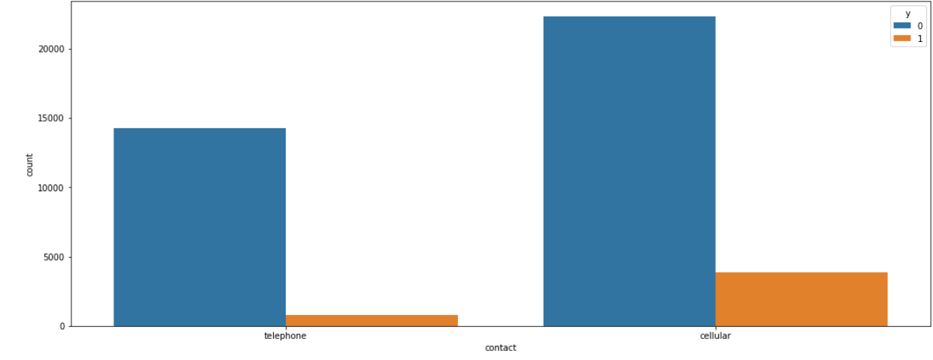
GRAPHS BETWEEN DIFFERENT PREDICTORS AND TARGETS
Education
Campaign
Contact
People with university degree and high school have more probability of depositing
During the first campaign there is more probability of depositing
People who can be contacted using cellular have more probability of depositing

Slide 14
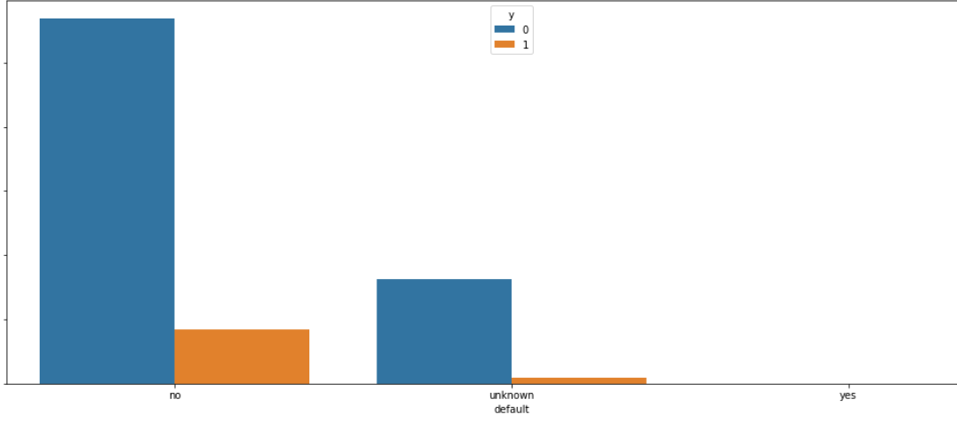
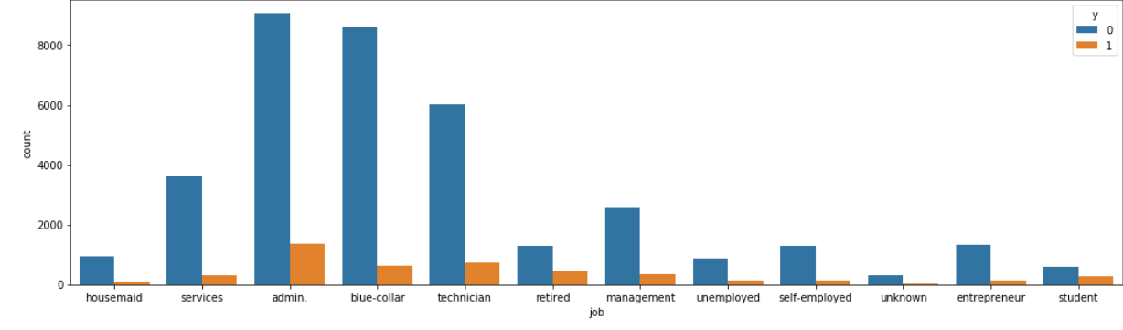
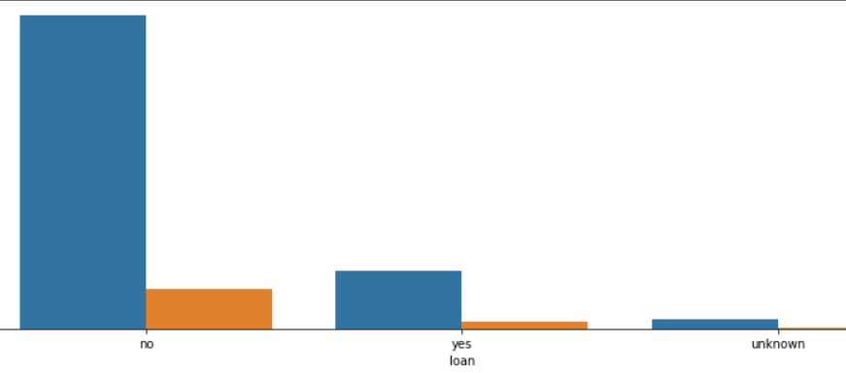
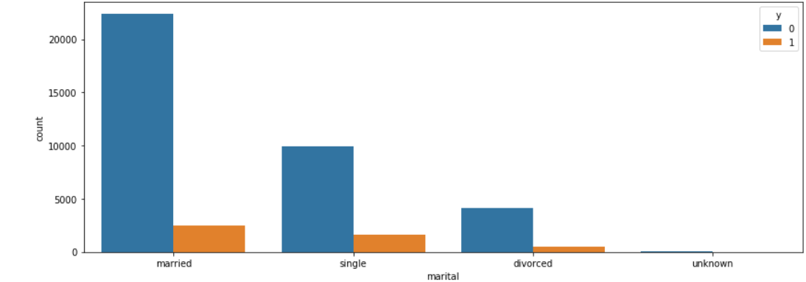
default
There are more ppl with no credit having more deposits
Admin and blue collar job people are depositing more in number which indicates there is a correlation with targetor y
job
Loan
There are more people with no loan have more deposits
Marital
People who are married have more probability of depositing

Slide 15
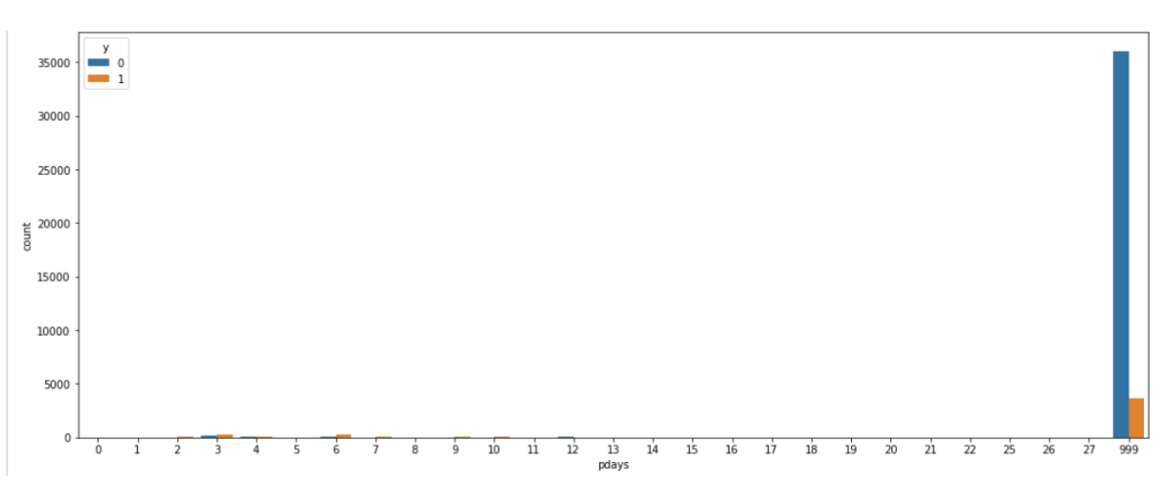
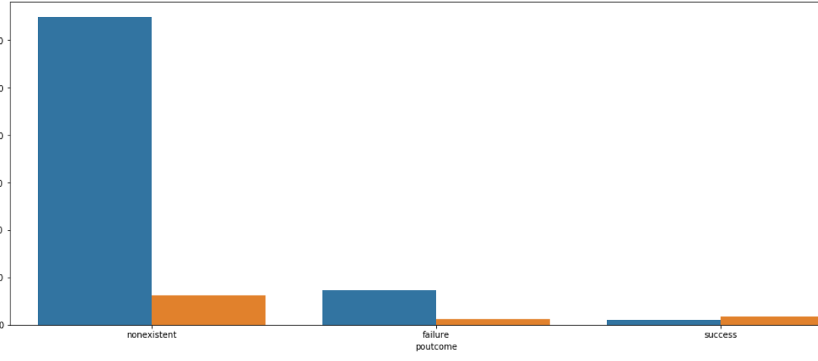
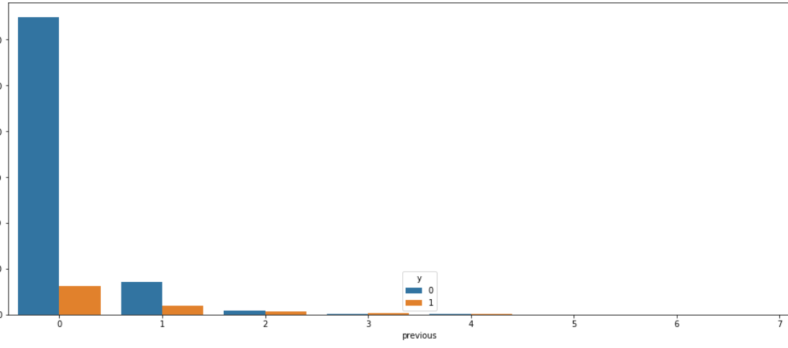
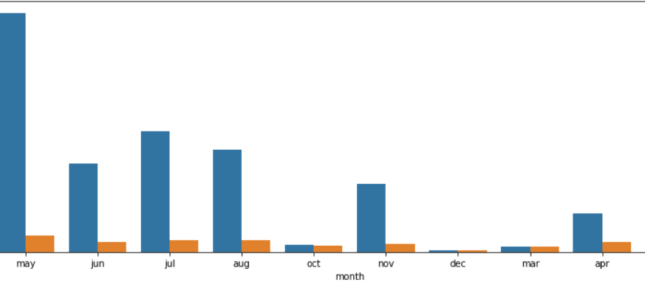
pdays
If there are more no of pdays there is more porbability of pdays
poutcome
People who are non existence have more probability of depositing than the one who have been called in the last campaign
previous
There is more probability of depositing in beginning and reducing for a slowly period of time
People have deposited more in month of may
month

Slide 16
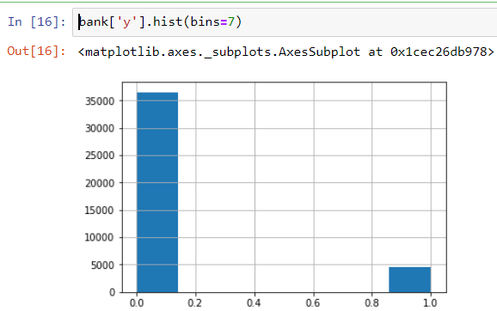
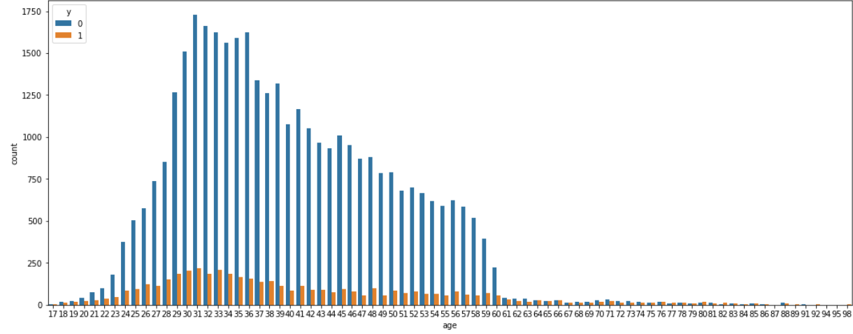
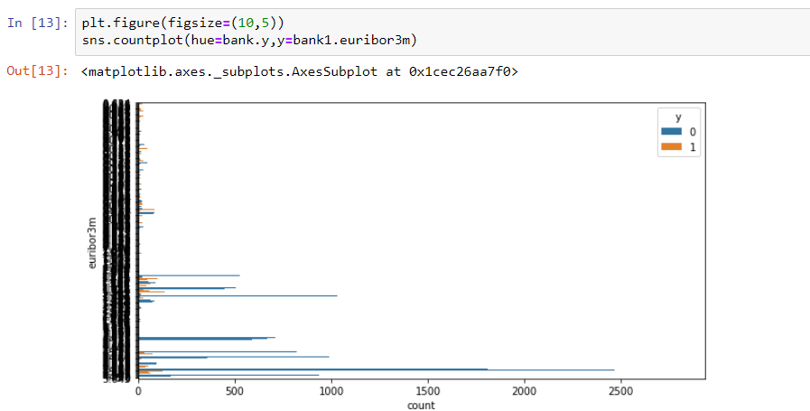
AGE
The people between ages of 20’s and 50’s had more probabilities of depositing
Histograms are used for data visualization , where the entire data is being categorized into different bins.
We specify the bins size by giving ‘bins=100’ or any required value of bins.
Here countplot is being created for valuating or counting the values of the specific column or it shows us the range of the values .

Slide 17
MODELS ANALYSIS
Model analysis is done using regressions or classifications
There are different types of regressions and classifications like:
1. linear or multiple regression
2. logistic regression
3. random forest
4. Decision trees
5. Support Vector machine
6. Naïve Bayes
7. KNN

Slide 18
Classification models
As we are dealing with categorical data , we must use classification to find out the models , in case of continuous data we use the regression concept like linear or multiple with OLS models to create the models .
Classification models include : 1. Logistic regression(
2. Random Forest(taking decisions from many
trees)
3. Decision Tree( decision from 1 tree)
4. Naïve Bayes(( based on
conditional probabilities)
5. Support vector machine (
6. KNN

Slide 19
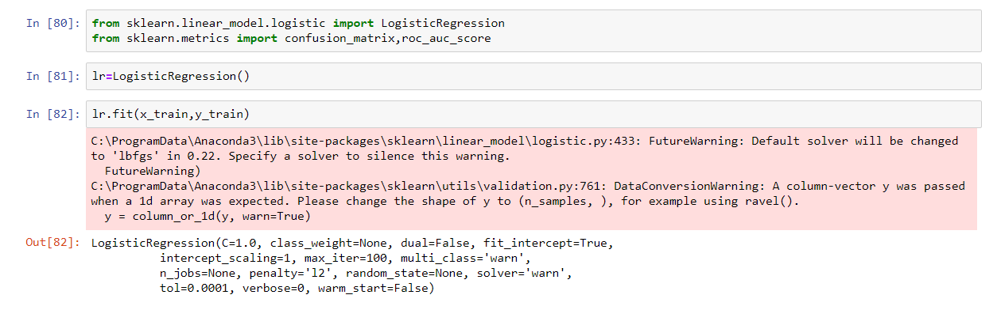
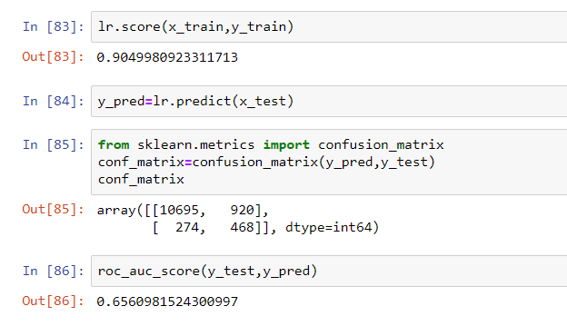
LOGISTIC REGRESSION
Accuracy is 90.4%
ROC Accuracy is 65.6%

Slide 20
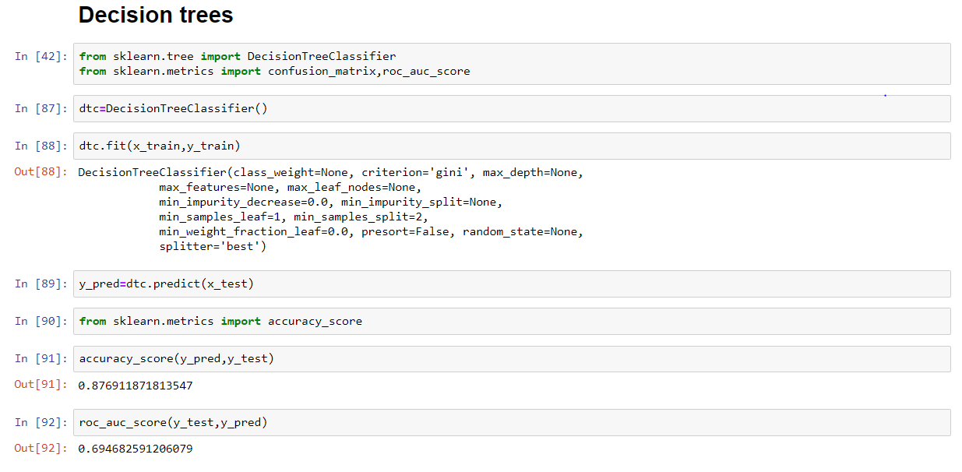
Decision trees
Accuracy is 87.6%
ROC Accuracy is 69.4%

Slide 21
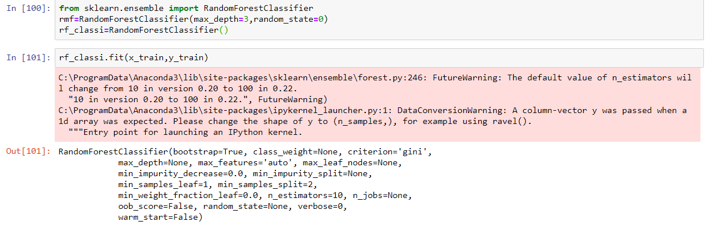
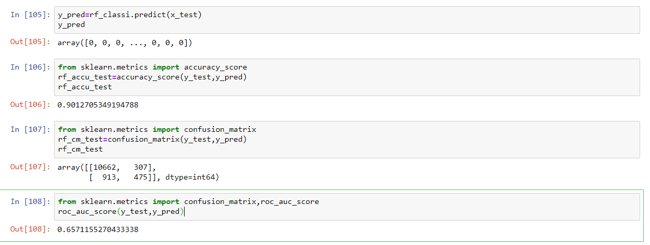
Random forest
Accuracy is 90.1%
ROC Accuracy is 65.7%

Slide 22
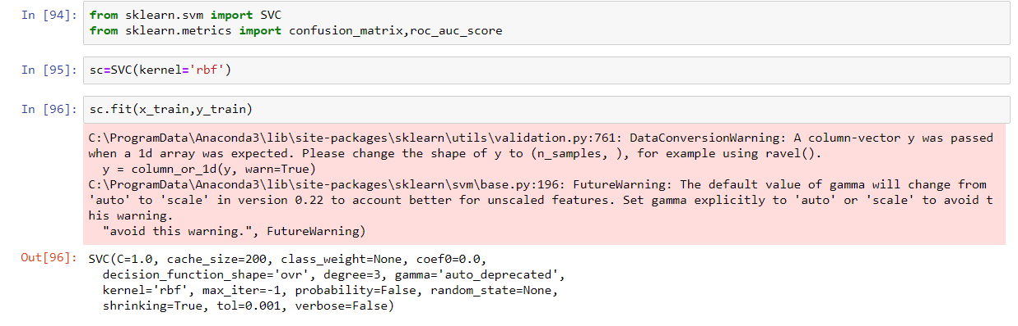
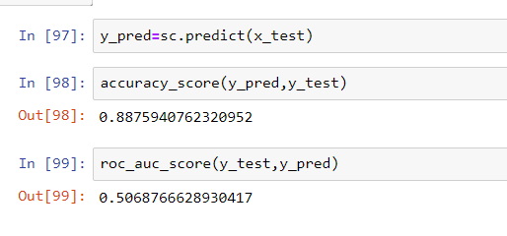
Support vector machine
Accuracy is 88.7%
ROC Accuracy is 50.6%

Slide 23
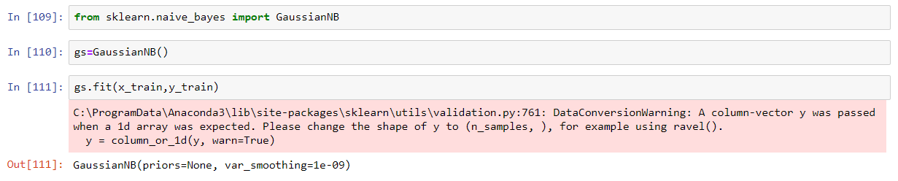
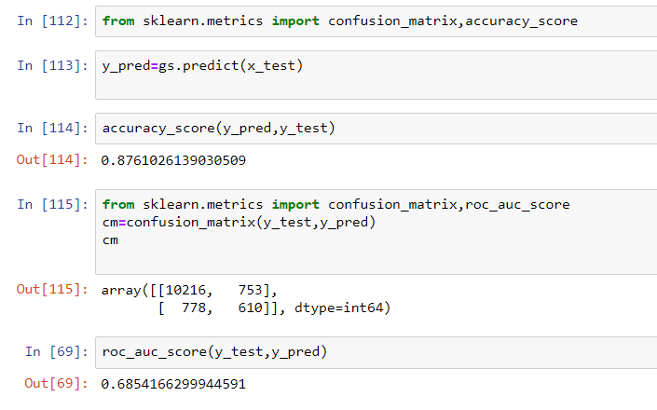
Naïve bayes
Accuracy is 87.6%
ROC Accuracy is 68.5%

Slide 24
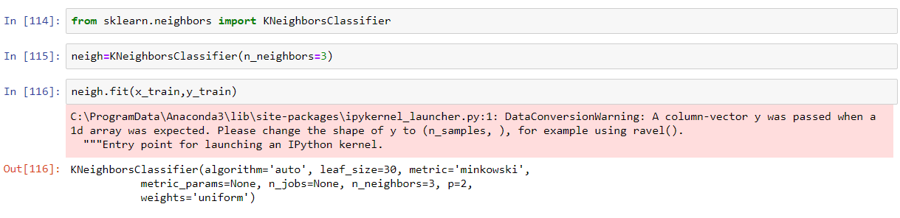
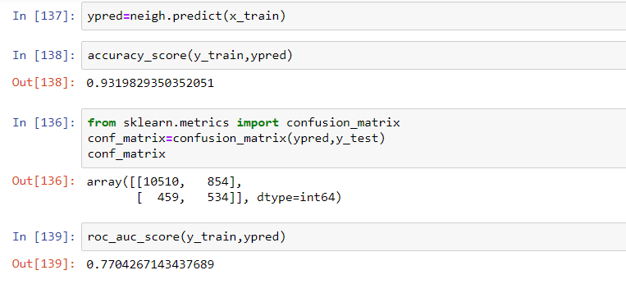
KNN( K NEAREST NEIGHBOUR)
Accuracy is 93.1%
ROC Accuracy is 77%

Slide 25
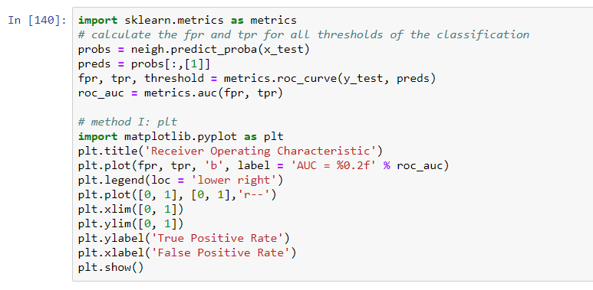
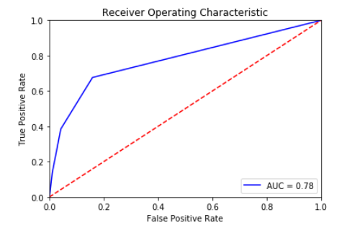
ROC ( Receiver operating characteristics)
We have obtained the ROC curve of the KNN classification, as we have got high accuracy of ROC here .
ROC curve is used for plotting against TPR( true positive rate) and FPR( false positive rate) at various threshold settings

Slide 26
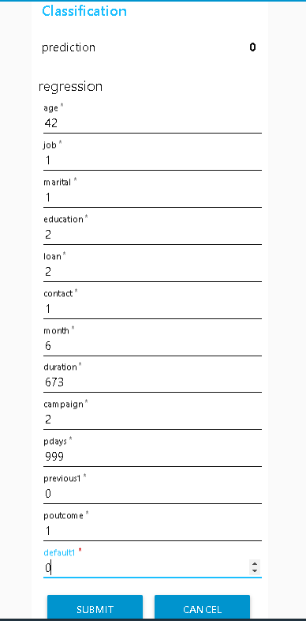
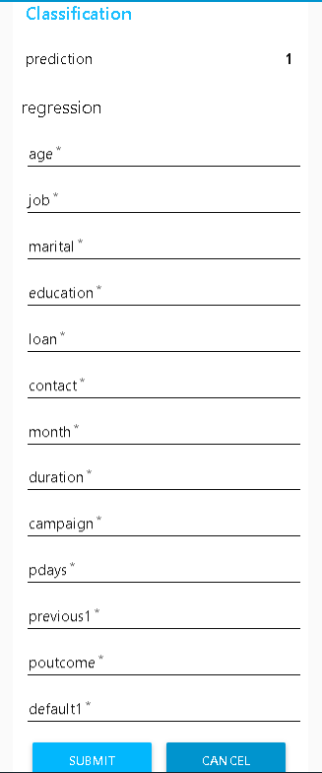
RESULT TO SHOW THE PREDICTION

Slide 27
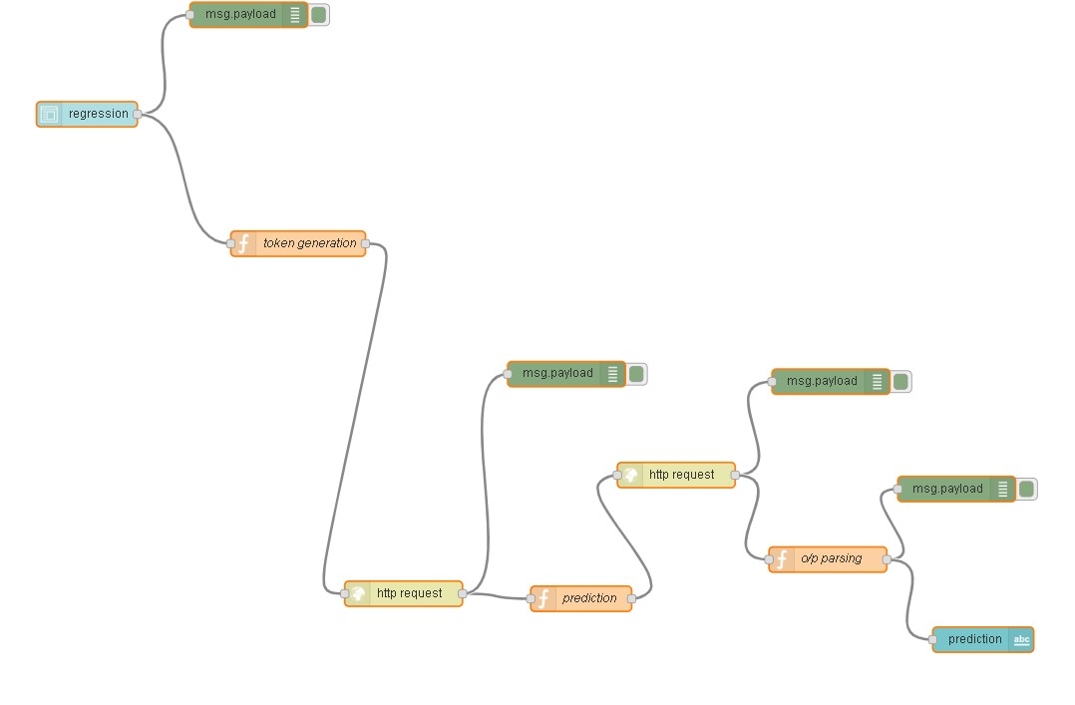
FLOW DIAGRAM IN NODERED

Slide 28
Conclusions
The highest accuracy is obtained with the KNN classification
i.e , 93.1% , which means if there are 100 experiments done then there are
chances of 93 outcomes to come true .

