Slide 1
Unlocking Pizza Sales Success: Insights from SQL A Data-Driven Approach to Boosting Revenues

Slide 2
01
Total Revenue: The Bottom Line
Table of Contents
02
Average Order Value: Maximizing Sales
03
Total Pizzas Sold: Measuring Popularity
04
Total Orders: Customer Engagement Insight
05
Average Pizzas per Order: Order Composition
06
Daily Trends: Understanding Business Cycles
07
Hourly Trends: Timing is Everything
08
Sales by Pizza Category: Identifying Favorites
09
Sales by Pizza Size: Customer Preferences
10
Top 5 Best Sellers: Spotlight on Success
11
Bottom 5 Worst Sellers: Room for Improvement
12
Thank You for Your Attention!

Slide 3

1
Total Revenue: The Bottom Line
Understanding total revenue is crucial; it reflects the overall financial performance. Revenue can be easily calculated using SQL: SELECT SUM(total_price) AS Total_Revenue FROM pizza_sales; This data is the heartbeat of any business, guiding strategic decisions. Higher total revenue indicates a healthier business and the success of sales strategies. Regularly monitoring this KPI helps identify trends and make adjustments.

Slide 4

2
Average Order Value: Maximizing Sales
The Average Order Value (AOV) helps gauge how much customers spend per order. It can be calculated with: SELECT SUM(total_price) / COUNT(DISTINCT order_id) AS Avg_Order_Value FROM pizza_sales; A higher AOV signifies effective upselling and cross-selling strategies. Tracking AOV can help in designing better promotions and combos. Improving AOV can significantly enhance overall revenue.

Slide 5

3
Total Pizzas Sold: Measuring Popularity
Knowing the total pizzas sold gives insight into product demand. This can be evaluated using: SELECT SUM(quantity) AS Total_Pizza_Sold FROM pizza_sales; Sales data can reveal trends in consumer preferences. Regular analysis can help you adapt to changing tastes. Focused marketing strategies can further boost sales.

Slide 6

4
Total Orders: Customer Engagement Insight
Total orders reflect customer engagement and frequency of purchases. Tracking total orders is simple: SELECT COUNT(DISTINCT order_id) AS Total_Orders FROM pizza_sales; This metric helps in evaluating outreach and promotional efforts. A growing number of orders indicates increased market penetration. Understanding customer behavior can tailor future marketing.

Slide 7

5
Average Pizzas per Order: Order Composition
The Average Pizzas per Order provides insight into customer preferences. Calculate it using: SELECT CAST(CAST(SUM(quantity) AS DECIMAL(10,2)) / CAST(COUNT(DISTINCT order_id) AS DECIMAL(10,2)) AS Avg_pizza_per_Order FROM pizza_sales; This helps understand how many pizzas customers typically order together. Analyzing this can optimize menu offerings and bundle strategies. Encouraging more pizzas per order can lead to higher sales.

Slide 8
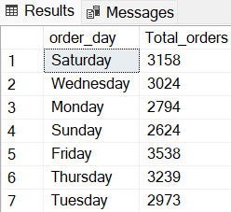
6
Daily Trends: Understanding Business Cycles
Daily trends for total orders provide insight into peak times for sales. Use SQL: SELECT DATENAME (DW, order_date) AS order_day, COUNT(DISTINCT order_id) AS Total_orders FROM pizza_sales GROUP BY DATENAME (DW, order_date); Identifying busy days helps in staffing and resource management. This data drives effective marketing tactics designed to boost sales. Timely promotions can be aligned with high-traffic days.

Slide 9
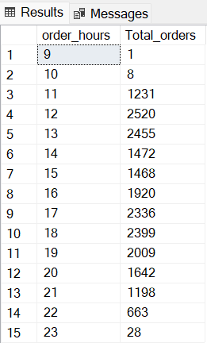
7
Hourly Trends: Timing is Everything
Hourly trends reveal when customers are most likely to order. Leverage SQL: SELECT DATEPART(HOUR,order_time) AS order_hours, COUNT(DISTINCT order_id) AS Total_orders FROM pizza_sales GROUP BY DATEPART(HOUR, order_time) ORDER BY DATEPART(HOUR, order_time); This insight helps manage staffing and operational efficiency. Optimizing delivery and promotions during peak hours enhances customer satisfaction. Targeted marketing can lead to increased sales during off-peak times.

Slide 10
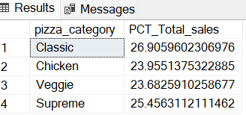
8
Sales by Pizza Category: Identifying Favorites
Understanding which pizza categories dominate sales is essential. Analyze with: SELECT pizza_category, SUM(total_price) * 100 / (SELECT sum(total_price) FROM pizza_sales) AS PCT_Total_sales FROM pizza_sales GROUP BY pizza_category; This data guides inventory and promotional strategies. Emphasizing popular categories can drive further sales. Adapting menus based on category performance can increase profitability.

Slide 11
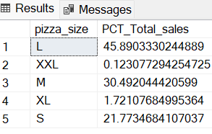
9
Sales by Pizza Size: Customer Preferences
Determining the sales percentage by pizza size reveals customer preferences. Engage with: SELECT pizza_size, SUM(total_price) * 100 / (SELECT sum(total_price) FROM pizza_sales) AS PCT_Total_sales FROM pizza_sales GROUP BY pizza_size; Tailoring marketing strategies to promote best-selling sizes can improve sales. Effective pricing strategies can be derived from analyzing these insights. Aligning your offerings with consumer preferences maximizes satisfaction.

Slide 12
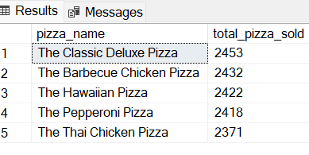
10
Top 5 Best Sellers: Spotlight on Success
Identifying the top-selling pizzas plays a key role in marketing success. Use SQL to find these: SELECT TOP 5 pizza_name, SUM(quantity) AS total_pizza_sold FROM pizza_sales GROUP BY pizza_name ORDER BY SUM(quantity) DESC; Highlighting these pizzas can drive sales for the entire menu. Promotions centered around best sellers can elevate customer interest. Continually monitoring this can help sustain market relevance.

Slide 13
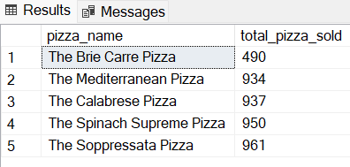
11
Bottom 5 Worst Sellers: Room for Improvement
Learning from your bottom sellers can be as critical as celebrating successes. Discover these with: SELECT TOP 5 pizza_name, SUM(quantity) AS total_pizza_sold FROM pizza_sales GROUP BY pizza_name ORDER BY SUM(quantity) ASC; Analyzing poorly performing products can unveil needed adjustments. Revamping or redefining these menu items can spark renewed interest. Eliminating or rebranding low-sellers optimizes the menu.

Slide 14
12
Thank You for Your Attention!
Thank you for exploring the insights from our pizza sales analysis. Data-driven strategies can transform your business approach. Regularly revisiting these key metrics is essential for success. Let’s keep innovating and responding to customer needs. Together, we can achieve new heights in pizza sales!

