Slide 1
AMEX
Asset Management Enterprise System

Slide 2
Business Requirements
FIXED ASSET AUDIT is eminent due to the fact that, the values generally appearing in your GL or Fixed Asset Register seldom verified with the Actual Asset Data AT Site ( based on its current availability, condition, value etc. ) Hence requires its Physical count, tagging, Reconciliation etc. Once Assets are verified at various site, we label them wherever necessary ( based on the numbering systems the FA Register generates ) and reconcile them with book value and Vice Versa.
Create a Categorized Asset Database with Supplier, Manufacturer, Brand, Model, and Value .
Fixing ID for each Asset.
Assigning Asset to Division, Department, and Custodian
Track Asset Movements.
Perform Periodical Audit
Dispose Assets (Damaged, Missing, etc.,)
To know Depreciation of Assets using different Depreciation Methods

Slide 3
Difficulties in Manual Process
Keeping a Categorized Asset Database with Supplier, Manufacturer, Brand, Model, and Value manually is time consuming and prone to mistake Generating and Fixing ID for each Asset manually is not at all practical Assigning Asset to Division, Department, and Custodian manually and keeping the record demands more human resources Tracking Asset Movements manually is again a time consuming process Perform Periodical Audit with out the help of a system demands more human resources and time Creating Depreciation Report for each Assets using different Depreciation Methods like Straight Line, Double Decline, and Sum of Digits practically require more effort than we think

Slide 4
Manual Process – First Step?
Create complete list of assets in a paper
Time consuming process
Start Searching Assets (Two Methods)
Search for the asset as Listed in the paper
Not a good practice (first item in the list may be located in the farthest corner of the building and the 10th one may be the nearest)
Locate the Asset and Search in the list to
mark as found
Practical Approach but (Searching manually in the list to mark as found is not an easy job, especially when the number of assets are more than 100. This manual process is a long and tedious work that is prone to mistakes)

Slide 5
Tagging Process using AMEX

Slide 6
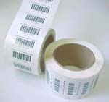
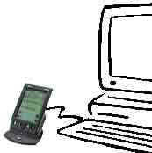

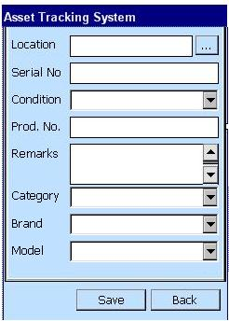
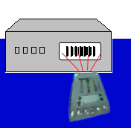
Tagging Process using AMEX - Steps
Step 1: Generate Barcode
Step 2: Down Load Master Info to HHT
Step 3: Attach barcode to an Asset
Step 6: Up Load Master
Info from HHT
Step 4: Scan the barcode
Step 7:
The Result
Step 5: Enter information about the
Asset directly onto the scanner

Slide 7
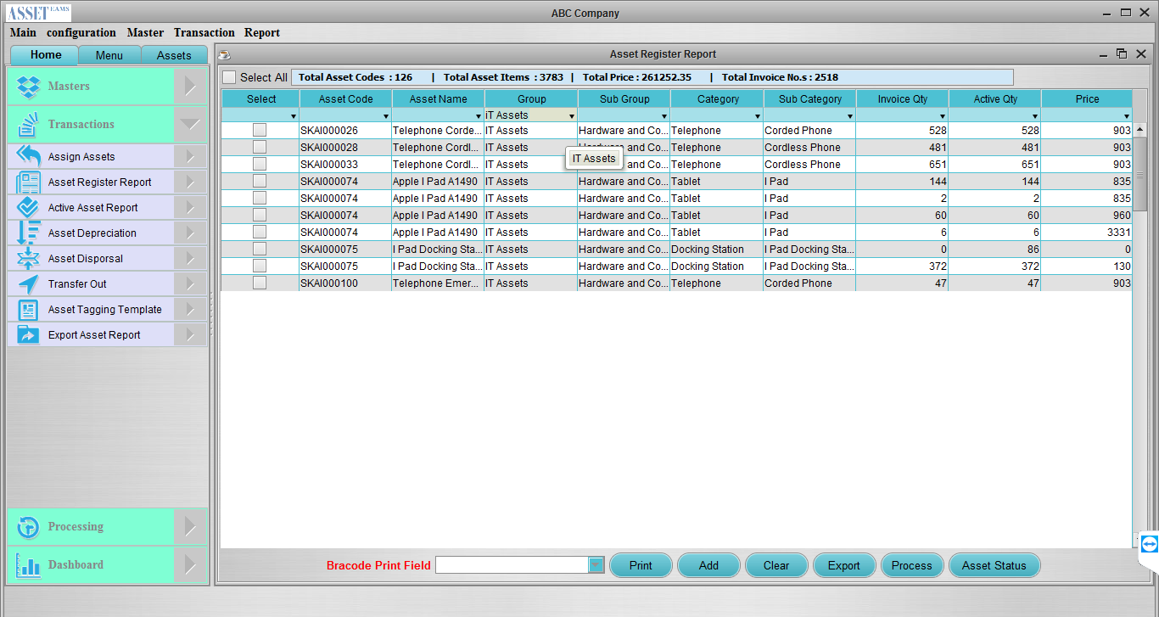
Tagging Process using AMEX
The Result of Tagging Process
Scanned Assets

Slide 8
Tagging Process using AMEX
Works to be Done Before Tagging (Back office System Requirement)
Asset Groups / Sub Groups Categories
Asset Categories / Sub Categories Brands and models Suppliers & Manufacturers Locations (Sites \ Buildings \ Floors \ Rooms) Divisions \ Departments \ Employees Define Label and Label Format Generate Barcodes for each Assets (Example: Printers) Print Label with Barcode for a Particular type of Asset (Example: Printers)
Barcode
Data Transfer from Back Office System to Hand Held Device
Cradle the Hand Held Device Down Load Master information to Hand Held Device Brands and models Locations (Sites \ Buildings \ Floors \ Rooms) Assets and Asset Categories Asset Status (Good Condition, Damaged, Under Service, etc.)
Transfer

Slide 9

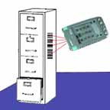
Tagging Process using AMEX
Tagging Using Hand Held Device
Stick Label
And
Scan Barcode
Stick Printed Label to the Asset (Example: Printer) Scan or Select Location of the Asset Scan the barcode using Hand Held Device Capture Asset Attributes Using Hand Held Device Select Condition of asset (Good, Damaged, Under Service, etc.,) Scan Product Serial No. given by the Manufacturer (if the asset has a product serial no.) Enter any remarks that user want to give while tagging Select Category of the Asset (Example: Epson Printer, Samsung Printer) Select Brand and Modal Save the Data Move to Next Asset (Example: Another Printer)

Slide 10
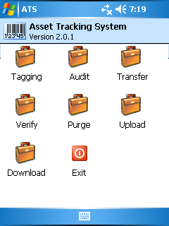
Tagging Process using AMEX
Upload Tagged Asset Information to the Back Office
Cradle the Hand Held Device
Upload Tagged Asset Information
Transfer
Upload Tagged Asset Information
User can verify and approve data using AMEX Back Office System

Slide 11
AMEX – Enterprise Application - Back Office
Some User Interfaces

Slide 12
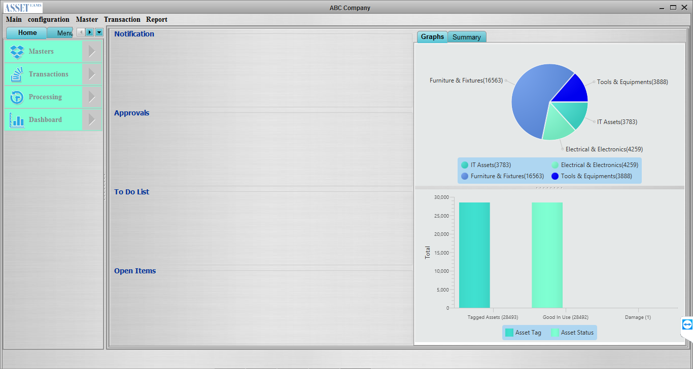
AMEX – Enterprise Application

Slide 13
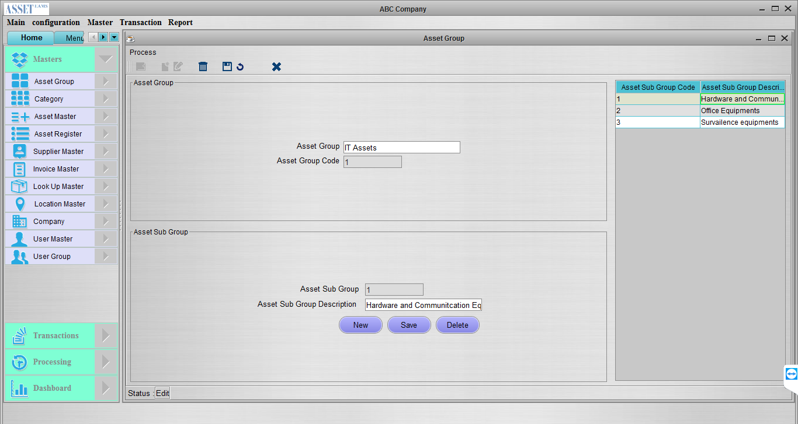
AMEX: Asset Groups And Sub Groups

Slide 14
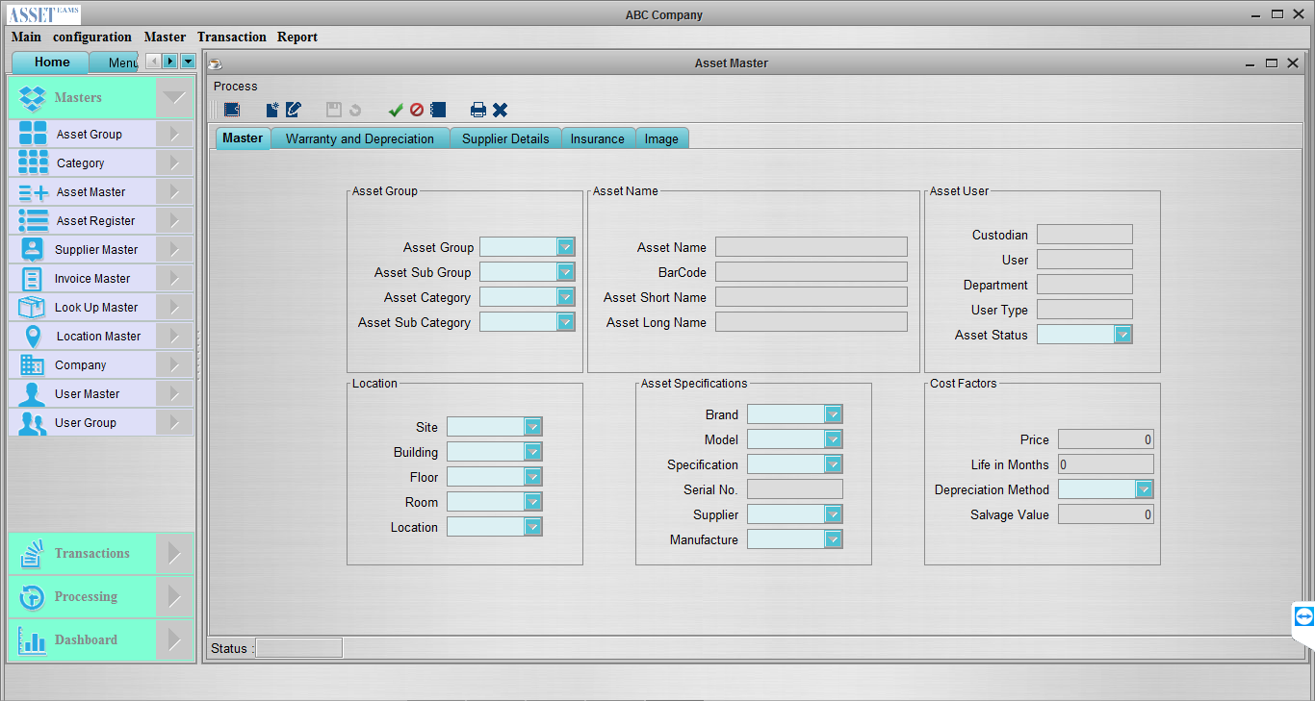
AMEX: Asset Master

Slide 15
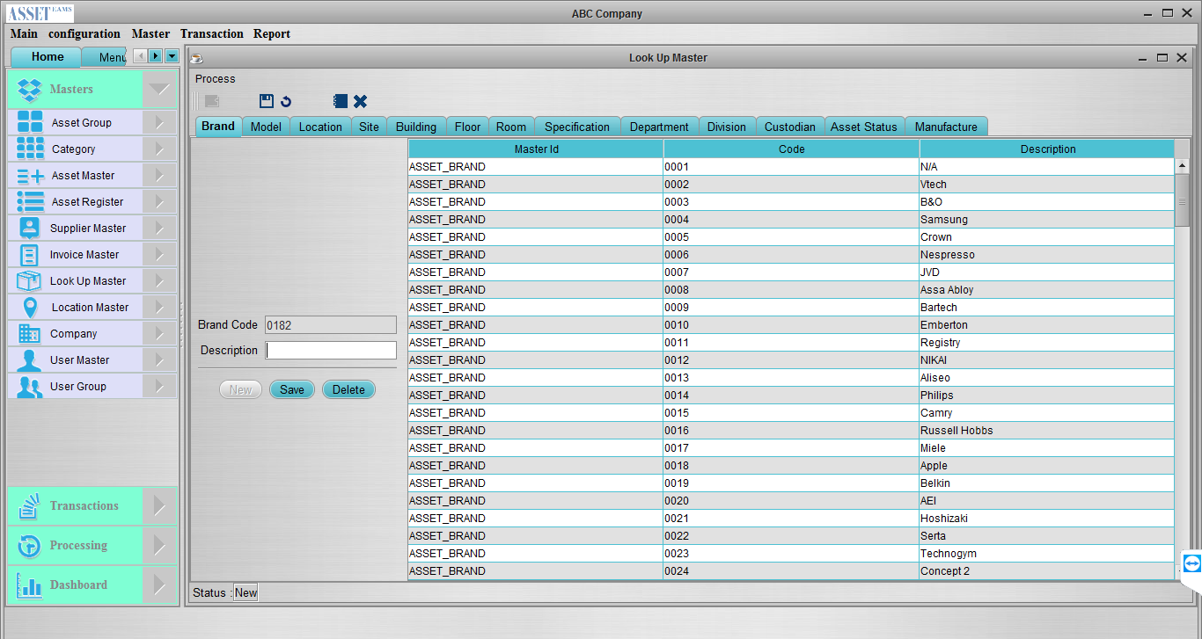
AMEX: Asset Lookup Masters

Slide 16
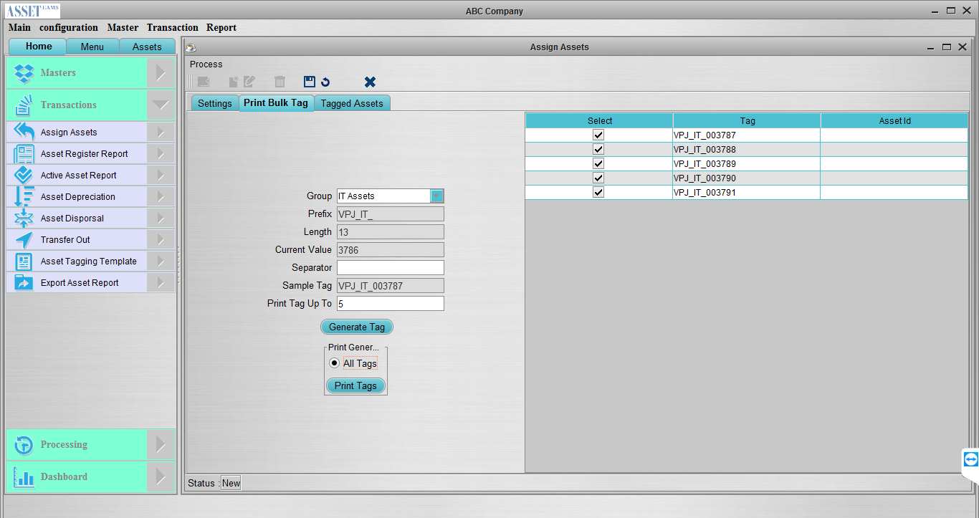
AMEX: Generate Asset Tags

Slide 17
AMEX: Asset Register Report

Slide 18
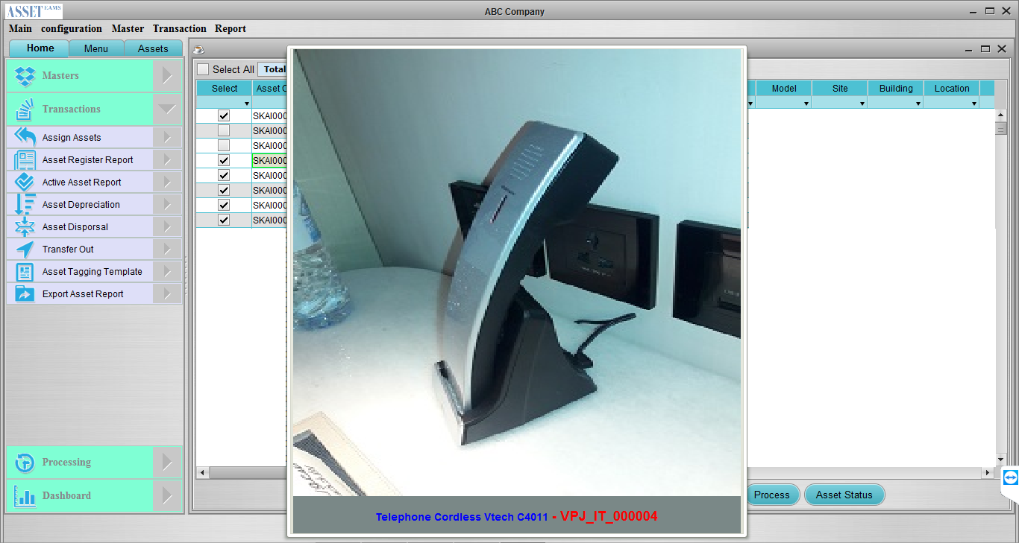
AMEX: Asset Images

Slide 19
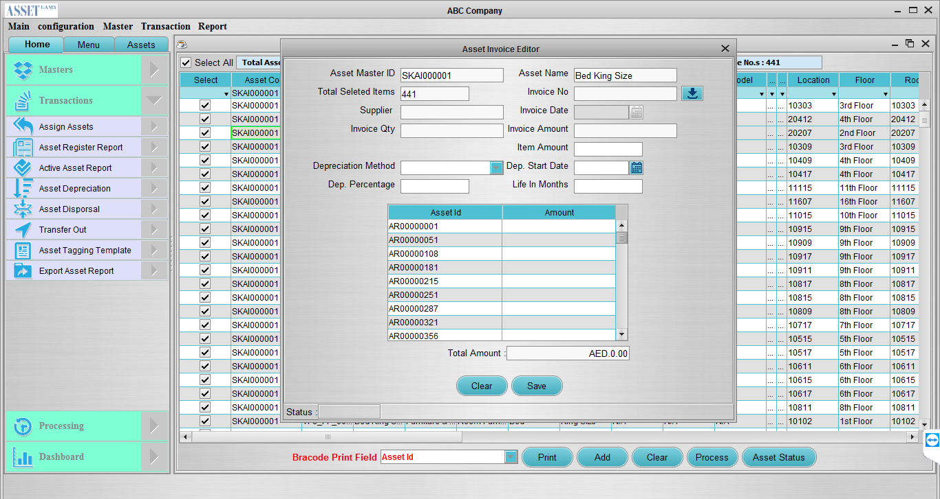
AMEX: Asset Invoice Matching

Slide 20
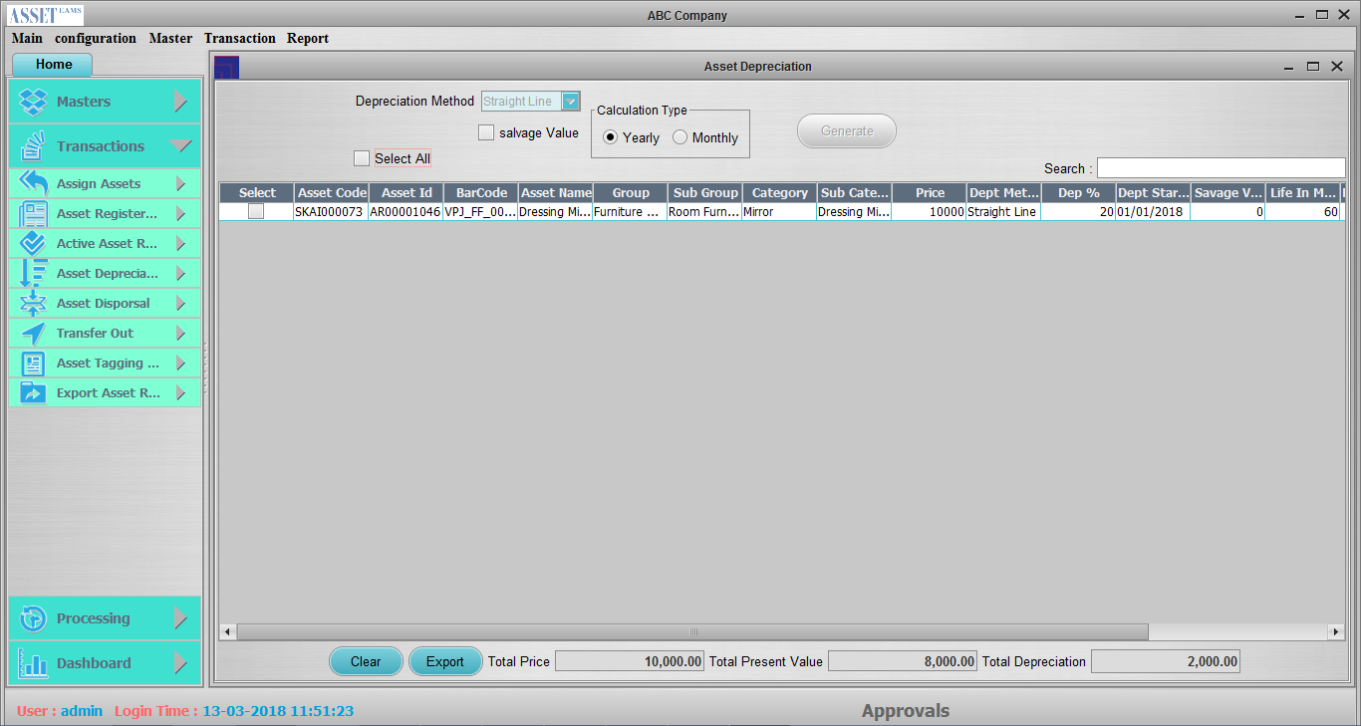
AMEX: Asset Depreciation

Slide 21
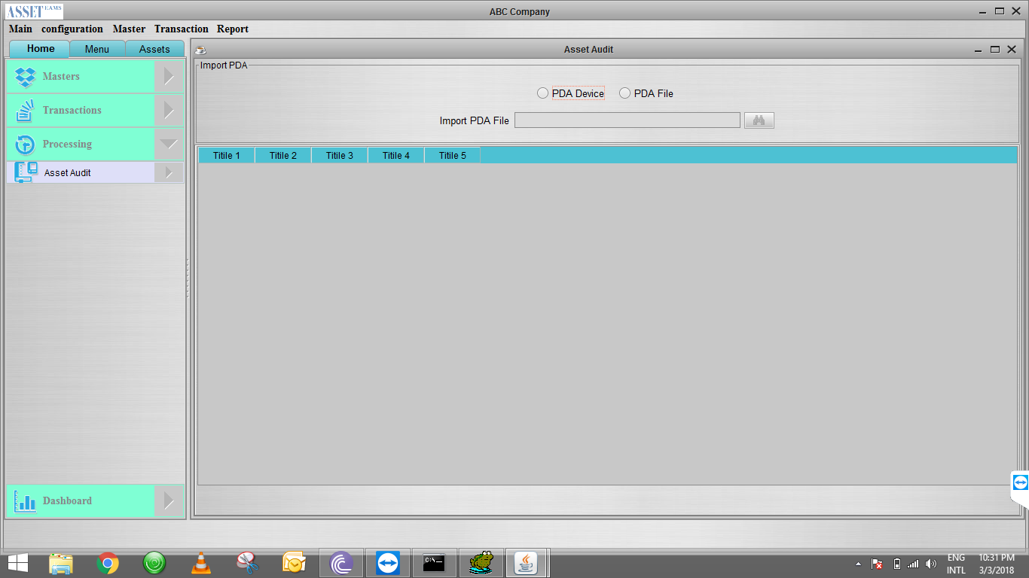
AMEX: Asset Auditing

Slide 22
AMEX : Other General Modules
Company Profile
User Master
User Group
Barcode Settings
Invoice Master
Supplier Master
Asset Tagging Template
Asset Audit Data Processing etc…

