Slide 1
WMS
Warehouse Stock Management System

Slide 2
Business Requirements
WMS system enables a company to maintain a centralized record of every assets/products in the control of the organization, providing a single source of truth for the location of every item and its needful information. WMS is a tool that allows you to track goods across your business’s supply chain. Barcode technology brings the concept of identifying and tracking your products. WMS integrates with barcode scanners for instant product identification and labeling which maintain just the right amount of inventory for each product and stocks
Create product master with all the needful data(By bulk data upload)
Generate unique barcodes for the products and fix.
Warehouse stock will update as per the barcode generation
Transfer Out/Check out items with help of PDA device.
Device will fetch product information and employee information and which will transfer to system
System will stock details as per the current warehouse stock and transfers/check outs

Slide 3
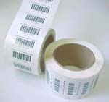
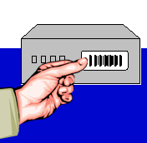
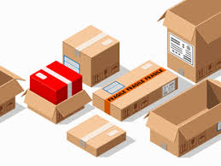
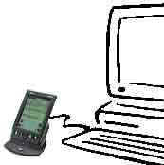
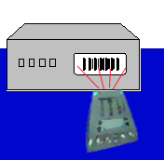

WMS Process
Step 1: Upload/Create
product master
Step 2:Print Barcodes
Step 3: Attach barcode to Product
Step 6: Stock reports
Step 4: Scan the barcode
For Transfer/Check out
Step 7:
The Result
Step 5: Enter Delivery information and update

