Slide 1
Language Identification from Short Audio Clips
Using MFCC and Classical ML
Predictive Analytics – Project #39 | AY 2025-26

Slide 2
Problem Statement
Task: Classify spoken language from 3–10 second audio clips
Target Languages: Malayalam, Tamil, Hindi, English, Kannada
Approach: Classical ML with handcrafted acoustic features (no deep learning)
Evaluation: Macro F1-score with 5-fold cross-validation
Challenge: Discriminating closely related Dravidian languages

Slide 3
Dataset Sources
Language | Source | Samples
Malayalam | OpenSLR SLR63 | ~1000
Tamil | OpenSLR SLR65 | ~1000
Hindi | OpenSLR SLR103 | ~1000
English | LibriSpeech SLR12 | ~1000
Kannada | OpenSLR SLR79 | ~1000

Slide 4
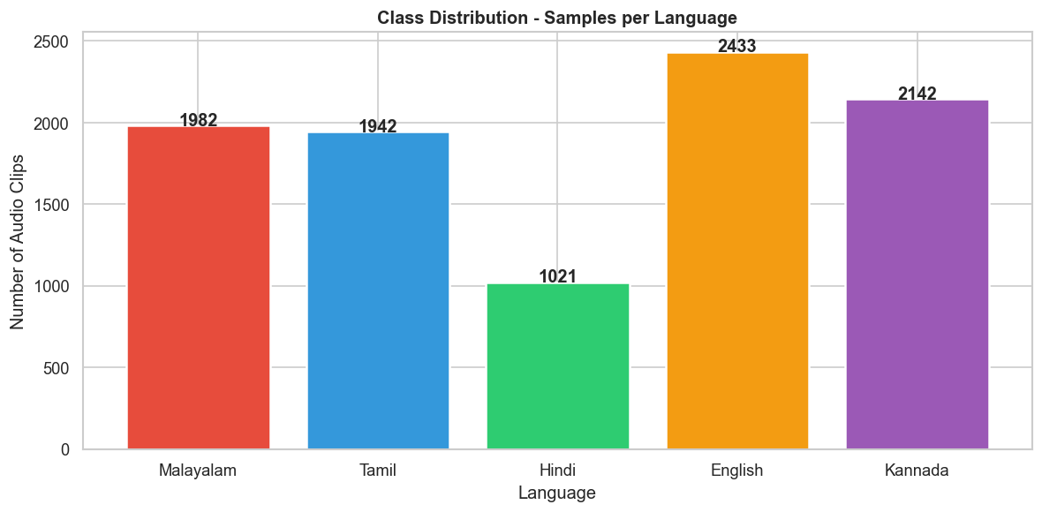
EDA: Class Distribution
Balanced dataset across 5 languages ensures fair evaluation.

Slide 5
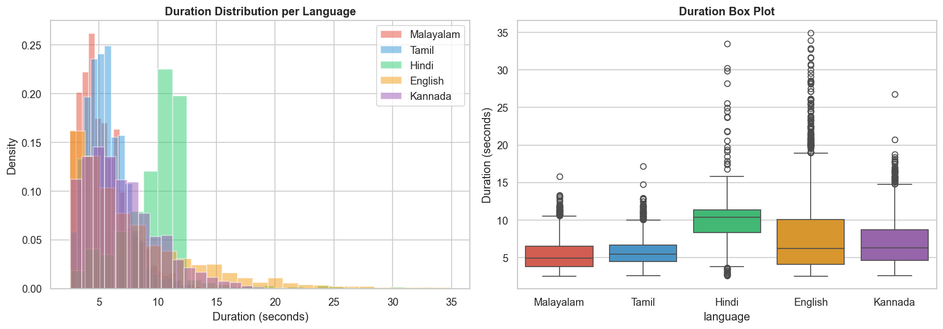
EDA: Duration Distribution
All clips standardized to 5.0 seconds during preprocessing.

Slide 6
Data Preprocessing Pipeline
1. Resampling to 16 kHz mono
2. Voice Activity Detection (VAD) – silence trimming
3. Duration standardization to 5.0 seconds
4. Amplitude normalization (RMS = 0.1)
5. Pre-emphasis filter (α = 0.97)

Slide 7
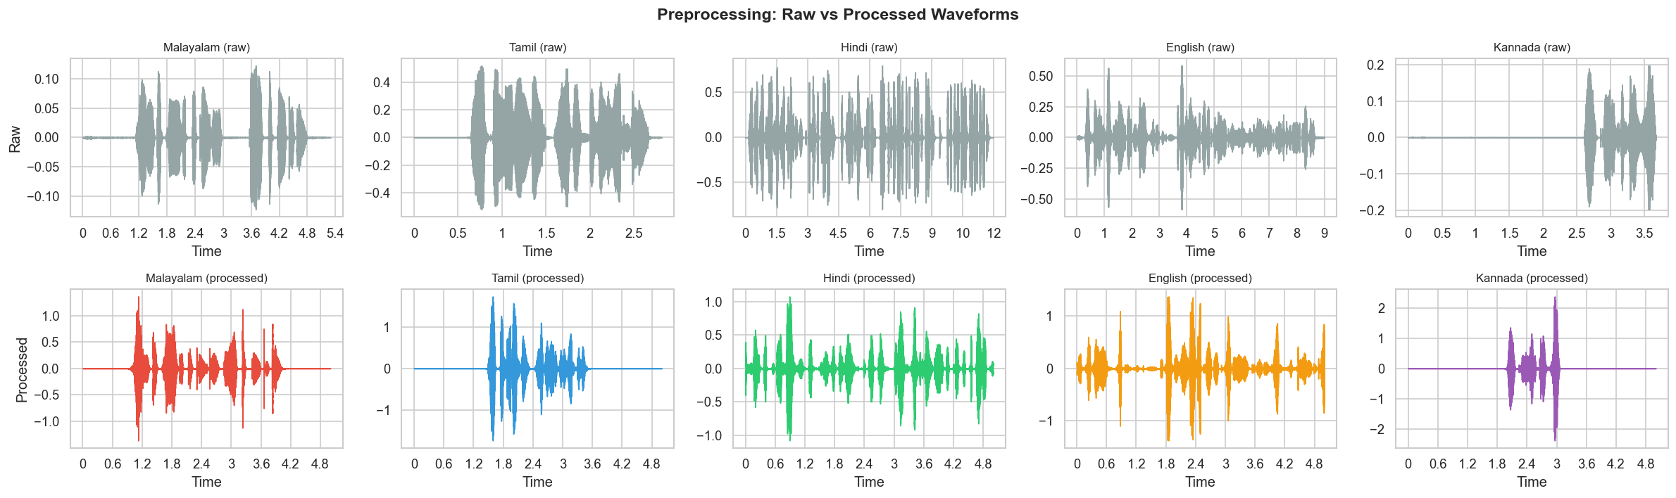
Preprocessing: Before vs After
Cleaning produces consistent signals for feature extraction.

Slide 8
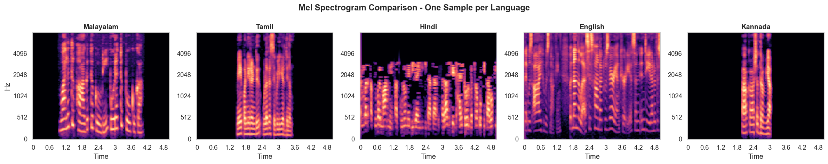
EDA: Spectrogram Comparison
Distinct spectral signatures across language families.

Slide 9
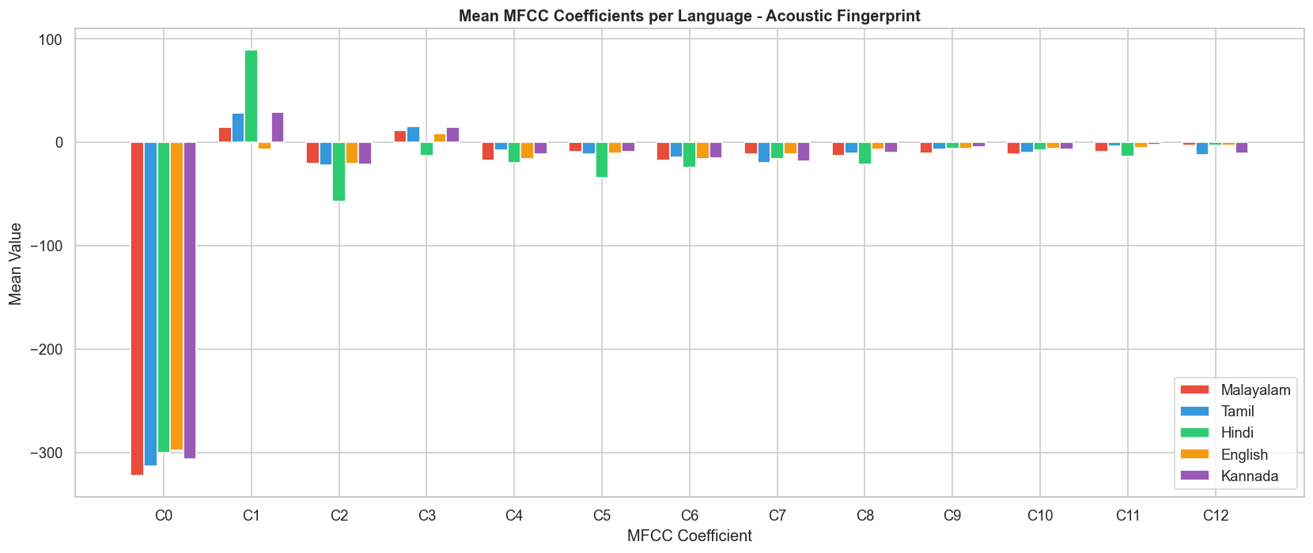
EDA: MFCC Profiles by Language
Clear separability in lower-order MFCC coefficients.

Slide 10
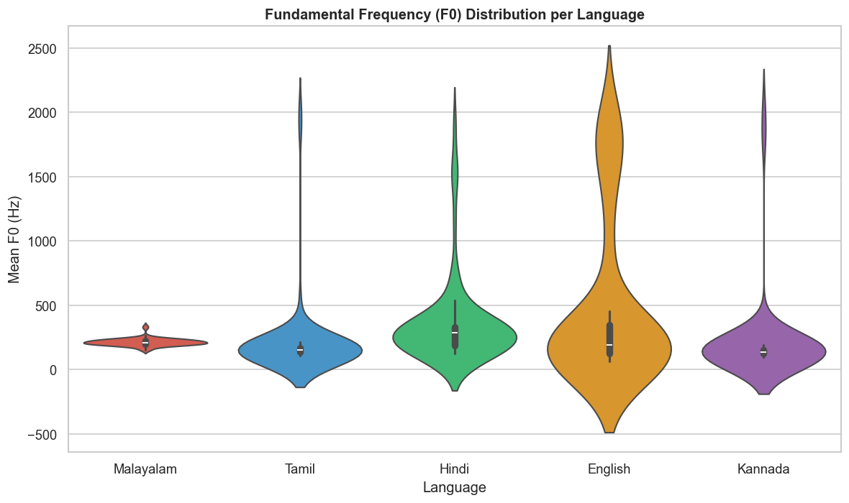
EDA: Pitch (F0) Distribution
Prosodic differences between language families visible in F0.

Slide 11
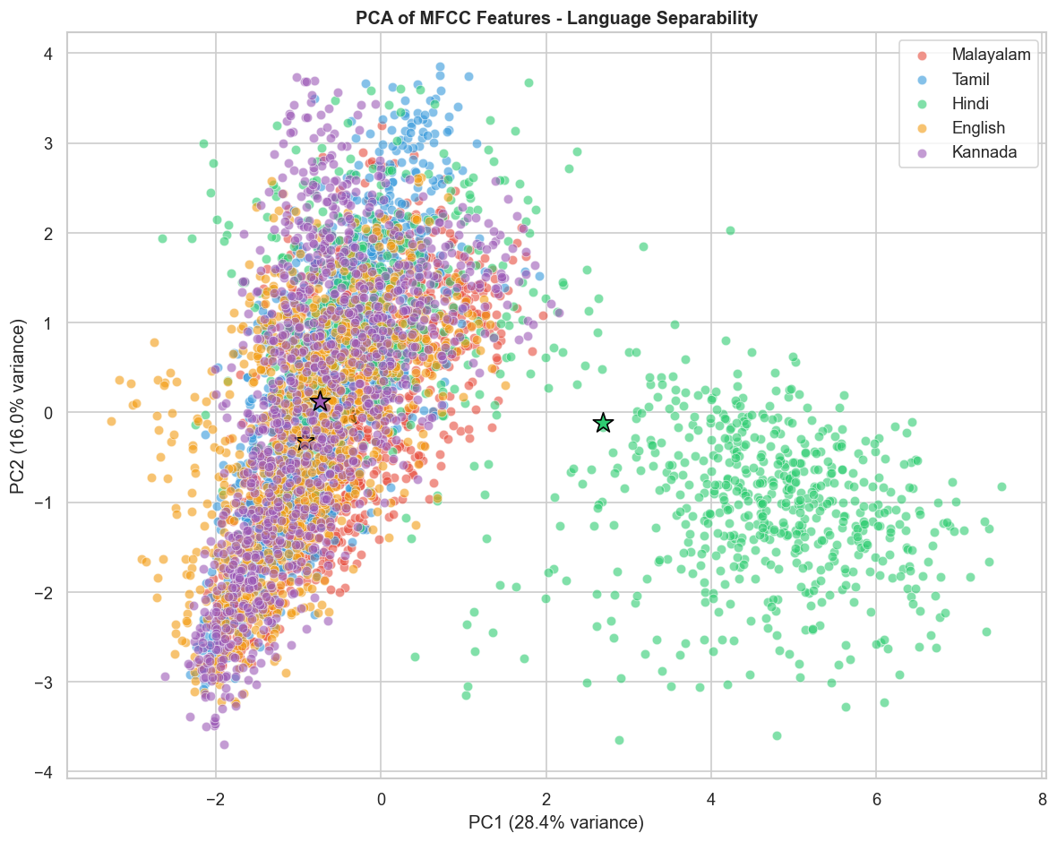
EDA: PCA Visualization
Feature space shows reasonable language separability in 2D.

Slide 12
Feature Engineering
Feature Group | Description | Dims
MFCC + Δ + ΔΔ | Cepstral (mean & std) | 78
Prosodic | Pitch, energy, rate | 6
Spectral | Centroid, rolloff, BW | 4
Phonotactic | ZCR proxy | 2
Total (selected) |  | 70

Slide 13
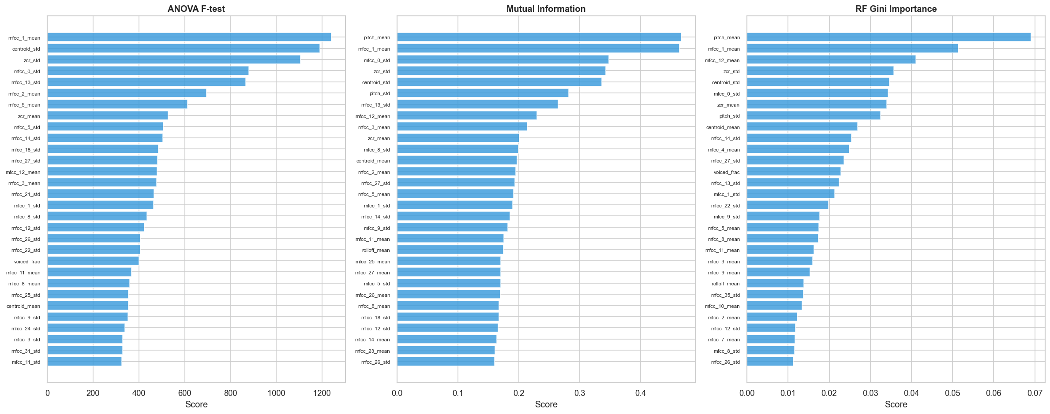
Feature Selection (SelectKBest)
Top 70 of 90 features retained using mutual information scoring.

Slide 14
Models Trained
SVM (RBF Kernel) – class_weight='balanced'
Random Forest – 200 estimators
Logistic Regression – 'lbfgs' solver, max_iter=2000
All use stratified 5-fold cross-validation
70 standardized features after SelectKBest

Slide 15
Model Comparison Results
Model | CV Macro F1 | Test Accuracy | Test Macro F1 | Macro AUC | Inference (ms)
SVM (RBF) | 0.9301 ± 0.0073 | 0.9210 | 0.9212 | 0.9943 | 0.18
Random Forest | 0.8979 ± 0.0140 | 0.9010 | 0.9011 | 0.9868 | 0.05
Logistic Regression | 0.8562 ± 0.0197 | 0.8600 | 0.8599 | 0.9764 | 0.00

Slide 16
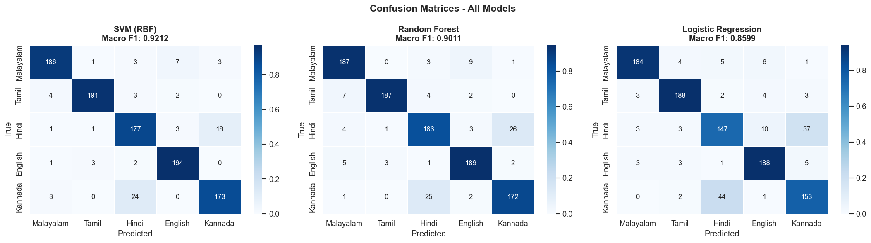
Confusion Matrices
Most confusions between related Dravidian languages (expected).

Slide 17
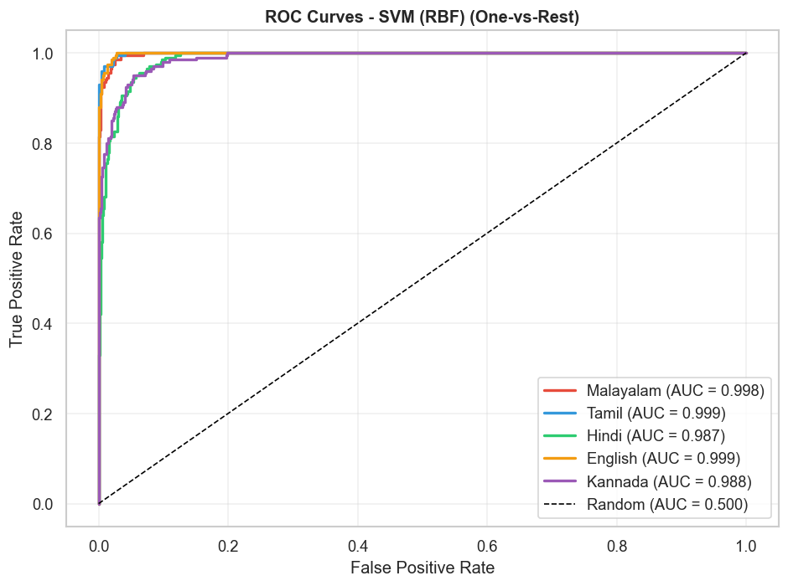
ROC Curves
All models achieve AUC > 0.97; SVM leads with 0.9943.

Slide 18
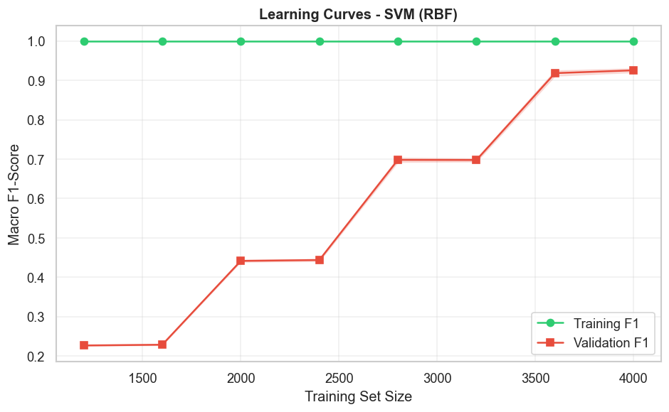
Learning Curves
Performance improves with data; no severe overfitting observed.

Slide 19
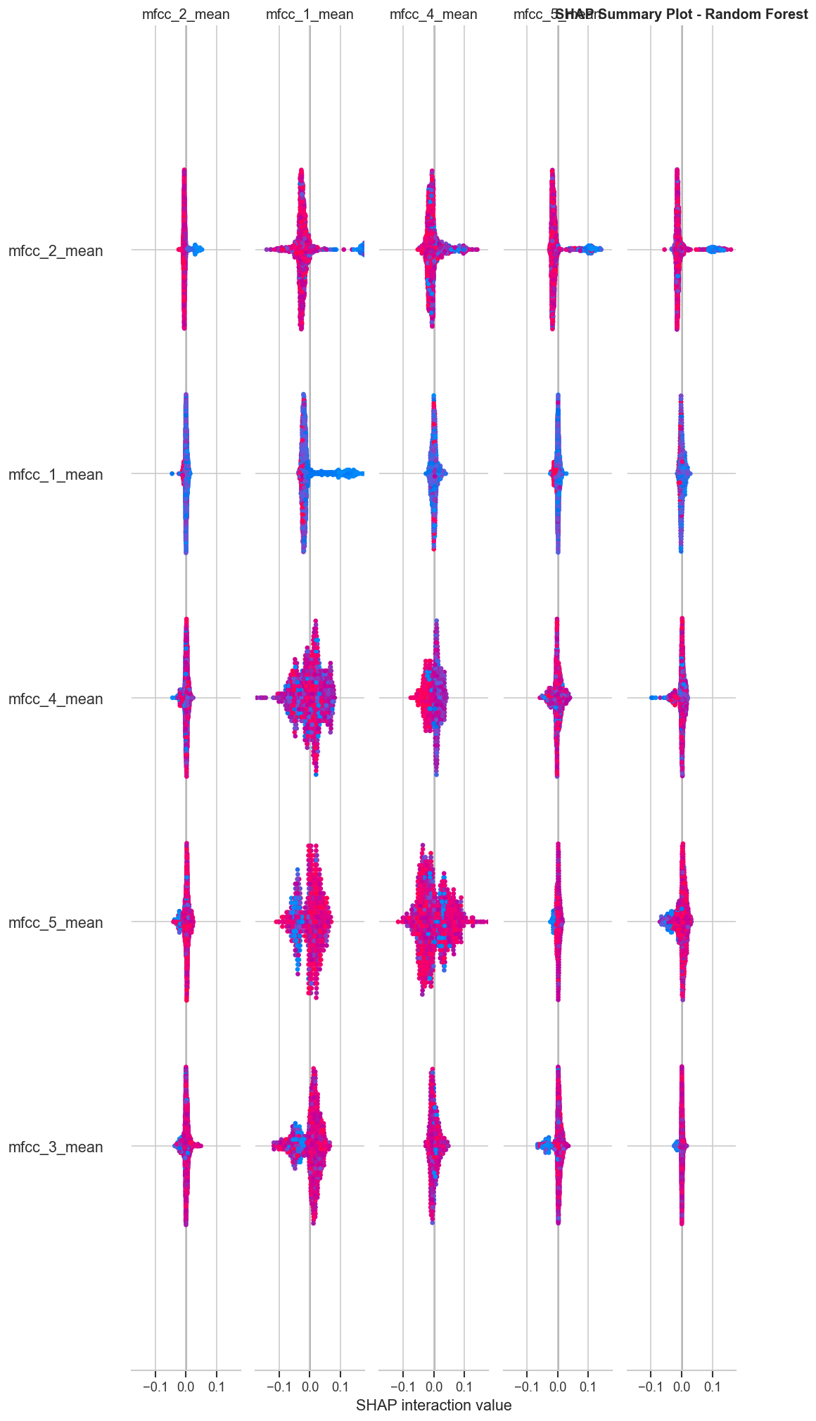
SHAP Analysis
SHAP values show MFCC dynamics dominate language discrimination.

Slide 20
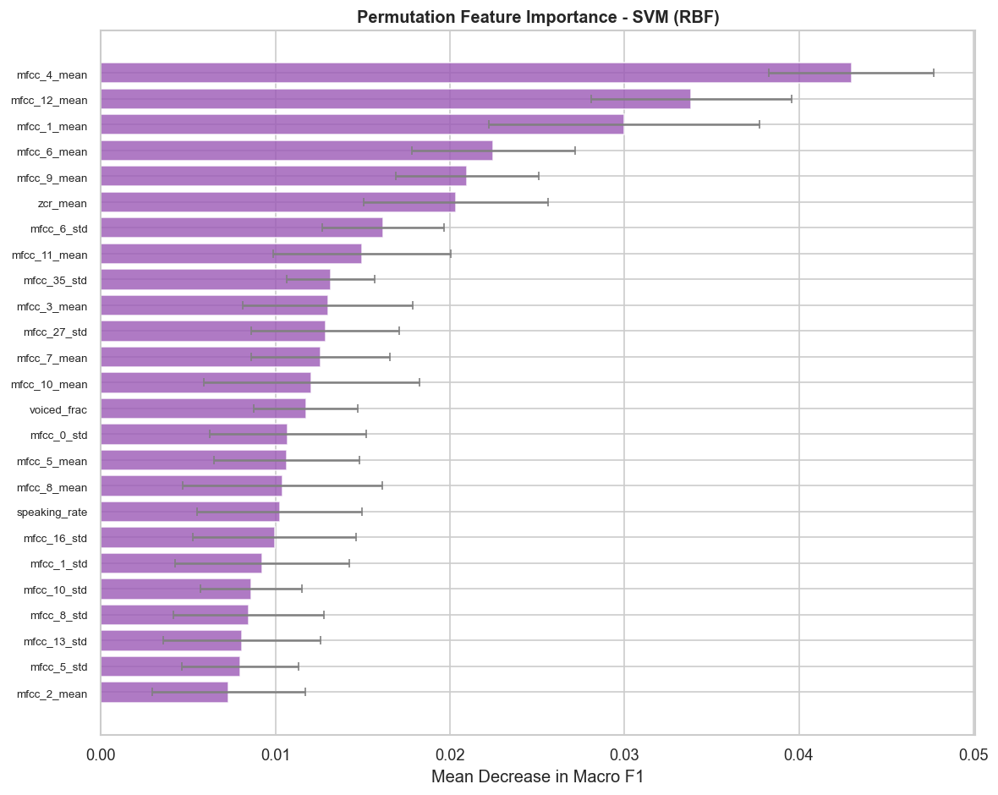
Permutation Feature Importance
Delta MFCC coefficients are most critical for classification.

Slide 21
Deployment: Streamlit Web App
Upload WAV/MP3/FLAC for real-time identification
Waveform & Mel spectrogram visualization
Class probability bar chart
Acoustic radar analysis
Multi-model comparison view
Run: streamlit run app.py

Slide 22
Key Findings & Conclusion
SVM (RBF) achieves best performance: 92.10% accuracy, 0.92 F1
MFCC dynamics are the most discriminative features
Dravidian languages show expected higher confusion rates
Multi-feature approach outperforms single feature families
All models exceed random baseline (20%) and target (78% F1)

Slide 23
Future Work
Deep learning comparison (x-vectors, wav2vec 2.0)
More Indian languages and dialects
Code-switching scenarios
Noisy and real-world audio conditions
Data augmentation for improved robustness

