Slide 1
PNEUMONIA DETECTION

Slide 2
Abstract
Pneumonia accounts for a significant proportion of patient morbidity and mortality.Pneumonia is an infection that influences the air sacs in one or both lungs.Early diagnosis and treatment of pneumonia is critical to preventing complica-tions including death.Chest X-rays are the most common imaging examination tool used in practice,critical for screening,diagnosis and management of a variety of diseases including pneumonia.
However,two thirds of the global population lacks access to radiology diag-nostics,according to an estimate by World Health Organization.Detecting pneumonia in chest radiography can be difficult for radiologists.The appearance of pneumonia in X-ray images is often vague,can overlap with other diagnosis and can mimic many other benign abnormalities.These discrepancies cause considerable variability among radiologists in the diagnosis of pneumonia.
In this project,builds a method that can automatically detect pneumonia from Chest X-ray.For that,here used advanced Machine Learning techniques.By using CNN(Convolutional Neural Network)the features in the image can be automatically extracted.Basically in this project the user can input a chest X-ray and the output is that the input have pneumonia or not.

Slide 3
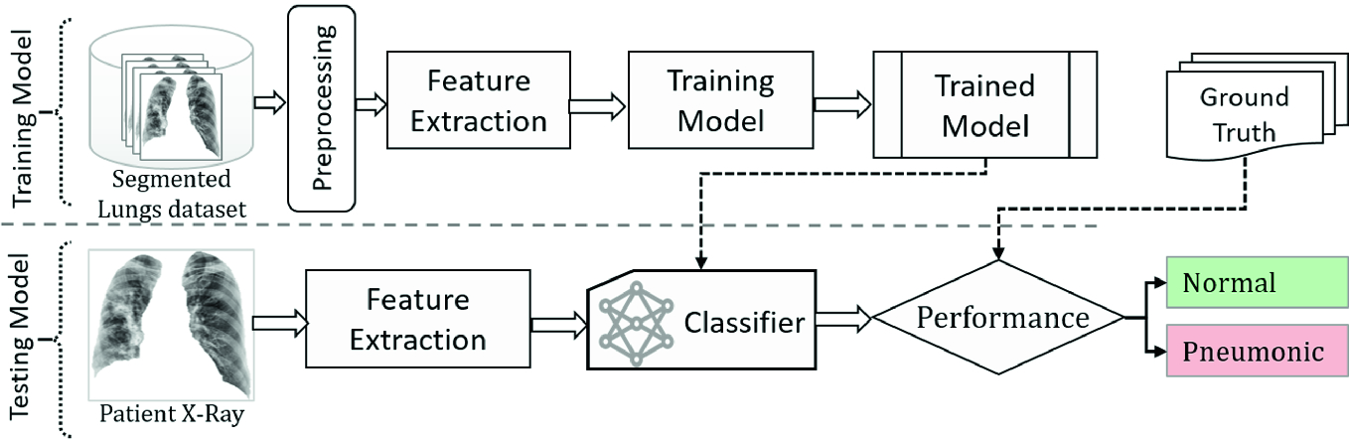
Working Diagram

Slide 4
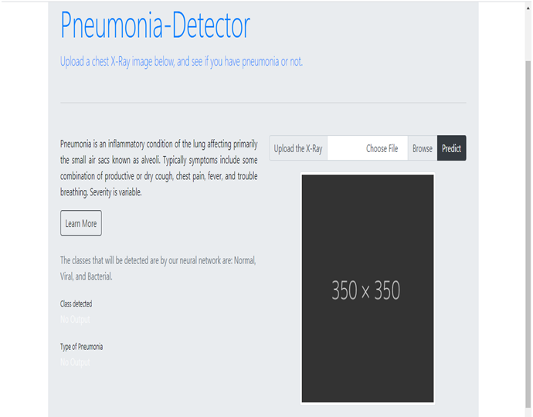
Template
Home Page

Slide 5
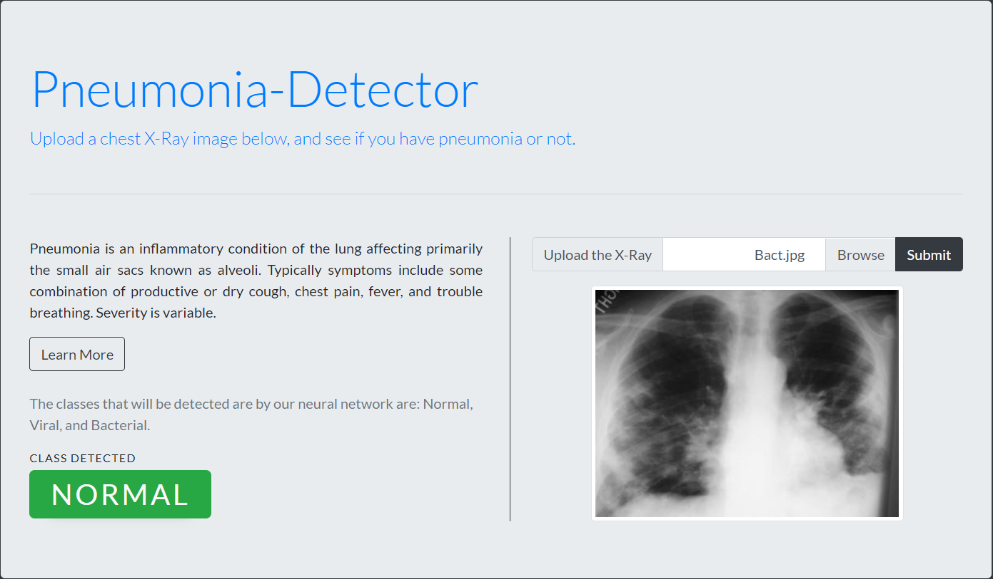
Prediction

Slide 6
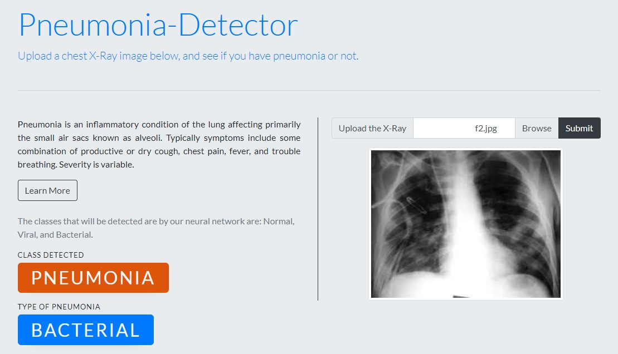

Slide 7
Git Repository
https://github.com/sreekuttyshaji5555/Pneumonia.git

