Slide 1

IBM NAAN MUTHALVAN AI- PHASE1
Fake News Detection Using NLP
TEAM MEMBER
NAME: SREELAKSHMI M
Regno: 721921243109

Slide 2

Fake News Detection Using NLP
Detecting fake news using Natural Language Processing (NLP) involves analyzing text data to identify misleading or false
information. Here's a simplified overview of the process
Data Collection: Gather a dataset of news articles, both real
and fake, with labeled annotations indicating their authenticity.
Text Preprocessing: Clean and preprocess the text data by
removing stop words, punctuation, and performing stemming or lemmatization.

Slide 3
Dataset Link: https:
//www.kaggle.com/datasets/clmentbisaillon/fake-and-real-news- dataset
Phase 1: Problem Definition and Design Thinking
Problem Definition: The problem is to develop a fake news detection model using a Kaggle dataset. The goal is to distinguish between
genuine and fake news articles based on their titles and text. This
project involves using natural language processing (NLP) techniques to preprocess the text data, building a machine learning model for classification, and evaluating the model's performance.

Slide 4
Design Thinking:
Data Source: Choose the fake news dataset available on Kaggle,
containing articles titles and text, along with their labels (genuine or fake).
Data Preprocessing: Clean and preprocess the textual data to prepare it for analysis.
Feature Extraction: Utilize techniques like TF-IDF (Term Frequency- Inverse Document Frequency) or word embeddings to convert text into numerical features.
Model Selection: Select a suitable classification algorithm (e.g.,
Logistic Regression, Random Forest, or Neural Networks) for the fake news detection task.
Model Training: Train the selected model using the preprocessed data.
Evaluation: Evaluate the model's performance using metrics like accuracy, precision, recall, F1-score, and ROC-AUC.

Slide 5
Datasets
.FakeNewsNet: This dataset contains fake news articles and their
sources. It includes various types of fake news, such as satire, hoaxes, and propaganda. The dataset also provides information about the
sources of these articles.
LIAR Dataset: The LIAR dataset contains statements labeled as true or false. It was created by fact-checking statements made by politicians. Each statement is accompanied by additional metadata, making it
suitable for research on fake news detection.
FakeNewsChallenge Dataset: This dataset was used for the Fake News Challenge competition. It contains a large number of news articles
labeled as "true" or "false." It's suitable for training and evaluating fake news detection models.

Slide 6
Model Selection: Choose an appropriate NLP model for fake news detection. Common models include:
- Logistic Regression
- Naive Bayes
- Support Vector Machines (SVM)
- Deep Learning models (e.g., Recurrent Neural Networks - RNNs, Convolutional Neural Networks - CNNs, or Transformer -based models like BERT).
Training: Train the selected model on the preprocessed dataset, using the labeled data to learn patterns that
distinguish fake news from real news.
Evaluation: Evaluate the model's performance using metrics like accuracy, precision, recall, F1-score, and ROC-AUC to
measure how well it distinguishes fake news from real news.

Slide 7
source code

Slide 8

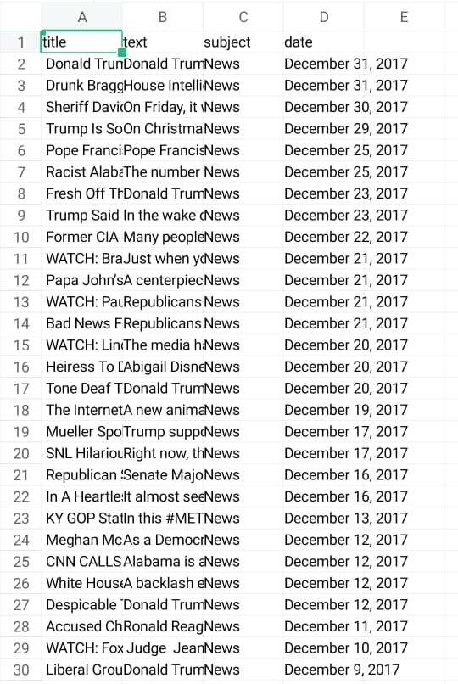
Dataset

Slide 9
Fine-tuning: Optimize the model by adjusting
hyperparameters or using techniques like cross- validation to improve its performance.
Deployment: Deploy the trained model in a real- world environment where it can analyze and
classify news articles as fake or real.

Slide 10
Continuous Monitoring: Continuously update and retrain the model with new data to
adapt to evolving techniques used to create fake news.

Slide 11



