Slide 1
Git
To check the git installed or not
git --version
Initialize git locally
git init
Configure git
git config --global user.name “username”
git config --global user.email “email@example.com”
git config --global core.editor “code --wait”
git config --global core.autocrlf true

Slide 2
Add remote origin
git add remote origin “gitrepolink.git”
Create branch
git checkout –b <branch_name>
Add file to git locally
git add .
git add <directory>
Commit file with message
git commit –m “message”

Slide 3
Checking file status in local
git status
Check difference between local and Github
git diff
git diff “fileA”
Adding file to github repository
git push origin <branch_name>

Slide 4
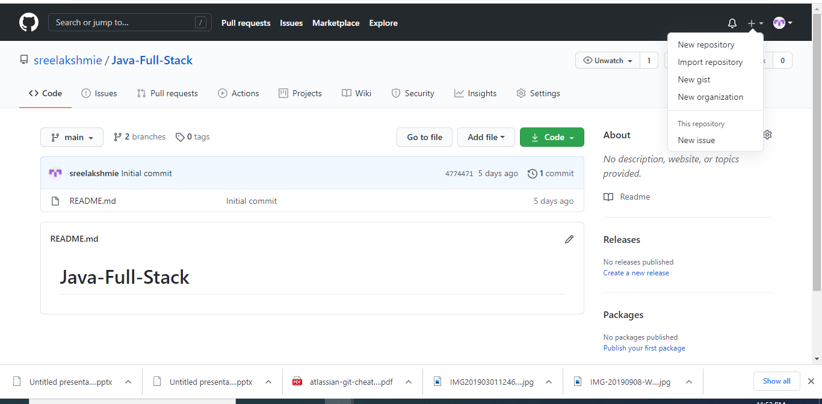
Github
Creating a new repository

Slide 5
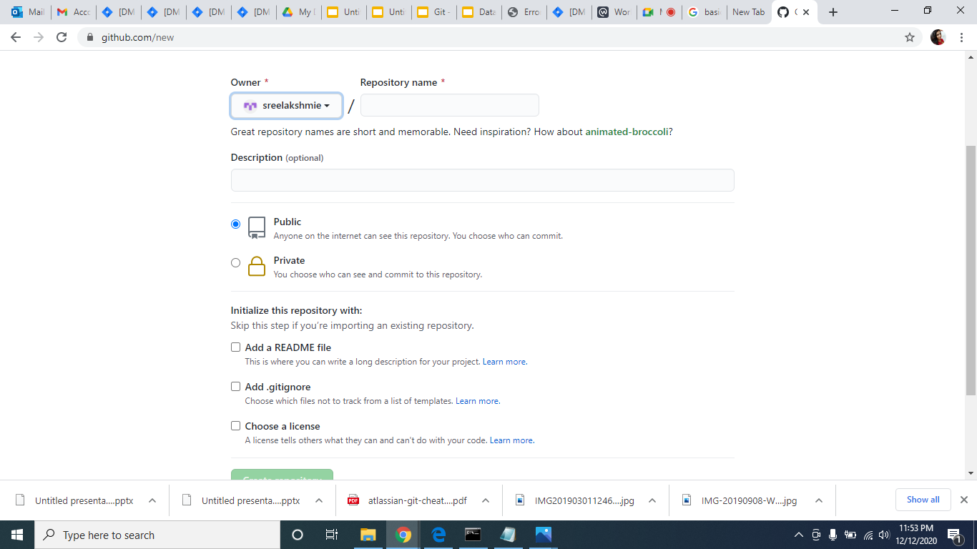

Slide 6
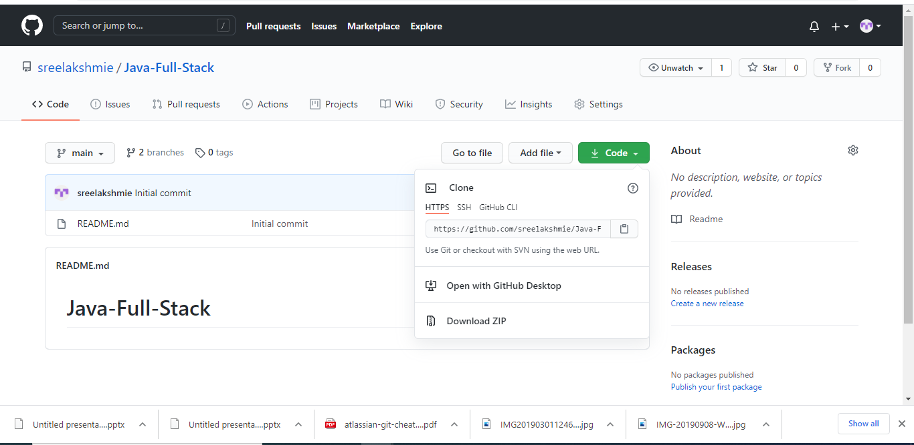
Getting Repository Link From Code button

