Slide 1
MongoDB - Index
SREELAKSHMI E NAIR UID : 161099 sreelakshmi.nair1@ust.com

Slide 2
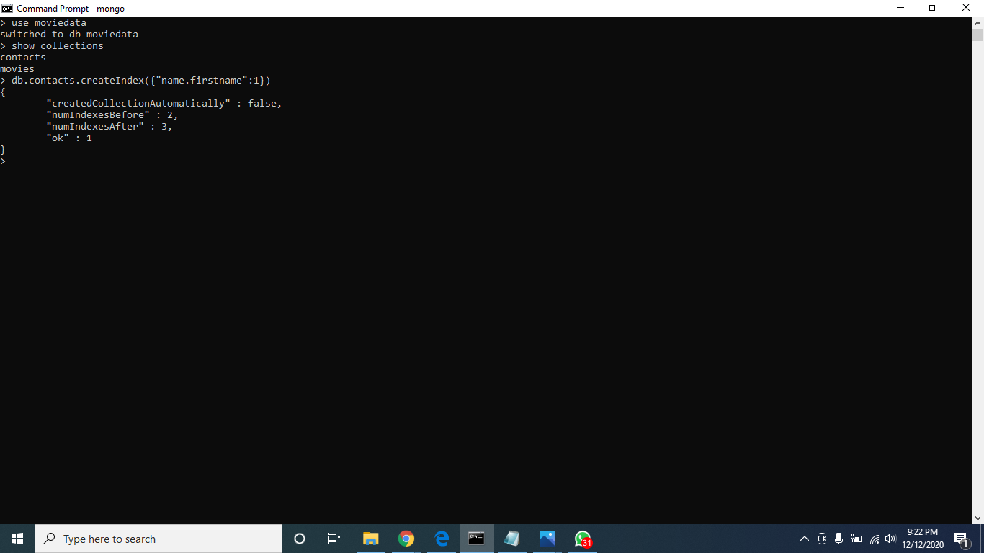
Create Index :

Slide 3
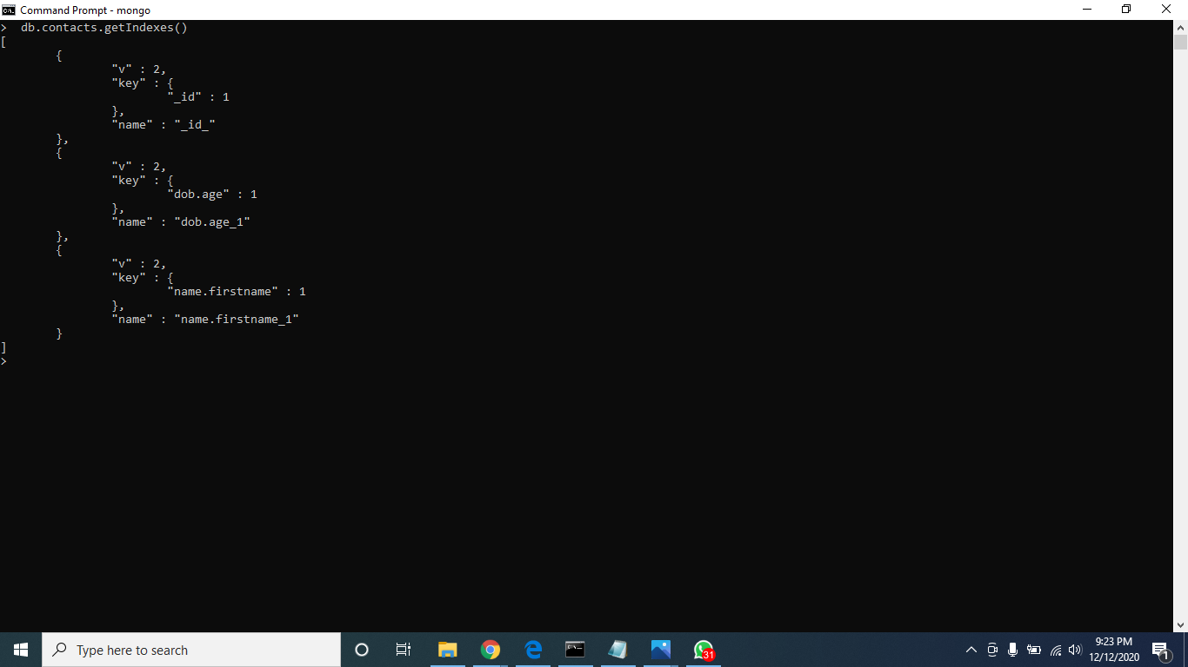
Get Index :

Slide 4
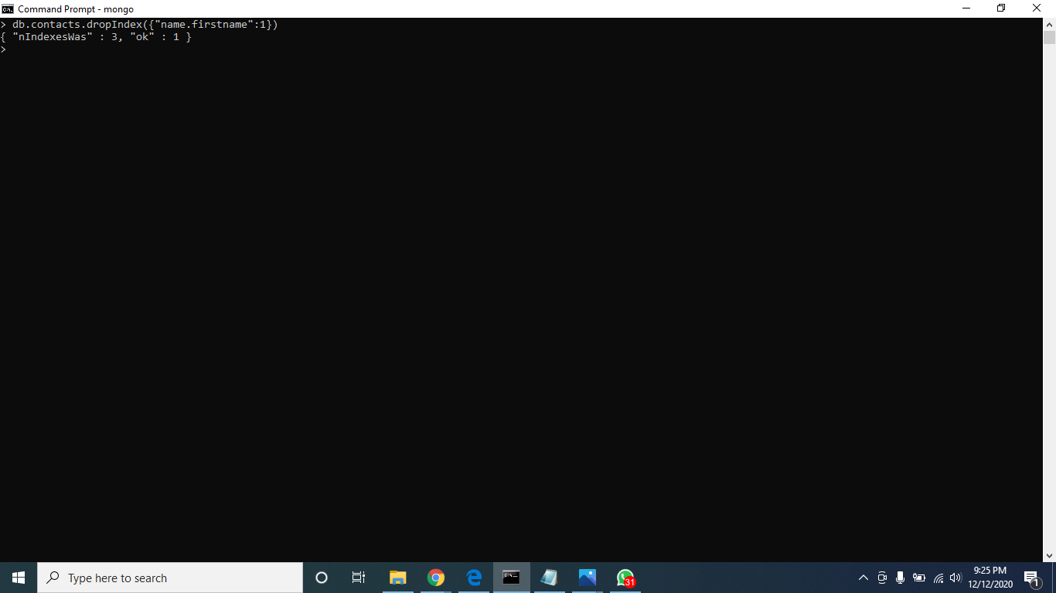
Drop Index :

Slide 5
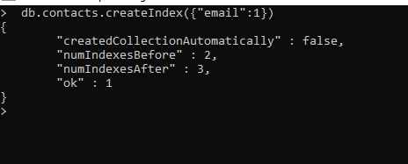
Single Index :

Slide 6

Compound Index :

Slide 7
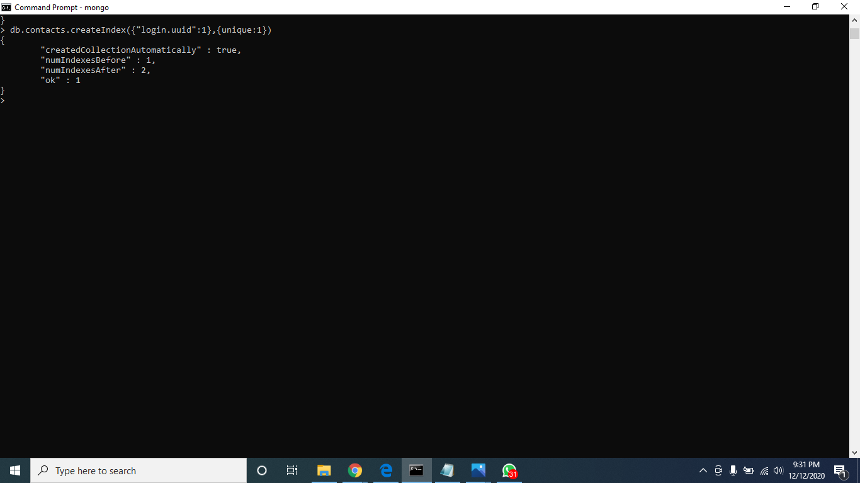
Unique Index :

Slide 8

TTL Index :

Slide 9
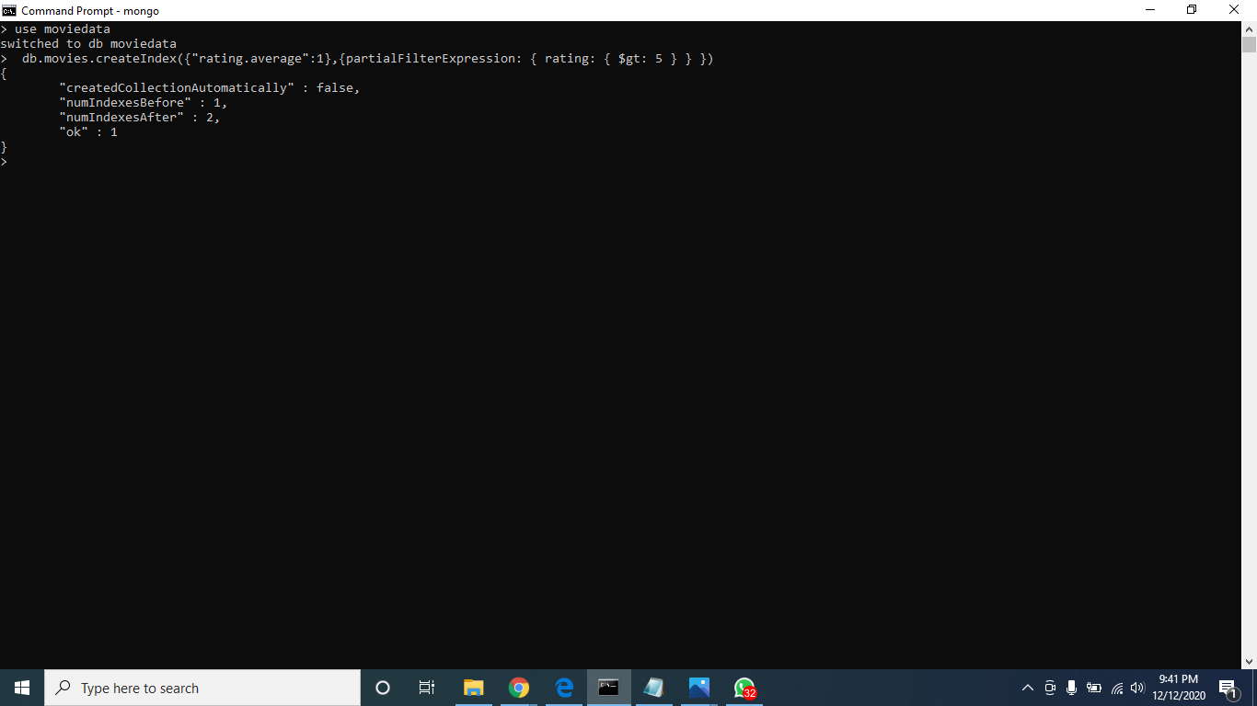
Partial filter Index :

