Slide 1
Query and Projection Operators
SREELAKSHMI E NAIR UID : 161099 sreelakshmi.nair1@ust.com

Slide 2
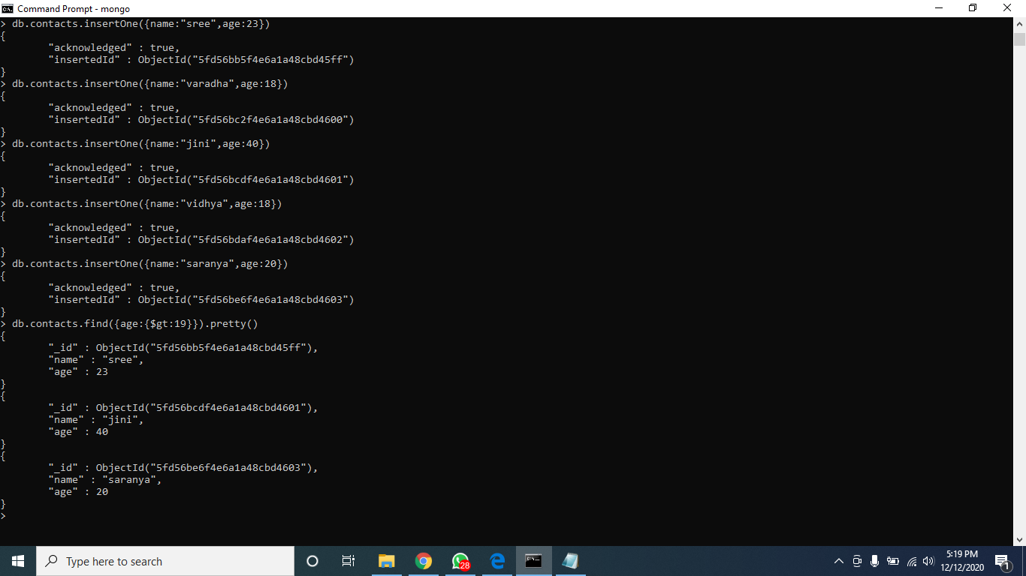
Comparison operators : Greater than : gt
g

Slide 3
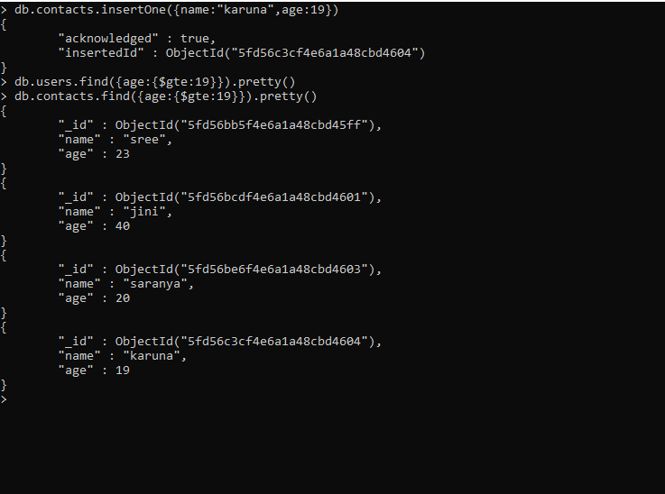
Greater than or equal to : gte

Slide 4
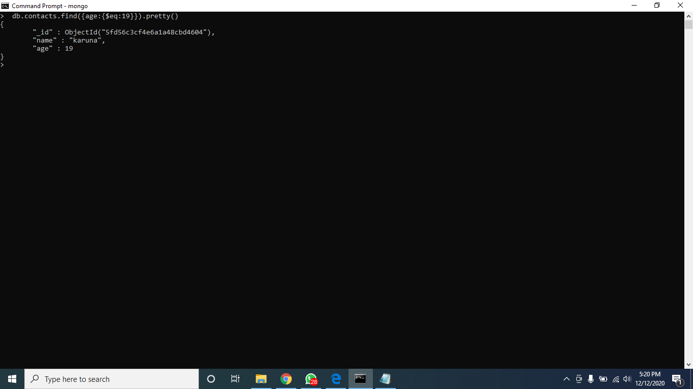
Equal : eq

Slide 5

in:

Slide 6

Less than : lt

Slide 7
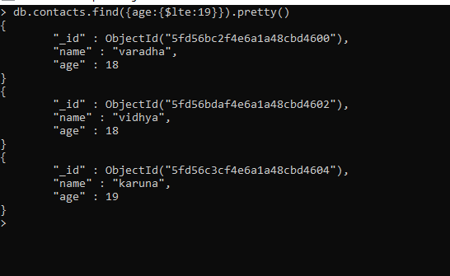
Less than or equal to : lte

Slide 8

Not Equals : ne

Slide 9

Not In : nin

Slide 10
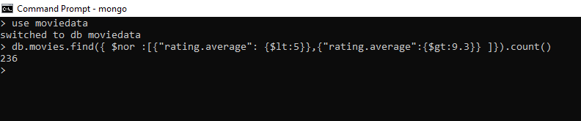
Logical Operators : NOR :

Slide 11

OR :

Slide 12

AND :

Slide 13

NOT :

Slide 14
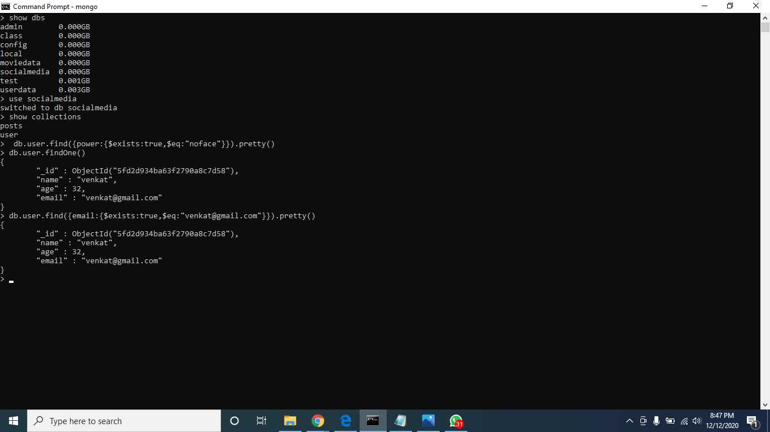
Element operators :

Slide 15
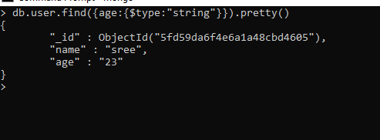

Slide 16
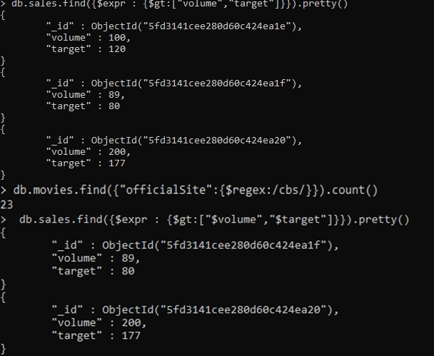
Evaluation operators :

Slide 17
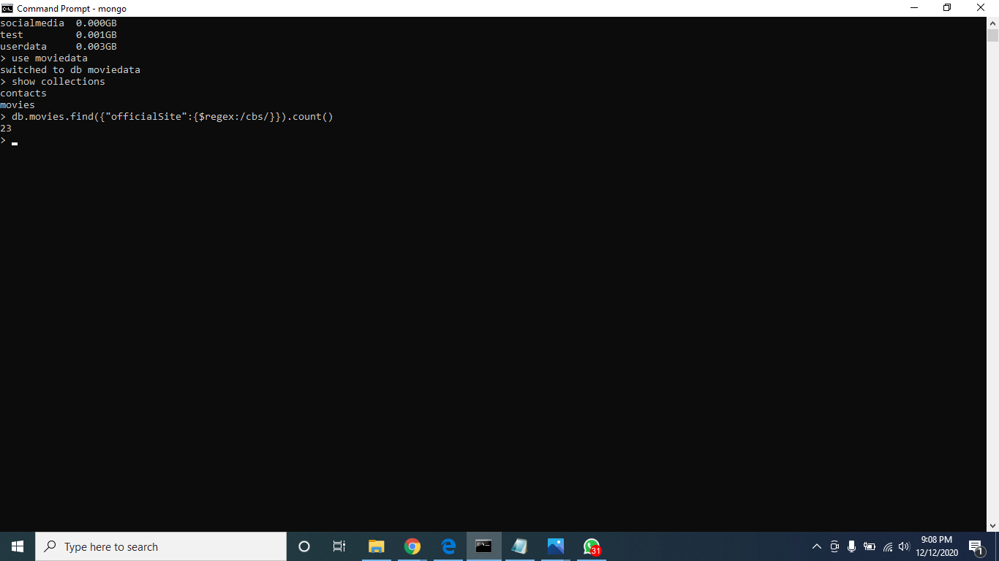

Slide 18
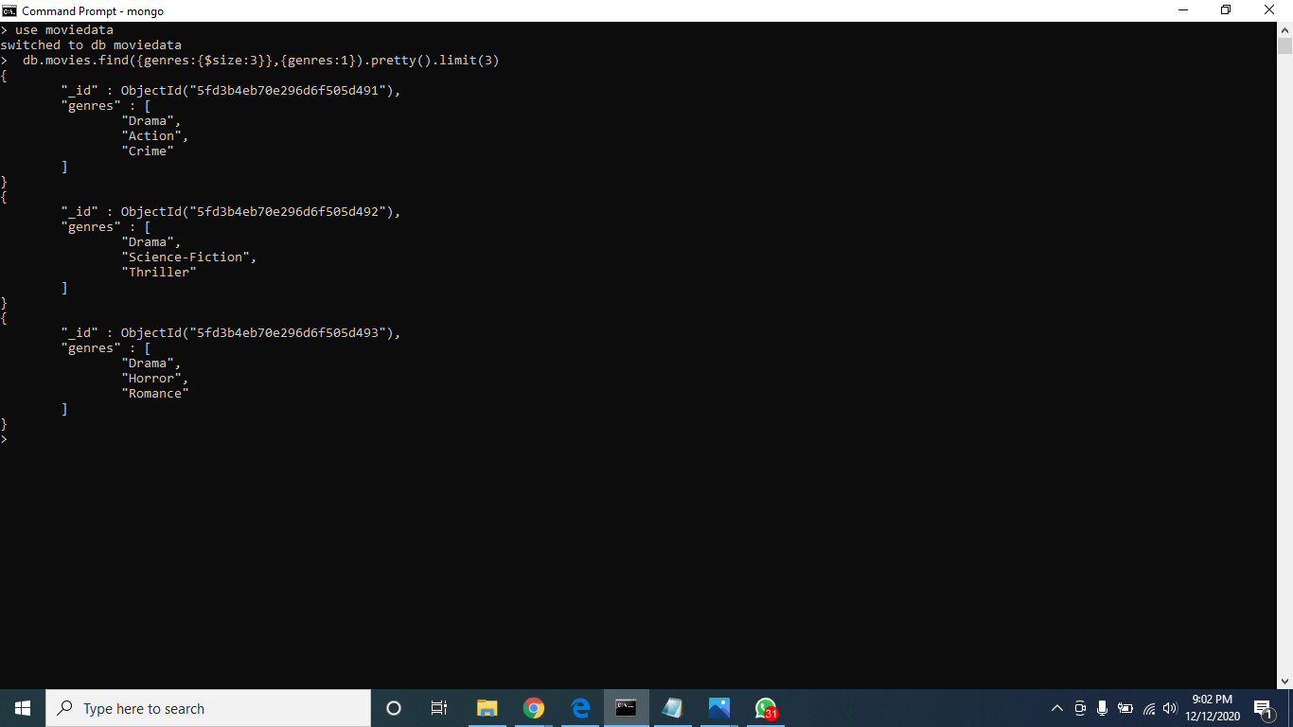
Array Operators :

Slide 19
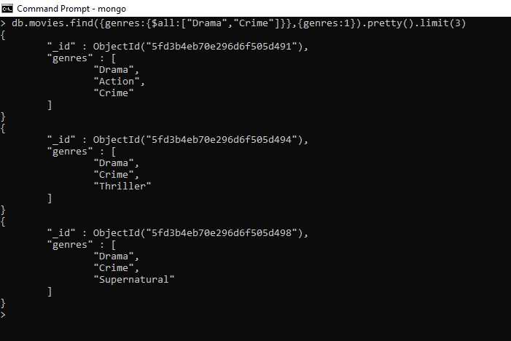

Slide 20


Slide 21
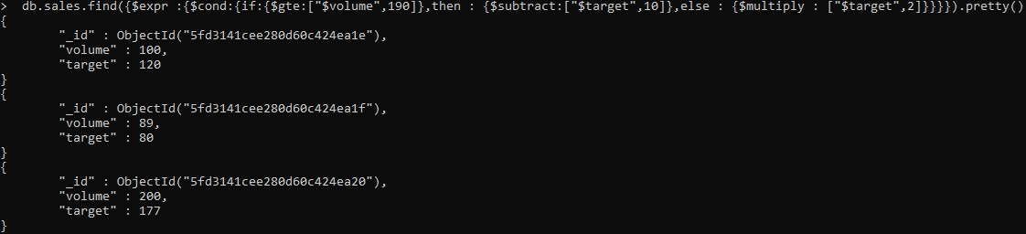
Aggregation pipeline operators :

