Slide 1
MongoDB - Day 2
SREELAKSHMI E NAIR UID : 161099 sreelakshmi.nair1@ust.com

Slide 2
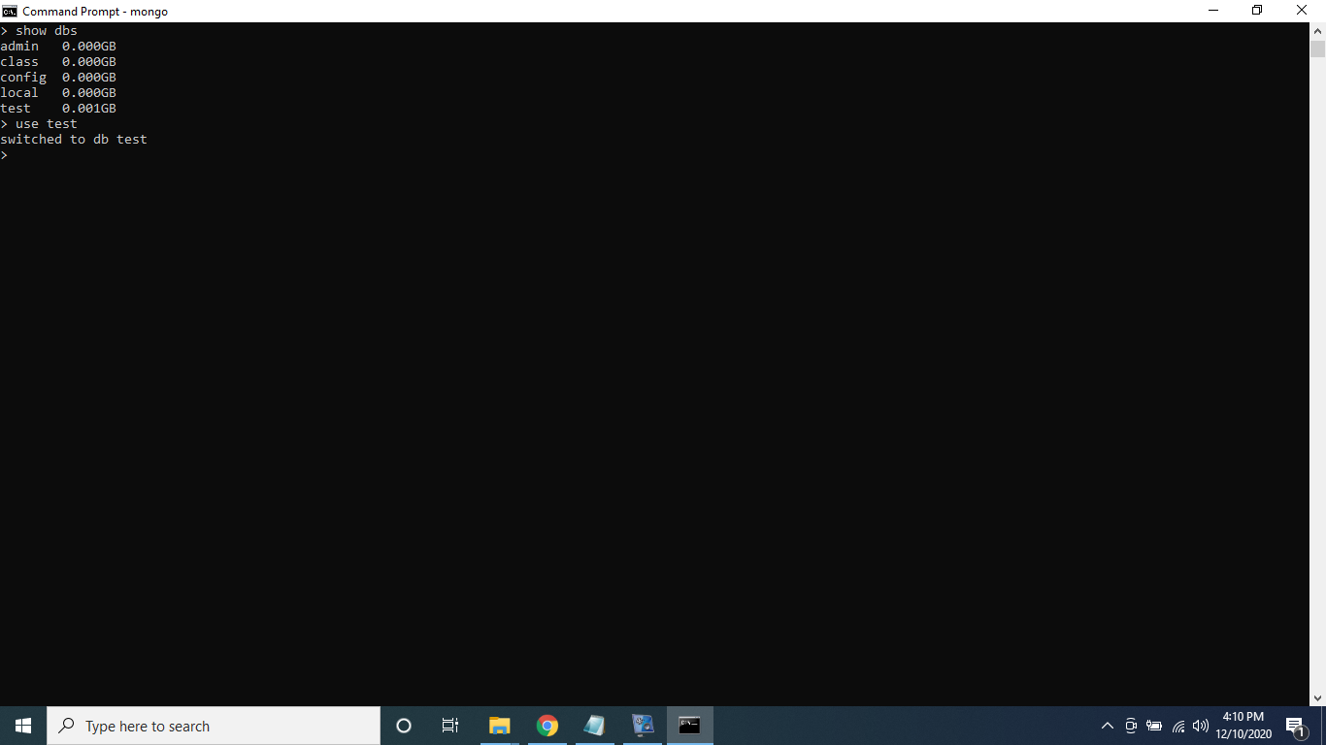
Switched to test DB

Slide 3

Inserting single Document

Slide 4
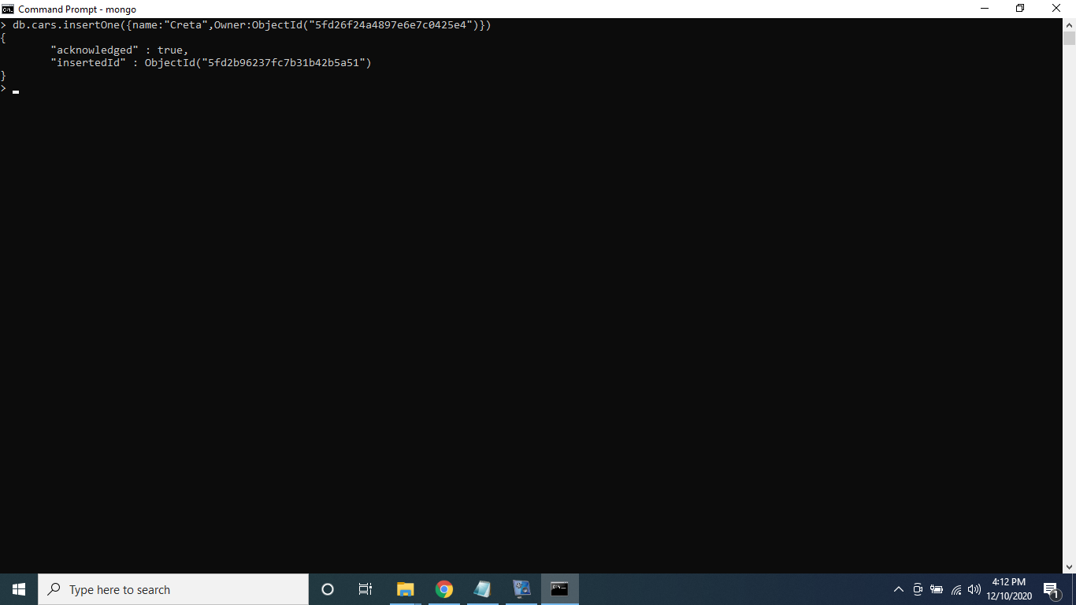
One to One Relation

Slide 5
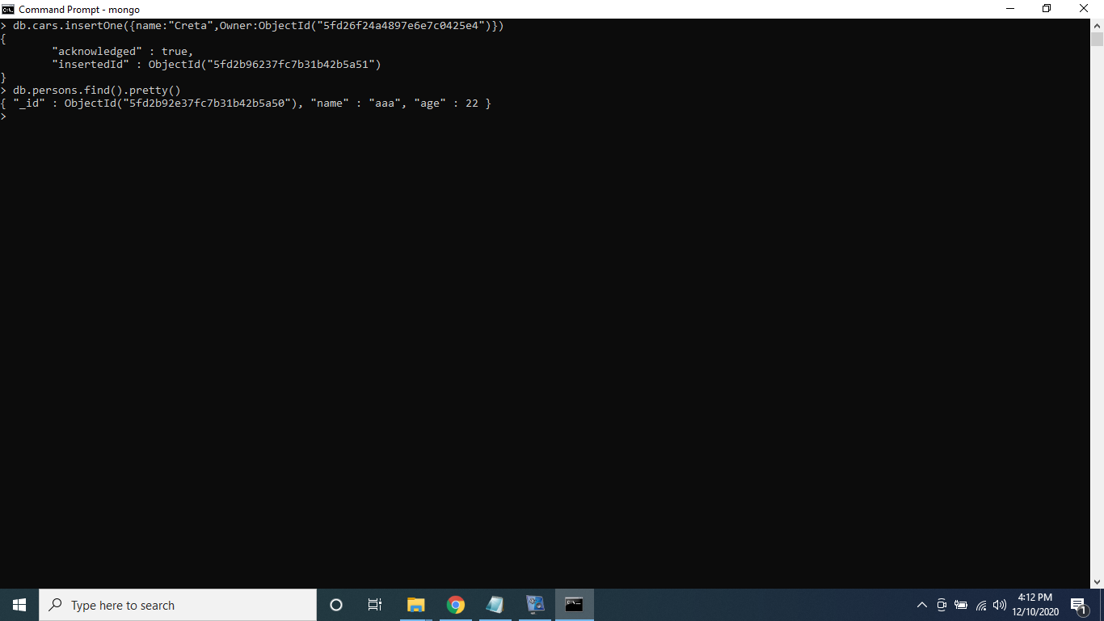
Displaying Result of One to one Relation

Slide 6


One to Many Relation

Slide 7

Displaying Result of One to Many Relation

Slide 8


Many to Many Relation Example 2

Slide 9
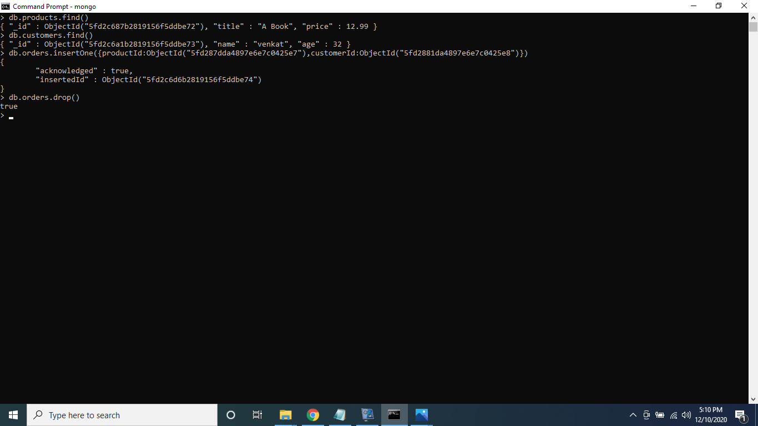

Slide 10
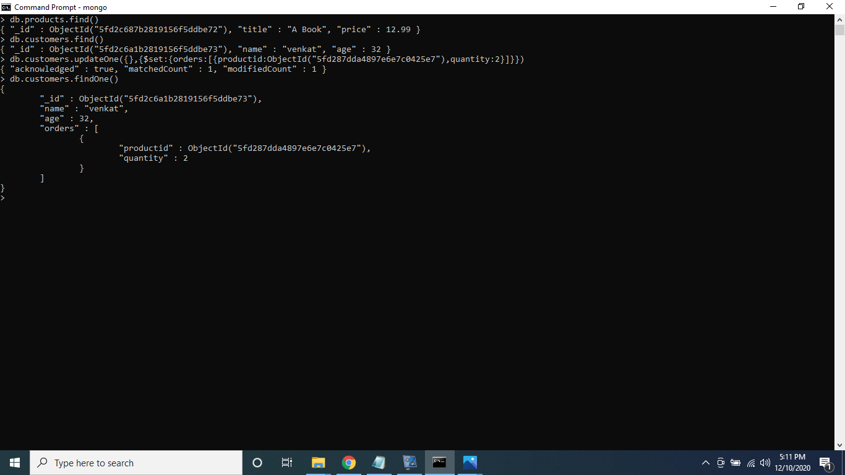


Slide 11

Many to Many Relation

Slide 12

Join using Lookup

Slide 13
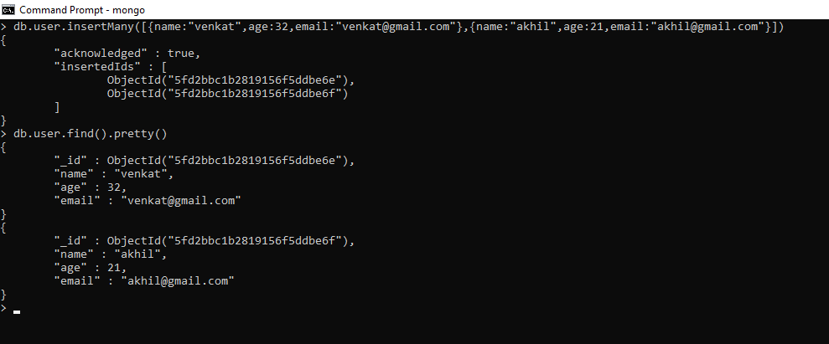
Blog - Project

Slide 14
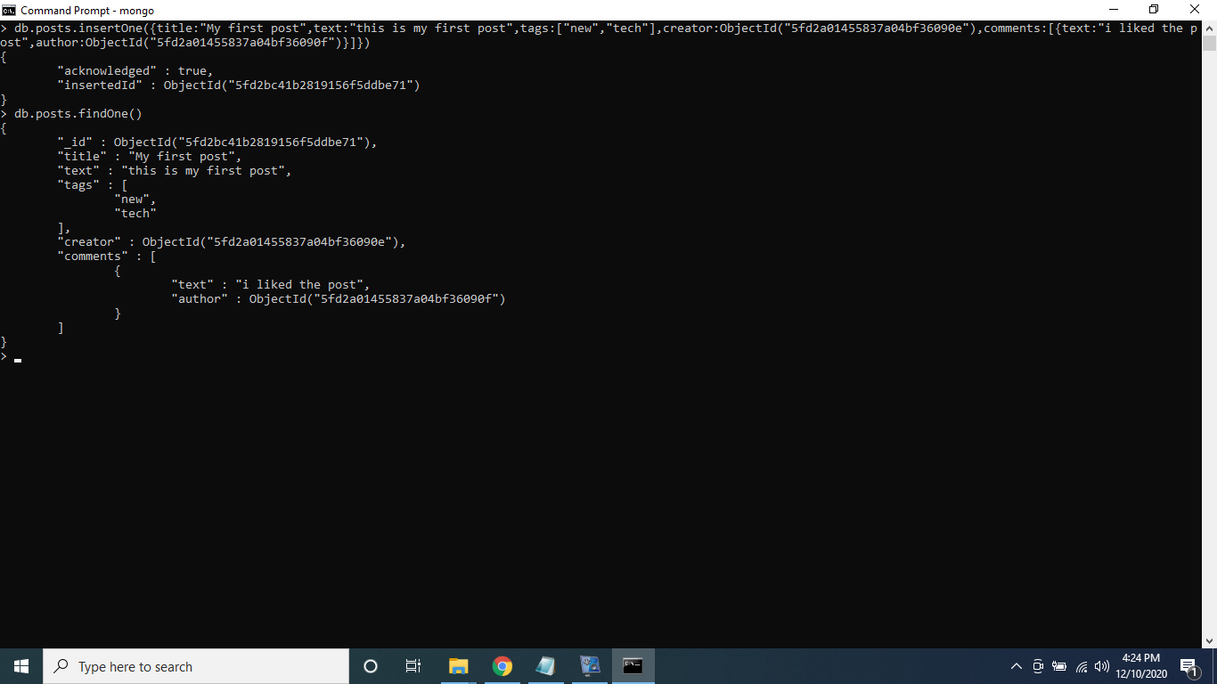

Slide 15
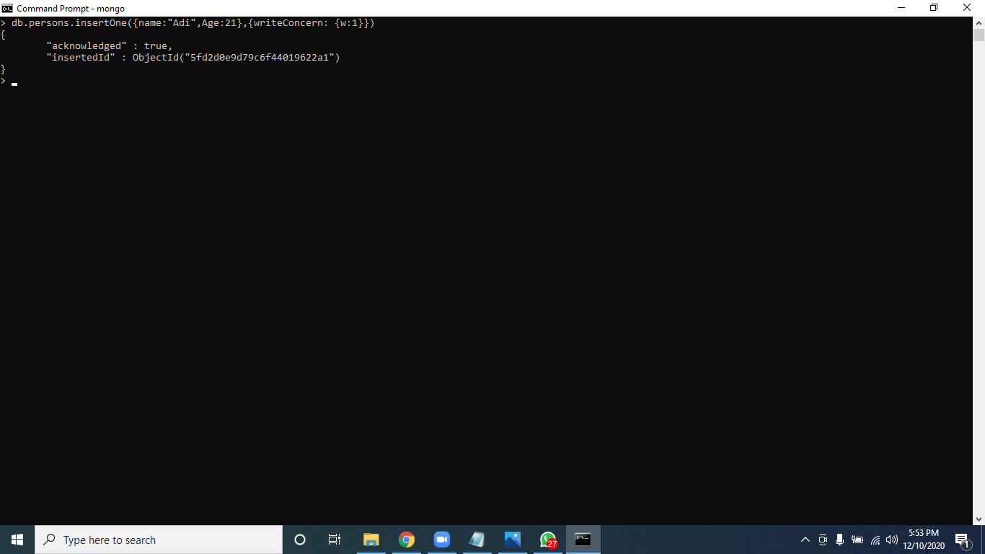
Insert - writeConcern

Slide 16


Slide 17


Slide 18
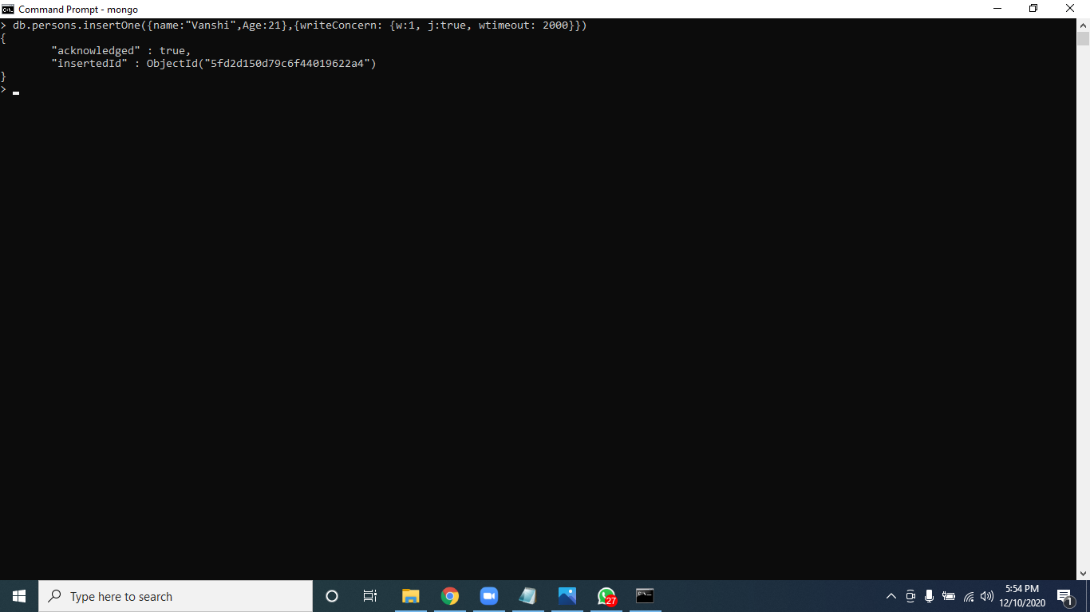

Slide 19


Slide 20
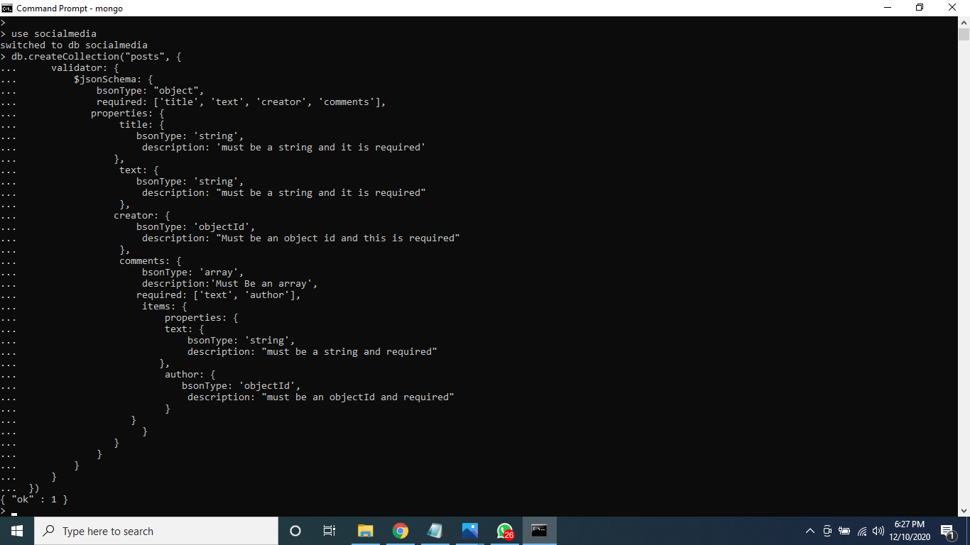
Validator

Slide 21
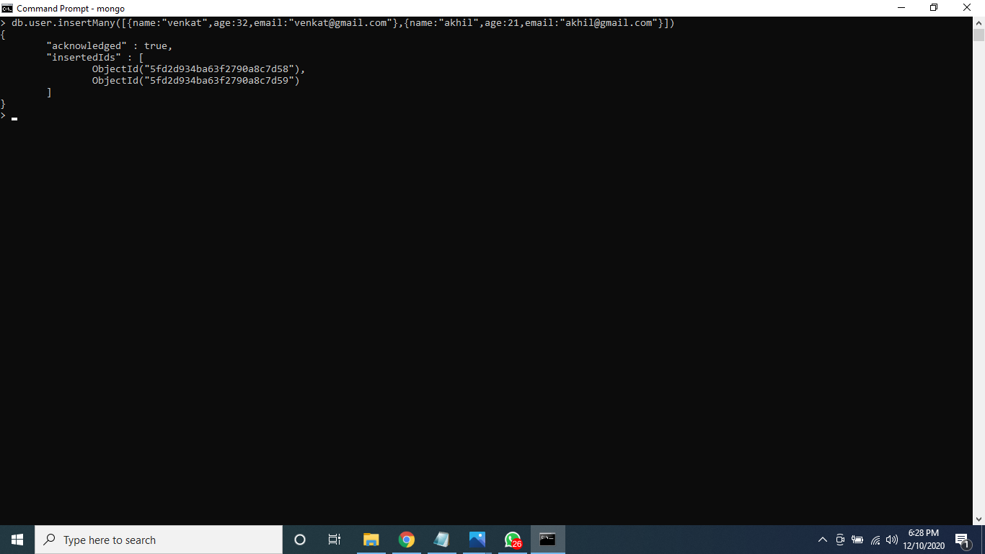

Slide 22
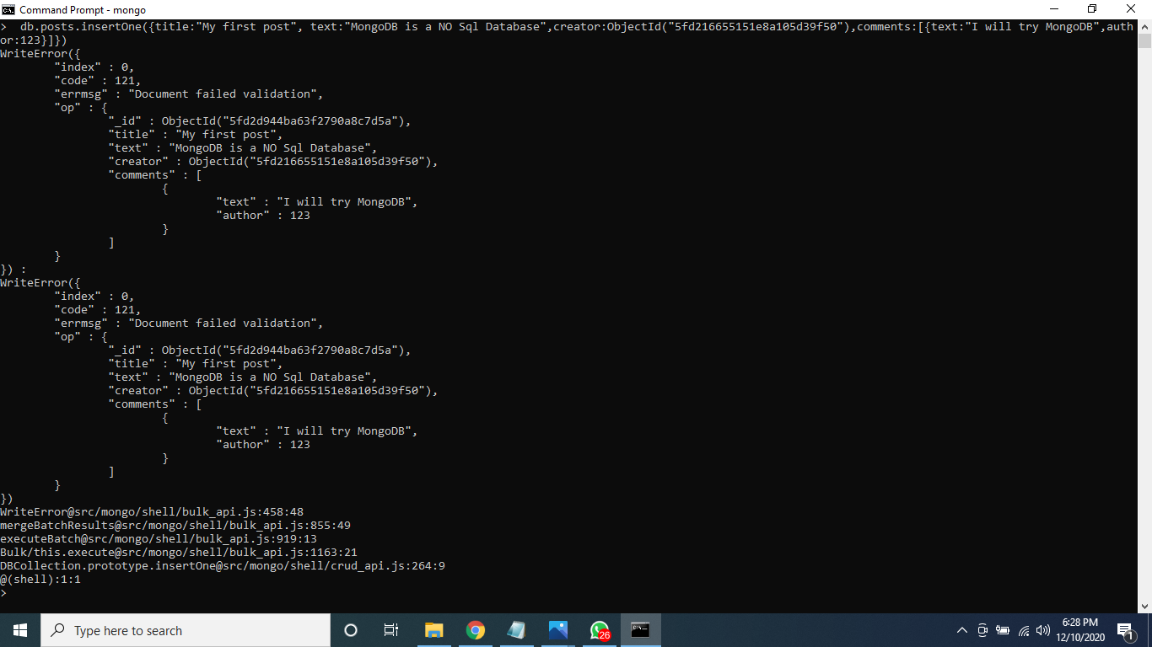

Slide 23
