Slide 1
DIVE AND CONQUER

Slide 2
GENERAL METHOD
The divide – and conquer strategy will compute a problem with n inputs by splitting the inputs into k distinct subsets,1<k<=n ,yielding k sub problems.
These sub problems are solved
A method will combine sub solution into solution of the whole.
Can reapply Divide – And – Conquer strategy if sub problems are relatively large.
(Cont…)

Slide 3
Often sub problems resulting from DAndC strategy are of same type as original problem. For those case we can reapply DAndC recurssively. Then the larger prblms are divided into smaller and smaller prblms of the same kind until they are small enough to be solved without splitting. Cont…

Slide 4
Algorithm
Control abstraction for
DIVIDE AND CONQUER strategy

Slide 5
Algorithm DAndC(P)
{
if ( Small(P))
then return S(P);
else
{
divide P into smaller instances P1,P2…Pk,K>=1;
Apply DAndC to each of these sub problems;
return Combine(DAndC(P1),DAndC(P2),…,(DAndC(Pk));
}
}
Cont…

Slide 6
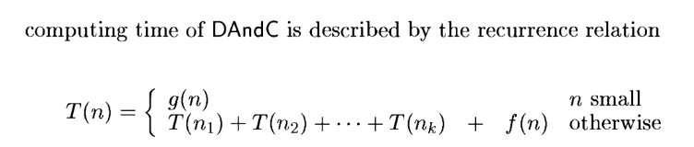
Where
T(n) - is the time for DAndC on any input of size n
g(n)- is the time to compute the answer directly for small inputs.
The function f(n) is the time for dividing P and combining the solutions to subproblems.

Slide 7
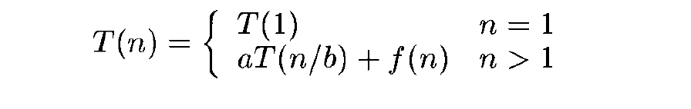
Computing the time of DAndC where T(n) – Time for DAndC on any input of size n. f(n) - time for dividing and combining solutions to subproblems. Where a and b are known constants.

Slide 8

Algorithm
Binary search

Slide 9
Problem definition
Let a_{i}, 1<=i<=n,be a list of elements that are sorted in non decreasing order.
The problem is to determine whether a given element x is present in the list.
If x is present ,determine a value j such that a[j]=x.If not in the list then return j as zero.

Slide 10
Cont…
Searching problem can be denoted as P(n,ai,al,x) where n is number of elements in the list, ai....al is the list of elements, x is the element to be searched.
Divide – and-conquer can be used to solve this problem.
Let Small(P) is true if n=1.In this case S(P) will take value i if x=a_{i} ,otherwise it will be zero.
Running time complexity when n=1,g(1)= Θ(1)

Slide 11
Cont..
If P has more than one element,can be divided into subproblems
Pick index q in range[i,l] compare x with a[q]
3 possibilities
x= a[q];can solve immediately
x<a[q];x need to search only in sublist a[i] to a[q-1]
x>a[q]; x need to search only in sublist to a[q+1] to a[l]

Slide 12
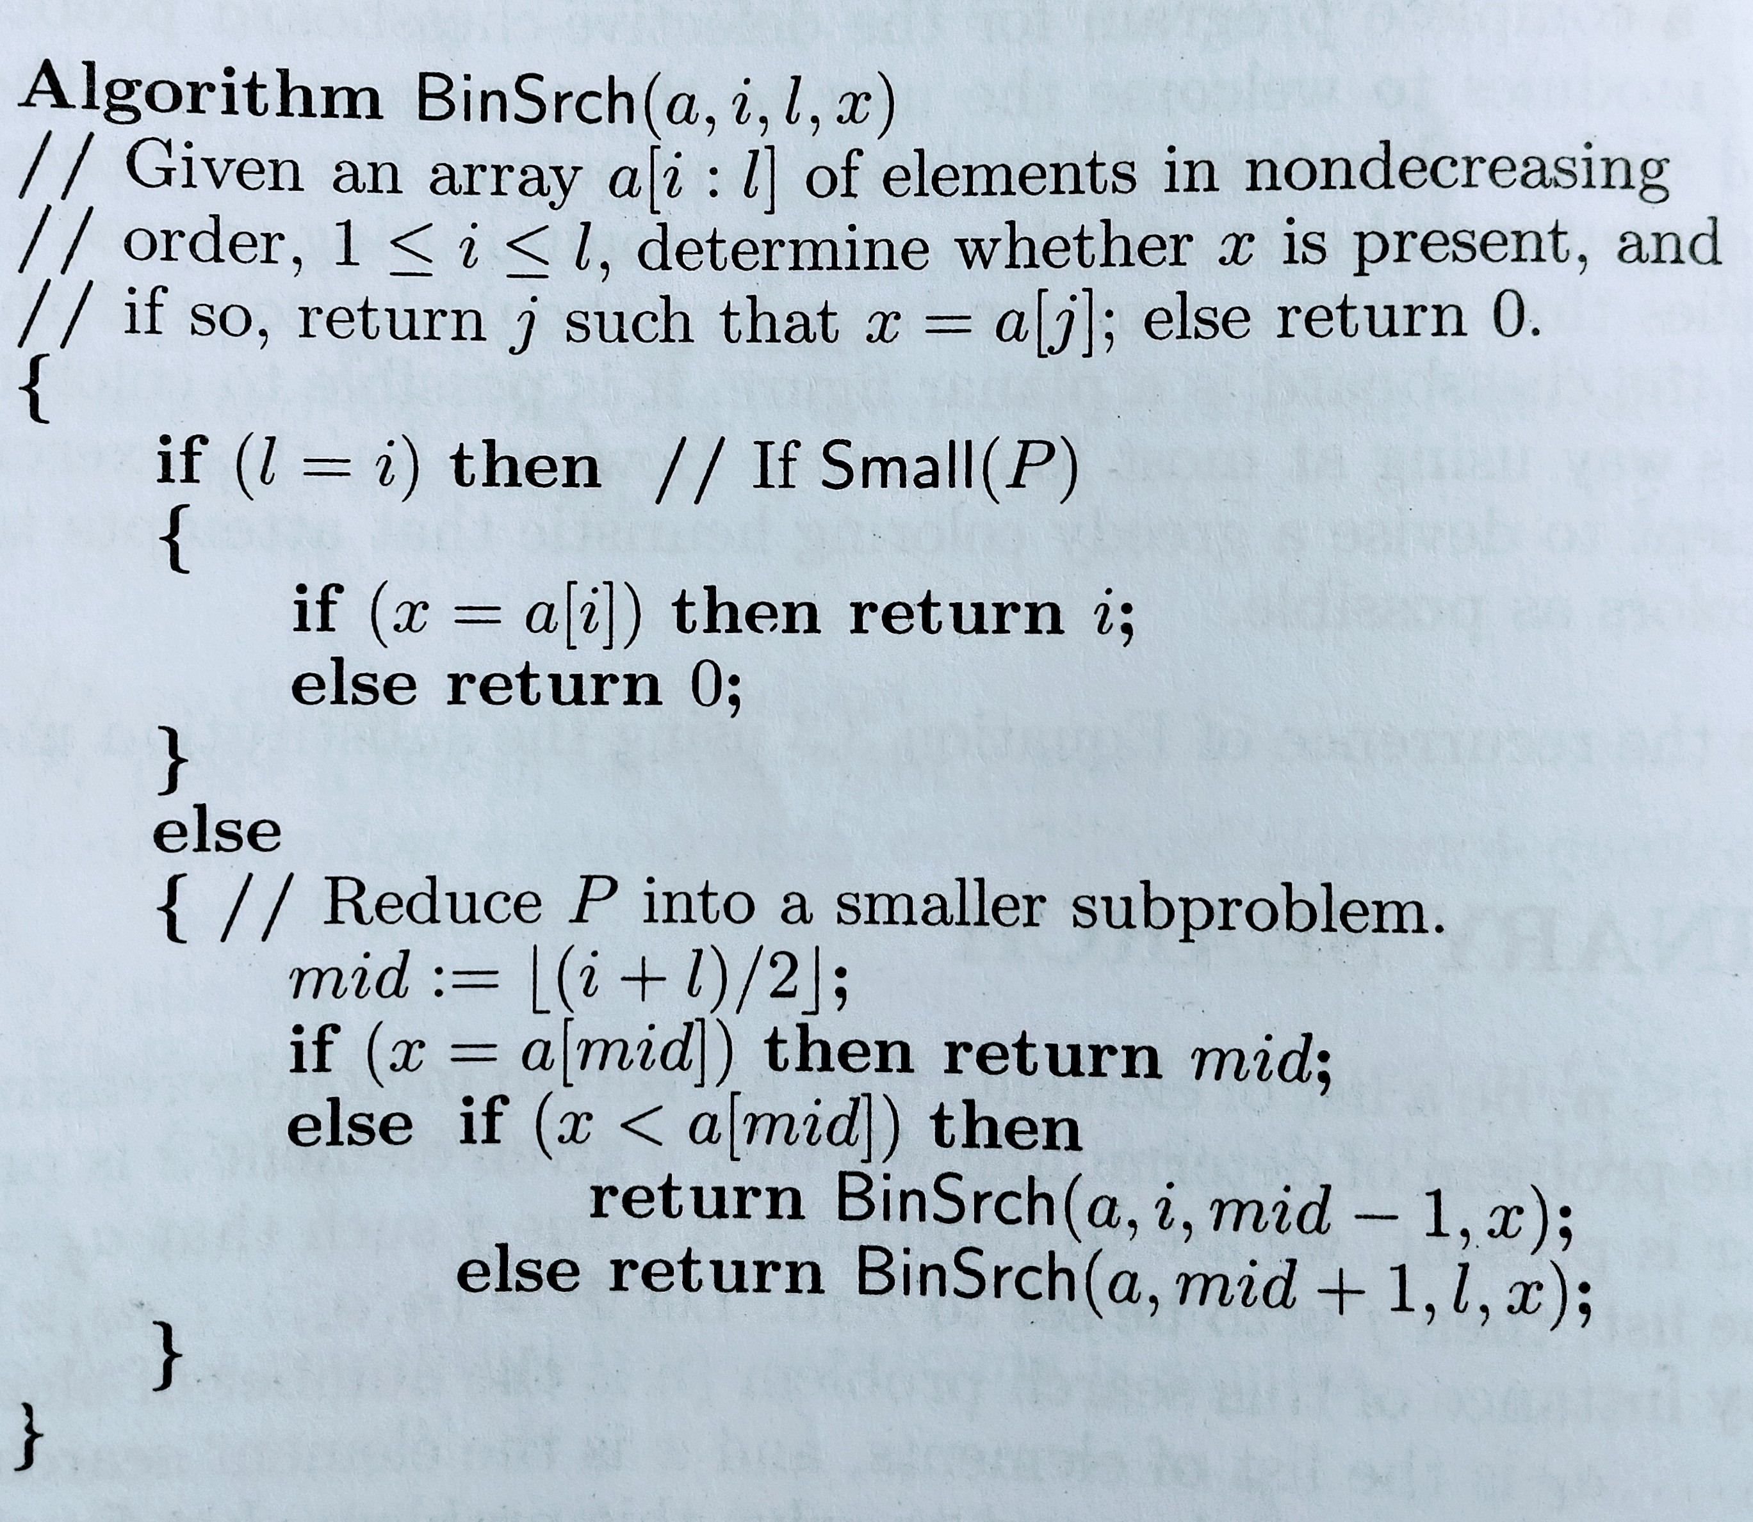

Slide 13

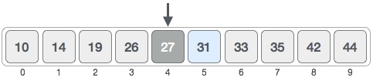
Example:binary search - x= 31

Slide 14

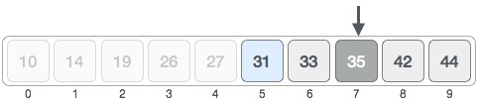

Slide 15

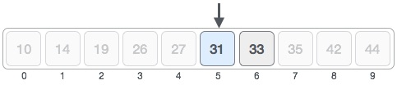


Slide 16
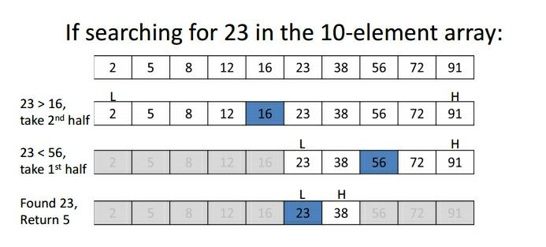
Example 2

