Slide 1

Merge sort

Slide 2
Divide-and-Conquer
Divide
Divide the problem into a number of sub-problems
Similar sub-problems of smaller size
Conquer
Conquer the sub-problems
Solve the sub-problems recursively
Sub-problem size small enough to solve the problems in straightforward manner
Combine
Combine the solutions of the sub-problems
Obtain the solution for the original problem

Slide 3
Merge Sort Approach
To sort an array A[low . . High]:
Divide
Divide the n-element sequence to be sorted into two subsequences of n/2 elements each
Conquer
Sort the subsequences recursively using merge sort
When the size of the sequences is 1 there is nothing more to do
Combine
Merge the two sorted subsequences

Slide 4
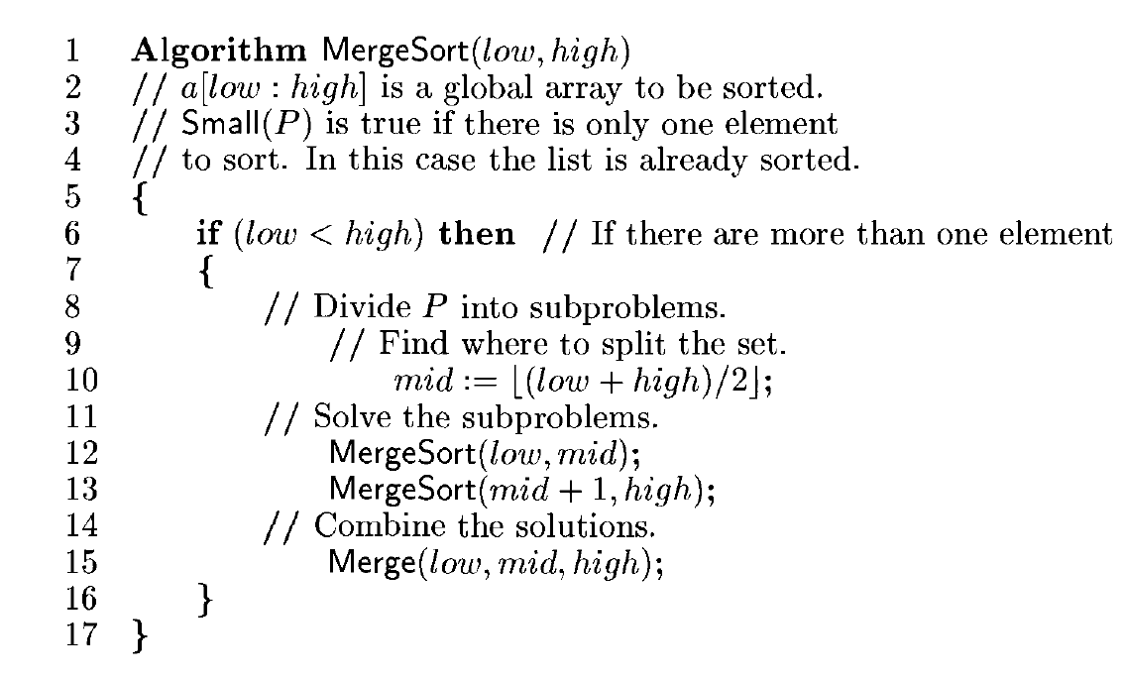

Slide 5
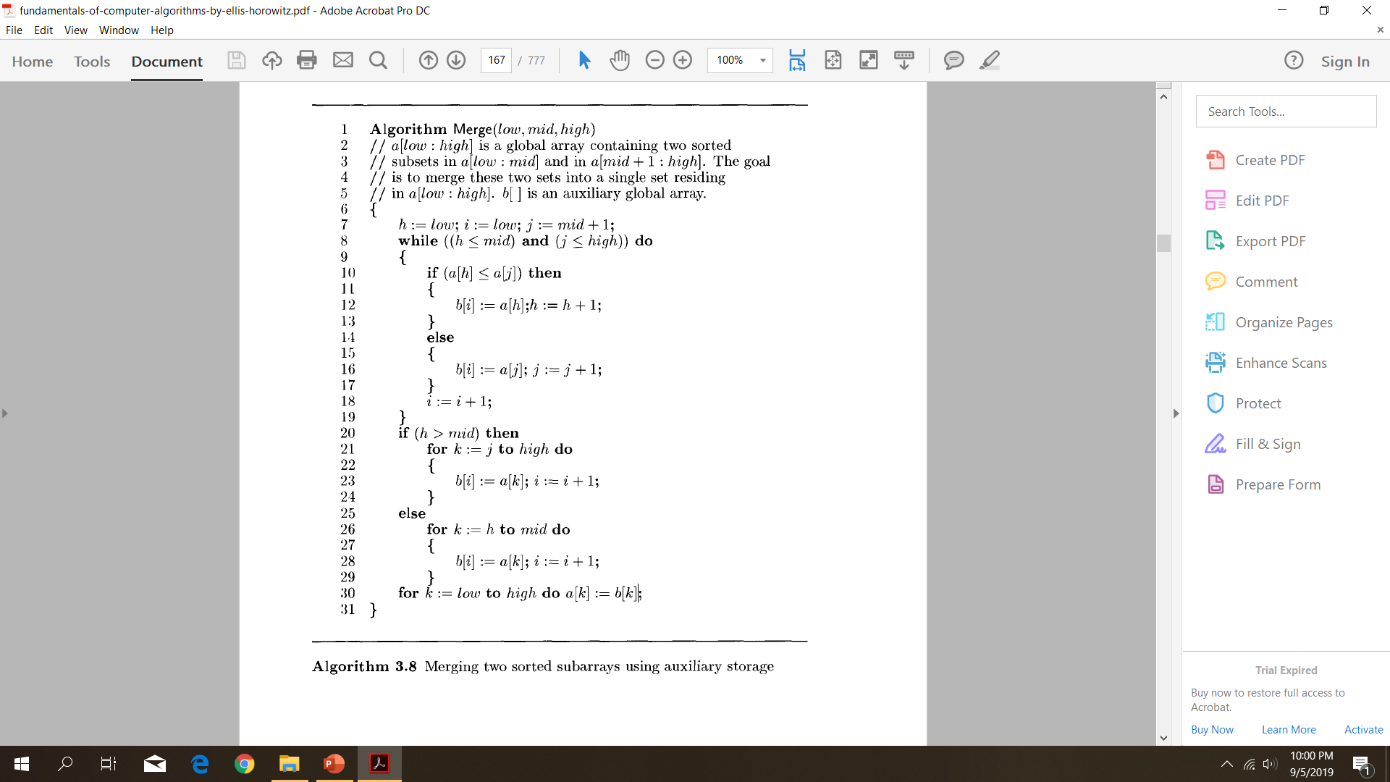

Slide 6
Example 1
a[l:10]= (310, 285,179,652,351,423,861, 254, 450,520).

Slide 7
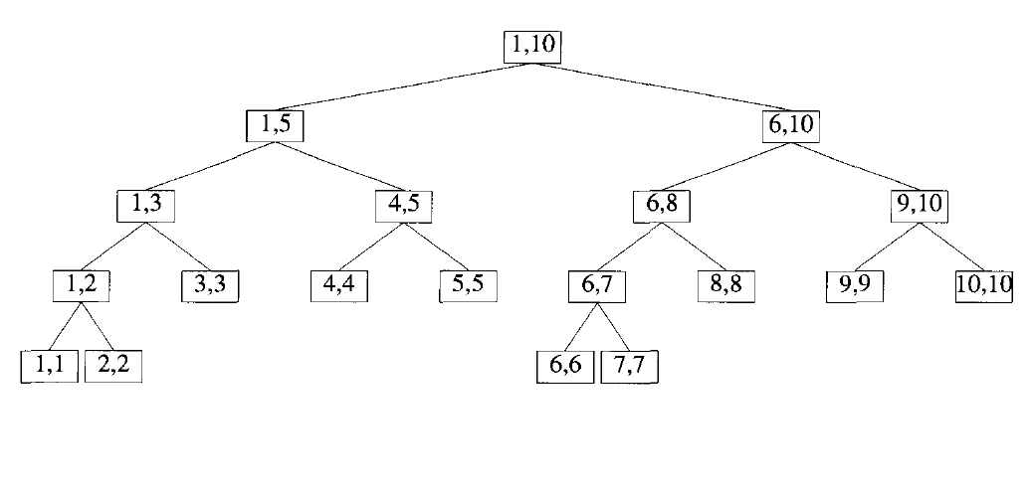
Example
a[l:10]= (310, 285,179,652,351,423,861, 254, 450,520).

Slide 8
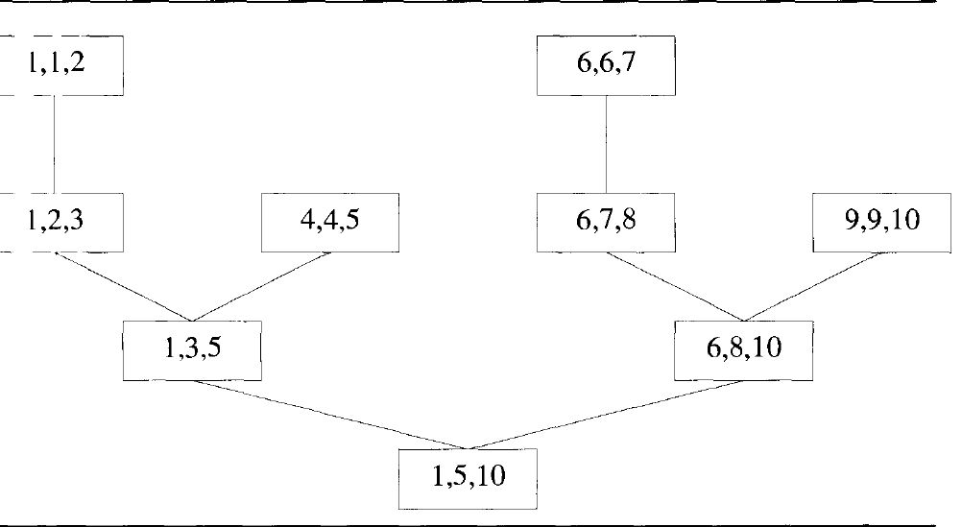

Slide 9
Example 2

Slide 10



. Example 2 elements to sort : 1,6,3,2,7,5,8,4. We need to sort this array using merge sort

Slide 11





Slide 12
Example 3
2 | 6 | 11 | 4 | 5 | 7

Slide 13
Time complexity of merge sort = O ( n log n) Recurrence relation of merge sort a ; n=1 T(n)= { 2T(n/2)+cn ;n>1 a,c are constants

