Slide 1
Introduction to C++

Slide 2
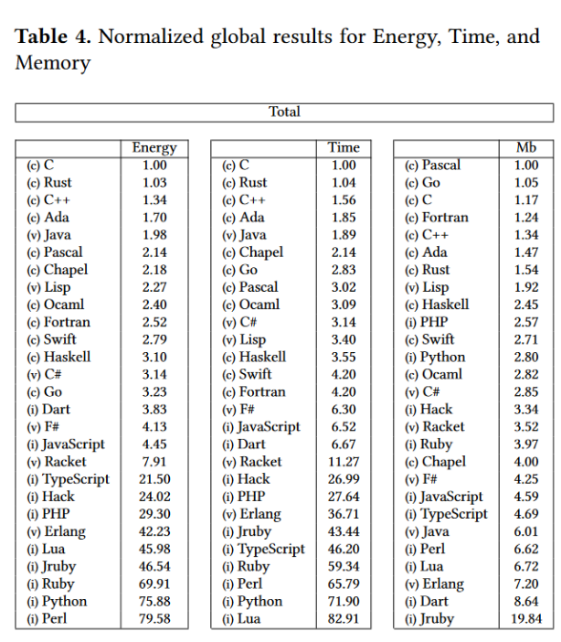
Why C++?
Modern and efficient language
Used by major companies, for all relevant Browsers and many programs that need to run efficiently

Slide 3
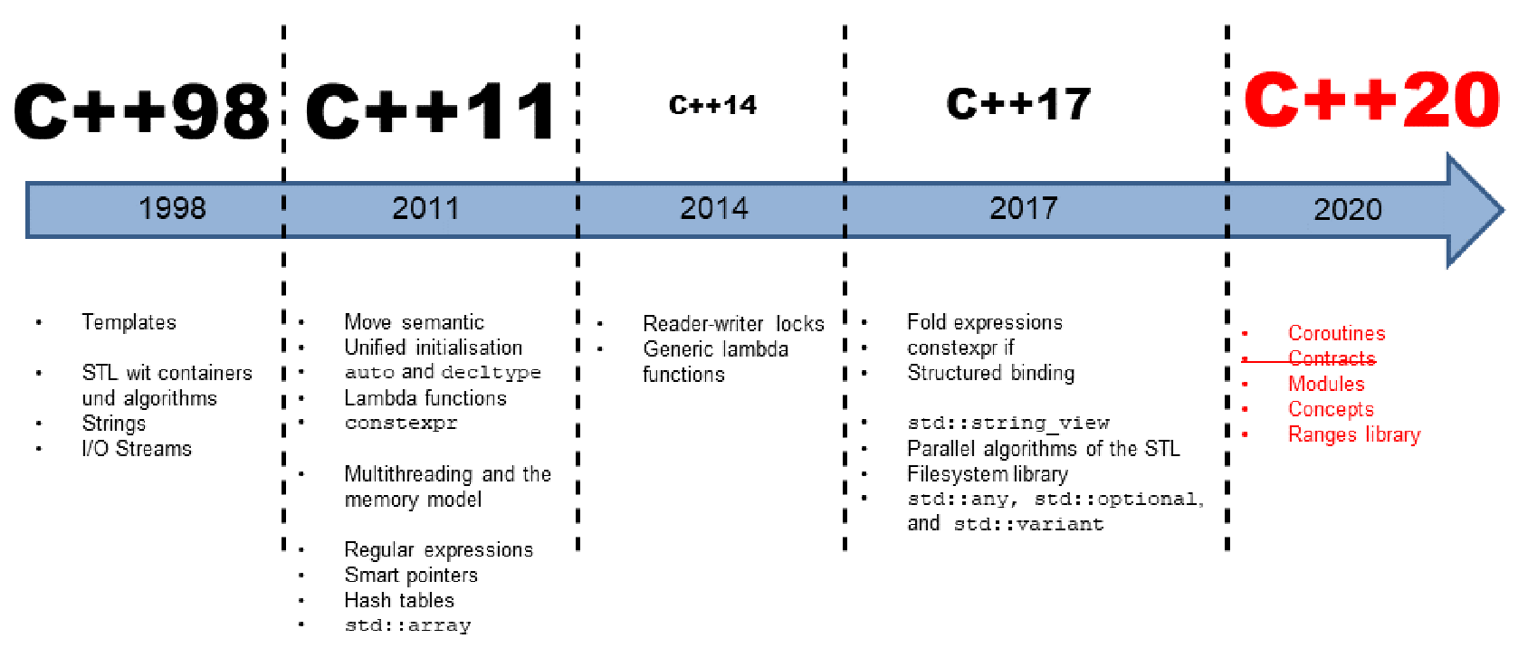
History of C++
Developed by Bjarne Stroustrup in 1983
Aimed for fast, simple to use, cross-platform language

Slide 4
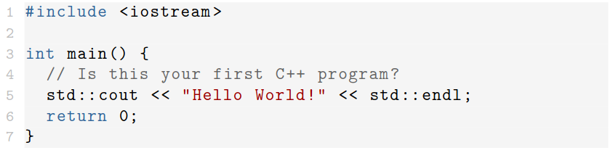
Hello World!
Comments by // or multi-line comments with /* <comment> */
Simplest program:
Connects to std output. Also:
std::cin for input
std::cerr for errors
Return value: 0 means OK
Header. Things you need but haven‘t written yourself go here. Distinguish between:
#include <file> for system files
#include “file” for local files

Slide 5
Compilation
Unlike e.g. Python, C++ is a compiled language
Code needs to be translated in machine-readable code
We will usually use g++
Example: g++ -o hello_world hello_world.cpp
Will create a binary called hello_world that can be executed

Slide 6
General Concepts

Slide 7
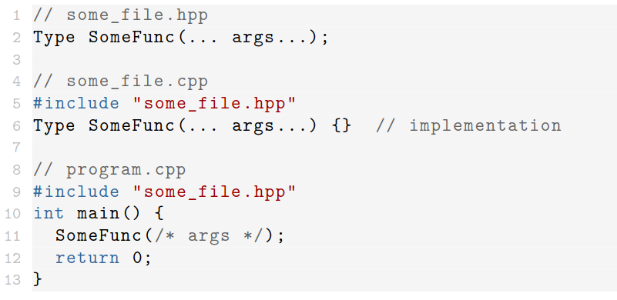
Functions
Declaration and definition can be separated
Best Practice: Declare all funtions in a header file (*.h or *.hpp). The definition goes into *.cpp files
Overloading: Define same function for different inputs

Slide 8
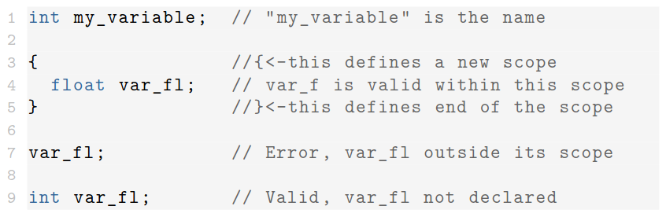
Variables
Variables always have a certain type, e.g. int or string
You can also define a variable as auto to have the type automatically assigned according to the assigned value
Pay attention to the scopes of the code:

Slide 9
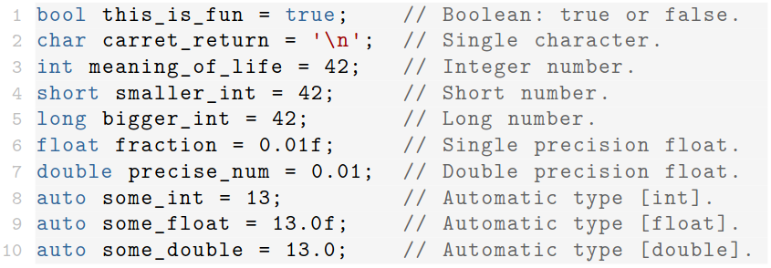
All the Types
Several types available out-of-the-box:

Slide 10
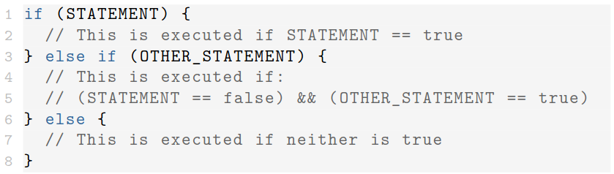
If Statements
Execute code conditionally, depending on boolean expression
Can be extended with else statements
Ternary form: (STATEMENT) ? <if true> : <else>

Slide 11
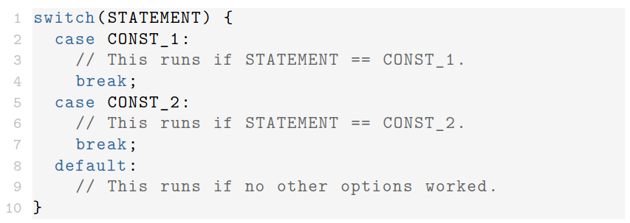
Switch Statement
Similar to if, but for multiple cases
Execution will start at matching case and will fall through
Use break to stop after one case

Slide 12
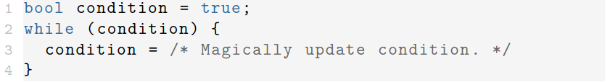
While Loop
Repeat certain actions, while a statement is true
Variations: do-while and while-do
Easy to trap yourself in an endless loop!
Use break to stop and continue to go to the next iteration

Slide 13


For Loop
Repeat until some condition is met
Can also be used to iterate through some range

Slide 14
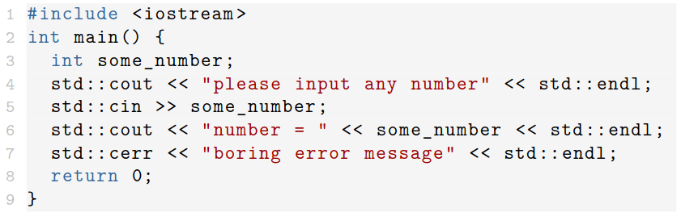
I/O Streams
Handle stdin, stdout, stderr
Part of #include <iostream>

Slide 15
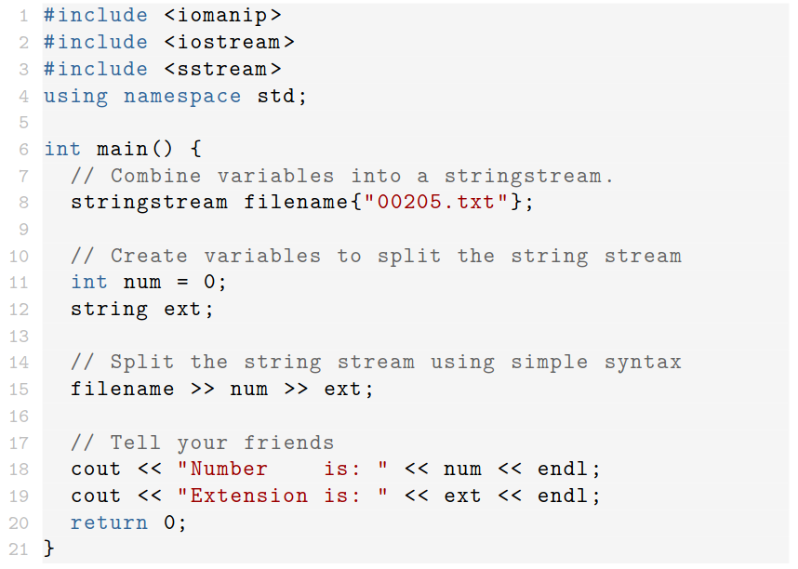
String Streams
Combines non-strings into strings and vice versa

Slide 16
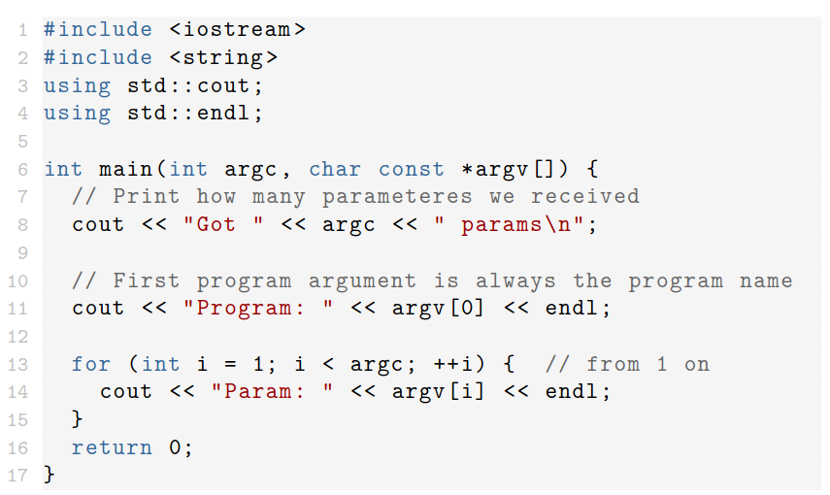
Arguments
Arguments passed to main function
Argc is number of arg’s, argv are the arg’s as strings

Slide 17
Classes

Slide 18
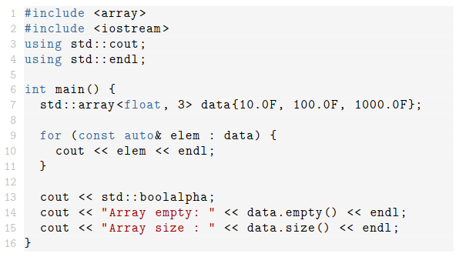
Std::array
Collection of items of same type
Access via arr[i], starting at 0

Slide 19
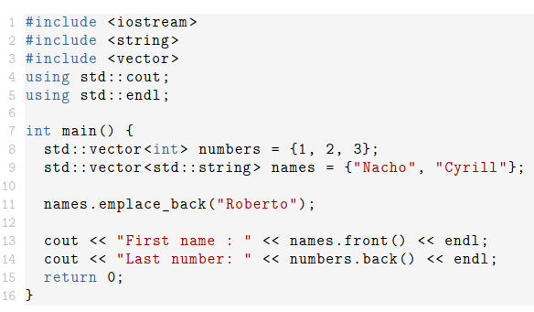
Std::vector
Part of #include <vector>
Dynamic table, can be extended, shortened during runtime
Fast and flexible

Slide 20
Std::map
List of pairs of two variable types, e.g. <int, string>
Pair consituents are called <key, value>
Keys have to be unique within a map

Slide 21
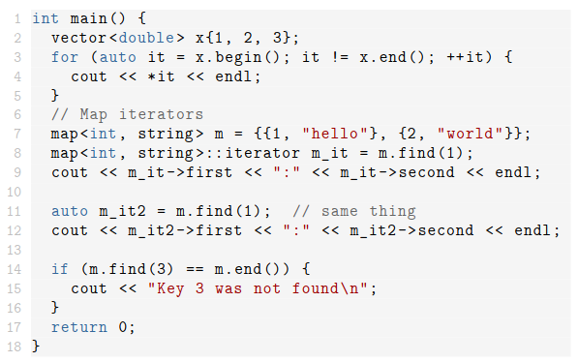
Iterators
Tie std library containers, e.g. vectors, to the data they contain
Always point to specific element inside
Can be incremented by itr++
Useful for range-based for loops

Slide 22
Class Basics - I
Classes are created to “invent” new variable types
Each class represents a concept, e.g. vehicles
Potential connection between classes, e.g. car, truck, boat are conceptually all vehicles
Helpful to structure code, as it mimics the way people think

Slide 23
Class Basics - II
Classes consist of members, e.g. variables and functions
Members can be accessed via “.” (objects) or “→” (pointers)
Operators can be defined for each class
Public members are interface to the rest of the code, private members are internal
Alternative: struct, by default everything is public

Slide 24
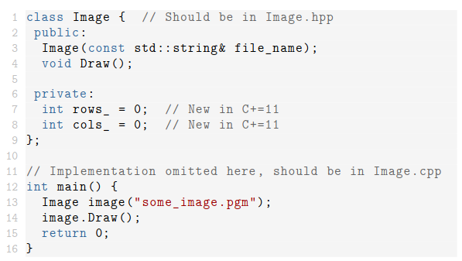
Example Class
Class describes an image
Every part of the code can define images and draw them
Number of rows and columns are internal information

Slide 25
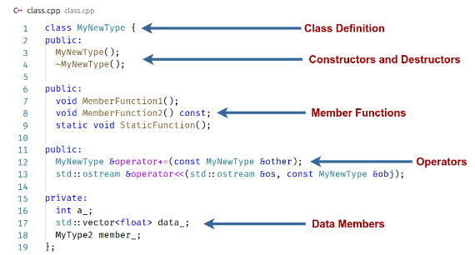
Classes – General Structure
Each class has constructors and destructor that handle the data when defined or deleted
By default everything is private

Slide 26
Constructor & Destructors
At least one Constructor, exactly one Destructor
Constructors
  Named like the class
  Can be called with arguments, will assign values to internal parameters
Destructor
  Named ~ClassName()
  Last thing called during lifetime of an object

Slide 27
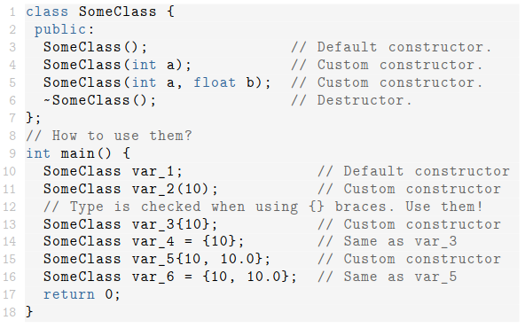
Constructor Calls - Example
Many different ways of calling a constructor
Dependent on the initialising values you want to pass

Slide 28
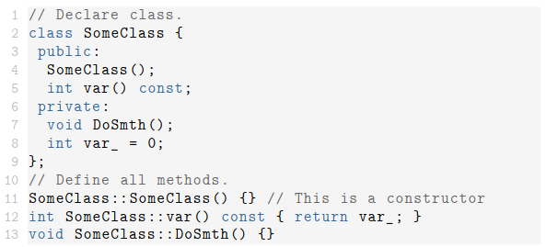
Declaration & Definition
Data members belong to declaration
Class methods can be defined elsewhere (c.f. split into header and cpp files)
Class name becomes part of function name

Slide 29
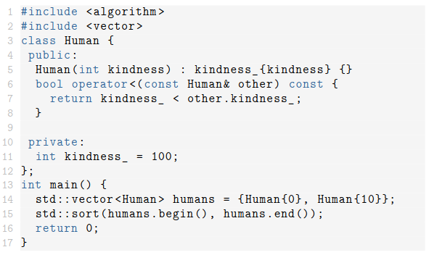
Classes - Keywords
Const: after function states that object isn’t changed

Slide 30
Classes - Keywords
Static:
Member variables:
  Shared between all objects of this type
Member functions:
  Don’t need to be called as <object>.function()
  But as ClassName::function(<parameters>)
  Independent of all instances of the class

Slide 31
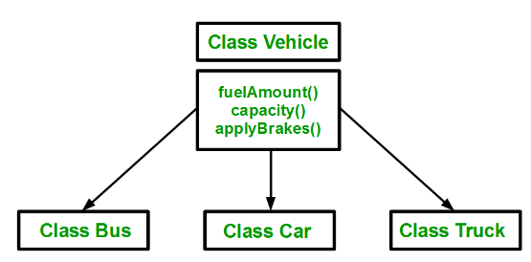
Classes - Inheritance
One general base class, e.g. Vehicle
Many specialised derived classes

Slide 32

Classes - Inheritance
Three types of inheritance in C++
We’ll be using public inheritance:
  Keeps access specifiers of base class
Corresponds to a “is a” relationship, e.g. a bus “is a” vehicle
Can add specialised members that aren’t generally applicable to vehicles

Slide 33
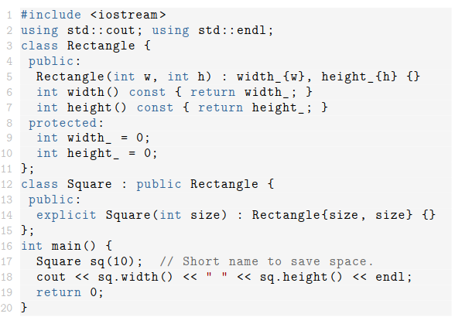
Inheritance - Example
Base class are rectangles
Implement squares as “specialised” rectangles

Slide 34
Classes - Keywords
Virtual:
  A virtual function can be overridden by derived classes
  Pure virtual functions have to be overridden

Slide 35
Memory & Pointers

Slide 36

Pointers
Pointers store memory addresses of any kind of data
<Type>* is a pointer to type <Type>
Initialise pointers to either an address or NULL
These are raw pointers and are disfavoured
Better use smart pointers whenever suitable

Slide 37
(De)referencing
Generally: & returns the address of an object, also true for pointers (referencing)
This way you can call functions by reference:
  function( &inputParameter )
  No copying of the object required
Dereferencing: Return object that sits at a certain address/reference
If ptr is a pointer, *ptr will return the object

Slide 38
Stack & Heap
Stack:
  Static Memory available short term (scope)
  Small but very fast
Heap:
  Dynamic Memory available during runtime
  Slower than Stack
  Modified by new and delete

Slide 39


new & delete
Control of memory is completely up to you!
New returns the heap address of the object
You (!) need to free the memory after use
Easy to create memory leaks (inaccessible addresses)
Causes slow runtime and potential crash

Slide 40
Smart Pointers
Manage lifetime of pointers and own the allocated memory
Part of #include <memory>
Focus on unique_ptr and shared_ptr
Other than memory management, identical to raw pointers
Dereference via *ptr, access via ptr->

Slide 41
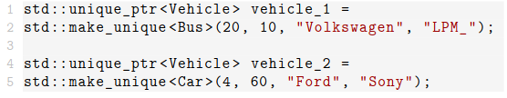
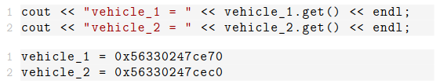
Unique Pointer - Example
Example based on vehicles:
Cannot be copied, but moved:
Addresses before the move:
And after the move:

Slide 42
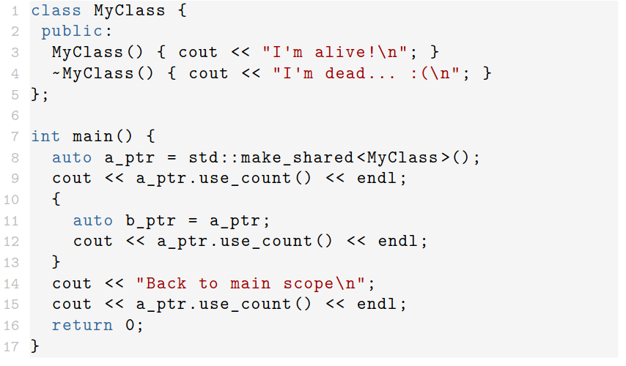
Shared Pointer - Example
Many shared pointers can point to the same address
Has a usage counter, +1 when copied, -1 when destructed, frees memory at 0

Slide 43
When to use what?
Generally: use smart pointers whenever you need to manage memory
Raw pointers are fine as temporary storage for addresses for example
Default should be unique_pointer
If you need something copyable, use shared pointers
Every single new or delete is a potential memory leak

Slide 44
Templates

Slide 45
Templates
Templates can define two things in C++
It can be a family of classes
It can be a family of functions (possibly inside of a class)
Motivation: Generic functions like abs()
  Don’t want to define for every possible type like int, float, double, long, complex?, ...

Slide 46

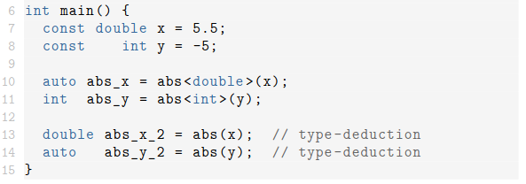
“absolute” Template
Define generic abs<T>() function:
Technically, templates aren’t functions but a pattern to make functions
Only instantiated for used functions, if no one uses “abs<int>” no instantiating by the compiler
Use:

Slide 47
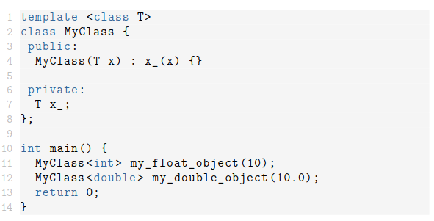
Template classes
Pattern for making classes
E.g. vector is a template class

Slide 48
Lambda Functions

Slide 49
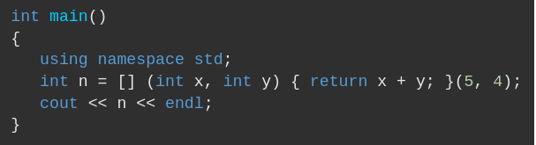
Lambda Functions
Small anonymous functions of most basic form:
[capture](parameter list){lambda body}
The capture: which variables of the scope should be used inside of the function (can be empty)
The parameter list: list of input parameters, like a regular function
The lambda body: Like the body of any function

Slide 50
Debugging & References

Slide 51
Debugging & References
You will often face code that doesn’t work without knowing exactly why
Easiest thing to do: Put couts into the code
  This way, you’ll see where the code is before it crashes and which values variables have at any given time
More complex machinery like gdb or valgrind (find out yourself)
StackExchange, StackOverflow, Google in general

