Slide 1
Text classification for Kennedys IQ
Prepared by: Sreelal B

Slide 2
Problem Statement
To analyze and build a machine learning solution for the classification of news articles based on 5 different categories.

Slide 3
Solution Approach
Data preparation
Data pre-processing & EDA
Modelling

Slide 4
1. Data preparation
Corpus of news articles containing 2225 documents were collected in zip format
Developed an automated python script to convert the data set into a format to be used in following stages

Slide 5
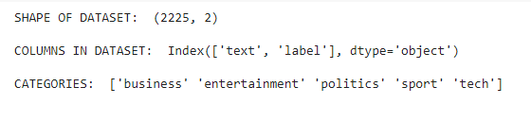

2. Data pre-processing and Exploratory analysis
Understanding the dataset
Checking if null values present in the dataset

Slide 6
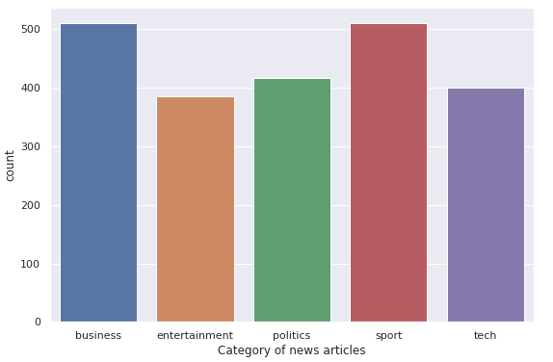
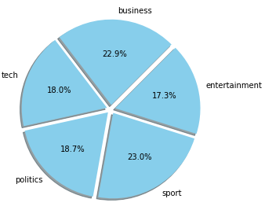
Distribution of categories
Observation: Here the classes are approximately balanced, hence not performing any under sampling or oversampling method

Slide 7
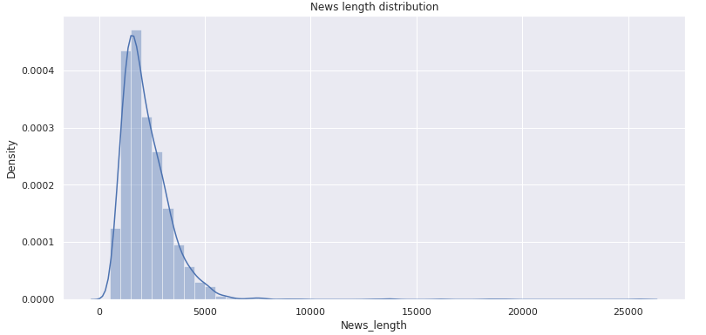
Let’s look at the distribution of length of news articles

Slide 8
Observations:
We have only a few articles with more than 10k characters
The 95 percentile of article length is seen as 4288.
Dropping the articles with more than 4288 characters as those are only 5% of total number of records.
Removing larger document helped in better comprehension while model building

Slide 9
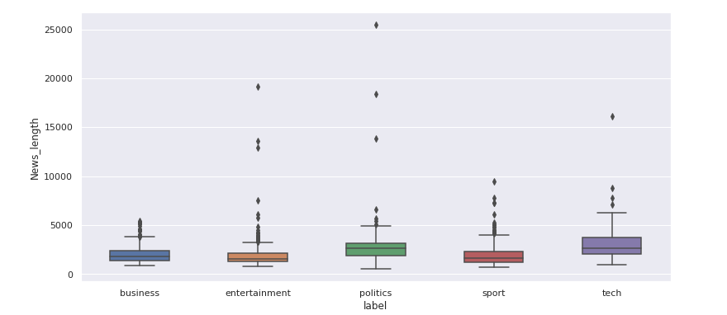
Let’s look at box plot of article length:
Before:

Slide 10
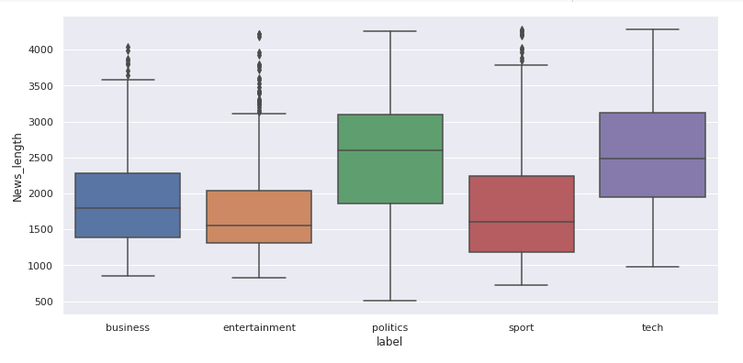
After:

Slide 11
Performed data cleaning steps using nltk library
Using regular expression to clean the text
Removing the stop words and special characters
Lemmatization

Slide 12
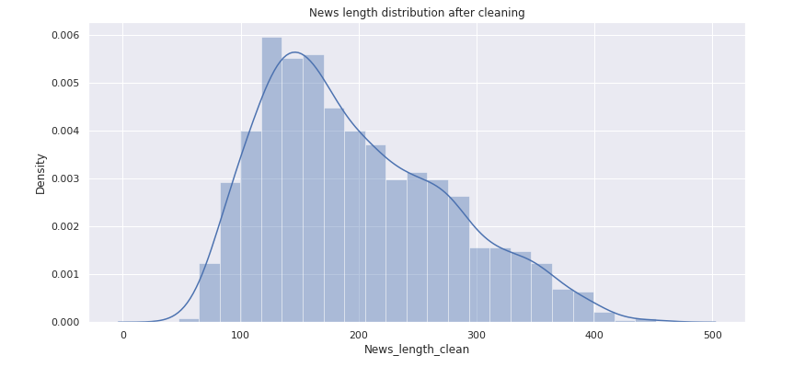
After data cleaning steps, article length looks like:

Slide 13

Visualizing most occurring words in each category
In business

Slide 14
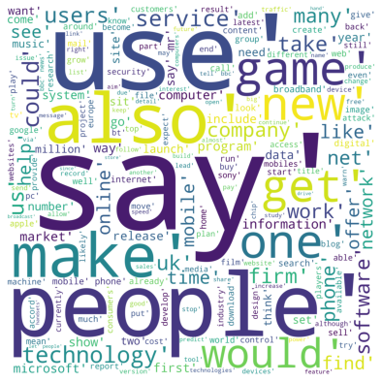
In tech

Slide 15
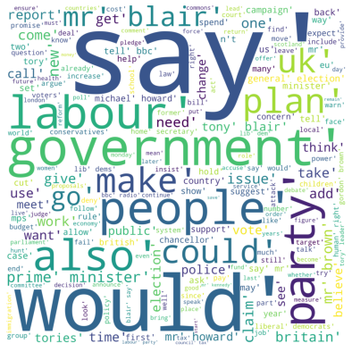
In politics

Slide 16
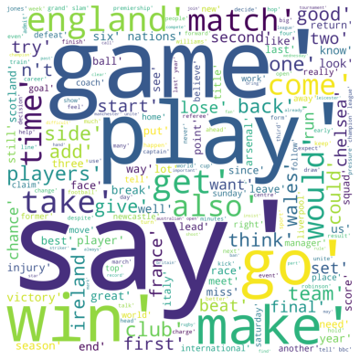
In sports

Slide 17

In entertainment

Slide 18
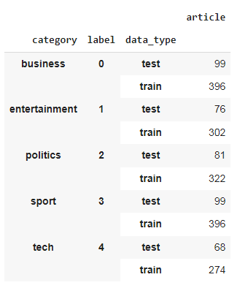
3. Modelling
Started with splitting the data set into train and test for building model
And labelling the
category column as unique ID’s

Slide 19
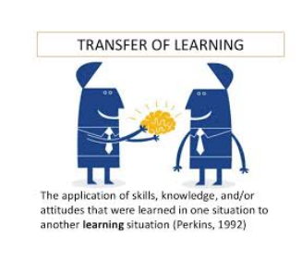
Here, I am proposing a transfer learning approach to solve this NLP problem

Slide 20
To solve most NLP problems effectively, model requires to understand the contextualized meaning of words in sentences
BERT (Bidirectional Encoder Representations from Transformers) can generate contextualized word embeddings.
I am using bert_en_uncased_L-12_H-768_A-12 model pretrained with Wikipedia and bookcorpus.
Getting this model from tensorflow hub and fine tuning with our data set to solve the use case in hand.

Slide 21
How does it work?
Text inputs need to be transformed to numeric token ids and arranged in several tensors before inputting to BERT.
Text representation BERT can understand:
Input Word IDs – Represents a unique token/word in a sentence. Need CLS and SEP tokens to distinguish the beginning and the end of a sentence.
Input masks – Help to distinguish tokens from padding elements. It indicates the position of words
Type IDs – To distinguish different sentences. It two sentences are to be processes, each word in the first sentence masked to 0 and each word in second sentence to 1

Slide 22
An example of 1 article after converting to the needed format

Slide 23
Now we have the input ready, downloading the BERT model from tensorflow hub and fine tuning it to get the sequence embeddings.
BERT model returns 2 outputs:
Pooled_output – represents each input sequence as a whole. Think of this as an embedding for the entire article
Sequence_output – represents each input token in the context. Think of this as a contextual embedding for every token/word in the article.
For effective classification, I am going to use the pooled_output array

Slide 24
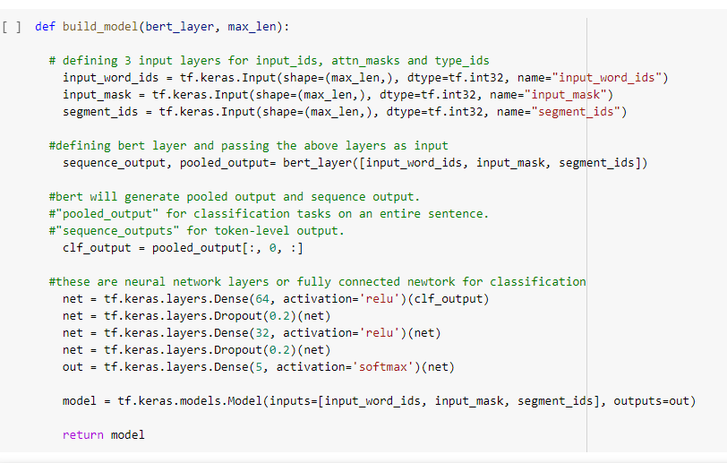
The vector embeddings from the BERT layer will be passed on to a fully connected feed forward network for classification

Slide 25
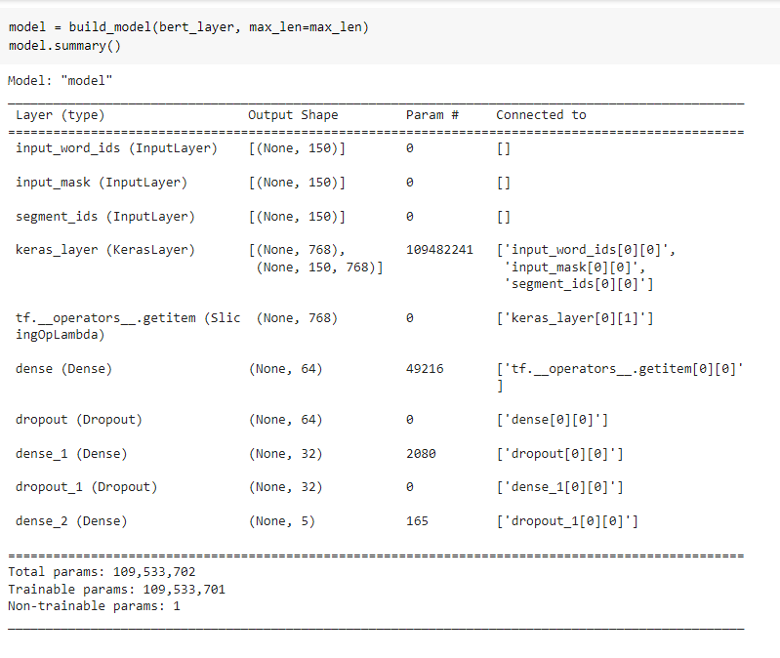
Model summary looks like:

Slide 26
Compiling the model with the proposed parameters of BERT architecture
Loss function is categorical cross entropy as we are dealing with a multi class classification problem and softmax function in the output layer
Training the model with processes text input and labels with 3 epochs.
The train labels were converted into its one-hot representation to fit the model

Slide 27
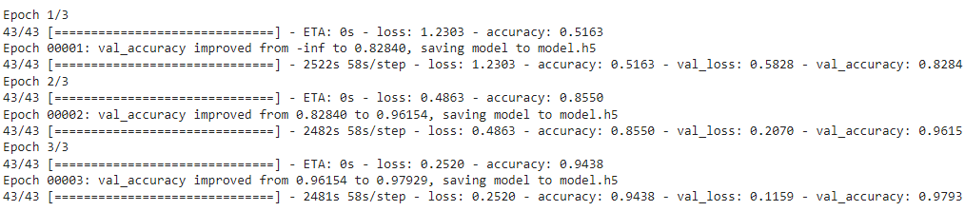
The training process:
It is observed that, train accuracy and validation accuracy is considerable improving with each epoch while reducing the loss

Slide 28
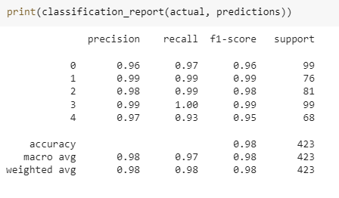
Model prediction
Done prediction with test data and printed classification report by comparing to actual labels
The categories are mapped to its id’s as:

Slide 29
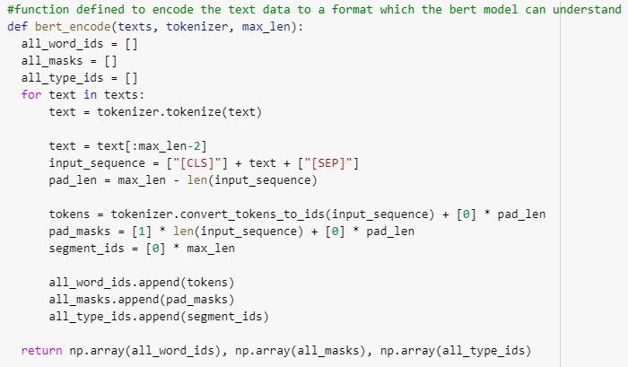
Another approach for converting tokens for BERT input layer
In the approach discussed, manually transformed the text data to a format which the BERT model can understand

Slide 30
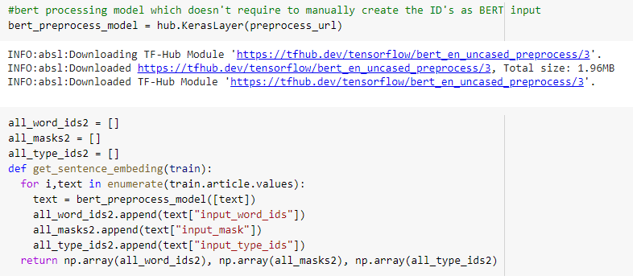
Instead of previous approach, TensorFlow Hub provides a matching preprocessing model for each of the BERT models discussed earlier, which implements this transformation from the TF.text library.

Slide 31
Work Around using Hugging Face Transformer library
Exploring the hugging face library, it is set up such that it has a collection of pre-trained transformer based models for different language modelling tasks
For eg: “transformers.BertForSequenceClassification” class has the implementation for text classification problems
Constructed BERT tokenizer to encode the text data to the format discussed already. Explored different tokenization approaches hugging face provides:
Tokenizer.encode() – simple method to get the word based IDs
Tokenizer.encode_plus() – Returns dictionary of word id’s, input masks and type id’s
Tokenizer.batch_encode_plus() – Works well if we have multiple sentences in a record. It will generate dictionary of id’s for each input sentence
Tokenizer() – Directly use the class without any method. Returns the encoded form based on the input type

Slide 32
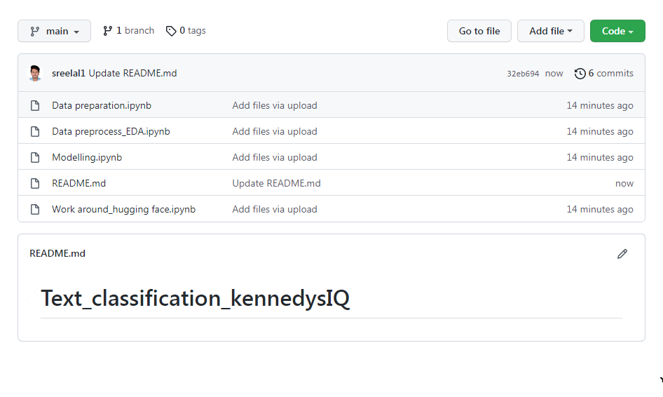
Github repo for the code can be accessed here

Slide 33
Thank You

