Slide 1
Construction Cost Estimation
Market Research & Validation
Problem → Validation → Insights → KPIs → Solution Direction
MRV Project | 26 September 2026
Team 9
Muvva Sree Lasya
Srivatsan Ramesh
Muthiah Sivavelan

Slide 2
1. Problem Statement
The research focuses on homeowners constructing a new house.
Core problem
People constructing houses struggle to accurately estimate their construction budgets and face challenges with monitoring their spending leading to cost overruns.
Research objectives
• Validate whether cost overruns are a recurring experience.
• Identify the major sources of budget differences.
• Understand current estimation and expense-tracking practices.
• Assess demand for a reliable estimation tool.
Market Research & Validation | Construction Cost Estimation
2

Slide 3
2. How We Validated the Problem
Primary responses established the problem signal; the 100-record dataset supported deeper Tableau analysis.
22
Primary survey responses
Actual collected responses
100
Analysis records
Used for Tableau exploration
12
Survey questions
Construction journey + solution demand
What we measured
• Targeted people who had constructed a house, were constructing, or were planning to construct.
• Questions covered budget, estimation method, confidence, final cost difference, causes, tracking and tool adoption.
How we interpret the evidence
• 22-response survey: directional validation of the problem.
• 100-record analysis dataset: quantitative distributions and KPI calculations.
Market Research & Validation | Construction Cost Estimation
3

Slide 4
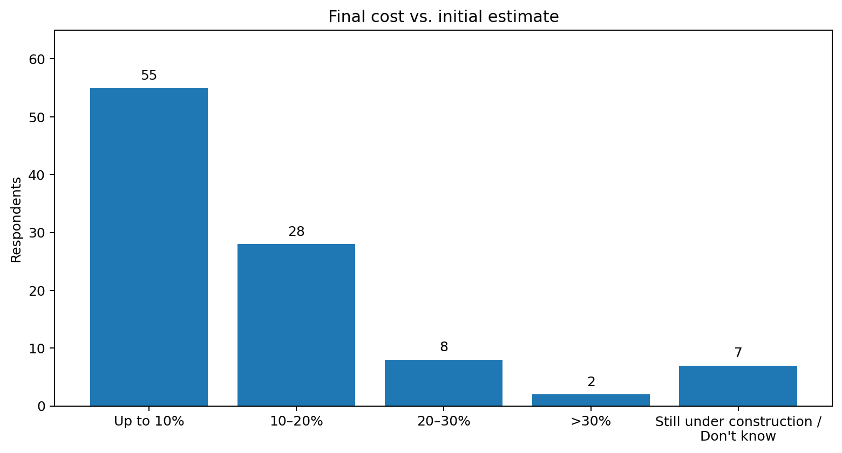
3. Validation: The Problem Shows Up in Real Experiences
The primary survey and analysis dataset point in the same direction.
93%
Respondents reporting an overrun
93 of 100
87%
Likely to use a reliable estimator
Analysis dataset
What the distribution says
• 55% reported the final cost was up to 10% higher.
• 28% reported a 10–20% increase.
• 10% reported an increase above 20%.
• 7% were still under construction or did not know the final cost.
Market Research & Validation | Construction Cost Estimation
4

Slide 5
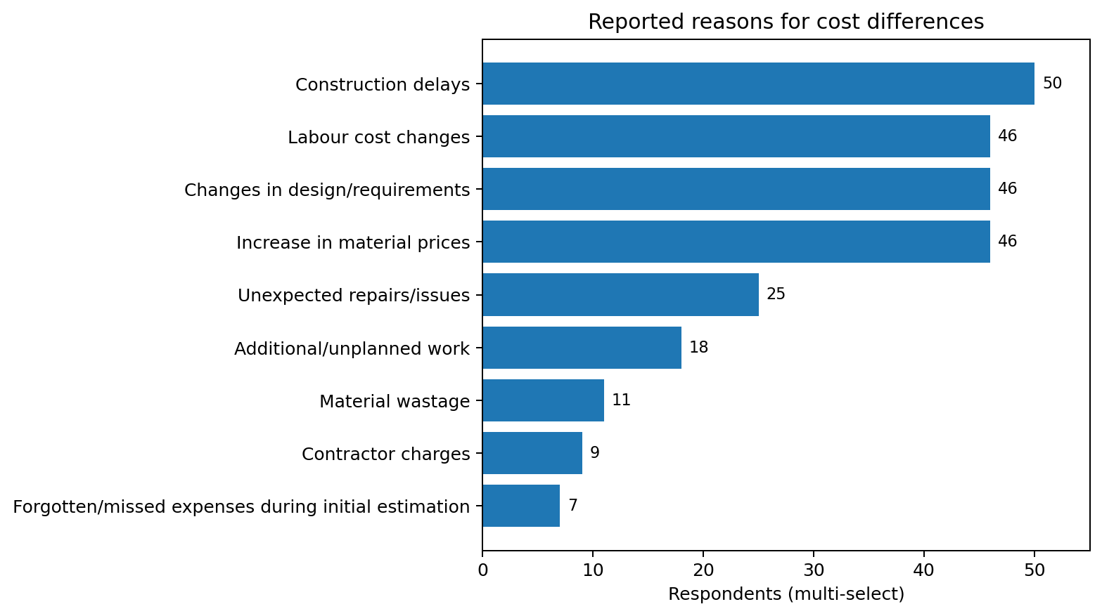
4. What Drives the Cost Difference?
Multi-select responses reveal several interacting causes rather than one single driver.
Most frequently reported causes
• Construction delays — 50
• Design / requirement changes — 46
• Material price increases — 46
• Labour cost changes — 46
• Unexpected repairs/issues — 25
• Additional/unplanned work — 18
Counts are multi-select; one respondent can appear in several causes.
Market Research & Validation | Construction Cost Estimation
5

Slide 6
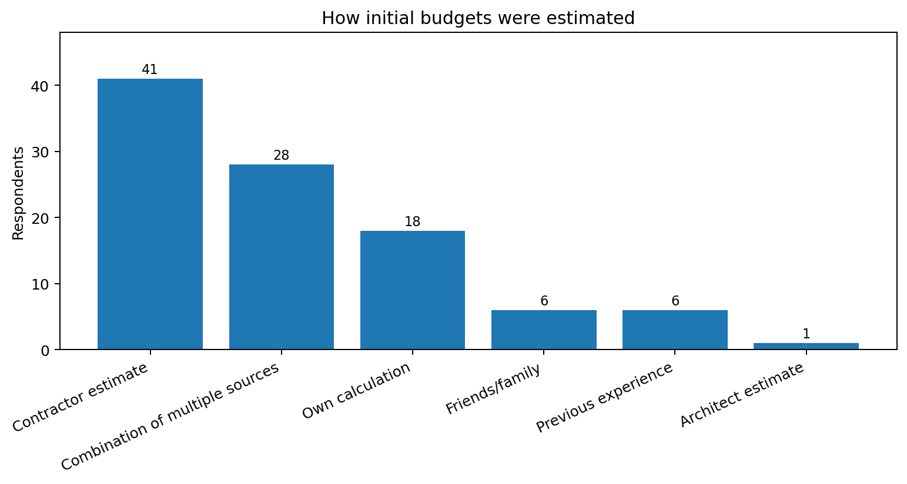
5. Estimation Is Often Contractor-Led
The process relies heavily on external estimates and informal practices.
Key finding
• 41% initially estimated through a contractor.
• 28% used a combination of sources.
• 78% were very or somewhat confident in their initial estimate.
• Average estimation confidence score: 3.87 / 5.
This creates a useful tension: confidence does not prevent overruns.
Market Research & Validation | Construction Cost Estimation
6

Slide 7
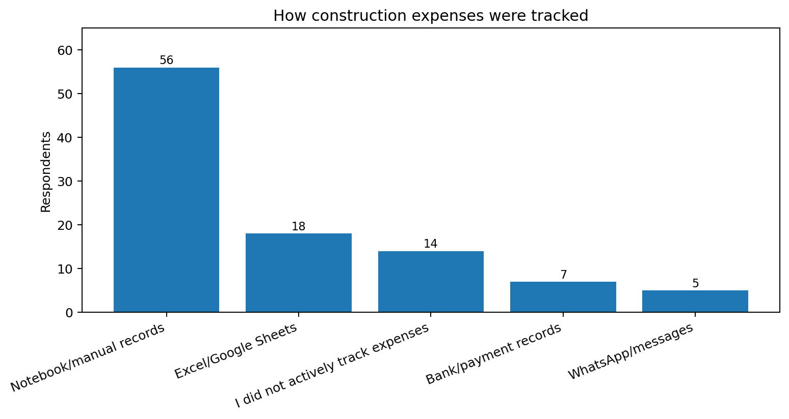
6. Budget Control Is Mostly Manual
The tracking process is fragmented, while keeping within budget is difficult for many respondents.
Key finding
• 56% used notebook/manual records.
• 18% used Excel/Google Sheets.
• 14% did not actively track expenses.
• 70% said staying within the planned budget was difficult or very difficult.
Market Research & Validation | Construction Cost Estimation
7

Slide 8
7. There Is Evidence of Solution Demand
Respondents were asked about a reliable pre-construction cost estimator based on location, house size, materials and requirements.
87%
Probably / definitely would use
100-record analysis dataset
13%
Not sure
100-record analysis dataset
Implication for solution design
• The strongest validated direction is not simply “track spending”; respondents also want better confidence before construction starts.
• A solution can therefore connect pre-construction estimation with ongoing budget control.
Market Research & Validation | Construction Cost Estimation
8

Slide 9
8. Primary KPIs
Five KPIs summarize the validated problem using the 100-record analysis dataset.
93%
Budget Overrun Rate
10.38%
Average Budget Overrun
10.75%
Significant Overrun Rate (>20%)
41%
Unexpected Expense Rate
3.87 / 5
Estimation Confidence Score
Method notes
• 93%: any reported overrun
• 10.38%: average using representative range values
• 10.75%: >20% among known final-cost responses
Market Research & Validation | Construction Cost Estimation
9

Slide 10
9. Supporting Marketing & Validation Metrics
These metrics connect the problem evidence with the potential value and adoption of the proposed solution.
41%
Cost-Control Pain Rate
Share experiencing both a cost overrun and unexpected/unplanned expenses or repairs.
87%
Solution Adoption Rate
Share who would probably or definitely use a reliable cost-estimation tool.
70%
Budget Control Difficulty Rate
Share finding it difficult or very difficult to stay within the planned budget.
73%
Active Budget Monitoring Rate
Share regularly comparing actual spending with the planned budget.
Together, the metrics indicate a clear pain point, difficulty in budget control, and initial interest in a solution.
Market Research & Validation | Construction Cost Estimation
10

Slide 11
10. Key Insights
What the evidence means for the problem.
01
Overruns are common
93% of the 100-record analysis dataset reported final costs above their initial estimate.
02
The problem is multi-causal
Delays, design changes, material prices and labour changes were each reported by 46–50 respondents.
03
Unexpected costs matter
41% reported unexpected repairs/issues or additional/unplanned work.
04
Confidence ≠ accuracy
Average confidence was 3.87/5 even though overruns were widespread.
05
Current control is manual
56% relied on notebooks/manual records and 70% found budget control difficult.
06
There is solution interest
87% of the analysis dataset and 91% of the primary survey indicated they would probably/definitely use a reliable estimator.
Market Research & Validation | Construction Cost Estimation
11

Slide 12
11. Proposed Solution
Smart Construction Cost Estimation Tool:
A tool that estimates total construction cost using location, house size, material choices, labour, contractor inputs and other project requirements. Once construction begins, users can monitor their actual spending and compare it with the planned budget, with variance tracking and alerts.
Conclusion
The research supports a problem around both pre-construction cost estimation and ongoing budget control. The next step is to prototype a solution that connects the two rather than treating them as separate tasks.
Market Research & Validation | Construction Cost Estimation
12

