Slide 1
Smart Shopping
Increment 1

Slide 2
Progress
Developed an Android Application in this Increment which will have:
1) Login Screen developed which have Transitions from one page to another with Proper validations and interaction with Sqlite Database to check if the user is valid or Not.
2) Register Screen developed with all necessary validations like fields empty check, email validation, password validations etc.. We also have a check whether user already exists or not. Here also we have interaction with Sqlite database to store/retrieve data.
3) A HomeScreen of Smart Shopping which is under development stage which will have a Greeting and two buttons i.e.. For updating Profile and Logging out.

Slide 3
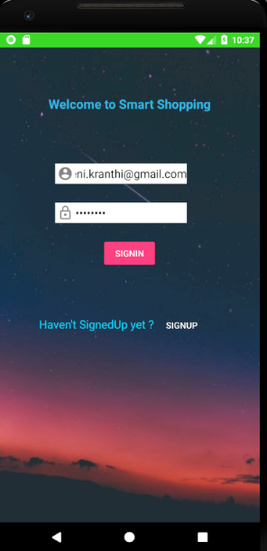
Login Screen
Login UI: A Login UI like below with validations and Transitions are developed with a user validation check.

Slide 4
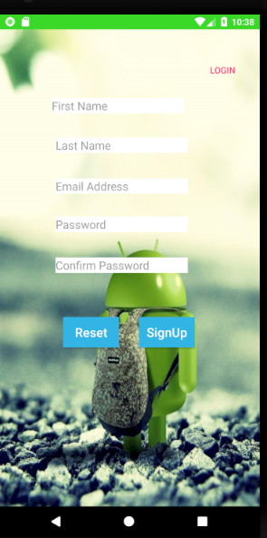
Register Screen
Registration UI: Registration UI is having Interaction with Sqlite Database which will store data of the user and also validates if the user already exist and throwing error messages in UI if any validation failed.

Slide 5
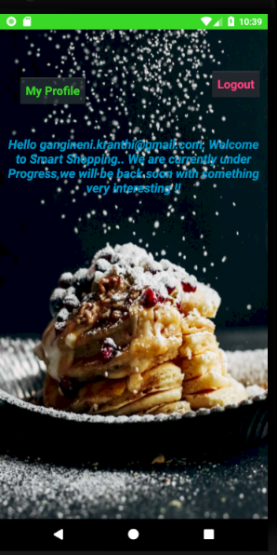
Home Screen
Home UI: Home UI is under progress now. Currently we have a greeting and two buttons from
which user can either update his profile or logout from the app.

Slide 6
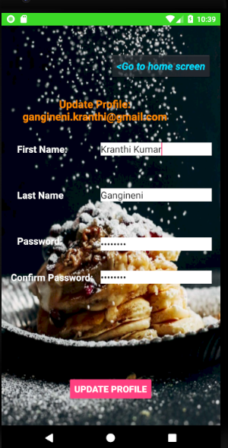
Update Profile
My Profile: This screen provides a way to update the user profile where he/she can change his details (Other than emailId). On Successful update the page will be reloaded having a Toast saying Profile updated successfully and showing updated details in UI.

Slide 7
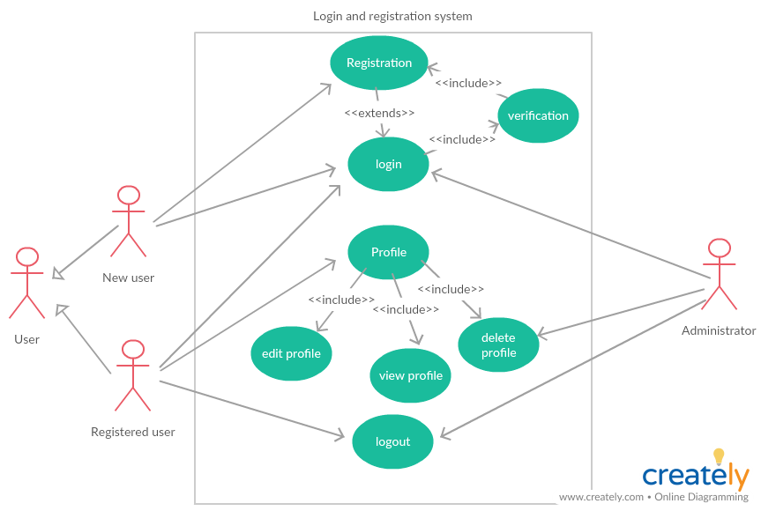
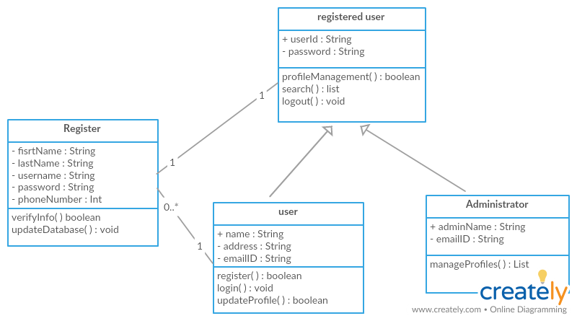
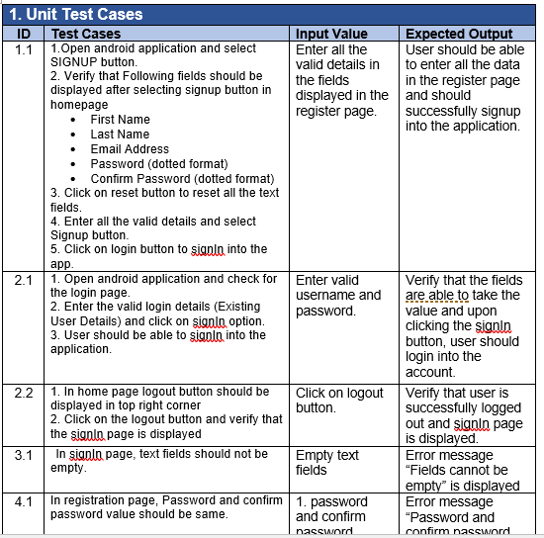
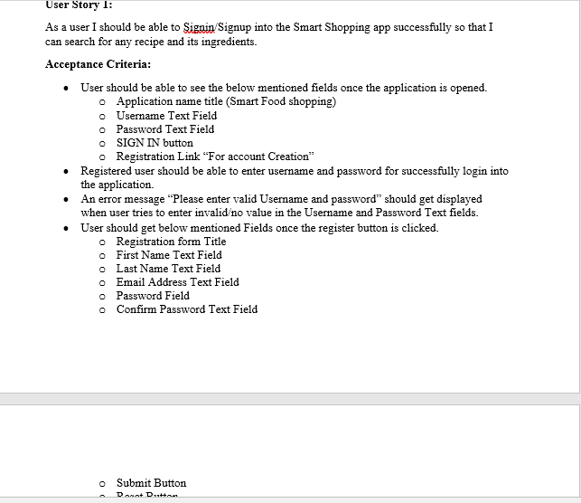
Others For this increment we prepared Use Case Diagram, Test Cases & Results, User Story, class diagram

Slide 8
Thank you

