Slide 1
Increment-2
SMART SHOPPING

Slide 2
Progress:
Used Edamam Recipe API to fetch the recipe details.
Inserted and fetched data from database to show in UI via categories (Veg, Non-Veg, Others).
Used Google Maps and Four Square API to show our current location and show top 10 nearby shopping market stores.
Added functionality such that user can be able to rate the Recipe and he can be able to see his rating every time he sees the recipe.
Displaying the Required Ingredients, Nutrients details and Source URL of a recipe.

Slide 3
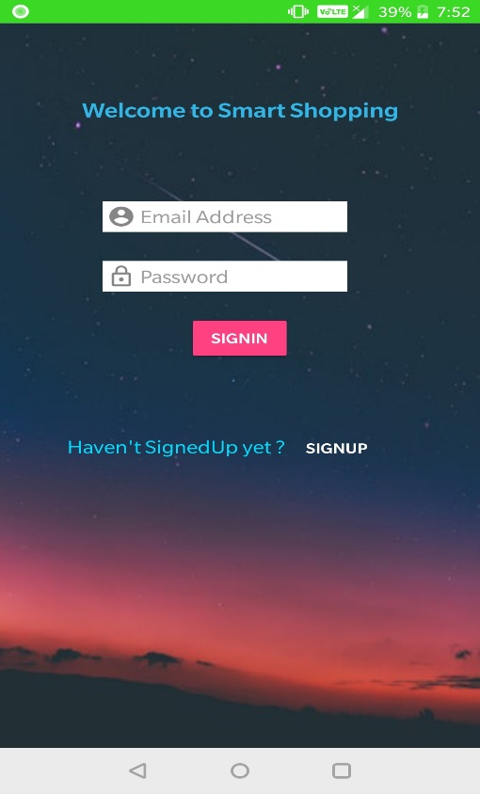
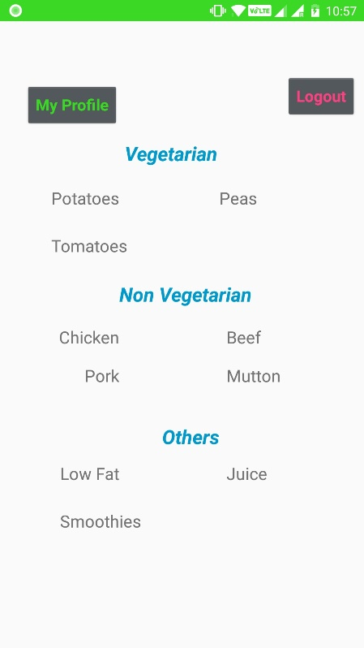
Fetching Data

Slide 4
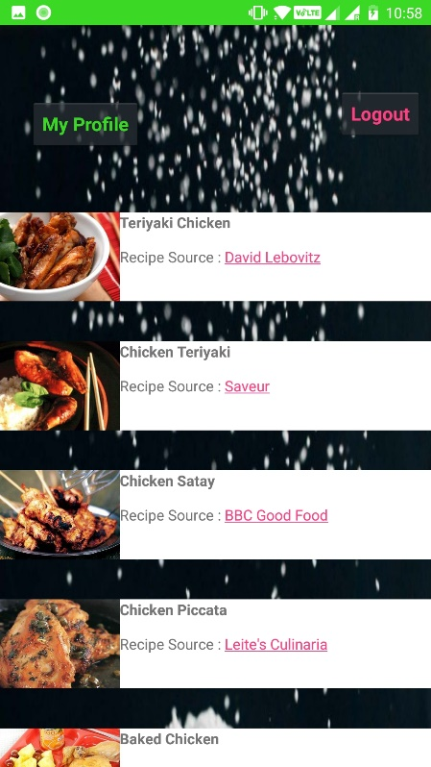
Edamam Recipe API

Slide 5
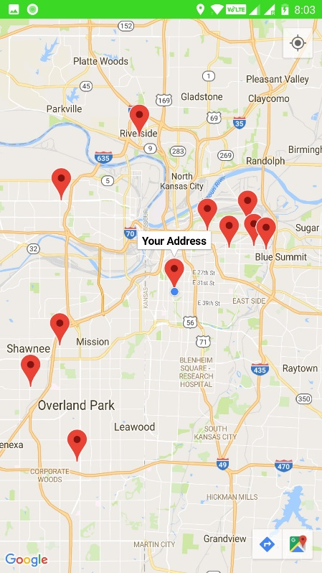
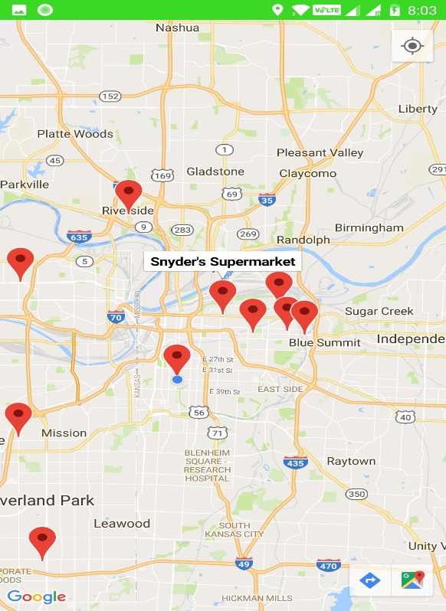
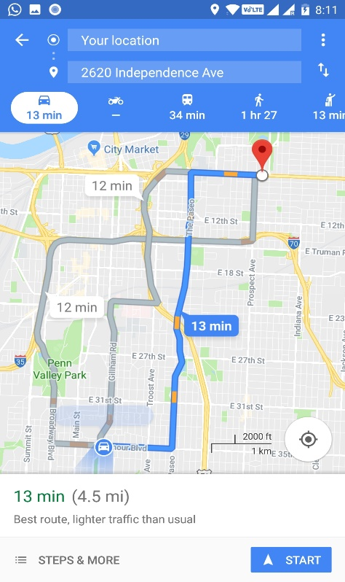
Google Maps and Four Square API

Slide 6
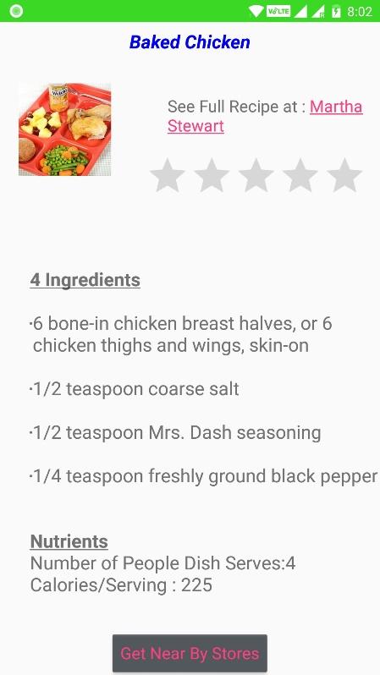
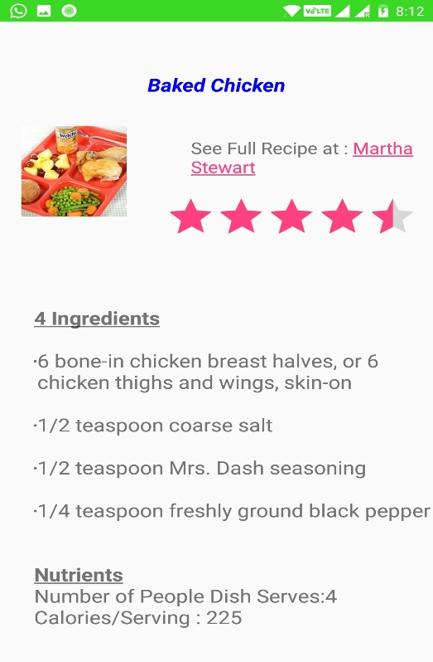
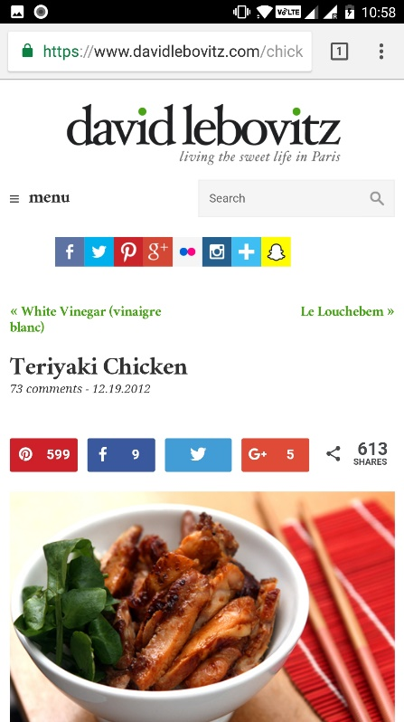
Recipe Screen

Slide 7
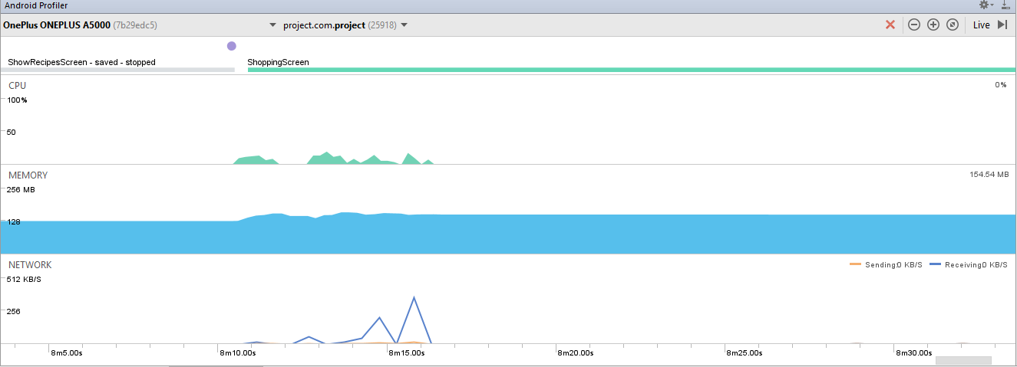
Performance Check using Android Profiler

Slide 8
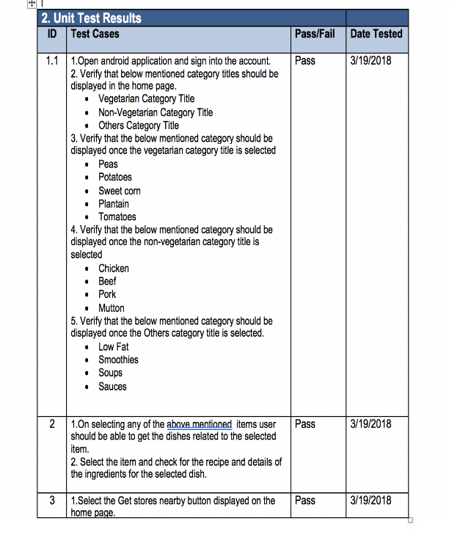
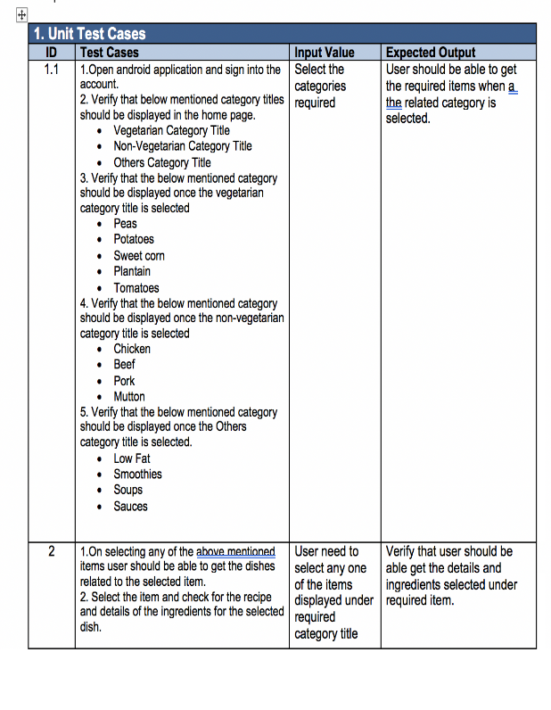
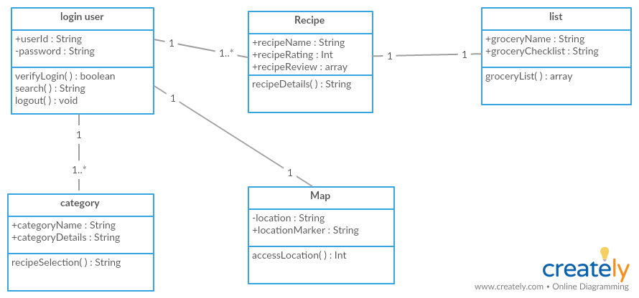
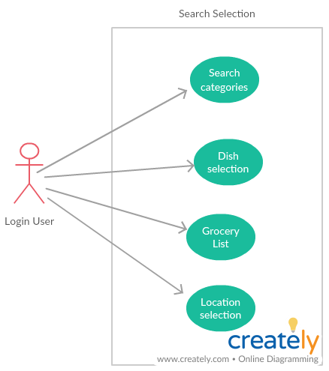
Others

Slide 9
Thank You

