Slide 1

CAMP RIDE

Slide 2
INTRODUCTION
The College Bus Management System – CampRide is a web-based application developed to manage and organize college transportation services in an efficient way. In this project, the frontend is connected to the backend, and essential modules such as login, registration, admin panel, student panel, and contact page are already implemented.The system allows students to sign up, log in, and access their bus details, while administrators can manage student records, bus routes, and feedback through the admin panel. By integrating both the frontend and backend, CampRide ensures secure data handling, easy accessibility, and smooth communication between students and the administration.This project reduces manual work, minimizes errors, and provides a user-friendly platform for managing the entire college bus system digitally.

Slide 3

OBJECTIVES
Security & Privacy
To provide secure login and protect sensitive student and admin data.
Automation of Bus Management
To replace the manual process of bus allocation, route management, and student registration with an automated system.
Centralized Database
To maintain a centralized database of students, buses, routes,
fees, and feedback for easy access and management.

Slide 4
EXISTING SYSTEM
Currently, most colleges manage bus facilities manually or using simple registers/spreadsheets.
Student Registration: Students submit their details on paper forms or offline to the transport office.
Bus Allocation: Buses are assigned manually by checking capacity, routes, and student details.
Fee Management: Payment of bus fees is done at the college office, and records are kept in registers.
Communication: Students are informed about routes, timings, or changes verbally or through notice
boards.
Feedback/Complaints: No proper system to record or track complaints; usually handled informally.

Slide 5

PROPOSED SYSTEM
Features of the Proposed System
1.
Online Student Registration
Students can register themselves by filling in details online.
Saves time and reduces paperwork.
2.
Bus & Route Management
Admin can add, update, and manage buses and routes.
Students can view their allocated bus and route details.
3.
Login System
Secure login for students and admins.
Different access levels for admin (management) and students (view/update).
6.
Feedback & Complaint System
Students can submit feedback or complaints.
Admin can track and resolve issues effectively.

Slide 6
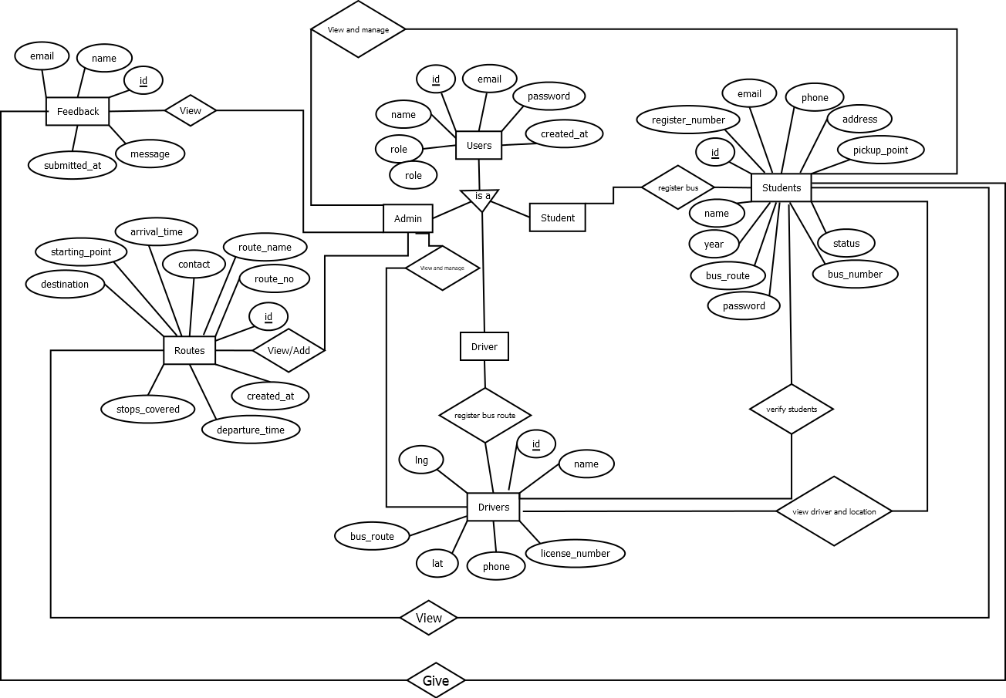
ER DIAGRAM

Slide 7
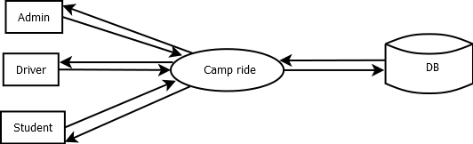
DFD
LEVEL 0

Slide 8
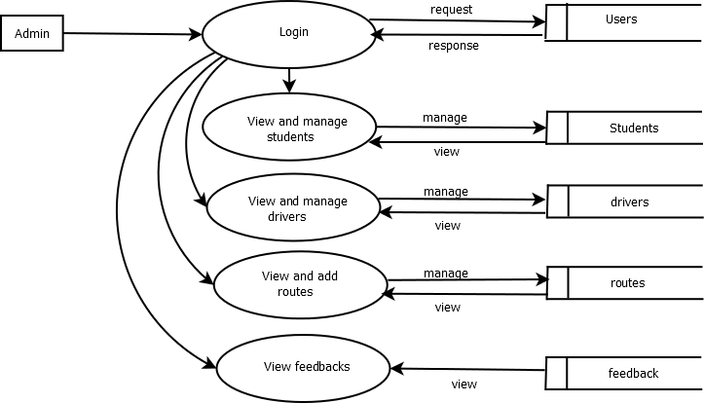
LEVEL 1

Slide 9
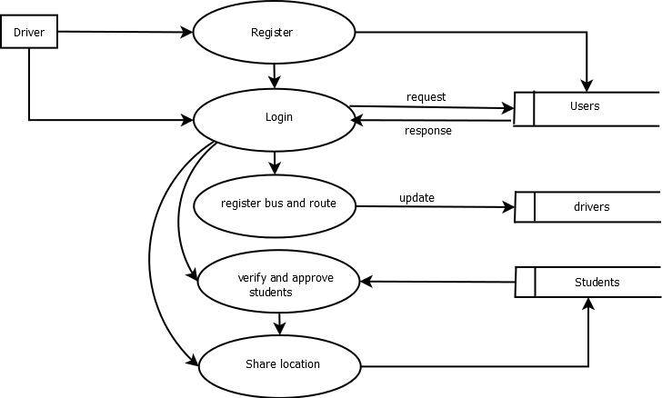
LEVEL2

Slide 10
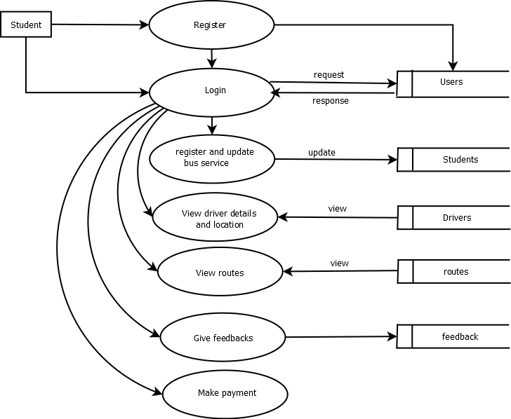
LEVEL 3

Slide 11
TABLES student
Routes
Field name | Data Type | Description
Rout_id | Int | Unique id for route
Route_name | Varchar(100) | Route name
Start_point | Varchar(100) | Starting location
End_point | Varchar(100) | Ending location
Distance_km | Decima(5,2) | Total distance in kilometers
Field name | Data Type | Description
Student _id(pk) | Int | Unique id for each student
Name | Varchar(100) | Student’s full name
Register_number | Varchar(50) | Rollno/register no
Department | V archar(100) | Branch
Year | Int | Year of study
Contact_no | Varchar(15) | Students phone number
Address | Varchar(255) | Residential address
Bus number | Int | Allocated bus
Pickup_point | varchar | Allocated bus stop
Bus_route | varchar | route
status | varchar | View status

Slide 12
Users
feedback
Field name | Data type | Description
Id | int | Unique user ID
Email | Varchar(100) | User’s email address
Password | Varchar(255) | Encrypted user password
Created_at | Timestamp | Account creation date and time
Role | Varchar(50) | Role of the user (e.g., Admin, Student, Driver)
Name | Varchare(100) | Full name of the user
FIELD NAME | DATA TYPE | DESCRIPTION
id | Int | Unique admin id
name | Varchar(50) | Student id
message | Varchar(255) | Feedback message
Email | Varchar(100) | Contact email
Submitted_at | timestamp | Registering for the bus service

Slide 13
Driver
FIELD NAME | DATA TYPE | DESCRIPTION
Driver_id(pk) | Int | Unique id for driver
Name | Varchar(100) | Driver’s full name
License_no | Varchar(50) | Driving license number
Contact_no | Varchar(15) | Drivers pjone number
Bus_number | Varchar(255) | Dresidential address
Bus_route | varchar | The route allocated to the driver’s bus.
lat | decimal | Current latitude position of the driver/bus (for live tracking).
ing | decimal | Current latitude position of the driver/bus (for live tracking).

Slide 14
CONCLUSION
The College Bus Management System successfully streamlines and automates the management of college transportation services, replacing traditional manual processes with an efficient, reliable, and user-friendly web-based platform. By integrating functionalities for Admin, Driver, and Student, the system ensures smooth coordination among all stakeholders. It enhances data accuracy, minimizes human error, and improves overall operational efficiency.
The system effectively handles key tasks such as student registration, route allocation, fee management, and driver assignment, ensuring transparency and accountability in every process. Its structured database design allows for secure data storage and easy retrieval, contributing to better decision-making and administrative control.
In conclusion, the project demonstrates the importance of technology in improving institutional operations. With potential future enhancements like GPS-based tracking, mobile app integration, and online payment gateways, the College Bus Management System can evolve into a comprehensive and scalable transportation management solution for educational institutions

Slide 15
THANK YOUU

